Slide 1


SUBJECT- ENGLISH
INTRODUCTION
Humanity, Social concern for poor village people and Poetic device

Slide 2
Poem - Audio https://youtu.be/aHWDhTze2ec

Slide 3
A Road Side Stand By Robert Frost

Slide 4
A FEW FACTS ABOUT THE POET ROBERT FROST
- Robert Frost ,an American poet Laureate of Vermont.
Born in San Francisco -1874 and died in 1963.
-Received prestigious Pulitzer Prize for Literature four times .
His well known works are ‘My Butterfly’, ‘Stopping by the Woods in a Snowy Evening , The Road not taken, Mending Wall, A Roadside Stand.

Slide 5
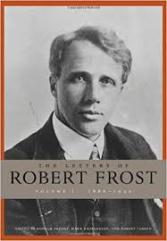
A FEW FACTS ABOUT THE POET ROBERT FROST
- Robert Frost ,an American poet Laureate of Vermont.
Born in San Francisco -1874 and died in 1963.
-Received prestigious Pulitzer Prize for Literature four times .
His well known works are ‘My Butterfly’, ‘Stopping by the Woods in a Snowy Evening , The Road not taken, Mending Wall, A Roadside Stand.

Slide 6
VISION AND TECHNIQUE
Frost has a profound visison of life.
He wrote about people and landscapes.
His poems are concern with human tragedies and fears, his reaction to the complexities of life and his ultimate acceptance of his burdens.
He deals with the problems of the characters in an analytical manner.
The technique that he uses is to draw a human significance and a moral lesson by portraying the charaters.
He has used this technique in the poem “A Road Side Stand”

Slide 7
SUB-CONCEPTS
Human tragedies
Feeling of humanity
Sympathy and humanism towards poor
Equal development of city or village irrespective of rich or poor
Pathetic picture of a roadside stand
Complexities of life

Slide 8
THEME OF THE POEM:
The poem 'A Roadside Stand' is the poet's plea for consideration for the simple people of the countryside whose lives have shown no progress.
He expresses his pain at their sadness and sorrow and seeks support and relief for them.
He hopes someone would work unselfishly for their rehabilitation and not exploit them.
He brings out the wide disparity between the ‘haves’ and the ‘have-nots’ with pitiless clarity and humanity and seems to suggest that the economic well-being of a country depends on the balanced development of villages and cities.

Slide 9
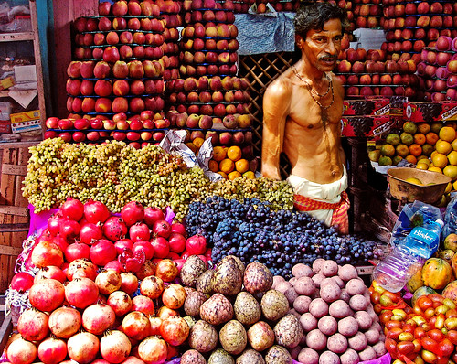
BACKGROUND AND SETTING OF THE POEM
In this poem, the poet presents a vivid picture of a roadside stand and the poor rural people who ran it.
He describes the lives of poor people with deep sympathy and humanity.
The city folk who drove through the countryside hardly paid any heed to the roadside stand or the people who ran it.
If at all they did, it was to make some complaint.

Slide 10
INTRODUCTION
A roadside stand is a poem written by the highly-acclaimed poet, Robert Frost who is regarded for his realistic depiction of rural life using which he touched several difficult social themes of the time.
In this poem, the poet highlights the plight of the deprived villagers who are aching for some money to lead a prosperous life.
The poet is also very critical of the way the city folks treat these villagers who are selling their locally produced goods and whizzing past them without a sense of empathy.

Slide 11
CONTENTS OF A Road Side Stand
Extract -1 Line – 1-6
“The little old house was out with a little new shed In front at the edge of the road where the traffic sped, A roadside stand that too pathetically pled, It would not be fair to say for a dole of bread, But for some of the money, the cash, whose flow supports The flower of cities from sinking and withering faint.”

Slide 12
DRILLING OF NEW/DIFFICULT WORDS :
SHED - A simple rooted structure or a hut usually made of wood to store things
SPED - To go fast or move quickly
PATHETICALLY PLED – Pathetically means in a way that arouses pity, sympathy, or compassion, to be pitiful inferior or inadequate. Pled means to make an emotional request or appeal.
DOLE OF BREAD - Dole means ‘the money given by the government (or a charity) on regular intervals to the unemployed’. “ Dole of Bread means a portion of bread (or any food) given as a charity to the unemployed”.
CASH FLOW - The amount of money moving into and of a business.
WITHERING FAINT- ‘Withering’ means ‘the process of becoming weak and then drying and decaying. If something withers, it slowly fades away and disappears. ‘Faint (in this context) means to collapse or lose consciousness’.

Slide 13
EXPLANATION OF A Road Side Stand
Extract -1 Line – 1-6
The poet starts the poem by describing the stand set up by the farmer on the roadside.
The way the stand is set up looks like it is begging for attention, but nobody cares to even look at it.
All that the farmer wants is not for someone to give him a piece of bread as a charity, but he wants the money that the city folks use.
Whose cash flow sustain their business and helps them live a good life.
He wants the same for his business.
He wants the money so that his business doesn’t sink and wither.
He wants the money so that he too can experience the benefits that the rich people enjoy.

Slide 14
POETIC DEVICE USED IN EXTRACT -1
Line – 1-6
PERSONIFICATION
‘A roadside stand that too pathetically pled’
The shed has been personified (personification) to plead

Slide 15
CONTENTS OF A Road Side Stand
Extract -2 Line – 7-13
“The polished traffic passed with a mind ahead,
Or if ever aside a moment, then out of sorts
At having the landscape marred with the artless paint
Of signs that with N turned wrong and S turned wrong
Offered for sale wild berries in wooden quarts,
Or crook-necked golden squash with silver warts,
Or beauty rest in a beautiful mountain scene,”

Slide 16
DRILLING OF NEW/DIFFICULT WORDS :
OUT OF SORTS - Signify unwell or upset or unhappy or annoyed
MARRED -- To spoil something to ruin the appearance of something
WOODEN QUARTS -- A quart is a quarter of a gallon (1 gallon = 4 quarts, 1 quart = 946.35g)
By wooden quarts, the poet is probably referring to a small light basket used for holding fruits and vegetables.
CROOK-NECKED -- A variety of squash having a narrow curved neck.
SILVER WARTS - - Warts are small, rough and hard growths that are similar in colour to the rest of the skin.
Silver Warts could mean the colour of the hard growths on the squash

Slide 17
EXPLANATION OF A Road Side Stand
Extract -2 Line – 7-13
All the city folks travelling in a posh vehicle don’t even glance at the shed.
Their minds are preoccupied with a big and profitable business that they run in the city.
And because of that, they fail to notice the plight of the rural folks selling goods in the roadside stand.
Even if they do notice their surrounding and the shed for a fleeting moment, they are quick to judge about the badly painted road signs, the wrong way the North and South sign s point on the road, and the unsightly road sheds and houses – which made the scenery look bad in the eyes of the city folks.
They fail to notice the beautiful produce of wild berries and golden squashes for sale.

Slide 18
POETIC DEVICE USED IN EXTRACT -2
TRANSFERRED EPITHET
The polished traffic is the skilful use of a transferred epithet in the depiction of the urban city-dwellers who passed through the countryside with their minds preoccupied in their profession and the related.
The poet states that in their preoccupation, if ever aside remained a moment, they spent it on scrutinizing and judging the destitution of their surroundings.
They appear mad at having the beauty of the landscape marred by the presence of the shed and other rustic signs.
The poet goes on to mention a few of the produce being sold at the shed.

Slide 19
CONTENTS OF A Road Side Stand
Extract -3 Line – 14-22
“You have the money, but if you want to be mean,
Why keep your money (this crossly) and go along.
The hurt to the scenery wouldn’t be my complaint
So much as the trusting sorrow of what is unsaid:
Here far from the city we make our roadside stand
And ask for some city money to feel in hand
To try if it will not make our being expand,
And give us the life of the moving-pictures’ promise
That the party in power is said to be keeping from us”.

Slide 20
DRILLING OF NEW/DIFFICULT WORDS :
MEAN- Unkind, or unwilling to share things – especially money
CROSSLY - In an annoyed and slightly angry way
MOVING-PICTURES – A film

Slide 21
EXPLANATION OF A Road Side Stand
Extract -3 Line – 14-22
The rich folks' attitude towards the poor people irks the rural folks.
The city dwellers are unwilling to buy from the roadside sheds and share their city money, so the farmer calls them unkind and tells them to keep their money and go away from that place.
The farmer is angry and upset not because of the complaints of the city folks about the scenery being ruined by shabby roadside stands, but the things still left unsaid that they hold inside their hearts.
They trust the promises made by the city folks and hope that they would buy their products but are often left disappointed and in sorrow because the city folks ignore them completely.

Slide 22
EXPLANATION OF A Road Side Stand
Extract -3 Line – 14-22
The roadside stands have been set up by the rural folks far away from the city perhaps because it is cheaper to set up shops in the countryside.
The only thing that the farmer asks of the city folks is to give them some city money so that they too can have a prosperous business and see their lives improve ‘City money’ is big compared to the money possessed by the farmer.
The rural folks do not want the money as a source of income but rather want it to experience the city life depicted in the movies.
They accuse the politicians in the power of denying them a comfortable life enjoyed by the city folks.

Slide 23
POETIC DEVICE USED IN EXTRACT -3
The paragraph is a Dramatic Monologue by the peasant in charge of the shed.
The peasant agrees that money indeed belongs to the city dwellers, however, if they were interested in imparting biased judgment and other uninvited observations, they could keep their money to themselves and move along.
Their complaint on the marred scenery does not hurt the peasants as much as the sorrow that is left unsaid. ‘Trusting Sorrow’ is a metaphor and refers to the fact that the peasants set up the shed in the hopes (‘trusting’) of attracting city folk to buy their produce, thus providing the additional income to enjoy the luxuries of life.
However, they are disappointed (‘sorrow’) in the fact that no one is interested in their sales, but rather on the elimination of the shed that mars the landscape.
Once again, the poet stresses on the fact that the peasants do not want the money as the lone source of income but as an additional allowance that will provide them with the lifestyle depicted in the movies.
‘City Money’ is used by the poet as it differs from country money in usage but shares the same source.
Using light satire, Frost admonishes the political party in power for keeping the farmers from enjoying an equal lifestyle like the city-dwellers.

Slide 24
CONTENTS OF A Road Side Stand
Extract -4 Line – 23-31
“It is in the news that all these pitiful kin
Are to be bought out and mercifully gathered in
To live in villages, next to the theatre and the store,
Where they won’t have to think for themselves anymore,
While greedy good-doers, beneficent beasts of prey,
Swarm over their lives enforcing benefits
That are calculated to soothe them out of their wits,
And by teaching them how to sleep they sleep all day,
Destroy their sleeping at night the ancient way.”

Slide 25
DRILLING OF NEW/DIFFICULT WORDS :
PITIFUL KIN - Pitiful means ‘something or someone. Who is so small, poor, or inadequate that they deserve pity.
Kin means ‘one’s family and relations’. Here, ‘pitiful kin’ might refer to the group of people who are in a very sad and sorry state.
GOOD-DOERS - A person who does good acts.
SWARM OVER - A large number of people gathered all together at once.
SOOTHE - To gently make someone feel calm and less worried.
OUT OF THEIR WITS - To frighten or scare someone to such an extent that they behave irrationally (not thinking clearly or logically).

Slide 26
EXPLANATION OF A Road Side Stand
Extract -4 Line – 23-31
The news stories cover the good deeds of the rich folk – how they have taken steps to bring the rural folk closer to the cities where they can experience a better life and live close to the theatre and the shops.
But the poet points out that the rich folks do it for the poor.
They lure the poor folks by promising them a great life only to leave them worse than ever before.
The poor people, who once had lands of their own and worked independently, are no longer independent.
They have slowly been lead into a trap by the wolves and sheep’s clothing.
They’ve lost their sleep because of believing in the lies of the rich folks

Slide 27
POETIC DEVICE USED IN EXTRACT -4
Farmers tend to live in rustic areas due to the presence of farmlands.
The idea behind the paragraph is that real-estate brokers force farmers from the villages into towns promising them riches and benefits.
The farmers will indeed be rich for a while after which they will be left scoundrels ultimately resulting in the benefit of the brokers.
‘Greedy good-doers’ and ‘beneficent beasts of prey’ are both oxymoron (and great use of alliteration).
They stand for the estate brokers who try to make the farmers leave the land by promising the farmers benefits that make them complacent, so the farmers will not have to think for themselves any longer as they will no longer be in want.
Now sluggish, the farmers have learnt to sleep all the day thereby losing their sleep at night.
‘The ancient way’ spoken of over here simply refers to the lifestyle wherein one works and toils during the day, coming home tired in the evening and thereby taking a well-deserved good night’s rest.

Slide 28
CONTENTS OF A Road Side Stand
Extract -5 Line – 32-43
“Sometimes I feel myself I can hardly bear
The thought of so much childish longing in vain,
The sadness that lurks near the open window there,
That waits all day in almost open prayer
For the squeal of brakes, the sound of a stopping car,
Of all the thousand selfish cars that pass,
Just one to inquire what a farmer’s prices are.
And one did stop, but only to plow up grass
In using the yard to back and turn around;
And another to ask the way to where it was bound;”
“And another to ask could they sell it a gallon of gas
They couldn’t (this crossly); they had none, didn’t it see?”

Slide 29
DRILLING OF NEW/DIFFICULT WORDS :
Vain – something that is of no value or is unsuccessful
Plow up (plough up) – In the poem, it means ‘to damage the surface of the ground by walking or driving over it too much’
Bound - to go or plan to go to a certain place. (In the poem the driver stops and asks the rural folks for directions to the place it was going.)
Lurk – To wait secretly without anybody noticing – especially to attack someone or do something bad. Ex- I saw someone lurking in the shadows outside my window.
Squeal – along , very high- pitched noise or cry
Gallon – a large volume of something or a unit of measurement for liquids that is equal to eight pints ( 1 gal 3.78 litres)

Slide 30
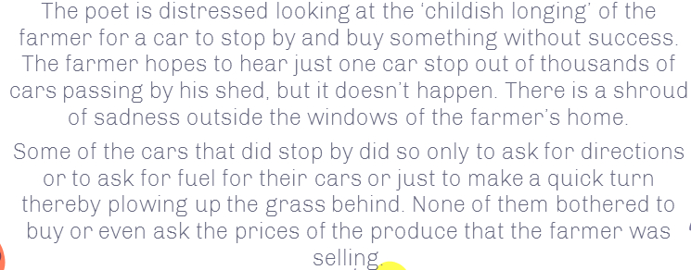
EXPLANATION

Slide 31
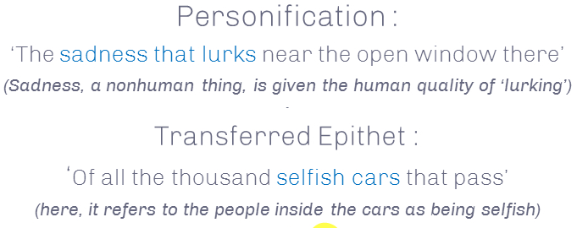
POETIC DEVICE USED IN EXTRACT -5

Slide 32
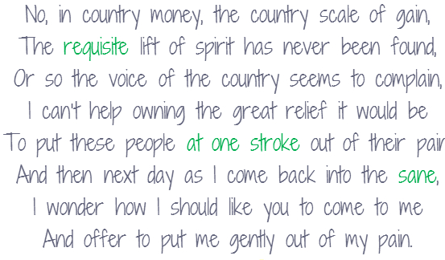
CONTENTS OF A Road Side Stand
Extract -6 Line – 46-52

Slide 33

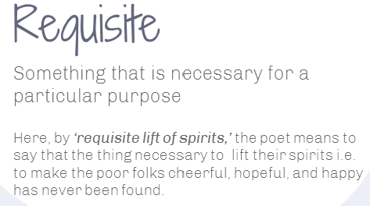

DRILLING OF NEW/DIFFICULT WORDS :

Slide 34
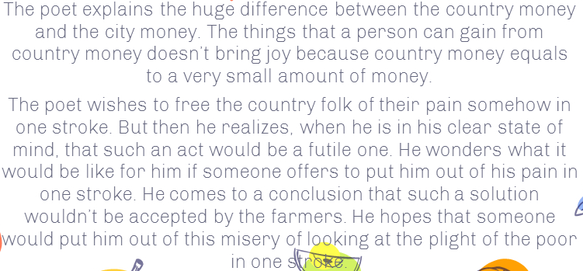
POETIC DEVICE USED IN EXTRACT -5

Slide 35
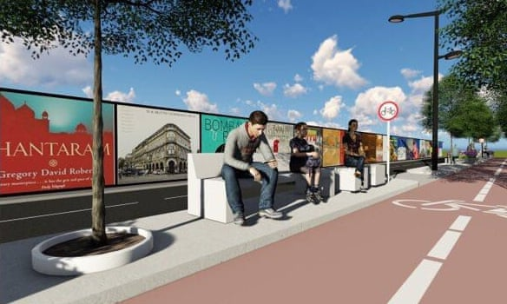
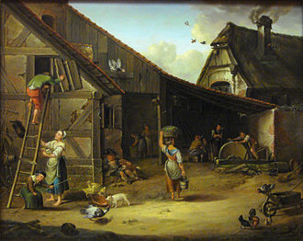
Conclusion of A Roadside Stand
A Roadside Stand shows us the great contrast between the comfortable life of city dwellers and the harshness faced by the impoverished rural people.

Slide 36
MAY I CHECK UP YOUR COMPREHENSION?
Who made the roadside stand and where?
What is the ‘childish longing’ that the poet refers to? Why is it ‘vain’?
Why does Robert Frost sympathies with the rural poor and is anguished at the plight of the stand owners?
Why cars are called ‘selfish’?
Why can not the poet bear the childish longing of the poor people?
What are the two significant roles of money in the lives of poor people?
Explain the phrase in the poem ‘greedy good-doers’ implies
Near the end of the poem, why does the poet seek an unrealistic solution for the poor people’s distress even though earlier he had blamed them for their ‘childish longing in vain’?
What are the usual complaints made by the city men when they stop at the roadside stand?
What do the poor people of the roadside stand feel when the city men decline from buying anything?

Slide 37
An Advice
Please read the lesson thoroughly at home.
Doubts , if any, should be asked for clearance in the next period.
Attempt answering the questions.

Slide 38
THANKING YOU
ODM EDUCATIONAL GROUP

