Slide 1


STACK
PERIOD-3
SUBJECT : COMPUTER SCIENCE
CHAPTER NUMBER: 5
CHAPTER NAME: STACK

Slide 2
Learning Outcomes:
Students will know about type of stacks
They will learn conversion of infix to postfix expression

Slide 3
Discussed so far:
Implementation of stack in Python
Sample program & run

Slide 4
Sub Concepts:
Types of stacks
Polish String
Infix to Postfix Notation

Slide 5
Types Of Stacks:
Item-Node:
  An item stored in a stack is called as item-node sometimes.
  In the program we studied the previous class, the stack contained item-nodes containing just integers.
  If you want to create stack that may contain logically group information such as member details like member no, member name, age etc.,
  For such a stack the item-node will be a list containing the member details and then this list will be entered as an item to the stack.

Slide 6
4
3
2
1
0
20
10
4
3
2
1
0
D
C
B
A
4
3
2
1
0
20,"Shreya",30
13, "Rohan",35
Top = 3
Top = 1
Top = 1
(a)
(b)
(c)
For stack of figure(a) the stack will be implemented as Stack of integers as item-node is of integer type.
For stack of figure(b) the stack will be implemented as stack of strings as item-node is of string type.
For stack of figure(c) the stack will be implemented as stack of lists as item-node is of list type.

Slide 7
Stack Applications:
  There are several applications and uses of Stack.
  The stacks are basically applied where the LIFO scheme is required.
Reversing a Line:
  A simple example of stack application is reversing a given line.
  We can accomplish this task by pushing each character on to a stack as it is read.
  When the line is finished, characters are then popped off the stack and they will come off in the reverse order as shown

Slide 8
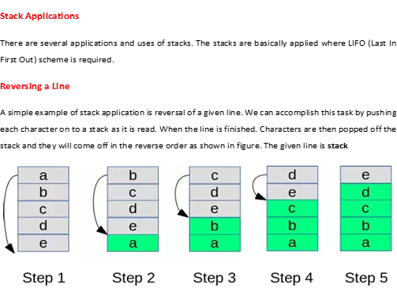

Slide 9
Polish String:
  Another application of stacks is in the conversion of arithmetic expressions in high-level programming languages into machine readable form.
  As our computer system can only understand and work on a binary language, it assumes that an arithmetic operation can take place in two operands only e.g. A + B, C x D, D/A etc.
  But in our usual form an arithmetic expression may consist of more than one operator and two operands .

Slide 10
  These complex arithmetic operations can be converted into polish strings using stacks.​
  Polish string, named after a polish mathematician, Jan Lukasiewicz, refers to the notation in which the operator symbol is placed either before its operands (prefix notation) or after its operands (postfix notation) in contrast to usual form where operator is placed in between the operands (infix notation).​

Slide 11
Following Table Shows the Three Types of Notations:
  Expressions in infix , prefix & postfix notations.
INFIX | PREFIX | POSTFIX
A + B | +AB | AB+
(A + B) * (C + D) | *+AB+CD | AB+CD+*
A – B / (C * D ^ E) | -A/B*C^DE | ABCDE^*/-

Slide 12
Conversion of Infix Expression to
Postfix(Suffix) Expression:
  While evaluating an infix expression, there is an evaluation order according to which
    Brackets or Parenthesis
    Exponentiation
    Multiplication or Division
    Addition or Subtraction
  Take place in the above specified order.
  The operators with same priority are executed from left to right.

Slide 13
To convert an infix expression into a postfix expression, this evaluation is taken into consideration.
An infix expression may be converted into postfix from either manually or using a stack.
The manual conversion requires two passes.
One for inserting braces and another for conversion.
However, the conversion through stack requires single pass only.
The steps to convert an infix to postfix manually is:
Determine the actual evaluating order by inserting braces.
Convert the expression in the innermost braces into postfix notation by putting the operator after the operands.
Repeat step(II) until entire expression is converted into postfix notation.

Slide 14
Example : Convert (A + B) x C / D into postfix notation.
Solution:
Step I : Determine the actual evaluation order by putting braces
    = ((A + B) x C) / D
Step II : Coverting expressions in innermost braces
    = ((A B + ) x C) / D
    = (A B + C x) / D
    = A B + C x D /

Slide 15
Example : Convert ((A + B) * C / D + E ^ F) / G into postfix notation.
Solution:
The actual evaluation order is given by
    = ((((A + B) * C) / D) + (E ^ F)) / G
Coverting expressions in innermost braces
    = ((((A B + ) * C) / D) + (E F ^) / G
    = (((A B + C *) / D) + E F ^) / G
    = ((A B + C * D /) + E F ^) / G
    = (A B + C * D / E F ^ +) / G
    = A B + C * D / E F ^ + G /

Slide 16
Session Review:
Types of stacks
Polish String
Infix to Postfix Notation

Slide 17
Assignments:
What is item-node?
Covert : A + B * C ^ D / E - F

Slide 18
THANKING YOU
ODM EDUCATIONAL GROUP

