Slide 1


STACK
PERIOD-1
SUBJECT : COMPUTER SCIENCE
CHAPTER NUMBER: 5
CHAPTER NAME: STACK

Slide 2
Learning Outcomes:
Students will get introduced with stack
Get familiar with the terms related with stacks

Slide 3
Sub Concepts:
Introduction with stack
LIFO
Terms associated with stack

Slide 4
Introduction To Data Structure:
The term data structure refers to a data collection with well-defined operations and behaviour or properties.
A stack is a linear structure implemented in LIFO (Last In First Out) manner where insertions and deletions are restricted to occur only at one end-stack’s top.
LIFO means element last inserted would be the first one to be deleted.
The stack is also a dynamic data structure as it can grow (with increase in number of elements) or shrink ( with decrease in number of elements).

Slide 5
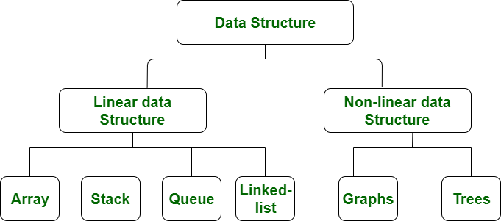

Slide 6
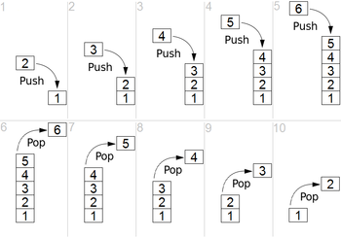
Consider the figure that illustrates the operations (Push and Pop) on a stack.

Slide 7
Data can only be removed from the top (pop), i.e., the element at the top of the stack. The removal of element from a stack is technically called POP operation.
A new data element can only be added to the top of the stack (push) . The insertion of element in stack is technically called PUSH operation.
The stack is a dynamic data structure as it can grow (with increase in number of elements) or shrink (with decreases in number of elements).
A static data structure, on the other hand, is the one that has fixed size.

Slide 8
Other Stack Terms:
There are some other terms related to stacks, such as Peek, Overflow and Underflow.
Peek:
Refers to inspecting the value at the stack’s top without removing it.
It is also sometimes referred as inspection.
Overflow:
Refer to situation (ERROR) when one tries to push an item in stack that is full.
This situation occurs when the size of the stack is fixed and cannot grow further or there is no memory left to accommodate new item.

Slide 9
Underflow:
Refers to situation (ERROR) when one tries to pop an item from an empty stack.
That is, stack is currently having no item and still one tries to pop an item.​

Slide 10
Session Review:
Introduction with stack
LIFO
Terms associated with stack

Slide 11
Assignments:
What is stack and which scheme does it implements?
Define the terms associated with stacks?

Slide 12
THANKING YOU
ODM EDUCATIONAL GROUP

