Slide 1


WEB HOSTING, NETWORK SECURITY AND PROTECTION
PERIOD-9
SUBJECT: COMPUTER SCIENCE
CHAPTER NUMBER: 8
CHAPTER NAME: NETWORKING

Slide 2
Learning Outcomes:
Students will learn about web hosting
Learn about its types.
Know about the network securities.

Slide 3
Discussed So Far :
Mobile processors
Wireless connectivity
Internetworking terms and concepts

Slide 4
SUB-CONCEPTS:
Web Hosting
Their types
Network Security and methods

Slide 5
Web Hosting:
Web Hosting is a means of hosting web-server application on a computer system through which electronic content on the Internet is readily available to any web-browser client.
The computer system providing the webhosting is known as webserver or the web host. Basically, the web hosts allow their customers to place web documents, such as html pages, graphics, and other multimedia files etc. onto a special type of computer
Types of Webhosting:
Free Hosting
Virtual or Shared Hosting
Dedicated Hosting
Co-location Hosting

Slide 6
Web 2.0:
Web 2.0 refers to added features and applications that make the web more interactive, support easy online- information exchange and interoperability. Some noticeable features of Web 2.0 are blogs, wikis, video-sharing websites, social networking websites, RSS etc.​
some of the most noticeable are :​
Facebook WordPress​
Myspace Flickr​
Twitter Blogger ​
Digg Del.icio.us ​
YouTube​

Slide 7
HTML:
The World Wide Web is an exciting new medium, bringing information, images, advertising and what not to every desktop.
Everything that you see on the Web is documents written in a special language called HTML or Hypertext Mark-up Language.
This language tells the browsers like Mosaic or Netscape or Internet Explorer how to display text, pictures, and links on the screen.
HTML provides many layout commands, called tags that let you control the presentation of information on a web page.
For example, there are tags for various types of headings, lines, image alignment, paragraph alignment, hyperlinking etc.
In HTML, both the tag semantics and the tag set are fixed.

Slide 8
XML ( eXtensible Mark-up Language)​:
​
XML is a mark-up language for documents containing structured information. ​
Structured information contains both content (words, pictures, etc.) and some indication of what role that content plays (for example, content in a section heading has a different meaning from content in a footnote, which means something different than content in a figure caption or content in a database table, etc.).​
Almost all documents have some structure. ​
XML specifies neither semantics nor a tag set. In fact, XML is really a meta-language for describing mark-up languages. ​
In other words, XML provides a facility to define tags and the structural relationships between them. ​
Since there is no predefined tag set, there cannot be any preconceived semantics.​

Slide 9
DHTML (Dynamic HTML):
DHTML refers to Web content that changes each time it is viewed.
For example, the same URL could result in a different page depending on any number of parameters, such as :
Geographic location of the reader
Time of day
Previous pages viewed by the reader
Profile of the reader
DHTML refers to new HTML extensions that will enable a Web page to react to user input without sending requests to the Web server.
“Dynamic HTML’’ is typically used to describe the combination of HTML, style sheets and scripts that allows documents to be animated. Dynamic HTML allows a web page to change after it is loaded into the browser.

Slide 10
Web Scripting:
The process of creating and embedding scripts in a web page is known as web-scripting.
A script or a computer-script is a list of commands that are embedded in a web- page normally and are interpreted and executed by a certain program or scripting engine.
Scripts may be written for a variety of purposes such as for automating processes on a local-computer or to generate webpages on the web.
The programming languages in which scripts are written are called scripting languages.
There are many scripting languages available today. Most common ones are VBScript, JavaScript, ASP, PHP, PERL, JSP etc.

Slide 11
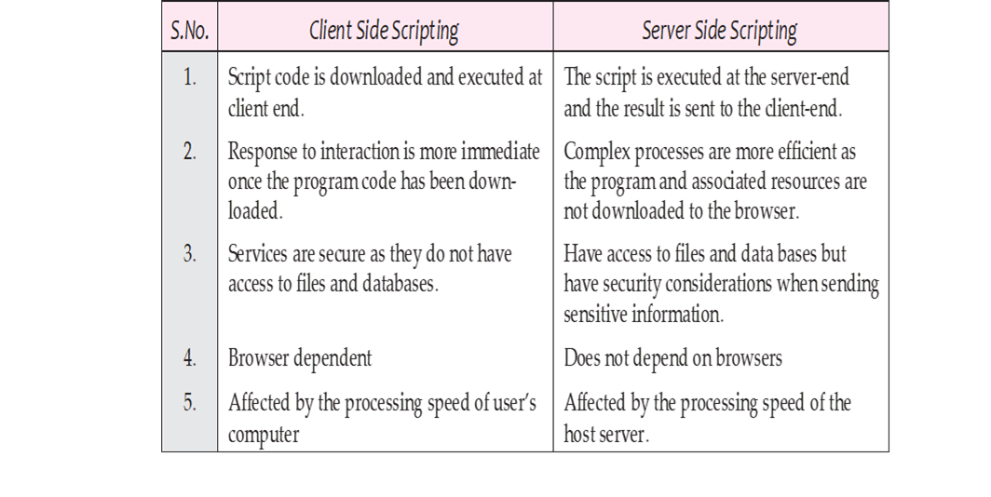
Scripts are broadly of following two types :​
Client side scripting​
Server side scripting​

Slide 12
Network Security Concepts:
While ensuring network security, the concerns are to make sure that only legal or authorized users and programs gain access to information resources like databases.
Also, certain control mechanisms are setup to ensure that properly authenticated users get access only to those resources that they are entitled to use.

Slide 13
The problems encountered under network security can be summarised as follows :​
Physical Security holes:
When individuals gain unauthorized physical access to a computer and temper with files. Hackers do it by guessing passwords of various users and then gaining access to the network system.​
​
Software Security holes:
​
When badly written programs or ‘privileged’ software are compromised into doing things that they should not be doing.​
​
Inconsistent Usage holes​:
When a system administrator assembles a combination of hardware and software such that the system is seriously flawed from a security point of view.​

Slide 14
Protection Methods:
To counter or reduce the security threats received under this category, many protection methods are used. These protection methods are being discussed briefly in the coming lines.
Authorization:
Authorization determines whether the service provider has granted access to the web service to the requestor.
Basically, authorization confirms the service requestor’s credentials.
It determines if the service requestor is entitled to perform the operation, which can range from invoking the web service to executing a certain part of its functionality.
Authorization is performed by asking the user a legal login-id.
If the user can provide a legal login-id, he/she is considered an authorized user.

Slide 15
Authentication:
Authentication ensures that each entity involved in using a web service – the requestor, the provider, and the broker (if there is one) is what it claims to be. ​
Authentication involves accepting credentials from the entity and validating them against an authority.​
Authentication is also termed as password-protection as the authorized user is asked to provide a valid password, and if he/she can do this, he/she is an authentic user.​

Slide 16
Encrypted Smart Cards:
Passwords in a remote log-in session generally pass over the network in unencrypted form, any hacker (or cracker) can simply record it and can use it later maliciously to corrupt data/files or to harm anyone etc.
To counter such threats, newer approaches are suggested such as encrypted smart cards.
An encrypted smart card is a hand-held smart card that can generate a token that a computer system can recognise.
Every time a new and different token is generated, which even-though cracked or hacked, cannot be used later.

Slide 17
Biometric Systems:
The biometric systems form the most secure level of authorization. ​
The biometric systems involve some unique aspect of a person’s body such as fingerprints, retinal patterns etc. to establish his/her identity.​

Slide 18
Firewall:
A system designed to prevent unauthorized access to or from a private network is called Firewall.
Firewalls can be implemented in both hardware and software, or a combination of both.
Firewalls are frequently used to prevent unauthorized Internet users from accessing private networks connected to the Internet, especially intranets.
All messages entering or leaving the intranet pass through the firewall, which examines each message and blocks those that do not meet the specified security criteria.

Slide 19
There are several types of firewall techniques :​
Packet filter:
​
Looks as each packet entering or leaving the network and accepts or rejects it based on user-defined rules. Packet filtering is effective and transparent to users, but it is difficult to configure. ​
In addition, it is susceptible to IP spoofing.​
Application gateway:​
Applies security mechanisms to specific applications, such as FTP and Telnet servers. ​
This is highly effective but can impose a performance degradation.​

Slide 20
Proxy server:​​
Intercepts all messages entering and leaving the network. ​​
The proxy server effectively hides the true network addresses.​​
Circuit-level gateway:​​
Applies security mechanisms when a connection is established. ​​
Once the connection has been made, packets can flow between the hosts without further checking.​​

Slide 21
SESSION REVIEW:
Web Hosting
Their types
Network Security and methods

Slide 22
ASSIGNMENT:
What is web hosting?
Difference between client side and server side scrippting.
Discuss about firewall.

Slide 23
THANKING YOU
ODM EDUCATIONAL GROUP

