Slide 1


INTRODUCTION TO NETWORKING
PERIOD-6
SUBJECT: COMPUTER SCIENCE
CHAPTER NUMBER: 8
CHAPTER NAME: NETWORKING

Slide 2
Learning Outcomes:
Students will learn about different network devices.
Get to know modem,RJ-45,etc
Learn about 80-20 rule.

Slide 3
Discussed So Far :
Network topologies
Point-to-Point link
Their pros and cones

Slide 4
SUB-CONCEPTS:
Network devices
The 80-20 rule

Slide 5
Network Devices:
Modem:
A Modem is a computer peripheral that allows you to connect and communicate with other computers via telephone lines.
Modems allow you to combine the power of your computer with the global reach of the telephone system.
Modem changes the digital data from your computer into analog data, a format that can be carried by telephone lines.
In a similar manner, the modem receiving the call then changes the analog signal back into digital data that the computer can digest Called modulation/demodulation.

Slide 6
Modems come in two varieties:​
​
Internal modem: the modems that are fixed within the computer.​
External modems: the modems that are connected externally to a computer as other peripherals are connected​
RJ-45:
RJ-45 is short for Registered Jack-45.
RJ-45 is an eight-wire connector, which is commonly used to connect computers on the local area networks i.e., LANs, especially Ethernets. (Ethernet is a LAN architecture developed by Xerox Corp along with DEC and Intel).
Ethernet uses either a bus or star topology and supports data transfer rates of up to 10.

Slide 7
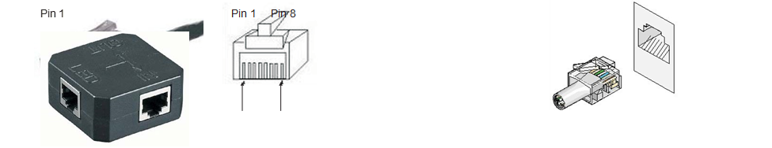
Ethernet Card:
As mentioned earlier, Ethernet is a LAN architecture developed by Xerox Corp in association with DEC and Intel.
Ethernet uses bus or star topologies and can support data transfer rates of up to 10 Mbps.
The computers that are part of Ethernet, must install a special card called Ethernet Card.

Slide 8
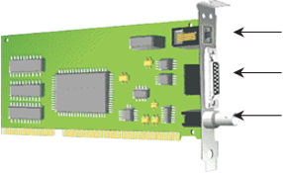

Slide 9
Hub:
A hub is a hardware device used to connect several computers together.
A hub that contains multiple independent but connected modules of network and inter-networked equipment.
A similar term is concentrator. A concentrator is a device that provides a central connection point for cables from workstations, servers, and peripherals.
In a star topology, twisted-pair wire is run from each workstation to a central concentrator.
Basically, hubs are multi-slot concentrators into which several multi-port cards can be plugged to provide additional access as the network grows.

Slide 10
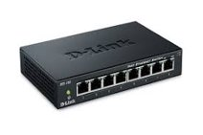
Hubs can be either passive or active.​
Active hubs electrically amplify the signal as it moves from one connected device to another. Active concentrators are used like repeaters8 to extend the length of a network.​
Passive hubs allow the signal to pass from one computer to another without any change.​

Slide 11
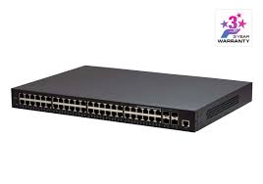
Switch:
A switch is a device that is used to segment networks into different subnetworks called subnets or LAN segments.
Segmenting the network into smaller subnets, prevents traffic overloading in a network.
A switch is responsible for filtering i.e., transforming data in a specific way and for forwarding packets (a piece of message being transmitted) between LAN segments. Switches support any packet protocol.

Slide 12
Repeater:
A repeater is a device that amplifies a signal being transmitted on the network.
Over distance, the cables connecting a network lose the signal transmitted.
If the signal degrades too much, it fails to reach the destination.
Or if it does arrive, the degradation of the message makes it useless.
Repeaters can be installed along the way to ensure that data packets reach their destination.
Repeaters are of two kinds : amplifier and signal repeater.

Slide 13
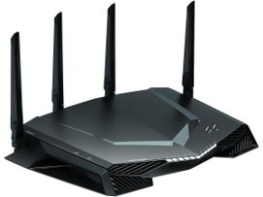

Slide 14
Bridge:
A bridge is a device that lets you link two networks together.
Bridges are smart enough to know which computers are on which side of the bridge, so they only allow those messages that need to get to the other side to cross the bridge.
This improves performance on both sides of the bridge.
As a packet arrives at the bridge, the bridge examines the physical destination address of the packet.
The bridge then decides whether to let the packet cross.

Slide 15
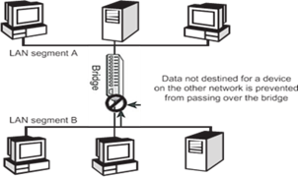

Slide 16
Gateway:
A gateway is a device that connects dissimilar networks.
A gateway operates at the highest layer of network abstraction.
It expands the functionality of routers by performing data translation and protocol conversion.
It is needed to convert Ethernet traffic from the LAN, to SNA10 (Systems Network Architecture) traffic on a legacy system.
It then routes the SNA traffic to the mainframe. When the mainframe answers, the reverse process occurs.

Slide 17
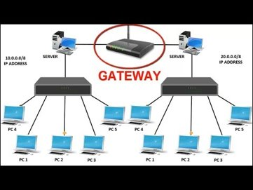

Slide 18
Wi-Fi Card:
A Wi-Fi card is either an internal or external Local Area Network adapter with a built-in wireless radio and antenna.
The most common Wi-Fi cards used in desktop computers are PCI-Express Wi-Fi cards made to fit the PCI-Express card slots on the motherboard.

Slide 19

Benefits:
The primary benefit of using a Wi-Fi card in a desktop computer is that it allows you to setup your work- station or home office without considering the proximity or availability of hard-line network access.

Slide 20
Good Network Design : The 80-20 Rule:
In a properly designed small to medium- sized network environment, 80 percent of the traffic on a given network segment is local (destined for a target in the same workgroup), and not more than 20 percent of the network traffic should need to move across a backbone (the spine that connects various segments or subnetworks).

Slide 21
General Process Of Designing Networks
Access needs and costs
Select topologies and technologies to satisfy needs
Model network workload
Simulate behavior under
expected load
Perform sensitively tests
Rework design as needed

Slide 22
SESSION REVIEW:
Network devices
The 80-20 rule

Slide 23
ASSIGNMENT:
Write about some network devices.
What is the 80-20 rule?

Slide 24
THANKING YOU
ODM EDUCATIONAL GROUP

