Slide 1


INTRODUCTION TO NETWORKING
PERIOD-5
SUBJECT: COMPUTER SCIENCE
CHAPTER NUMBER: 8
CHAPTER NAME: NETWORKING

Slide 2
Learning Outcomes:
Students will know about the networks topologies possible
Know what is point to point link
Know the pros and cones of all topologies.

Slide 3
Discussed So Far :
Different unguided media
Their pros and cones
Types of Network

Slide 4
SUB-CONCEPTS:
Network topologies
Point-to-Point link
Their pros and cones

Slide 5
Network Topologies:
      The pattern of interconnection of nodes in a network is called the topology of a network.
      factors to consider in making this choice, the most important of which are set out below:
      Cost. For a network to be cost effective, one would try to minimize installation cost.
      Flexibility. Because the arrangement of furniture, internal walls etc. in offices is often subject to change, the topology should allow for easy reconfiguration of the network. This involves moving existing nodes and adding new ones.

Slide 6
    Reliability. Failure in a network can take two forms. Firstly, an individual node can malfunction. This is not nearly as serious as the second type of fault where the network itself fails to operate. The topology chosen for the network can help by allowing the location of the fault to be detected and to provide some means of isolating it.​
Point-to-Point Link:
The main characteristic of P-P network is that each station receives exactly from one transmitter, and each transmitter transmits to exactly one receiver.
Transmit
X
Y
Receive

Slide 7
Types of topology:
            Star topology
            Bus topology
            Ring topology
            Circular topology
            Tree topology
            Graph topology
            Mesh topology

Slide 8
The Star Topology:
      This topology consists of a central node to which all other nodes are connected by a single path.
      It is the topology used in most existing information networks involving data processing or voice communications.
      The most common example of this is IBM 370 installations.
      In this case multiple 3270 terminals are connected to either a host system or a terminal controller.

Slide 9
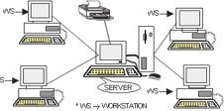

Slide 10
Advantages of the Star Topology:
        Ease of service.
        One device per connection.
        Centralized control/problem diagnosis.
        Simple access protocols.
Disadvantages of the Star Topology:
        Long cable length.
        Difficult to expand.
        Central node dependency.

Slide 11
The Bus or Linear Topology:
      Another popular topology for data networks is the linear.
      This consists of a single length of the transmission medium (normally coaxial cable) onto which the various nodes are attached .
      The topology is used in traditional data communication network where the host at one end of the bus communicates with several terminals attached along its length.
      The transmission from any station travels the length of the bus, in both directions, and can be received by all other stations.

Slide 12
The bus has terminators at either end which absorb the signal, removing it from the bus.​
Data is transmitted in small blocks, known as packets. Each packet has some data bits, plus a header containing its destination address.​
A station wanting to transmit some data sends it in packets along the bus. ​
The destination device, on identifying the address on the packets, copies the data onto its disk.​
​

Slide 13
Advantages of the Linear Topology:
      Short cable length and simple wiring layout.
      Resilient Architecture.
      Easy to extend.
Disadvantages of the Linear Topology:
      Fault diagnosis is difficult.
      Fault isolation is difficult.
      Repeater configuration.
      Nodes must be intelligent.

Slide 14
The Ring or Circular Topology:
The third topology that we will consider is the ring or circular.
In this case, each node is connected to two and only two neighbouring nodes.
Data is accepted from one of the neighbouring nodes and is transmitted onwards to another.
Thus, data travels in one direction only, from node to node around the ring.
After passing through each node, it returns to the sending node, which removes it.
It is important to note that data ‘passed through’ rather than ‘travels past’ each node.
This means that the signal may be amplified before being ‘repeated’ on the outward channel.

Slide 15
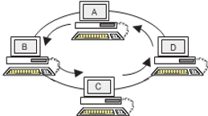

Slide 16
Advantages of the Ring Topology:
      Short cable length
      No wiring closet space required
      Suitable for optical fibers
Disadvantages of the Ring Topology:
      Node failure causes network failure.
      Difficult to diagnose faults.
      Network reconfiguration is difficult.

Slide 17
The Tree Topology:
      A variation of bus topology is the tree topology.
      The shape of the network is that of an inverted tree with the central root branching and sub-branching to the extremities of the network .
      Transmission in this topology takes place in the same way as in the bus topology.
      In both cases, there is no need to remove packets from the medium because when a signal reaches the end of the medium, it is absorbed by the terminators.
      Tree topology is best suited for applications which have a hierarchical flow of data and control.

Slide 18
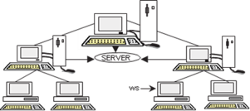

Slide 19
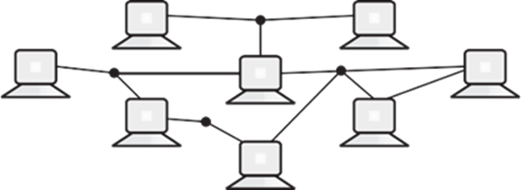
Graph Topology:
      In this topology, nodes are connected in an arbitrary fashion.
      A link may or may not connect two or more nodes.
      There may be multiple links also. It is not necessary that all the nodes are connected.
      But if a path can be established in two-nodes via one or more links, it is called a connected graph.

Slide 20
Fully Connected:
      When in a network each host is connected to other directly i.e., there is a direct link between each host, then the network is said to be fully connected. This characteristic is termed as full connectivity.

Slide 21
Mesh Topology:
      In this topology, each node is connected to more than one node to provide an alternative route in the case the host is either down or too busy.
      It is an extension to P-P network.
      The mesh topology is excellent for long distance networking because it provides extensive back-up, rerouting, and pass-through capabilities.
      Communication is possible between any two nodes on the network either directly or by passing through.
      This function is needed in the event of a line or node failure elsewhere in the network.
      The mesh topology is commonly used in large internetworking environments with stars, rings, and buses attached to each node.
      This is also ideal for distributed networks.

Slide 22
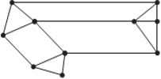

Slide 23
SESSION REVIEW:
Network topologies
Point-to-Point link
Their pros and cones

Slide 24
ASSIGNMENT:
What is point-to-point link?
Discuss all the topologies and their advantages.

Slide 25
THANKING YOU
ODM EDUCATIONAL GROUP

