Slide 1


INTRODUCTION TO NETWORKING
PERIOD-1
SUBJECT: COMPUTER SCIENCE
CHAPTER NUMBER: 8
CHAPTER NAME: NETWORKING

Slide 2
Learning Outcomes:
Students will get introduced with networks and goals.
They will learn about evolution of networks and its functioning.
Learn how networks works and what is interspace.

Slide 3
SUB-CONCEPTS:
Networks and it goals
Evolution of network
Functioning
Working
Interspace

Slide 4
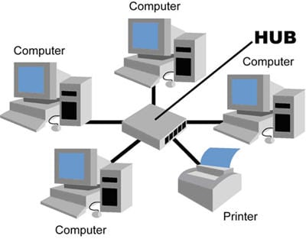
What is a Network ?
A network is defined as an interconnected collection of autonomous computers‘.
Two computers are said to be interconnected if they are capable of exchanging information.
Computers are autonomous. This means that no computer on the network can start, stop, or control another.

Slide 5
Network Goals:
Resource Sharing.
The aim is to make all programs, data, and peripherals available to anyone on the network irrespective of the physical location of the resources and the user.
Reliability.
A file can have copies on two or three different machines, so if one of them is unavailable (hardware crash), the other copies could be used.
For military, banking, air reservation and many other applications it is of importance.

Slide 6
Communication Medium. ​
Using a network, it is possible for managers, working far apart, to prepare financial report of the company. ​
The changes at one end can be immediately noticed at another.​
Application of Networks:
Resource sharing
Increased reliability
Reduced overall cost
Better communication facilities.

Slide 7
Evolution of Networking:
ARPANET
The seeds of today’s Internet were planted in 1969, when U.S. Department of Defence sponsored a project named ARPANET (Advanced Research Projects Agency NETwork).
The goal of this project was to connect computers at different universities and U.S. defence. Soon the engineers, scientists, students, and researchers who were part of this system, began exchanging data and messages on it
The users of this system were also able to play long distance games and socialize with people who shared their interests.

Slide 8
ARPANET started with a handful of computers, but it expanded rapidly. In mid-80’s, another federal agency, the National Science Foundation, created a new, high- capacity network called NSFnet, which was more capable than ARPANET. ​
NSFnet allowed only the academic research on its network and not any kind of private business on it. ​
So many private companies built their own networks, which were later interconnected along with ARPANET and NSFnet to form Internet.​
It was the Inter networking i.e., the linking of these two and some other networks (i.e., the ARPANET, NSFnet and some private networks) that was named Internet. ​
The original ARPANET was shut down in 1990, and the government funding for NSFnet discontinued in 1995. But the commercial Internet services came into picture, which are still running the Internet.​
​

Slide 9
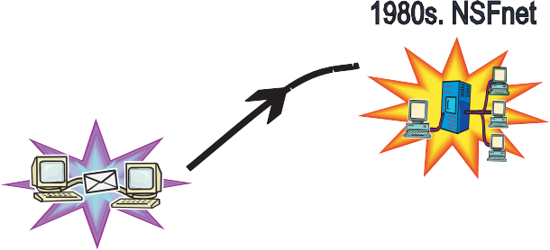
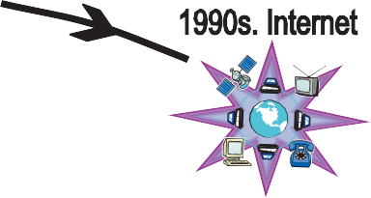

Slide 10
How Does Internet Work?
In Internet, most computers are not connected directly to the Internet.
Rather they are connected to smaller networks, which in turn are connected through gateways to the Internet backbone.
Gateway is a device that connects dissimilar networks.
Backbone is central interconnecting structure that connects one or more networks just like the trunk of a tree or the spine of a human being.

Slide 11
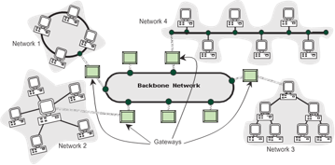

Slide 12
How Internet functions:
At the source computer, the message, or the file/document to be sent to another computer is firstly divided into small parts called Packets. A packet generally contains some information.
Each packet is given a number serial wise e.g., 1, 2, 3.
All these packets are then sent to the address of destination computer.
The destination computer receives the packets in random manner. (It may even receive packet 10 before packet 1 arrives). If a packet is garbled or lost, it is demanded again.
The packets are reassembled in the order of their number and the original message/file/document is obtained.

Slide 13
Internet Functioning:
Every computer connected to it uses the same set of rules for communication called protocol.
The communication protocol used by Internet is TCP/IP.
The TCP (i.e., Transmission Control Protocol) part is responsible for dividing the file/message into packets on the source computer. TCP is also responsible for reassembling the received packets at the destination or recipient computer.
The IP (i.e., Internet Protocol) part is responsible for handling the address of destination computer so that each packet is routed (sent) to its proper destination.

Slide 14
Interspace:
Interspace is a client/server software program that allows multiple users to communicate online with real-time audio, video, and text chat in dynamic 3D environments.
The Interspace is a vision of what the Internet will become, where users cross-correlate information in multiple ways from multiple sources.

Slide 15
SESSION REVIEW:
Networks and it goals
Evolution of network
Functioning
Working
Interspace

Slide 16
ASSIGNMENT:
What is network?
What are the goals of network?
What is ARPANET?
How does internet works?
Define interspace.
Explain the functioning of TCP an IP.

Slide 17
THANKING YOU
ODM EDUCATIONAL GROUP

