Slide 1


Introduction to MySQL and SQL
PERIOD-9
SUBJECT : Computer Science
CHAPTER NUMBER:2
CHAPTER NAME :SQL

Slide 2
Learning Outcomes:
          Student will know how to group a table using group by clause.
          They will learn to put conditions in group by using having clause.

Slide 3
Discussed so far:
          Delete command
          Update command
          Alter table command
          Drop table command
          Built in functions

Slide 4
Sub-Topics:
Group by clause
Having clause

Slide 5
Group by clause:
The GROUP BY statement groups rows that have the same values into summary rows, like "find the number of customers in each country".
The GROUP BY statement is often used with aggregate functions (COUNT(), MAX(), MIN(), SUM(), AVG()) to group the result-set by one or more columns.

Slide 6
To display the total salary of all the employees job wise.
      Select sum(Sal) from Emp group by job;
      Or
      Select Job, sum(Sal) from Emp group by job;

Slide 7
Job | Sum(Sal)
PRESIDENT | 5000
MANAGER | 8275
SALESMAN | 5600
CLERK | 4150
ANALYST | 6000

Slide 8
To list the number of employees and the average Mgr of the employees for each department.
Select DeptNo, count(*),avg(Mgr) from Emp
group by DeptNo;

Slide 9
DeptNo | Count(*) | Avg(Mgr)
10 | 2 | 3725
20 | 3 | 2358.33
30 | 6 | 1566.66
NULL | 3 | 2700

Slide 10
Placing conditions in group by:
(Having clause)
To list the number of employees and the average Mgr of the employees for each department with number of employees more than 2.
      Select DeptNo, count(*),avg(Mgr) from Emp group by DeptNo having count(*)>2;

Slide 11
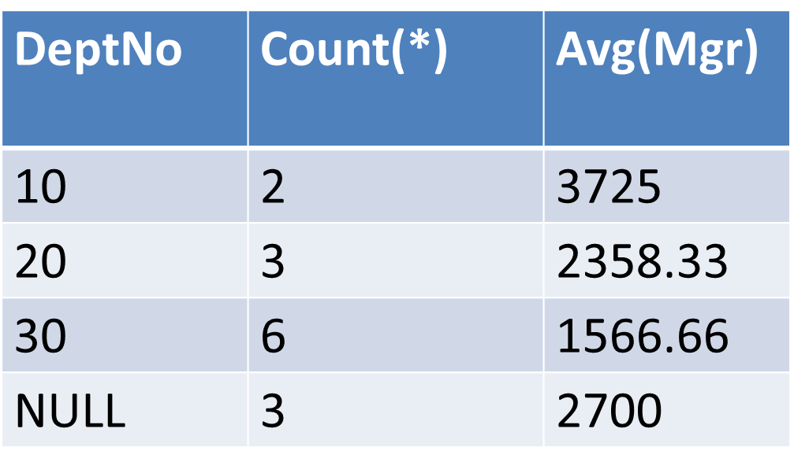

Slide 12
SESSION REVIEW:
Group by clause
Having clause

Slide 13
ASSIGNMENT:
What is the use GROUP BY?
How do we use HAVING clause?

Slide 14
THANKING YOU
ODM EDUCATIONAL GROUP

