Slide 1


Introduction to MySQL and SQL
PERIOD-8
SUBJECT : Computer Science
CHAPTER NUMBER:2
CHAPTER NAME :SQL

Slide 2
Learning Outcomes:
Student will know how to modify the data fields.
They will learn to modify the table structure.
They will be able to delete specific rows.
They can delete a table from the database.

Slide 3
Discussed so far:
Sorting
Aggregate functions

Slide 4
Sub-Topics:
Delete command
Update command
Alter table command
Drop table command
Built in functions

Slide 5
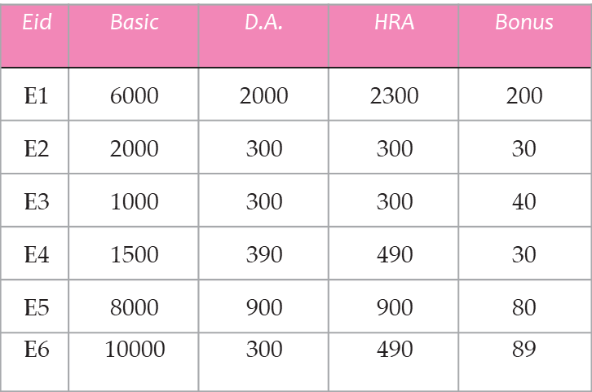
The DELETE Command:
The DELETE command removes rows from a table.
This removes the entire rows, not individual field values.
To remove all the contents of EMP table
DELETE FROM EMP;
EMP

Slide 6
To remove the tuples from employee that have Basic less than 2200
DELETE FROM EMP WHERE Basic< 2200;
To remove the tuples from EMP table whose Bonus is less than 50 and D.A. is equal to 300.
DELETE FROM EMP WHERE Bonus< 50 and D.A.=300;

Slide 7
The UPDATE Command (update+set) :
Update command is used to change some or all the values in an existing row.
To change the ROL of all items to 50:
UPDATE items SET ROL = 50 ;
To change ROL to 40 only for those items that have ROL as 20:
UPDATE items SET ROL = 40 WHERE ROL = 20 ;
Icode | Desp | Price | QOH | ROL | ROQ
I01 | Milk | 15.00 | 20 | 10 | 20
I02 | Cake | 5.00 | 60 | 20 | 50
I03 | Bread | 9.00 | 40 | 10 | 40
I04 | Biscuit | 10.00 | 50 | 40 | 60
I05 | Namkeen | 15.00 | 100 | 50 | 70
I06 | Cream Roll | 7.00 | 10 | 20 | 30
items

Slide 8
Updating Multiple Columns:
To update multiple columns, multiple column assignments can be specified with SET clause, separated by commas.
To update the ROL to 40 and QOH to 70 for items having icode less than ‘I04’, we shall write
UPDATE items SET ROL = 40, QOH = 70 WHERE icode < ‘I04’ ;

Slide 9
Using Expressions in Update :
If you want to increase the gross pay of all the employees by Rs. 900/-:
UPDATE employee SET gross = gross + 900 ;
To double the gross pay of employees of grade ‘E3’ or ‘E4’:
UPDATE employee SET gross = gross * 2
WHERE (grade = ‘E3’ OR grade = ‘E4’) ;

Slide 10
The ALTER TABLE Command (alter TABLE + add , alter TABLE + modify , ALTER TABLE+ DROP COLUMN):
ALTER TABLE+ADD
It adds new column to the existing table.
To add a new column tel_number of type integer in table Emp :
ALTER TABLE Emp ADD (tel_number integer) ;

Slide 11
Alter table + Drop Column :
To delete an existing column of a table, ALTER TABLE command can be used with Drop Column.
To delete the ContactName column from Customer table.
ALTER TABLE Customers DROP COLUMN ContactName;

Slide 12
Alter table + modify :
To modify existing columns of table( to change the data type or to modify the width of data type), ALTER TABLE command can be used.
To modify column Job of table Emp to have new width of 30 characters:
ALTER TABLE Emp MODIFY Job char(30);

Slide 13
SQL PRIMARY KEY on ALTER TABLE:
To create a PRIMARY KEY constraint for a column when the table is already created, use the following command:
ALTER TABLE Persons ADD PRIMARY KEY (ID);

Slide 14
Remove primary key with alter table:
To remove the primary key of student table, the command is:
Alter table student drop primary key;

Slide 15
The DROP TABLE Command :
The DROP TABLE command of SQL lets you drop or delete a table from the database.
The SQL requires you to empty a table before you eliminate from the database.
To remove all the rows from your table:
DELETE FROM items ;
Then you can drop the empty table items as follows :
DROP TABLE items ;

Slide 16
Some Built-In Functions:
SELECT lower (“HELLO’’) FROM Dual ; hello
SELECT upper (“friends’’) FROM Dual ; FRIENDS
SELECT replicate (“*#’’, 4) FROM Dual ; *#*#*#*#
SELECT substr (“Pointer’’, 3, 2) FROM Dual ; in
SELECT sysdate() FROM Dual; 2021-05-19 23:47:34
will return the current system date of your computer.

Slide 17
SESSION REVIEW:
Alter table command
Update command
Delete command
Drop table command
Some built in functions

Slide 18

ASSIGNMENT:
EMPLOYEE
Insert a new row to the EMPLOYEE table with the values 7, 12000, 3000, 2500, 470.
Delete the employee information whose Basic is less than 2000.
Increase the Bonus of the employees by 50 whose HRA is more than 2000.
Modify the width of Eid column to 5.
Add a new column DOB to EMPLOYEE table that will store the date of birth of the employees.
Eid | Basic | D.A. | HRA | Bonus
E1 | 6000 | 2000 | 2300 | 200
E2 | 2000 | 300 | 300 | 30
E3 | 1000 | 300 | 300 | 40
E4 | 1500 | 390 | 490 | 30
E5 | 8000 | 900 | 900 | 80
E6 | 10000 | 300 | 490 | 89

Slide 19
THANKING YOU
ODM EDUCATIONAL GROUP

