Slide 1


Introduction to MySQL and SQL
PERIOD-4
SUBJECT : Computer Science
CHAPTER NUMBER:2
CHAPTER NAME :SQL

Slide 2
Learning Outcomes:
Student will know the show table command and describe command.
They will learn about making simple queries , selecting rows and columns.
They will know the use of relational and logical operators with where clause.

Slide 3
Discussed so far:
Database Commands( CREATE, SHOW, DROP)
Creating Tables
CONSTRAINTS in CREATE TABLE Command

Slide 4
Sub-Topics:
Show tables command
Describe command
Making simple queries (SELECT Command)
Selecting All data
Selecting particular Rows
selecting particular columns

Slide 5
SHOW tables command:
To get a list of the tables in a MySQL database show tables
Command is used.
SHOW tables;

Slide 6
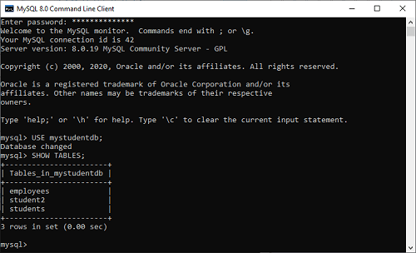

Slide 7
DESCRIBE Command:
The DESC is the short form of DESCRIBE command and is used to display the information about a table like column names and constraints on column name.
DESCRIBE student;
OR
DESC student;

Slide 8
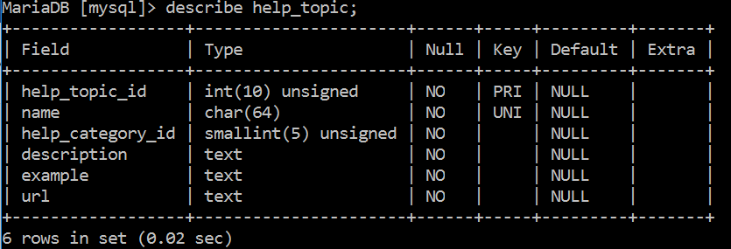

Slide 9
The SELECT Command
The SELECT command of SQL lets you make queries on the database. A query is a command that is given to produce certain specified information from the table.
SELECT <column name> [, <column name>,…] FROM <table name>;

Slide 10
Emp table:
EmpNo | EmpName | Job | Mgr | Hiredate | Sal | Comm | DeptNo
7839 | KING | PRESIDENT |  | 17-NOV-81 | 5000 |  | 10
7698 | BLAKE | MANAGER | 7839 | 01-MAY-81 | 2850 |  | 30
7782 | CLARK | MANAGER | 7839 | 09-JUN-81 | 2450 |  | 10
7566 | JONES | MANAGER | 7839 | 01-APR-81 | 2975 |  | 20
7654 | MARTIN | SALESMAN | 7698 | 28-SEP-81 | 1250 | 1400 | 30
7499 | ALLEN | SALESMAN | 7698 | 20-FEB-81 | 1600 | 300 | 30
7844 | TURNER | SALESMAN | 7698 | 08-SEP-81 | 1500 | 0 | 30
7900 | JAMES | CLERK | 7698 | 03-DEC-81 | 950 |  | 30
7521 | WARD | SALESMAN | 7698 | 22-FEB-81 | 1250 | 500 | 30
7902 | FORD | ANALYST | 7566 | 03-DEC-81 | 3000 |  | NULL
7369 | SMITH | CLERK | 7902 | 17-DEC-80 | 800 |  | NULL
7788 | SCOTT | ANALYST | 7566 | 09-DEC-82 | 3000 |  | 20
7876 | ADAMS | CLERK | 7788 | 12-JAN-83 | 1100 |  | 20
7934 | MILLER | CLERK | 7782 | 23-JAN-82 | 1300 |  | NULL

Slide 11
Examples:
To display all the rows present in the Emp table.
SELECT * FROM Emp ;

Slide 12
To display specific columns :
To list the number and name of all the employees
SELECT EmpNo, EmpName FROM Emp ;
EmpNo | EmpName
7839 | KING
7698 | BLAKE
7782 | CLARK
: | :
: | :

Slide 13
WHERE clause (Used to add condition):
To list the name and salary of the employees whose salary is more than 2900
SELECT EmpName, sal FROM emp WHERE sal > 2900 ;
EmpName | Sal
KING | 5000
JONES | 2975
FORD | 3000
SCOTT | 3000

Slide 14
Relational Operators:
To compare two values, a relational operator is used. The result of the comparison is true or false. The SQL recognizes following relational operators :
=, >, <, > =, < =, <> (not equal to)

Slide 15
Write commands for following queries:
To list the employee information working as “manager”.
List out the employee details working in department no 30.
To display the name, number and job of the employees whose mgr is less than 7600.
To list the employee name with their hiredate who are not working as clerks.
To list the job and employee no who have joined on or before “03-DEC-81”.

Slide 16
Select * from Emp where job=“manager”;
Select * from Emp where DeptNo=30;
Select EmpName,EmpNo,Job from Emp where Mgr<7600;
Select EmpName,Hiredate from Emp where Job<>“clerk”;
Select Job,EmpNo from Emp where Hiredate<= “03-DEC-81”;

Slide 17
Logical Operators:
The logical operators OR, AND, NOT are used to combine multiple conditions in the WHERE clause.
To list the employees’ details working in deptno 10 or 20 from table Emp.
SELECT * FROM Emp WHERE (deptno= 10 OR deptno= 20) ;
EmpNo | EmpName | Job | Mgr | Hiredate | Sal | Comm | DeptNo
7839 | KING | PRESIDENT |  | 17-NOV-81 | 5000 |  | 10
7782 | CLARK | MANAGER | 7839 | 09-JUN-81 | 2450 |  | 10
7566 | JONES | MANAGER | 7839 | 02-APR-81 | 2975 |  | 20
7788 | SCOTT | ANALYST | 7566 | 09-DEC-82 | 3000 |  | 20
7876 | ADAMS | CLERK | 7788 | 12-JAN-83 | 1100 |  | 20

Slide 18
To list all the employees’ details working as manager in department number 30.
SELECT * from Emp
WHERE (job= ‘MANAGER’ AND deptno=30) ;
EmpNo | EmpName | Job | Mgr | Hiredate | Sal | Comm | DeptNo
7698 | BLAKE | MANAGER | 7839 | 01-MAY-81 | 2850 |  | 30

Slide 19
To list all the employees’ details whose department number are other than 30.
SELECT * FROM emp WHERE (NOT deptno= 30) ;
or
SELECT * FROM emp WHERE (deptno<> 30) ;
EmpNo | EmpName | Job | Mgr | Hiredate | Sal | Comm | DeptNo
7839 | KING | PRESIDENT |  | 17-NOV-81 | 5000 |  | 10
7782 | CLARK | MANAGER | 7839 | 09-JUN-81 | 2450 |  | 10
7566 | JONES | MANAGER | 7839 | 02-APR-81 | 2975 |  | 20
7902 | FORD | ANALYST | 7566 | 03-DEC-81 | 3000 |  | NULL
7369 | SMITH | CLERK | 7902 | 17-DEC-80 | 800 |  | NULL
7788 | SCOTT | ANALYST | 7566 | 09-DEC-82 | 3000 |  | 20
7876 | ADAMS | CLERK | 7788 | 12-JAN-83 | 1100 |  | 20
7934 | MILLER | CLERK | 7782 | 23-JAN-82 | 1300 |  | NULL

Slide 20
SESSION REVIEW:
Show tables command
Describe command
Making simple queries (SELECT Command)
Selecting All data
Selecting particular Rows
selecting particular columns

Slide 21
Assignment:
Write a command to display the student table.
Write a command to display the name and roll of all the students.
Write a command to list out the name, roll and percentage of all the students of class XII.
Write a command to display the employee details whose salary is more than 50000 and working in dept. no 3.
Write a command to list the item details whose price is less than 600 or item code is equal to 101.

Slide 22
THANKING YOU
ODM EDUCATIONAL GROUP

