Slide 1


Introduction to MySQL and SQL
PERIOD-3
SUBJECT : Computer Science
CHAPTER NUMBER:2
CHAPTER NAME :SQL

Slide 2
Learning Outcomes:
Student will know the database commands( create, show, drop).
They will know to create a table using create table command.
They will learn about various constraints used in create table command.

Slide 3
Discussed so far:
How to start MySQL
Classification of SQL Statements
DDL vs. DML

Slide 4
Sub Topics:
Database Commands( CREATE, SHOW, DROP)
Creating Tables
CONSTRAINTS in CREATE TABLE Command

Slide 5
Database commands:
CREATE DATABASE Command
Use command
Show databases command
Drop database command

Slide 6
Show databases:
SHOW DATABASES lists the databases on the MySQL server.
To see all the databases created write the command
Show databases;

Slide 7
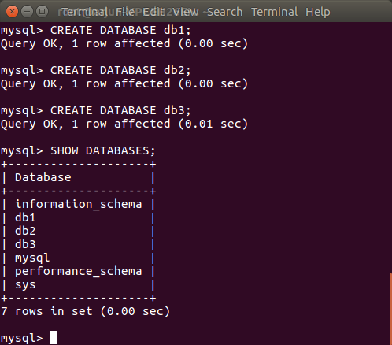

Slide 8
CREATE DATABASE Command:
This command is used to create a database.
To create a database named school the command is
Create database school;

Slide 9
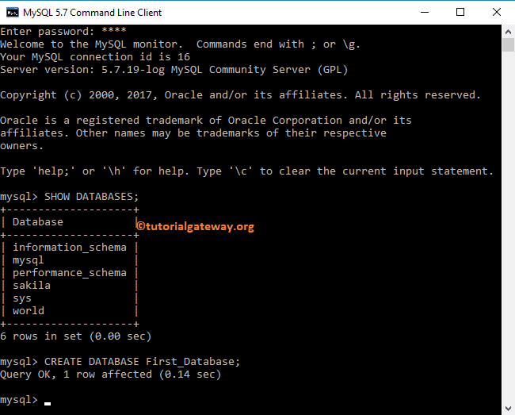

Slide 10
Accessing Database:
Use command:
Before doing any operation upon the table in the database , we need to open the database.
Syntax:
Use database name;
Ex:
To work with the database school the command is
Use school;

Slide 11
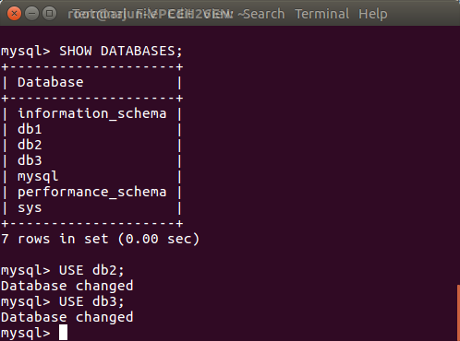

Slide 12
Drop database command:
The DROP DATABASE Statement is used to drop or delete a database.
Dropping the database will drop all database
objects (tables, views, procedures etc.) inside it.
Ex: To delete the database school
Drop database school;

Slide 13
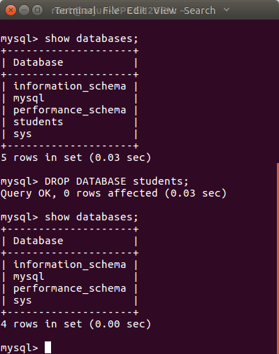

Slide 14
CREATE TABLE Command:
This command is used to create a table in the database.
To create an employee table whose scheme is as follows :
Employee (Ecode, Ename, Sex, Grade, Gross)
CREATE TABLE Employee
(Ecode integer,
Ename char(20),
Sex char(1),
Grade char(2),
Gross decimal ) ;

Slide 15
create a student table whose scheme is as follows :
student(Roll, Sname, Sex, Grade, Dob, Phoneno)
CREATE TABLE student
(Roll integer,
Sname char(20),
Sex char(1),
Grade char(2),
Dob date,
Phoneno integer ) ;

Slide 16
Constraints in create table commands:
Constraint:
A Constraint is a condition or check applicable on a field or set of fields.
Types of Constraints:
Unique constraint
Primary key constraint
Default constraint
Check constraint
Not null

Slide 17
UNIQUE Constraint:
The UNIQUE constraint maintains the uniqueness of a column in a table. More than one UNIQUE column can be used in a table.
CREATE TABLE employee
( Ecode integer,
Ename char (20),
Sex char (1),
Grade char (2),
Gross decimal UNIQUE ) ;

Slide 18
NOT NULL constraint:
The NOT NULL constraint enforces a column to NOT accept NULL values.
The NOT NULL constraint enforces a field to always contain a value.
CREATE TABLE employee
( Ecode integer,
Ename char (20) NOT NULL,
Sex char (1) NOT NULL,
Grade char (2),
Gross decimal UNIQUE ) ;

Slide 19
Primary Key Constraint:
This constraint declares a column as the primary key of the table. The primary keys cannot allow NULL values.
CREATE TABLE employee
( Ecode integer PRIMARY KEY,
Ename char (20),Sex char (1),
Grade char (2),Gross decimal UNIQUE ) ;

Slide 20
DEFAULT Constraint:
A default value can be specified for a column using the DEFAULT constraint. When a user does not enter a value for the column automatically the defined default value is assigned.
CREATE TABLE Geeks
( ID int NOT NULL,
Name char(20),
Age int,
Location char(25) DEFAULT 'Noida');

Slide 21
CHECK Constraint :
This constraint limits values that can be inserted into a column of a table.
For instance, consider the following SQL statement :
CREATE TABLE Persons
( ID int NOT NULL,
LastName varchar(255) NOT NULL,
FirstName varchar(255),
Age int CHECK (Age>=18)
);

Slide 22
Applying Table Constraints:
When a constraint is to be applied on a group of columns of the table, it is called table constraint. The table constraints appear in the end of table definition.
CREATE TABLE OrderItem
(OrderNum INTEGER PRIMARY KEY, ItemNum INTEGER , Quantity INTEGER , Price INTEGER , NOT NULL (Quantity, Price));

Slide 23
SESSION REVIEW:
Database Commands( CREATE, SHOW, DROP)
Creating Tables
CONSTRAINTS in CREATE TABLE Command

Slide 24
Assignments:
Write a command to list all the databases present in a server.
Write a command to create a new database called SCHOOL.
Write a command to use the database school.
Write a command to create a table school with the attributes NAME, ROLL, SECTION, ADDRESS.
Write a command to delete the database SCHOOL.

Slide 25
THANKING YOU
ODM EDUCATIONAL GROUP

