Slide 1


WORKING WITH FUNCTION
CLASS-XII, PERIOD-4
SUBJECT: Computer Science
CHAPTER NUMBER: 03
CHAPTER NAME: Working With Function

Slide 2
Learning Outcomes:
Know the concepts of Arguments​
Know the concepts of Parameter​
Know the concepts of Actual arguments​
Know the concepts of formal arguments​
Know the types of arguments​

Slide 3
Discussed So Far:
Order of execution of statements.
Concept of an execution frame.
Writing programs using own functions

Slide 4
Sub-Concepts:
Arguments and parameter
Actual arguments and formal arguments
Types of arguments

Slide 5
Arguments And Parameters:
Arguments :
These the values being passed in function call .
They are also referred as actual argument or actual parameter.
Example:
Sum( x, y)
X and y are the arguments

Slide 6
Parameters :
These are the values being received in function definition or header.
They are also referred as formal argument or formal parameter.
def multiply ( a, b ) :
print (a* b)
a, b are the parameters

Slide 7
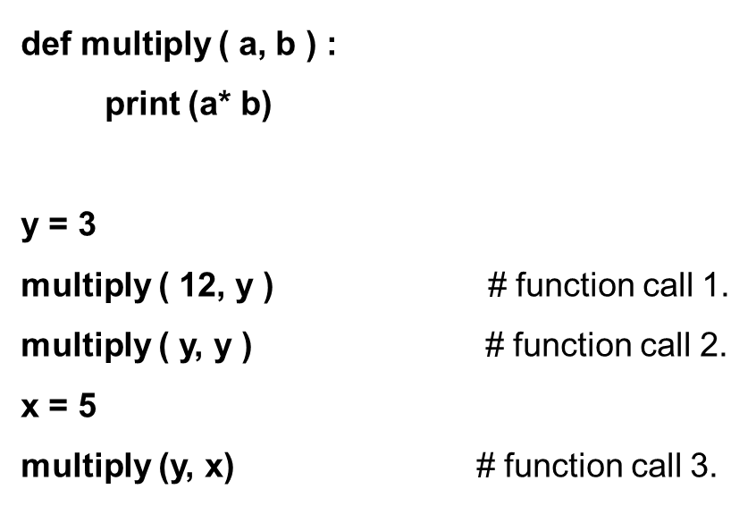
Example:

Slide 8
The function calls of multiply( ) as example:
multiply ( 12, y ) # function call 1.
multiply ( y, y ) # function call 2.
multiply ( y, x ) # function call 3.
With function-call 1, the variables a and b in function header will receive values 12 and y, respectively.
With function-call 2, the variables a and b in function header will receive values y and y, respectively.
With function-call 3, the variable a and b in function header will receive values y and x, respectively.

Slide 9
Types Of Arguments:
Positional arguments (Required arguments)
Default arguments
Keyword (or named) arguments

Slide 10
Session Review:
Concepts of Arguments
Concepts of Parameter
Concepts of Actual arguments
Concepts of formal arguments
Types of arguments

Slide 11
Assignments:
Differentiate between actual parameter and formal parameter.
What could be the different types of argument in a function?
WAP to multiply two integers using function.
WAP to calculate area of a circle using function.
WAP and SWAP 2 integers using functions.

Slide 12
THANKING YOU
ODM EDUCATIONAL GROUP

