Slide 1


WRITING ONTO A CSV FILE
PERIOD-11
SUBJECT: COMPUTER SCIENCE
CHAPTER NUMBER: 4
CHAPTER NAME: FILE HANDLING

Slide 2
Learning Outcomes:
Students will learn how to write into a CSV file
Will look into some examples and explanations

Slide 3
Discussed So Far:
Introduction to CSV file
Advantages of CSV files
CSV File handling
Reading a CSV file

Slide 4
Sub Concepts:
Writing into a CSV file
Examples and Explanations

Slide 5
Writing to CSV File:
To write to a CSV file in Python, we can use the csv.writer() function.
The csv.writer() function returns a writer object that converts the user's data into a delimited string.
This string can later be used to write into CSV files using the writerow() function.
In order to write to a CSV file, we create a special type of object to write to the CSV file "writer" .

Slide 6
writerow():
"object", which is defined in the CSV module, and which we create using the writer() function.​
The writerow() method allows us to write a list of fields to the file. ​
The fields can be strings or numbers or both.
​
Also, while using writerow(), you do not need to add a new line character (or other EOL indicator) to indicate the end of the line, writerow() does it for you as necessary.​

Slide 7
Practical Implementation:
Program to write data onto “student” CSV file using writerow() method.
import csv
fields = ['Name', 'Class', 'Year', 'Percent']
rows = [ ['Rohit', 'XII', '2008', '92']
['Shaurya', 'XI', '2004', '82']
['Deep', 'XII', '2002', '80']
['Prerna', 'XI', '2006', '85']
['Lakshya', 'XII', '2005', '72'] ]
filename = "D:/marks.csv"
with open(filename,'w',newline=' ') as f:
csv_w = csv.writer(f,delimiter = ',')
csv_w.writerow(fields)
for i in rows:
csv_w.writerow(i)
print("File created")

Slide 8
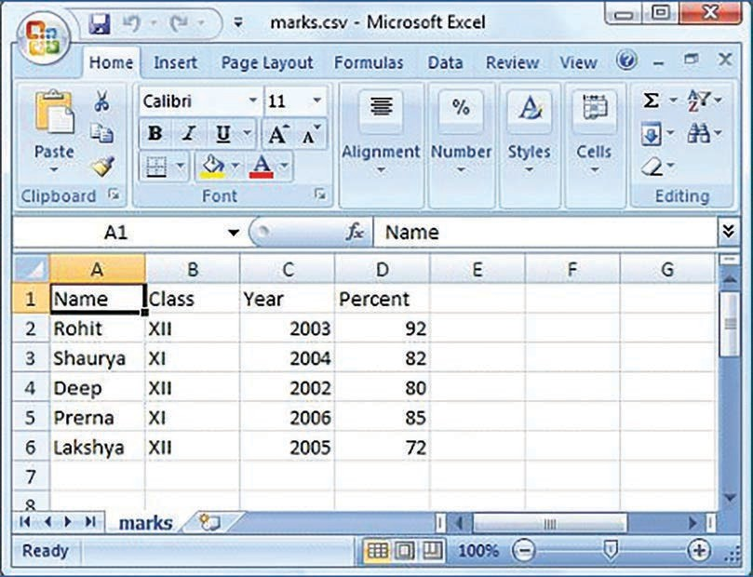
Contents of “marks.csv” created:

Slide 9
Explanation:
The very first line is for importing csv file into your program.
Next, the column headings for our data.
All the data stored inside these fields are placed inside variable rows.
student.csv will be created and stored inside your current working directory or the path that you mentioned.
‘w’ stands for write mode and we are using the file by opening it using "with open statement”.

Slide 10
csv.writer() is called to obtain a writer object and store it in the variable csv_w .​
writer() takes the name of file object ‘f’ as the argument. By default, the delimiter is comma (,).​
writerow(fields) is going to write the fields which are the column headings into the file.​
Using for loop, rows are traversed from the list of rows from the file. writerow(i) is writing the data row-wise in the file. ​
While giving csv.writer(), the delimiter taken is comma.
We can change the delimiter whenever and wherever required by changing the argument passed to delimiter attribute.​

Slide 11
writerows():
writerows() can write multiple rows into a CSV file provided it must be in the form of a nested sequence.
rows=[[“akash”,1,20], [“ankita”,2,30], [“azhar”,3,20], [“ahmed”,4,40]]
csv_w.writerows(rows)

Slide 12
Program to write data onto "student" csv file using writerows() method (modification of Practical Implementation ).
import csv
fields = ['Name', 'Class', 'Year', 'Percent']
rows = [ ['Rohit', 'XII', '2008', '92']
['Shaurya', 'XI', '2004', '82']
['Deep', 'XII', '2002', '80']
['Prerna', 'XI', '2006', '85']
['Lakshya', 'XII', '2005', '72'] ]
filename = "D:/newmarks.csv"
with open(filename,'w',newline=' ') as f:
csv_w = csv.writer(f,delimiter = ',')
csv_w.writerow(fields)
csv_w.writerows(rows)
print("All rows written in one go")
>>>
All rows written in one go

Slide 13
Session Review:
Writing into a CSV file
Examples and Explanations

Slide 14
Assignment:
How do you write into a CSV file? Give example.
What is a writer object?
Write the difference between writerow() and writerows()

Slide 15
THANKING YOU
ODM EDUCATIONAL GROUP

