Slide 1


INTRODUCTION TO CSV FILES, READING FROM A CSV FILE
PERIOD-10
SUBJECT: COMPUTER SCIENCE
CHAPTER NUMBER: 4
CHAPTER NAME: FILE HANDLING

Slide 2
Learning Outcomes:
Students will get introduced with CSV files
Learn about advantages of CSV files
Look into CSV file handling in Python & read a CSV file

Slide 3
Discussed So Far:
Random accessing with tell() & seek()
Absolute positioning
Relative positioning

Slide 4
Sub Concepts:
Introduction to CSV file
Advantages of CSV files
CSV File handling
Reading a CSV file

Slide 5
Introduction To CSV:
      In every span of today’s organizational working environment, data sharing is one of the major tasks to be carried out, largely through spreadsheets or databases.
      A basic approach to share data is through the comma separated values (CSV) file.
      CSV is a simple flat file in a human readable format which is extensively used to store tabular data, in a spreadsheet or database. A CSV file stores tabular data (numbers and text) in plain text.
      Files in the CSV format can be imported to and exported from programs that store data in tables, such as Microsoft Excel or OpenOffice Calc.

Slide 6
A “comma separated value” file is a delimited text file that uses a comma to separate values.​
Each line in a file is known as data/record. Each record consists of one or more fields separated by commas.
Tabular data is stored as text in a CSV file. The use of comma as a field separator is the source of the name for this file format.
It stores our data into a spreadsheet or a database.​

Slide 7
Advantages Of CSV Files :
      CSV is faster to handle.
      CSV is smaller in size.
      CSV is easy to generate and import onto a spreadsheet or database.
      CSV is human readable and easy to edit manually.
      CSV is simple to implement and parse.
      CSV is processed by almost all existing applications.

Slide 8
CSV File Handling In Python:
      For working with CSV files in Python, there is an inbuilt module called CSV which is used to read and write tabular data in CSV format.
      Therefore, to perform read and write operation with CSV file, we must import CSV module.
      CSV module can handle CSV files correctly regardless of the operating system on which the files were created.
      Along with this module, open() function is used to open a CSV file and returns the file object.
      We load the module in the usual way using import:
            >>> import csv

Slide 9
Operations on CSV file:
      Reading a CSV​
      Writing to a CSV​

Slide 10
Reading From CSV File:
      Reading from a CSV file is done using the reader object.
      The CSV file is opened as a text file with Python’s built-in open() function, which returns a file object.
      This creates a special type of object to access the CSV file (reader object), using the reader() function.
      The reader object is an iterable that gives us access to each line of the CSV file as a list of fields.

Slide 11
      You can also use next() directly on it to read the next line of the CSV file, or you can treat it like a list in a for loop to read all the lines of the file (as lists of the file’s fields).​
      This is shown in the practical implementation given below.​
      Before this, enter the student details in spreadsheet and save this file as shown:​
      Next step is to open the Notepad and enter the data for student.csv, which will be the equivalent for student.xls.​

Slide 12
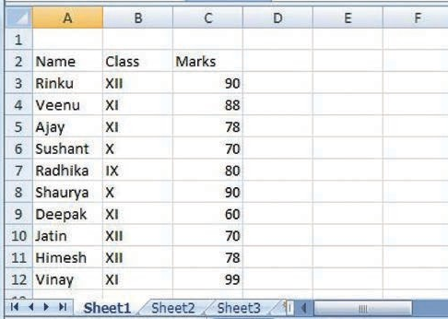
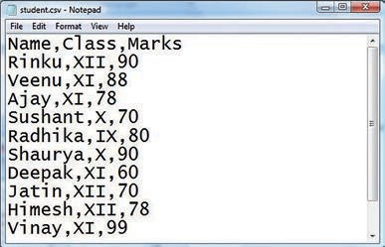
student.csv
student.xls

Slide 13
In student.csv (notepad) file, first line is the header and remaining lines are the data/records.
The fields are separated by comma, or we may say the separator character.
In general, the separator character is called a delimiter, and the comma is not the only one used.
Other popular delimiters include the tab (\t), colon (:) and semi-colon (;) characters.

Slide 14
Practical Implementation:
    Write a program to read the contents of “student.csv” file.
import csv
f = open(C:/Users/admin/Documents/student.csv",'r')
csv_reader = csv.reader(f)
for row in csv_reader:
  print(row)
f.close()

Slide 15
>>>
['Name', 'Class', 'Marks']
['Rinku', 'XII', '90']
['Veenu', 'XI', '88']
['Ajay', 'XI', '78']
['Sushant', 'X', '70']
['Radhika', 'IX', '80']
['Shaurya', 'X', '90']
['Deepak', 'XI', '60']
['Jatin', 'XII', '70']
['Himesh', 'XII', '78']
['Vinay', 'XI', '99']

Slide 16
Explanation:
      As seen from the above output, every record is stored in reader object in the form of a List.
      In the above code, we first open the CSV file in READ mode.
      The file object is named as f.
      The file object is converted to csv.reader object.
      We save the csv.reader object as csv_reader.

Slide 17
The reader object is used to read records as lists from a csv file. ​
Now, we iterate through all the rows using a for loop. When we try to print each row.​
One can find that row is nothing but a list containing all the field values. ​
Thus, all the records are displayed as lists separated by comma. ​

Slide 18
Practical Implementation:
    Write a program to read the contents of “student.csv” file using with open().
import csv
with open(C:/Users/admin/Documents/student.csv",'r') as csv_file:
  reader = csv.reader(csv_file)
  rows = []
  for rec in reader:
    rows.append(rec)
  print(rows)

Slide 19
>>>
[ ['Name', 'Class', 'Marks'], ['Rinku', 'XII', '90'], ['Veenu', 'XI', '88'], ['Ajay', 'XI', '78'], ['Sushant', 'X', '70'], ['Radhika', 'IX', '80'], ['Shaurya', 'X', '90'], ['Deepak', 'XI', '60'], ['Jatin', 'XII', '70'], ['Himesh', 'XII', '78'], ['Vinay', 'XI', '99'], [] ]

Slide 20
Practical Implementation:
    Write a program to count the number of records present in “student.csv” file.
import csv​
f = open(C:/Users/admin/Documents/student.csv",'r')​
csv_reader = csv.reader(f)​
​columns = next(csv_reader)
c = 0
for row in csv_reader:
c = c + 1
print("No. Of records are:",c)
>>>
No. of records are: 11

Slide 21
Session Review:
Introduction to CSV file
Advantages of CSV files
CSV File handling
Reading a CSV file

Slide 22
Assignment:
What is a CSV file?
What are the advantages of CSV files?
How do we read from a CSV file?
What is a reader object?

Slide 23
THANKING YOU
ODM EDUCATIONAL GROUP

