Slide 1


INTRODUCTION TO BINARY FILE PERIOD-6
SUBJECT: COMPUTER SCIENCE
CHAPTER NAME: FILE HANDLING
CHAPTER NO: 4

Slide 2
Learning Outcomes :
They will learn about different File Modes.
They will learn about the Pickle Module.
Students will know about Binary Files Operations.

Slide 3
Sub- Concepts:
Binary File Operations
File Modes
Writing into Binary File
Pickle Module
Reading from a binary file

Slide 4
Binary File:
Most of the files that we see in our computer system are called binary files.
Example:
Document files: .pdf, .doc, .xls etc.
Image files: .png, .jpg, .gif, .bmp etc.
Video files: .mp4, .3gp, .mkv, .avi etc.
Audio files: .mp3, .wav, .mka, .aac etc.
Database files: .mdb, .accde, .frm, .sqlite etc.
Archive files: .zip, .rar, .iso, .7z etc.
Executable files: .exe, .dll, .class etc.

Slide 5
Binary File Properties:
All binary files follow a specific format.
Not in human readable form.
Doesn’t have any EOL character.
They are in the form of binary, so translation is not required.
These files are faster in working.

Slide 6
File Modes:
Character | Function
rb | Open a file for reading only in binary format. Starts reading from beginning of file.
wb | Same as w but opens in binary mode.
rb+ | Same as rb but also allows to write into the file.
wb+ | Same as wb but also allows to read from file.
ab | Same as a but in binary format. Creates a new file if file does not exist.
ab+ | Same as ab but also open for reading.

Slide 7
Pickle Module:
Pickle module is used for Serialization and Deserialization.
Serialization:
Process to convert any kind of python objects (list, dict, etc.) into byte streams (0s and 1s) is called pickling or serialization or flattening or marshalling.
It is used to store python objects like lists, dictionaries, class objects, and more.

Slide 8
De-Serialization:
It is the reverse process of serialization.
Process to convert byte streams (0s and 1s) back into python object is called unpicking or De-serialization.
It is used to read from binary file.

Slide 9
Pickle Module Methods:
Methods under pickle module are:
dump() ------ for writing
load() -------- for reading

Slide 10
Writing To A Binary File: dump()
The open() function opens a file in text format by default.
To open a file in binary format, add 'b' to the mode parameter.
The "wb" mode opens the file in binary format for writing.
Use dump() to write records.
Pickle.dump(Rec, filehandle)

Slide 11
Write to a Binary File:
Example 1:( Write a list into a file)
import pickle
f=open("binfile.bin","wb")
num=[5, 10, 15, 20, 25]
Pickle.dump(num,f)
f.close()

Slide 12
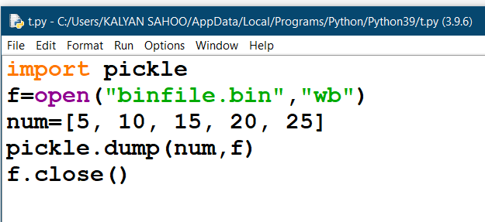
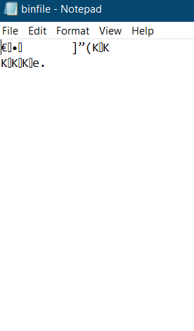
Program:
binfile:

Slide 13
Example 2: (Writing 5 students records into a binary file)
import pickle
file = open('important', ‘wb')
for i in range(5):
name= input('Enter name: ')
roll= input('Enter roll: ')
per= input('Enter per: ')
str=[name,roll,per]
pickle.dump(str, file)
file.close()

Slide 14
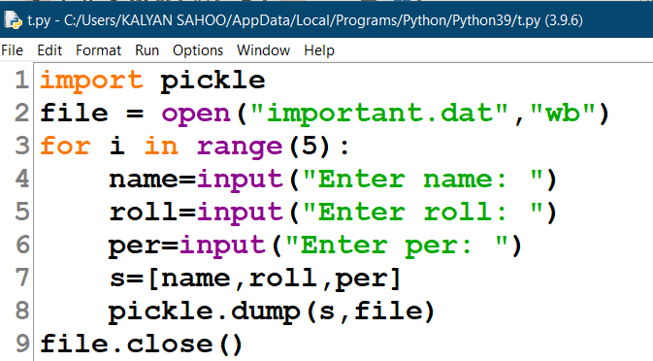
Program:

Slide 15
Reading from a binary file: load()
load() function is used to retrieve pickled data.
The argument of load function is the file object.
It reads a single record from the file and returns it.
Syntax:
Rec= pickle. load(file handle)

Slide 16
Example: (Read and display 1st 3 records from a binary file):
import pickle
file = open('important.dat', 'rb')
rec1= pickle.load(file)
rec2= pickle.load(file)
rec3= pickle.load(file)
Print(rec1)
Print(rec2)
Print(rec3)
file.close()

Slide 17
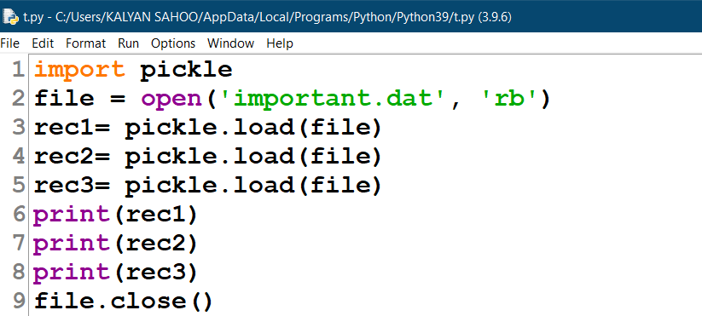
Program:

Slide 18
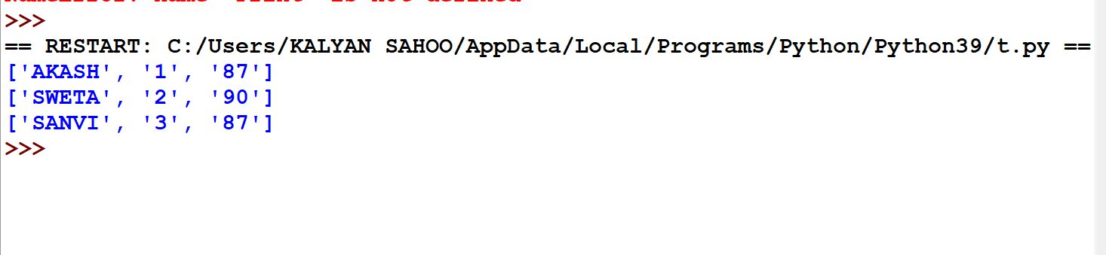
Output:

Slide 19
Session Review:
Binary File Operations
File Modes
Pickle Module
Writing into Binary File
Reading from a binary file

Slide 20
Assignments:
Write the properties of a binary file.
Differentiate between a text file and binary file.
Describe about pickle module.
Differentiate between pickling and unpickling.
create a binary file to store 5 books information in a file book_info.dat containing information like book name, authors name and price.
Write a program to read and display the first 5 records of a binary file.

Slide 21
THANKING YOU
ODM EDUCATIONAL GROUP

