Slide 1


Standard Input, Output and Error Streams, ABSOLUTE AND RELATIVE PATH
PERIOD-5
SUBJECT: COMPUTER SCIENCE
CHAPTER NUMBER: 4
CHAPTER NAME: FILE HANDLING

Slide 2
Learning Outcomes:
Students will learn about standard input, output & error streams
They will learn about absolute and relative path

Slide 3
Discussed So Far:
flush()
Processing a File
File Pointer

Slide 4
Sub Concepts:
Standard input, output and error streams
With statement in opening a file
Absolute and Relative Path

Slide 5
Standard Input, Output and Error Streams:
If someone asks you to give input to a program interactively or by typing, you known what device you need for it – the keyboard.
Similarly, if someone says that the output is to be displayed, you know which device it will be displayed on – the monitor.
So, we can safely say that the Keyboard is the standard input device and the monitor is standard output device.
Similarly, any error if occurs is also displayed on the monitor. So, the monitor is also standard error device.

Slide 6
That is,​
​
Standard input device (stdin) – reads from the keyboard​
Standard output device (stdout) – prints to the display and can be redirected as standard input.​
Standard error device (stderr) – Same as stdout but normally only for errors. ​
​
​
​
These standard devices are implemented as files called standard streams. ​
In Python, you can use these standard stream files by using sys module. ​
After importing, you can use these standard streams (stdin, stdout and stderr) in the same way as you use other files.​
​

Slide 7
Standard Input, Output Devices as Files:
If you import sys module in your program then, sys.stdin.read( ) would let you read from keyboard.
This is because the keyboard is the standard input device linked to sys.stdin.
Similarly, sys.stdout.write ( ) would let you write on the standard output device, the monitor
sys.stdin and sys.stdout are standard input and standard output devices respectively, treated as files.

Slide 8
Thus sys.stdin and sys.stdout are like files which are opened by the Python when you start Python. ​
The sys.stdin is always opened in read mode and sys.stdout is always opened in write mode. ​
Following code fragment shows you interesting use of these. It prints the contents of a file on monitor without using print statement :​
import sys​
fh = open(r”E:\poem.txt”)​
line1 = fh.readline( )​
line2 = fh.readline( )​
sys.stdout.write(line1)​
sys.stdout.write(line2)​
sys.stderr.write(“No errors occurred\n”)​

Slide 9
With Statement:
Python’s with statement for files is very handy when you have two related operations which you’d like to execute as a pair, with a block of code in between.
The syntax for using with statement is :
with open (<<filename>,<filemode>) as <filehandle>:
<file manipulation statements>
with open(‘output.txt’, ‘w’) as f:
f.write(‘HI there!’)

Slide 10
The above with statement will automatically close the file after the nested block of code. ​
The advantage of using a with statement is that it is guaranteed to close the file no matter how the nested block exits. ​
Even if an exception (a runtime error) occurs before the end of the block, it will close the file.​

Slide 11
Absolute and Relative Paths:
Full name of a file or directory or folder consists of path\primary name extension.
Path is a sequence of directory names which give you the hierarchy to access a particular directory or file name.
The Absolute Pathnames mention the paths from the top most level of the directory structure.
The relative Pathnames mention the paths with respect to another directory .
Let us consider the following structure :

Slide 12
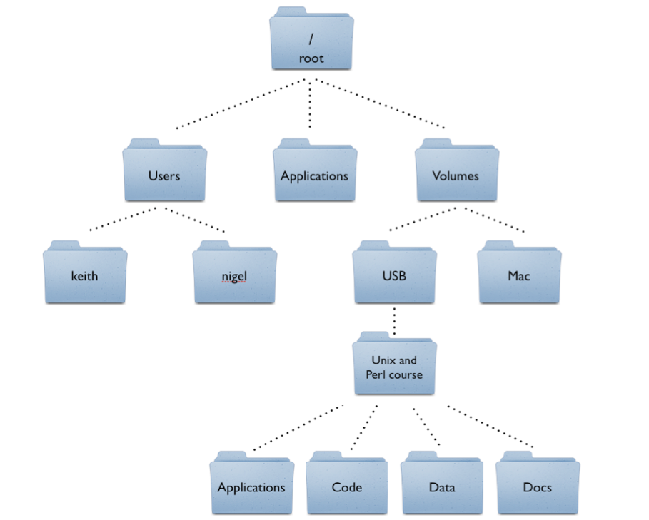
A Sample Directory Structure

Slide 13
Absolute path name:
Now the full name of directions Project, Sales and Accounts will be
E:\PROJECT, E:SALES and E : \ACCOUNTS respectively.
So format of path can be given as
Drive-letter :\directory [\directory…]
where first \(blackslash) refers to root directory and other (‘\’s) separate a directory name from the previous one.
Now the directory BACKUPS Absolute path will be :
E:\SALES\YEARLY\BACKUP

Slide 14
Similarly full name of ONE VBP file under PROJ2 subdirectory will be :
E : \ PROJECT\PROJ2\ONE.VBP
CASH ACT1’s Absolute path will be
E :\ACCOUNTS\CASH.ACT
and CASH.ACT2’S Absolute path will be
E : \ACCOUTNS\HISOTRY\CASH.ACT

Slide 15
Relative Path:
Relative Path is the hierarchical path that locates a file or folder on a file system starting from the current directory.
There are also the dot (.) and dot-dot (..) folders. These are not real folders but special names that can be used in a path.
A single period (“dot”) for a folder name is shorthand for “this directory.”
Two periods (“dot-dot”) means “the parent folder.”

Slide 16
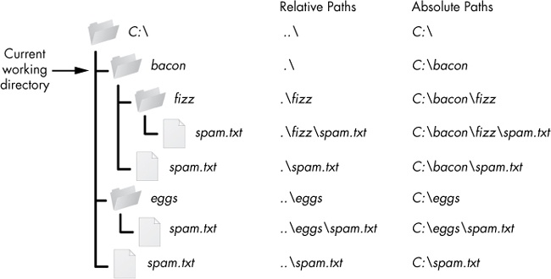

Slide 17
Session Review:
Standard input, output and error steams
Python data files
Absolute and Relative Path

Slide 18
Assignment:
What are the standard streams in Python?
What is absolute and relative path?

Slide 19
THANKING YOU
ODM EDUCATIONAL GROUP

