Slide 1


RELATIONAL ALGEBRA
PERIOD-5
SUBJECT: Computer Science
CHAPTER NUMBER: 1
CHAPTER NAME: DATABASE CONCEPT

Slide 2
Learning Outcomes:
Student will understand about relational algebra.
Will know about the different types of relational algebra.

Slide 3
Discussed So Far:
Keys
Types of keys
Primary key
Candidate key
Alternate key
Foreign key

Slide 4
Subtopics:
Relational algebra
Unary operation
Binary operation

Slide 5
Relational algebra:
The operations done on the relations are called as relational algebra.
Select operation
Project operation
Cartesian product
Union operation
Intersection operation
Set difference
unary
binary

Slide 6
Select operation (σ):
The SELECT operation is used for selecting certain tuples according to a given selection condition.
Sigma(σ) Symbol denotes it.
Syntax:
σ_{condition}(Relation)
Relational operators(<,<=,>,>=,=,≠)can be used in conditions.
More than one conditions can be used by combining with AND , OR operators.

Slide 7
Example:
Selects tuples from Tutorials where topic = 'Database’.
σ _{topic = "Database"} (Tutorials)
2. Selects tuples from Tutorials where the topic is “Database” and author is “guru99”.
σ topic = "Database" and author = "guru99"( Tutorials)
3. Selects tuples from Customers where sales is greater than 50000
σ _{sales > 50000} (Customers)

Slide 8
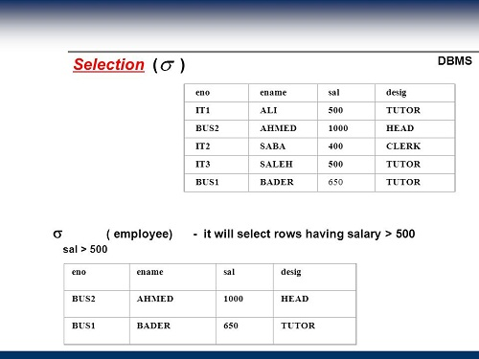

Slide 9
Project operation (π):
It displays certain columns of a table based on the specified attributes.
Syntax:
π_{<attribute list>}(Relation)
ID | Name | Subject | Age
100 | Ashish | Maths | 19
200 | Rahul | Science | 20
300 | Naina | Physics | 20
400 | Sameer | Chemistry | 21
Π _{Name, Age} (Student)
Name | Age
Ashish | 19
Rahul | 20
Naina | 20
Sameer | 21

Slide 10
Π _{ID , Name} (Student)
ID | Name
100 | Ashish
200 | Rahul
300 | Naina
400 | Sameer

Slide 11
Cartesian product (X):
The Cartesian Product called as the CROSS PRODUCT .
It combines the tuples of one relation with all the tuples of the other relation.
In the resultant relation the columns of both the input relations are added and the rows will be multiplied.

Slide 12
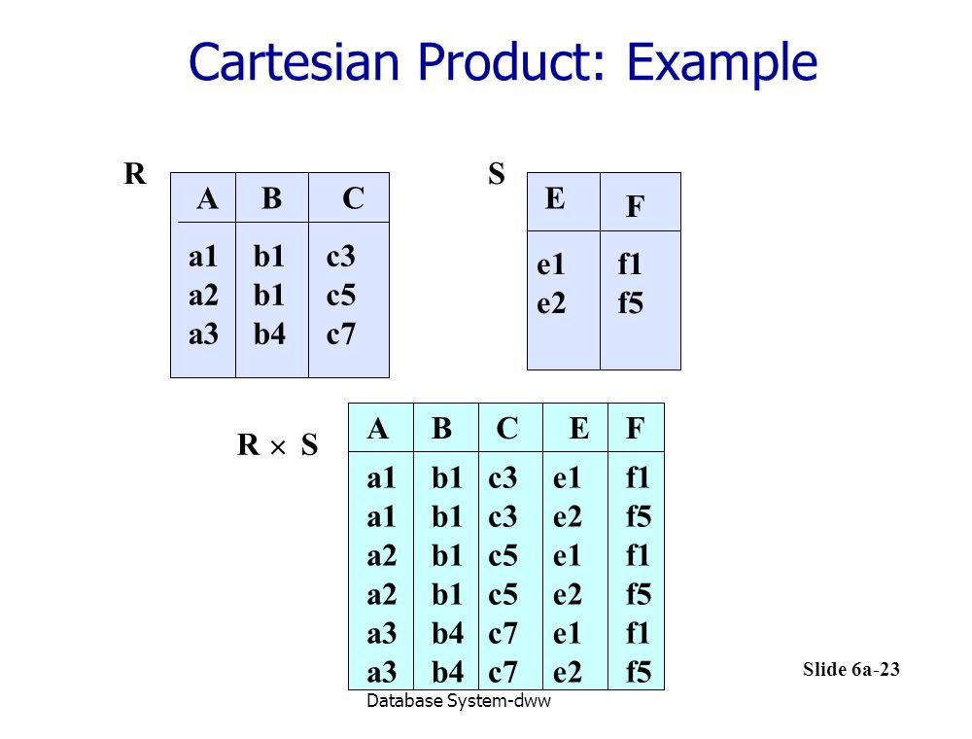

Slide 13
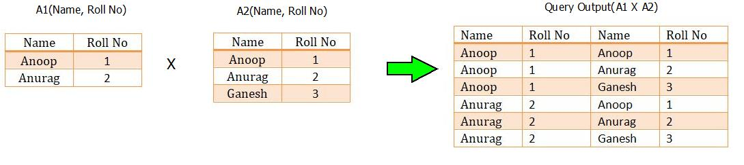

Slide 14
Union operation (U):
The union operation between two relations produces a third relation that combines tuples from both the relations.
The union operation between A and B is denoted by A U B that combines tuples from both the relations A and B.
Important:
Both the relations compulsory to have same number of attributes.
Both the relations compulsory to have same domain for the attributes.

Slide 15
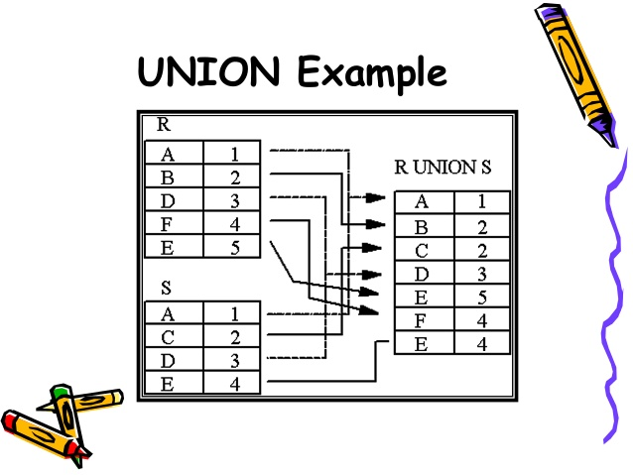
A U B=B U A
Redundant rows must be ignored

Slide 16
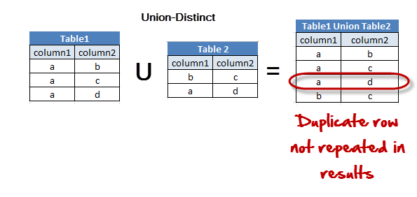

Slide 17
Intersection operation (∩):
The intersection operation between two relations produces a third relation that selects the common tuples from both the relations.
The Intersection operation between A and B is denoted by A ∩ B.
Important:
Both the relations compulsory to have same number of attributes.
Both the relations compulsory to have same domain for attributes.

Slide 18
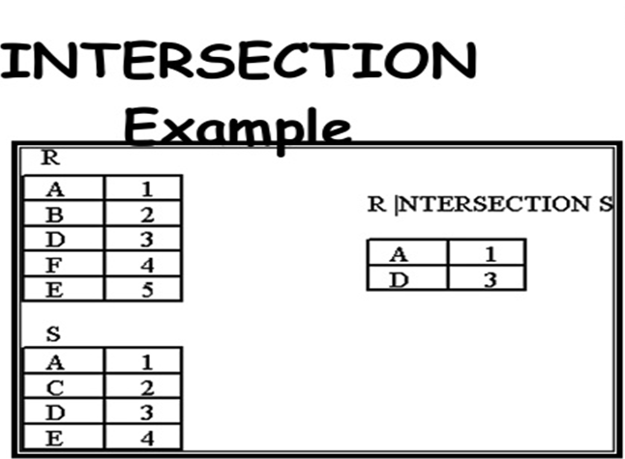
A ∩ B=B ∩ A

Slide 19
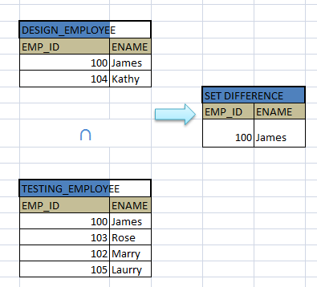
DESIGN_EMPLOYEE
∩
TESTING_EMPLOYEE

Slide 20
Difference operation (-):
Difference operation between two relations A and B produces the resultant relation as A-B that selects tuples present in A but not in B.
Important:
Both the relations compulsory to have same number of attributes.
Both the relations compulsory to have same domain for attributes.

Slide 21
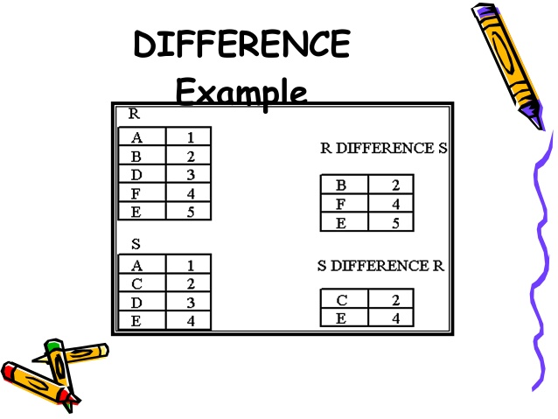
A-B ≠ B-A

Slide 22
SESSION REVIEW:
Select operation
Project operation
Cartesian product
Union operation
Project operation
Difference operation

Slide 23
ASSIGNMENT:
What is relational algebra?
Name the different relational operation that can be performed.
Give the syntax for select and project operation.
Write the difference between union and intersection operations.
Explain about Cartesian product between two relations with example.

Slide 24
THANKING YOU
ODM EDUCATIONAL GROUP

