Slide 1


KEYS AND ITS TYPES
PERIOD-4
SUBJECT : Computer Science
CHAPTER NUMBER:1
CHAPTER NAME :DATABASE CONCEPT

Slide 2
Learning Outcomes:
  Student will be familiarized with the concepts of keys.
  Will know about the different types of keys.
  More focused about distinguishing between the keys.
  Understanding about relational algebra.

Slide 3
Discussed So Far:
          Database users
          Data model
          Relational data model
          Terminology

Slide 4
Subtopics:
Keys
Types of keys
Relational Algebra

Slide 5
KEYS:
They are used to establish and identify relationships between tables and to uniquely identify any record or row of data inside a table.
A Key can be a single attribute or a group of attributes, where the combination may act as a key.

Slide 6
Types of keys:
      Primary key
      Candidate key
      Alternate key
      Foreign key

Slide 7
Primary key:
A primary key is a field which uniquely identifies each row/record in a database table.
Primary keys must contain unique values.
A primary key cannot have NULL values.
NULL means field kept vacant or written as NULL.
A table can have only one primary key, which may consist of single or multiple attributes.
When the primary key consists of more than one attributes it is called composite primary key.

Slide 8
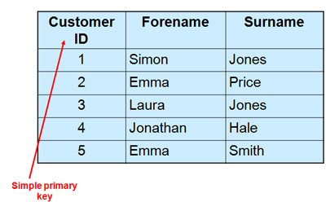

Slide 9
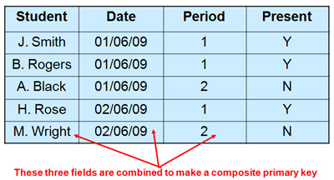

Slide 10
Candidate key:
A set of keys those are having the ability to be the primary key are called candidate keys.
Out of all the candidate keys one is selected as the primary key.
Alternate key:
The candidate keys which are not selected as the primary key are referred as alternate keys.

Slide 11
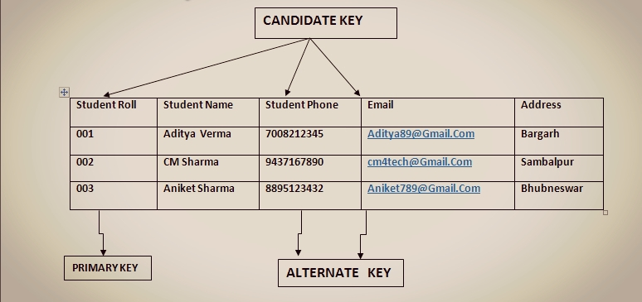

Slide 12
Foreign key:
      It establishes relationship between two tables.
      It is a non-key whose values are derived from the primary key of another table.
      The table in which the non-key or foreign key exists is called foreign table or detailed table.
      The table that defines the primary key is called the primary table or master table.

Slide 13
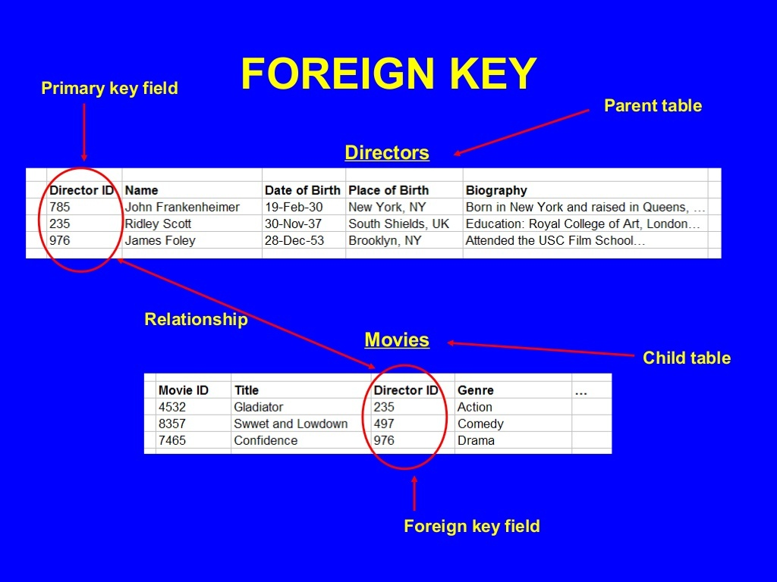

Slide 14
SESSION REVIEW:
Concept of keys
Primary key
Candidate key
Alternate key
Foreign key

Slide 15
ASSIGNMENT:
What are keys?
What are the types of keys?
Explain the differences between primary keys and candidate key.
What is alternate key? Explain with example.
What is candidate key? Explain with example.

Slide 16
THANKING YOU
ODM EDUCATIONAL GROUP

