Slide 1


DATA MODELS AND RELATIONAL DATA MODEL
PERIOD-3
SUBJECT : Computer Science
CHAPTER NUMBER:1
CHAPTER NAME :DATABASE CONCEPT

Slide 2
Learning Outcomes:
  Student will be familiarized with the data model.
  Will know about the different types data models.
  More focused about Relational data models.
  Students will know the terminologies used in relational data model.

Slide 3
Discussed So Far:
          Advantages of DBMS
          Disadvantages of DBMS

Slide 4
Subtopics:
Database users
Data models
Relational data model
Terminology

Slide 5
Database Users:
    End users:
        (who is not a computer-trained person but uses the database to get information)
    Application system analyst:
        (who is concerned about all the database at the logical level)
    Physical storage system analyst:
        (who is concerned about all the database at the physical level)

Slide 6
Data Model:
Data models are followed to create database.
They define the logical structure of a database .
They also define how data is connected to each other and how they are processed and stored inside the system.

Slide 7
Types Of Data Model:
The most widely used database models are :
    Hierarchical Data Model
    Network Data Model
    Relational Data Model

Slide 8
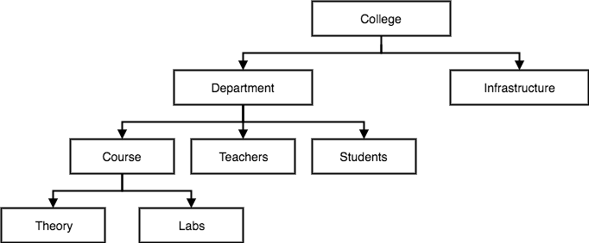
Hierarchical Model:
In hierarchical model, data is organized into tree-like structure with one-to-many relationship between two different types of data.
for example, one department can have many courses, many professors and of-course many students.

Slide 9
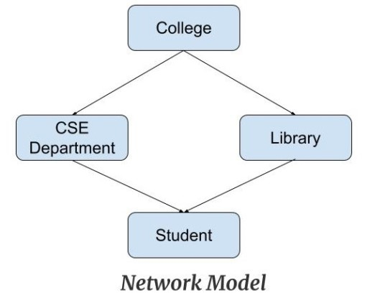
Network Data Model:
This model is an extension of the hierarchical model.
This model is the same as the hierarchical model, the only difference is that a record can have many to one relationship.

Slide 10
Relational Data Model:
Relational Model is the most widely used model.
In this model, the data is stored in a table with rows and columns.
The basic structure of a relational model is tables.
The tables are called relations in the relational model

Slide 11
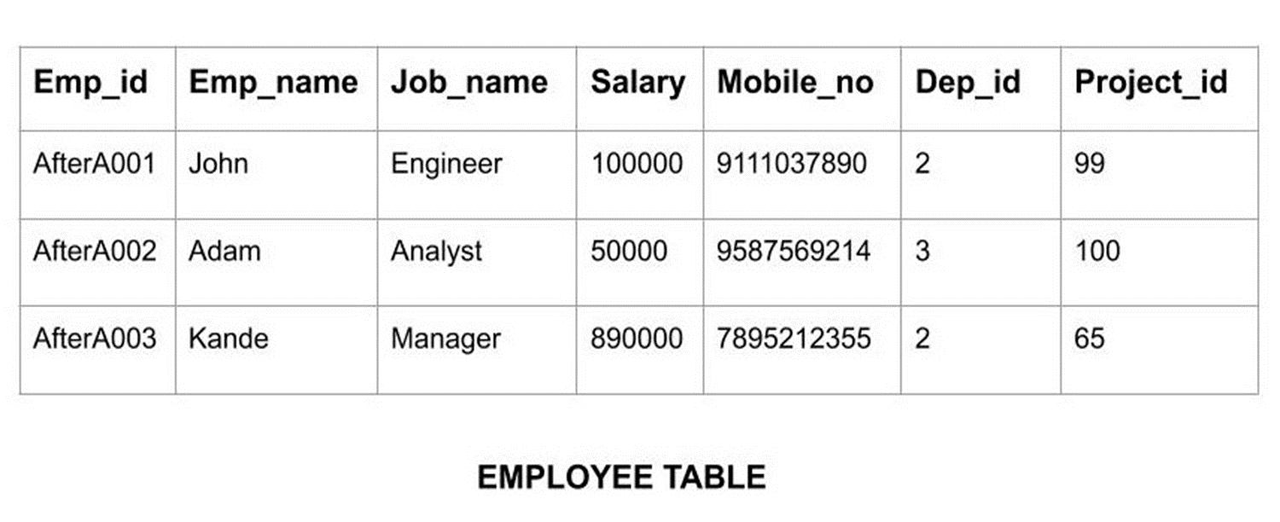

Slide 12
Terminology:
Relation
Attribute
Tuple
Degree
Cardinality
Domain

Slide 13
Relation:
    Tables of the database are referred as relations.
    A relation has two properties rows and columns.
    Rows represent records and columns represent attributes.
    Each relation in the database must have a unique name.

Slide 14
Attribute :
    The properties of a Table that are stored as columns are referred as attributes.
    e.g., Rollno, Name, Address , percentage etc.
Tuple :
  It is nothing but a single row of a table, which contains a single record.
Degree:
  The total number of attributes in the relation is called the degree of the relation.

Slide 15
Cardinality:
    The total number of rows present in the relation is called the cardinality of the relation.​
Domain :
    The pool of values from which actual values are given to an attribute is called the domain of that attribute.​

Slide 16

Relation: Employee
Attributes: Emp_id, Emp_name, job_name, Salary, Dep_id, Project_id
Tuples:
AftreAoo1 john engineer 100000 9111037890 2 99 AftreAoo1 Adam Analyst 50000 9587569214 3 100
AftreAoo3 kande manager 890000 7895212355 2 65
Degree: 7
Cardinality: 3
Domain of Dep_id:
1,2,3,4,5

Slide 17
SESSION REVIEW:
Database user
Data model
Relational data model
Terminology

Slide 18
ASSIGNMENT:
What are the different users in database?
Discuss the different models in database.
What is a relation ? What do you mean by attributes?
What is degree and cardinality?
Define domain.

Slide 19
THANKING YOU
ODM EDUCATIONAL GROUP

