Slide 1


INTRODUCTION TO DATABASE CONCEPT
PERIOD-1
SUBJECT: COMPUTER SCIENCE
CHAPTER NUMBER: 1
CHAPTER NAME: DATABASE CONCEPT

Slide 2
Learning Outcomes:
Student will be familiarized with the concepts of database.
They will know about the purpose of using a database system.
Will be more focused about DBMS.
Will know about some commonly used DBMS.

Slide 3
Subtopics:
Data
Database
Database System
DBMS

Slide 4
What is data?
Data means fact and figures.
These data can be recorded.
They can be the quantities, characters, or symbols.
Examples:
Joe,Smith, 1234,Circle,
SLC,UT, &, ####, A,mmm
8404,8015
553211014
1100100010000001101000000101

Slide 5
What is database:
Database is an organized collection of data.
Collection of related data items stored in one place.
They are the logical collection of relevant data.
Organized collection of logically related data is called database.
Example:
School database
Customer database
Employee database

Slide 6
School Database:
The database is organized as five files:
The STUDENT file stores data of each student
The COURSE file stores data about each course.
The SECTION stores the information about sections in a particular course.
The GRADE file stores the grades which students receive in the various sections
The TUTOR file contains information about each teachers.

Slide 7
What is Database System?
Database System is basically a computer based record keeping system.
This database system needs a software to be created and manipulated.

Slide 8
Some commonly used database applications:
Sector | Use of DBMS
Banking | For customer information, account activities, payments, deposits, loans, etc.
Airlines | For reservations and schedule information.
Universities | For student information, course registrations, colleges and grades.
Telecommunication | It helps to keep call records, monthly bills, maintaining balances, etc.
Finance | For storing information about stock, sales, and purchases of financial instruments like stocks and bonds.

Slide 9
Database Management System(DBMS):
DBMS is a software for creating and maintaining the database.
It helps us to do various operations on the database like insertion, deletion, updation, searching, sorting, merging etc.
DBMS allows users to create their own databases as per their requirement.
It provides an interface between the data and the software application.

Slide 10
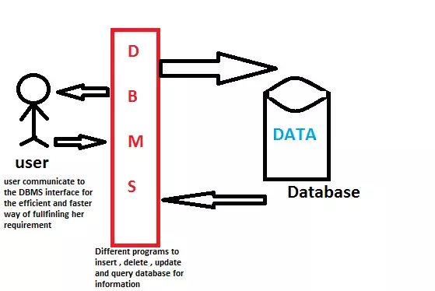
How it works?

Slide 11
Some Popular DBMS Software
MySQL
Microsoft Access
Oracle
dBase
FoxPro
SQLite
IBM DB2
LibreOffice Base
MariaDB

Slide 12
Session Review:
Concept of data
What is database
What is database system
DBMS

Slide 13
Assignments:
What is data? Give some examples.
What is database? Name some commonly used databases.
What is database system?
What is DBMS?
Name some popular DBMS software.

Slide 14
THANKING YOU
ODM EDUCATIONAL GROUP

