Slide 1


Simple applications of Kirchhoff’s laws
CLASS-XII
SUBJECT : PHYSICS
CHAPTER NUMBER: 03
CHAPTER NAME : CURRENT ELECTRICITY

Slide 2
B
Wheatstone Bridge:
P
Q
Currents through the arms are assumed by applying Kirchhoff’s Junction Rule.
I₁
I₁ - I_{g}
I_{g}
Applying Kirchhoff’s Loop Rule for:
A
G
C
Loop ABDA:
I₁.P + I_{g}.G - (I - I₁).R = 0
R
S
I - I₁
I
I - I₁ + I_{g}
I
Loop BCDB:
(I₁ - I_{g}).Q - (I - I₁ + I_{g}).S - I_{g}.G = 0
D
When I_{g} = 0, the bridge is said to balanced.
I
I
E
By manipulating the above equations, we get
P
R
Q
S

Slide 3
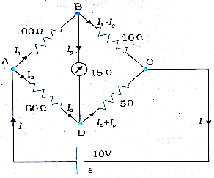
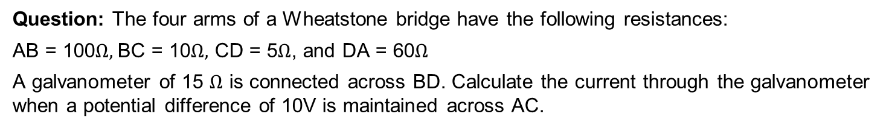
Numerical
Question: The four arms of a Wheatstone bridge have the following resistances:
AB = 100$Ω,$BC = 10$Ω,$ CD = 5$Ω$, and DA = 60$Ω$
A galvanometer of 15 $Ω$ is connected across BD. Calculate the current through the galvanometer when a potential difference of 10V is maintained across AC.

Slide 4
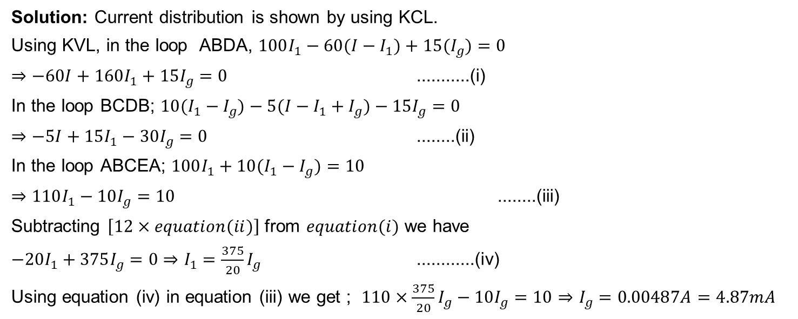
Numerical
Solution: Current distribution is shown by using KCL.
Using KVL, in the loop ABDA, $100I_{1}−60(I−I_{1})+15(I_{g})=0$
$⇒−60I+160I_{1}+15I_{g}=0$ ...........(i)
In the loop BCDB; $10(I_{1}−I_{g})−5(I−I_{1}+I_{g})−15I_{g}=0$
$⇒−5I+15I_{1}−30I_{g}=0$ ........(ii)
In the loop ABCEA; $100I_{1}+10(I_{1}−I_{g})=10$
$⇒110I_{1}−10I_{g}=10$ ........(iii)
Subtracting $\left[12×equation(ii)\right]$ from $equation(i)$ we have
$−20I_{1}+375I_{g}=0⇒I_{1}=\frac{375}{20}I_{g}$ ............(iv)
Using equation (iv) in equation (iii) we get ; $110×\frac{375}{20}I_{g}−10I_{g}=10$ $⇒I_{g}=0.00487A=4.87mA$

Slide 5
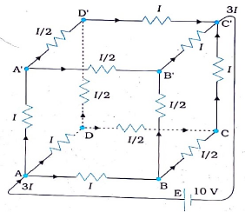
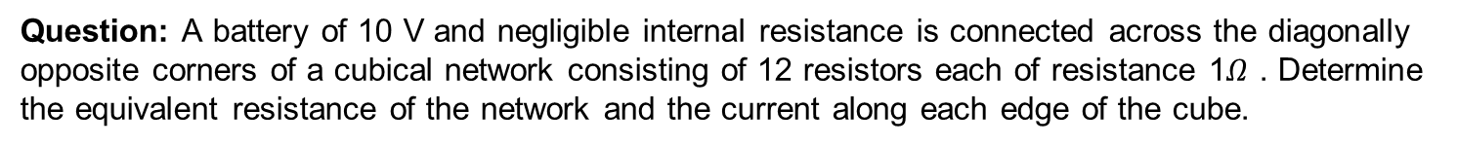
Numerical
Question: A battery of 10 V and negligible internal resistance is connected across the diagonally opposite corners of a cubical network consisting of 12 resistors each of resistance 1$Ω$ . Determine the equivalent resistance of the network and the current along each edge of the cube.

Slide 6
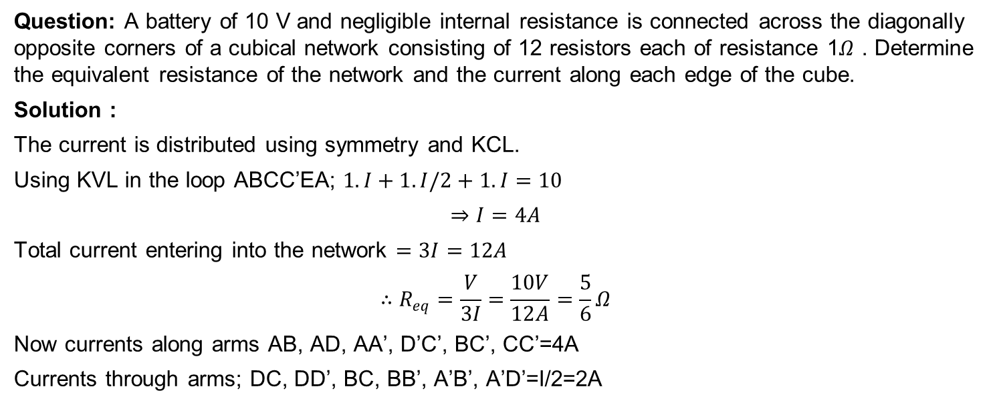
Numerical
Question: A battery of 10 V and negligible internal resistance is connected across the diagonally opposite corners of a cubical network consisting of 12 resistors each of resistance 1$Ω$ . Determine the equivalent resistance of the network and the current along each edge of the cube.
Solution :
The current is distributed using symmetry and KCL.
Using KVL in the loop ABCC’EA; $1.I+1.I/2+1.I=10$
$$⇒I=4A$$
Total current entering into the network $=3I=12A$
$$∴R_{eq}=\frac{V}{3I}=\frac{10V}{12A}=\frac{5}{6}Ω$$
Now currents along arms AB, AD, AA’, D’C’, BC’, CC’=4A
Currents through arms; DC, DD’, BC, BB’, A’B’, A’D’=I/2=2A

Slide 7
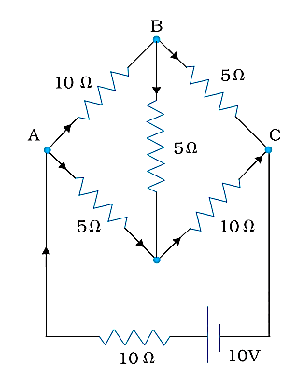
Numerical
Question: Determine the current in each branch of the network shown in the figure.(NCERT)

Slide 8
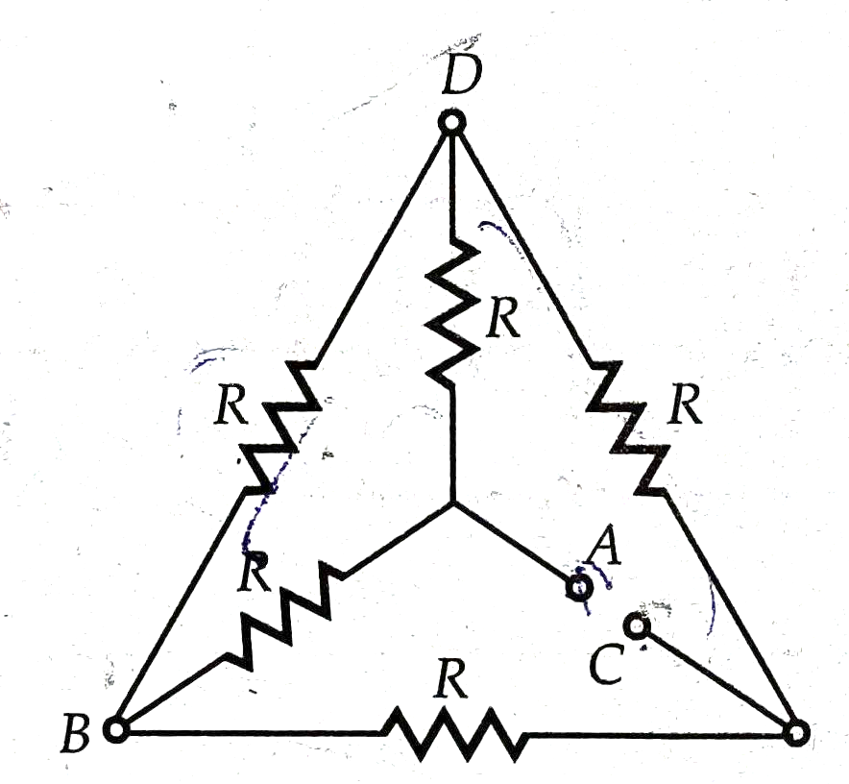
Numerical
Question: Each of the resistance in the network equals R. find the resistance between two terminals A and C

Slide 9
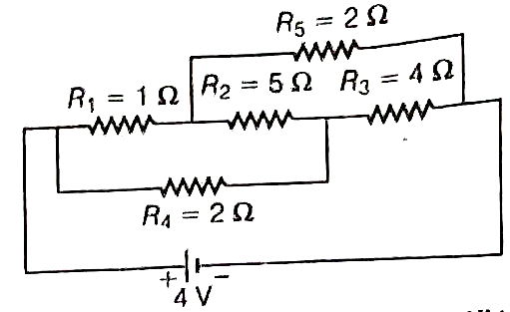
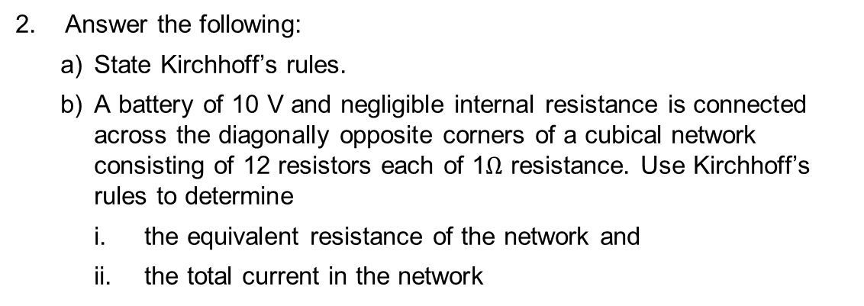
HOME ASSIGNMENT
Calculate the current drawn from the battery in the given network.
2. Answer the following:
  State Kirchhoff’s rules.
  A battery of 10 V and negligible internal resistance is connected across the diagonally opposite corners of a cubical network consisting of 12 resistors each of 1$Ω$ resistance. Use Kirchhoff’s rules to determine
    the equivalent resistance of the network and
    the total current in the network

Slide 10
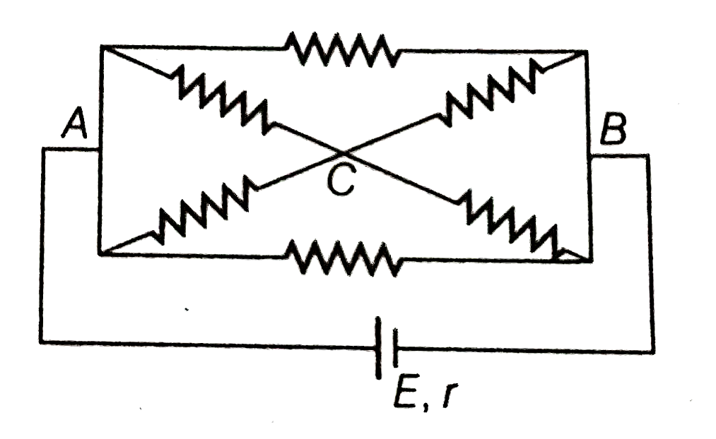
Home Assignment
3. Answer the following:
  State the two Kirchhoff s laws. Explain briefly, how these rules are justified?
  The current is drawn from a cell of emf E and internal resistance r connected to the network of resistors each of resistance r as shown in the figure. Obtain the expression for
    the current draws from the cell and
    the power consumed in the network.

Slide 11
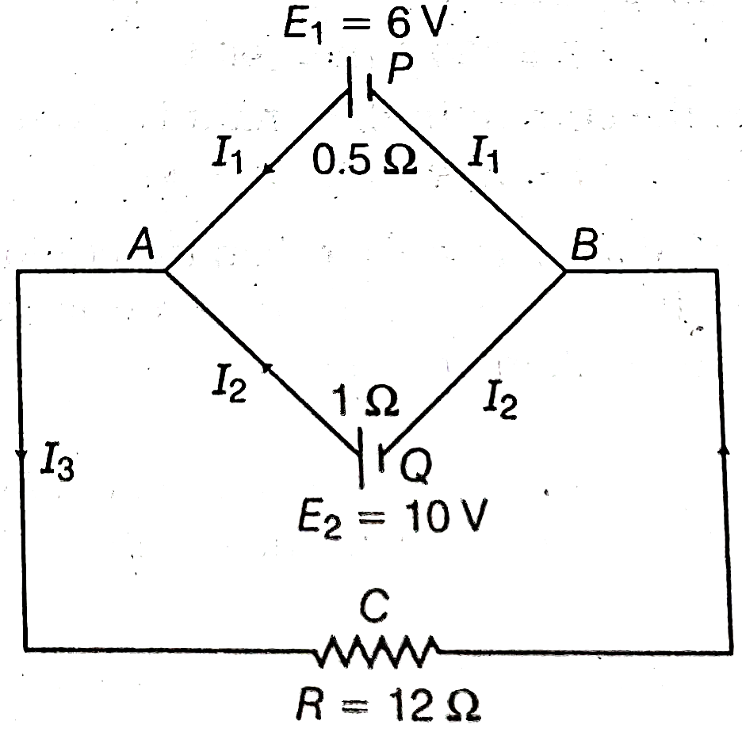
Home Assignment
4. State Kirchhoff’s rules. Apply Kirchhoff’s rules to the loops .ACBPA and ACBQA to write the expressions for the currents $I_{1}, I_{2} and I_{3}$in the network.

Slide 12
THANKING YOU
ODM EDUCATIONAL GROUP

