Slide 1


THE ESTABLISHMENT OF COMPANY POWER
VOYAGES OF DISCOVERY, THE BRITISH EAST INDIA
SUBJECT : HISTORY
CHAPTER NUMBER:2
CHAPTER NAME :THE ESTABLISHMENT OF COMPANY POWER

Slide 2
LEARNING OUTCOME
Student will be able to know about the adventure spirit of European explorers
∙ Student will be sensitized with the need of a strong administrative body ∙ They will be able to analyze various factors responsible for the colonialism ∙ Discuss about the importance unity.
∙ Learners will be sensitized about human rights of man and citizen ∙ Awareness regarding Equality, Liberty and Fraternity
∙ Building righteous conduct.
Students will able to understand:
i) How British entered India for trade.
ii) How British managed to establish trade supremacy in India by eliminating France and other European Countries.
iii).British followed all political procedure to establish trade in India.
Students will be able to understand:
1.Slowly, how the British managed to annex Indian territories.
ii) The weak point of Indians.
iii) The need of strength and unity.
iv) Need of strong administration.
Students will be able :
i) to know the way British annexed Indian Territories
ii) to understand the political shrewdness of British
iii) to know about Jhansi Rani and her bravery and patriotism
Students will be able:
i) To understand the advantage of efficient ruler.
ii) To know the cheap method of Britain to annex Indian Territory. iii) To know about the reasons for the success of Britain as the rulers of India.

Slide 3
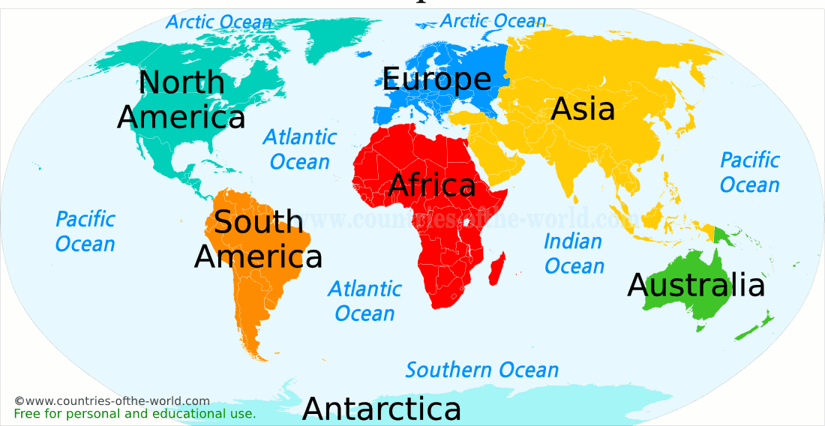
THE ESTABLISHMENT OF COMPANY POWER
INTRODUCTION
Introduction
The British came to India only for trade.
Their Trade Company was known as British East India Company

Slide 4
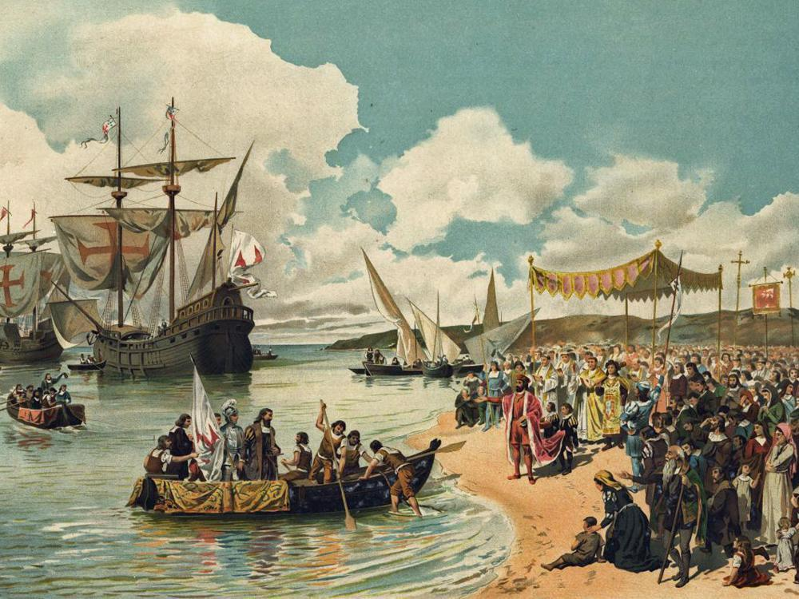
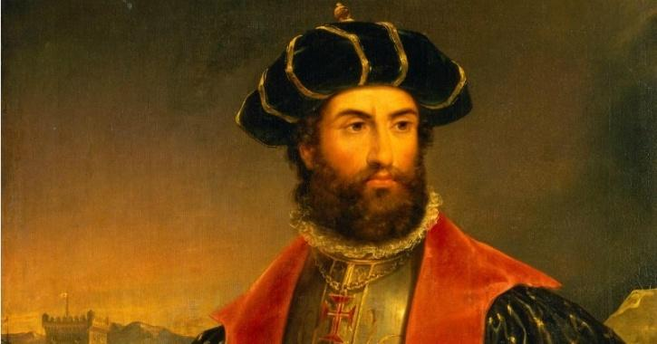
Voyages of discovery
Between 7th and 14th centuries Arab traders dominated the trade between the East and the West.
It became essential to find a direct sea route to the East. For this purpose a series of voyages were undertaken by European Explorers.
The Arab domination of the Indian Ocean was replaced by the Portuguese who were the first Europeans to establish a trade base in India. Followed by them, the Dutch, the British, and the French reached India for trade.

Slide 5
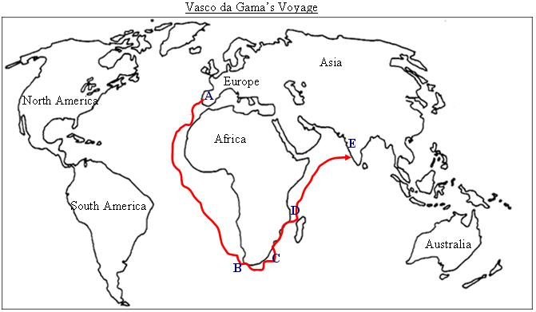
Vasco da Gama’s Voyage
Sea Route to India

Slide 6
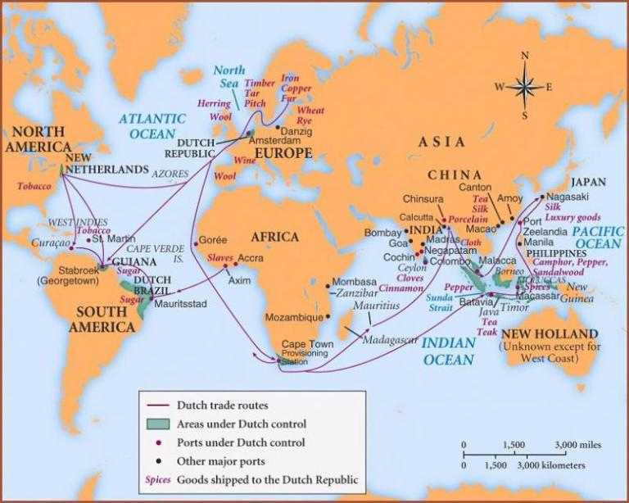
Formation of European Trading Companies in India
The Portuguese had trade settlements at Goa, Daman and Diu. Salsette, Bassein and Santhome near Chennai. (Salsette is an island in the state of Maharashtra on India’s west coast. Bassein is situated at about 70 kms North of Bombay in the Arabian Sea.)
The Dutch East India Company was formed in 1602 and established factories in Masulipatnam (Andhra Pradesh), Surat and Cochin.
The French were the last European power to enter India. The first French factory came up at Surat in 1668. They also acquired Mahe in Malabar on the west coast in 1724.
Video Link: https://www.youtube.com/watch?v=7-3A9f3vfE0&feature=youtu.be

Slide 7
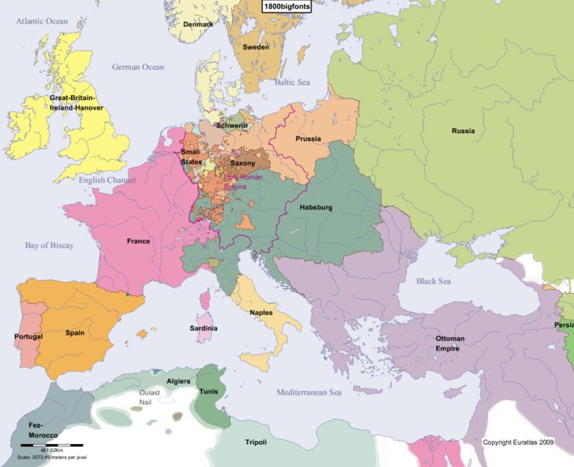
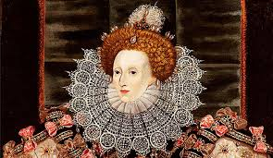
The British East India Company
The British East India Company was found in 1600 by a group of enterprising businessmen. On 31 December 1600, Queen Elizabeth 1 gave permission to the company to trade with India, in return for a share of its profits.
From Trading post to Presidency
The European trading companies used to come by ships, and the captains of the ships asked permission to the local rulers for trade. If trade proved profitable the captains set up trading posts which came to known as Factories.
Groups of factories developed came to known as Settlements. And the developed settlements came to known as Presidencies.

Slide 8
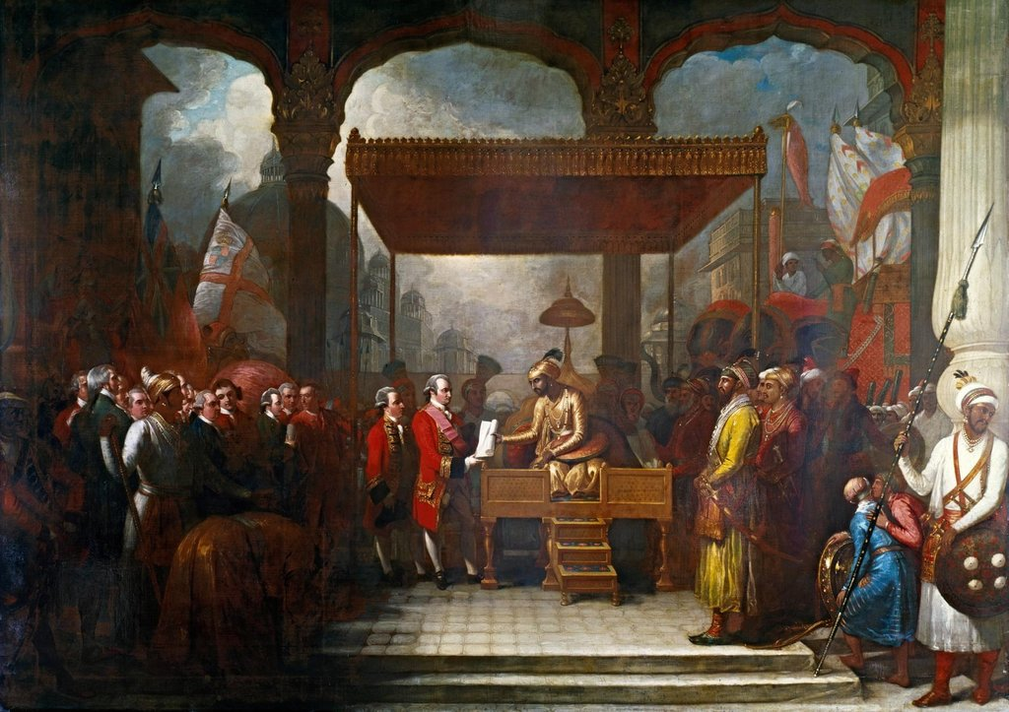
A British official Captain William Hawkins landed in Surat in 1612 and obtained permission from Mughal Emperor Jahangir to set up factories in Surat.
In 1615 King James 1 of England sent Sir Thomas Roe and he received permission from Jahangir to set up factories in any part of Mughal Empire.
From Traders to Rulers—The British Conquest of India
Starting from small trading settlements, the Europeans soon established powerful colonies in India.
Colony is a country or region that is politically controlled by another distant country and Colonialism is a rule of a country for a long period by another one.
Now India became Colony of British

Slide 9
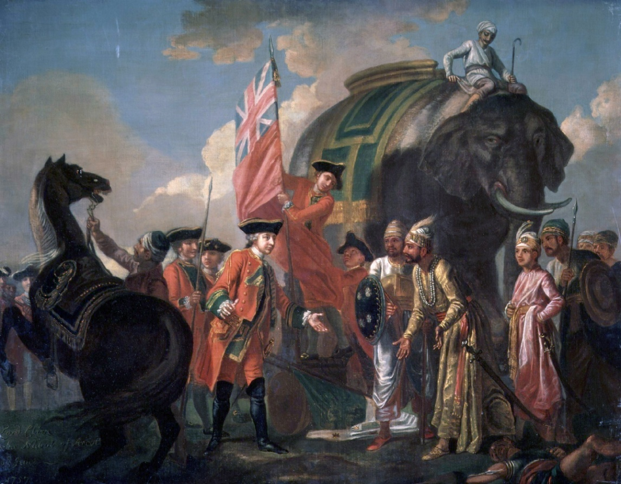
By the end of third Carnatic war the British defeated French and French detained in Pondicherry and Chandernagore. The result of the Carnatic War was The British became the main European Power in India.

Slide 10
Home Assignment
1.Name the first country which established trade base in India ?
2. Name the last country which established trade base in India ?
.3 Name the Portuguese explorer who discovered the sea route to India?
4.Name the Indian king from which the British got the permission to trade in India?
5.when was the Dutch East Company formed? and where they established their factories?
6.Who received the permission in 1616 to set up factories in any part of the Mughal Empire?
7. Define the term Colony?
8. Define the term colonialism?
9. What is meant by Carnatic wars?
10.Name the war which paved the way for the British to become the main European Power in India?

Slide 11

THANKING YOU
ODM EDUCATIONAL GROUP

