Slide 1


RURAL LIFE AND SOCIETY
SUBJECT : HISTORY CHAPTER NUMBER:4
CHAPTER NAME :RURAL LIFE AND SOCIETY

Slide 2
1 .Students came to understand what is patta system and who introduced it first.
2.They also get an idea about land revenue policies of Britain which they introduced in India.
3.They understand the names of different land revenue policies and its meanings.
4 They came to know the impact of revenue policies on the cultivators of India.
5. They also understand the causes for the Peasant revolts of India.
6 They came to know the meaning of commercialization of agriculture and indigo cultivation.
RURAL LIFE AND SOCIETY
LEARNING OUTCOMES

Slide 3
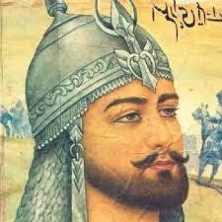
RURAL LIFE AND SOCIETY
In t r o d u c t i o n- DISCUSSION METHOD
In the olden days in India, land was held for life. Farmers cultivated a piece of land for generations. Nobody could evict them so long as they paid a part of their produce as tax. Villages were largely self sufficient.
During the rule of Sher Shah Suri land was measured and pattas were given for the first time. Revenue was charged depending on the fertility of the soil.

Slide 4
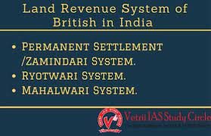
RURAL LIFE AND SOCIETY
Th e L a n d R e v e n u e P o l i c y u n d e r t h e B r i t i s h
The British east India company started to take land revenue and they demanded a fixed amount in cash. To pay the amount farmers had to cultivate cash crops like cotton, poppy, Indigo which brought in more money than food crops like wheat and rice. Now the Indian villages were no longer self sufficient.
In an effort to streamline the process the British started three forms of
revenue collection in India.
Permanent Settlement of Bengal
Ryotwari System
Mahalwari System

Slide 5
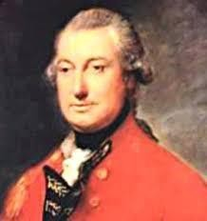
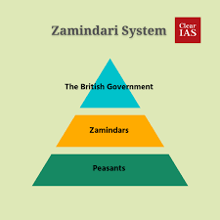
RURAL LIFE AND SOCIETY
Th e P e r m a n e n t S e t t l e m e n t o f B e n g a l
In 1793 Lord Cornwallis introduced the permanent
settlement of Bengal.
The Zamindars were required to pay a fixed amount in cash on a fixed date as land revenue to the treasury,
irrespective of what they could collect.
Many Zamindars benefitted more than either the company or the peasants.

Slide 6

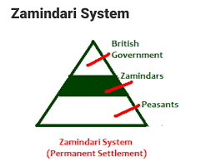
RURAL LIFE AND SOCIETY
Advantages For The British
Zamindars turned out to be firm supporters of the British
By fixing the land revenue the British government ensured that it
received the same fixed amount on a fixed date.
It was easier to deal with few Zamindars than with hundreds of farmers

Slide 7
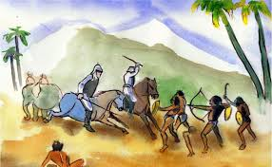
RURAL LIFE AND SOCIETY
Disadvantages For The Farmers
DRAMATIZATION METHOD WILL USE.
The Zamindars ill treated the farmers to extract the revenue.
Small farmers who to either sell or mortgage their lands to pay the revenue became landless laborer.
Many Land owners were evicted from their land by the British because they did not have pattas to prove their ownership.
To meet the increasing expenses the Government had to increase the tax in other provinces.

Slide 8
1.Who introduced Patta system in India?
2.Name three land revenue policies which was introduced by British?
3.Who introduced Permanent Settlement System of Bengal?
4. Mention the advantages of British from the Permanent Settlement of Bengal?
5. Mention the disadvantages of permanent settlement for the Farmers?
6 Name the provinces where the Permanent Settlement policy was introduced?
7. Name the revenue policy which introduced by Lord Cornwallis and Explain it ?
RURAL LIFE AND SOCIETY
HOME ASSIGNMENT

Slide 9
THANKING YOU
ODM EDUCATIONAL GROUP

