Slide 1


THE JUDICIARY
THE SUPREME COURT
SUBJECT : CIVICS CHAPTER NUMBER: 5
CHAPTER NAME :THE JUDICIARY

Slide 2
The Judiciary learning outcome of the lesson
After studying the lesson the children could understand
1.What is the importance of the Judiciary.
2. What is the structure and hierarchy of the Judiciary.
3.Who appoints the chief justice of Supreme court
4. What are the important functions of Supreme court.
5. What is meant by Lok Adalat.
5. What are Subordinate courts.
6. Why the chief justice of Supreme court is also known as chief justice of India.

Slide 3
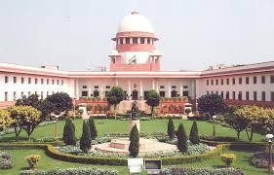
The Judiciary
The structure of the Judiciary Session -1
..
The Judiciary is organized hierarchically. The apex court in this structure is Supreme Court situated in New Delhi. Next come High Court , each state has its own High Court except Punjab and Haryana.
Next in the hierarchy are District Court and other Subordinate Courts

Slide 4
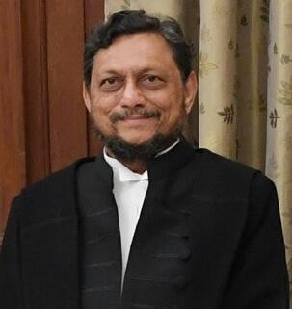
The Judiciary
The supreme court
Sharad Arvind Bobde

Slide 5
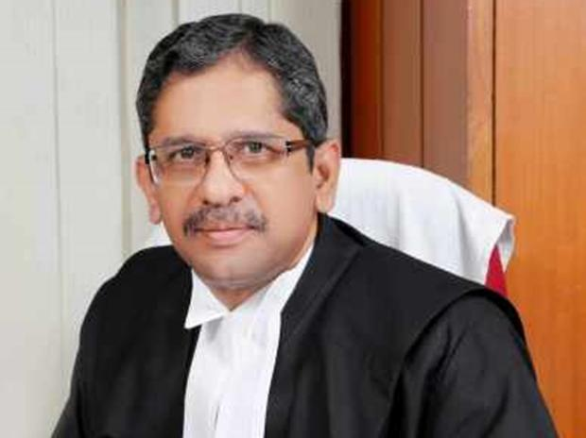
The Judiciary
The supreme court
Justice N V Ramana

Slide 6
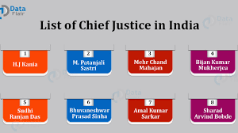
The Supreme Court
The Supreme Court is the highest Court in India. It is located in New –Delhi.
The Chief Justice is appointed by the President of India.
Required Qualifications
He must be a citizen of India.
He will be either an Advocate of High Court with 10 years
experience /High Court Judge with 5 years experience
must be a distinguished jurist ( expert in Law
Term of office
The Retirement Age of Supreme Court Judge is 65 years.
But if found guilty of misuse of Authority the parliament can remove him from the office through the process of Impeachment

Slide 7
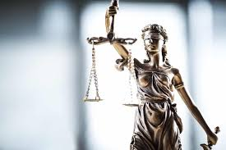
The Supreme Court
Powers and functions of the Supreme Court
Supreme Court and High Court have three types of Jurisdictions
Original Jurisdiction
Appellate Jurisdiction
Advisory Jurisdiction
Original Jurisdiction
The Supreme Court has the authority to hear certain types of cases for the first time came to known as Original Jurisdiction.
Cases that involve disputes over the interpretation of the Constitution can be brought directly to the Supreme Court
Cases dealing with violation of Fundamental Rights 3.disputes that arise between the central Government 4.disputes between two state governments or more

Slide 8
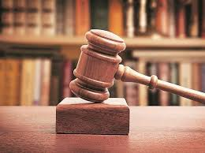
The Supreme Court
Appellate Jurisdiction
If a person is not satisfied with a judgment given by the High Court , he / she can
appeal to the Supreme Court. The Supreme Court will then hear the case and give the final judgment
Advisory Jurisdiction
The Supreme Court advises the President and the Council of Ministers, on matter of Constitutional issues or issues of public importance. The President also can seek the advice of the Supreme
Court.
JUDICIAL REVIEW
Any law or policy made by the government, that is not in accordance with the intention of the Constitution judiciary has the right to declare it as illegal.

Slide 9
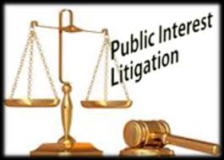
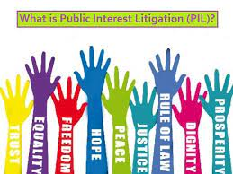
Supreme Court
COURT OF RECORDS
All the cases brought before the Supreme Court and the judgments have been given, are maintained as record by the Supreme Court.
CONTEMPT OF COURT
Contempt of Court refers to any behavior that opposes or defies the authority or dignity of the
court
Kalyan Singh ex chief minister of UP was punished by the Supreme Court to one day imprisonment for contempt of court in connection with the Babri Masjid Demolition Case..
PUBLIC INTEREST LITIGATION ( PIL)
Any citizen of India can go to the court if the interest of the public has been affected by the
deeds of the government is known as Public Interest Litigation

Slide 10
The Judiciary
High Court ( Home Assignments )
Which is the apex court in the state?
Who appoints the chief justice of high court?
What are the qualifications needed to become the chief justice of high court?
What is the age at which the high court judge retires? 5.Briefly mention the powers and functions of the High Court? 6.What do you mean by the term a petitioner or the appellate?
Who is a respondent?
What do you mean by Subordinate Courts?
9 .Which is the highest court in the district dealing with civil cases? 10.Which is the highest court in the district dealing with criminal cases?
Draw and explain the hierarchical structure of the various courts of the Indian Judiciary?
Differentiate between civil and criminal cases?

Slide 11
THANKING YOU
ODM EDUCATIONAL GROUP

