Slide 1


The Nationalist Movement (1885-1919)
SUBJECT : HISOTRY CHAPTER NUMBER:13
CHAPTER NAME : The Nationalist Movement (1885- 1919)

Slide 2


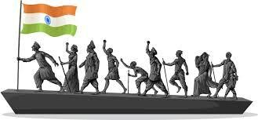
The Nationalist Movement (1885-1919)
Introduction
Session--1
After the Revolt of 1857 a feeling of Nationalism gradually spread across the country.
Nationalism is a feeling of pride in one’s country. It also refers to the desire for freedom, felt by felt by people under foreign domination. This growing sense of nationalism led to the birth of the Nationalist Movement and eventual freedom from colonial rule.

Slide 3

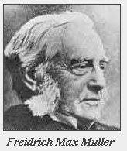
The Nationalist Movement (1885-1919)
Reasons for the growth of Nationalism.
Awakening of the Indians to their rich cultural heritage
Western scholars like Marx Muller and William Jones translated the Vedas, the Upanishads and other works of Indian literature in to English. Their research and writing made Indians aware of their great cultural heritage.
Exposure to Western ideas of Democracy and nationalism
The British introduced English education to train them to become clerks or occupy other low- level positions in government service. The new system of education exposed the Indian leaders to western ideas of Democracy and nationalism. They learnt of and were inspired by freedom struggles that had taken place in countries like America and France.

Slide 4
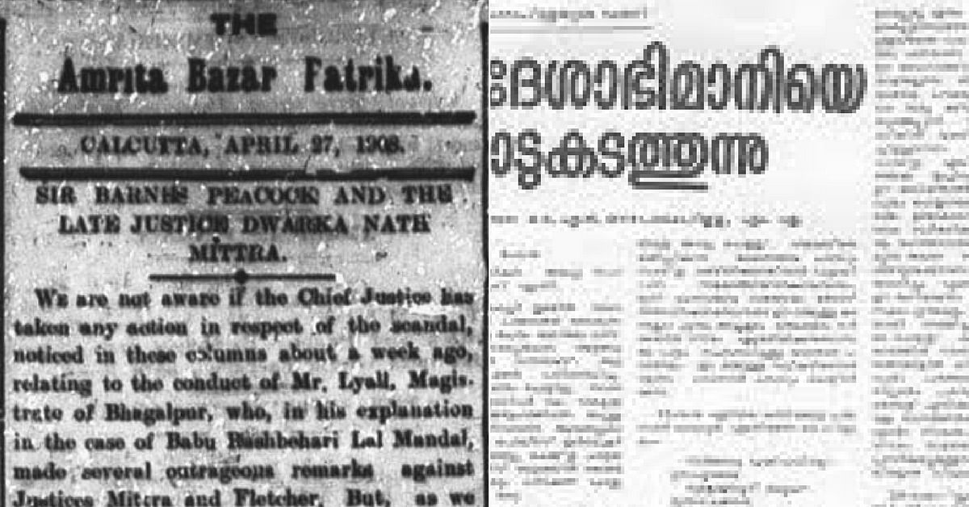
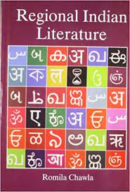
The Nationalist Movement (1885-1919)
Better means of Transport
The rail and road net works and the post and telegraph systems established by the British helped to unite the Indians. People from different parts of the country were able to communicate better with each other.
Growth of the regional press and regional literature.
A major factor responsible for the rise of nationalism was the growth of vernacular journalism and literature. The regionalpress was able to reach a far greater audience with its
revolutionary ideas than the English language press
.

Slide 5



The Nationalist Movement (1885-1919)
Economic exploitation by the British
The economic policies of the British had impoverished India. Recurring famines had occurred due to commercialization of agriculture ravaged the country side in the second half of 19th century aggravated the pathetic condition of the peasants. In 1877, the British Government held the Imperial Durbar in Delhi, at great cost to treasury even though the country was in the grip of terrible famine

Slide 6
The Nationalist Movement
Home Assignment
Who translated Vedas and Upanishads of Indian Literature in to English?
Define the term Nationalism?
3 . Briefly explain any five reasons for the growth of Nationalism in India during the period 1885 to1919?
How did the growth of regional press and regional literature help the growth of Nationalism in India?
How did better means of transport and communication help the growth of Nationalism in India?

Slide 7
THANKING YOU
ODM EDUCATIONAL GROUP

