Slide 1


ERRORS IN MEASUREMENT
XI- SCIENCE
SUBJECT : PHYSICS
CHAPTER NUMBER: 2
CHAPTER NAME : UNITS AND MEASUREMENT

Slide 2
COMBINATION OF ERRORS
In an experiment involving several measurements, the errors in all the measurements get combined.
Example:
Density is the ratio of the mass to the volume of the substance.
If there are errors in the measurement of mass and of the sizes or dimensions, then there will be error in the density of the substance.

Slide 3
COMBINATION OF ERRORS
(a) Error of a Sum:
Suppose two physical quantities A and B have measured values
A ± ΔA, B ± ΔB respectively, where ΔA and ΔB are their absolute errors.
Let Z = A + B
Z ± ΔZ = (A ± ΔA) + (B ± ΔB)
= (A + B) ± (ΔA + ΔB)
= Z ± (ΔA + ΔB)
± ΔZ = ± (ΔA + ΔB)
ΔZ = (ΔA + ΔB)
Note: When two quantities are added, the absolute error in the final result is the sum of the individual errors.

Slide 4
COMBINATION OF ERRORS
Numerical
The masses of two bodies measured are
Calculate the sum of the masses and the error therein.
Solution

Slide 5
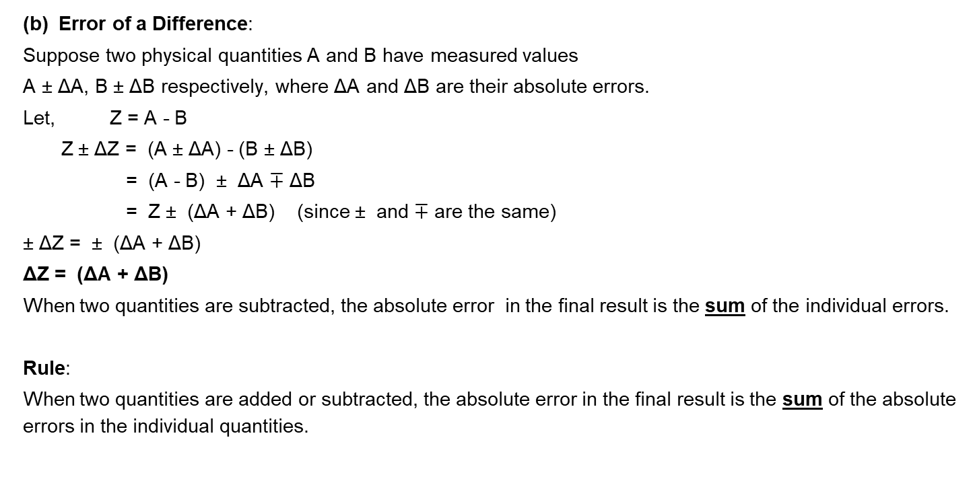
COMBINATION OF ERRORS
(b) Error of a Difference:
Suppose two physical quantities A and B have measured values
A ± ΔA, B ± ΔB respectively, where ΔA and ΔB are their absolute errors.
Let, Z = A - B
Z ± ΔZ = (A ± ΔA) - (B ± ΔB)
= (A - B) ± ΔA $∓$ ΔB
= Z ± (ΔA + ΔB) (since ± and $∓$ are the same)
± ΔZ = ± (ΔA + ΔB)
ΔZ = (ΔA + ΔB)
When two quantities are subtracted, the absolute error in the final result is the sum of the individual errors.
Rule:
When two quantities are added or subtracted, the absolute error in the final result is the sum of the absolute errors in the individual quantities.

Slide 6
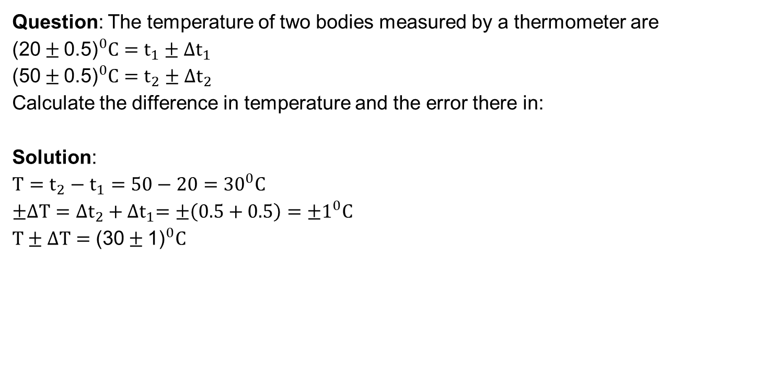
Numerical
Question: The temperature of two bodies measured by a thermometer are ${\text{(20}±\text{0.5)}}^{0}C=t_{1}±∆t_{1}$
$${\text{(}\text{5}\text{0}±\text{0.5)}}^{0}C=t_{2}±∆t_{2}$$
Calculate the difference in temperature and the error there in:
Solution:
$$T=t_{2}−t_{1}=50−20={30}^{0}C$$
$$±∆T={∆t}_{2}+{∆t}_{1}=±\left(0.5+0.5\right)=±1^{0}C$$
$$T±∆T={\text{(}\text{3}\text{0}±\text{1}\text{)}}^{0}C$$

Slide 7
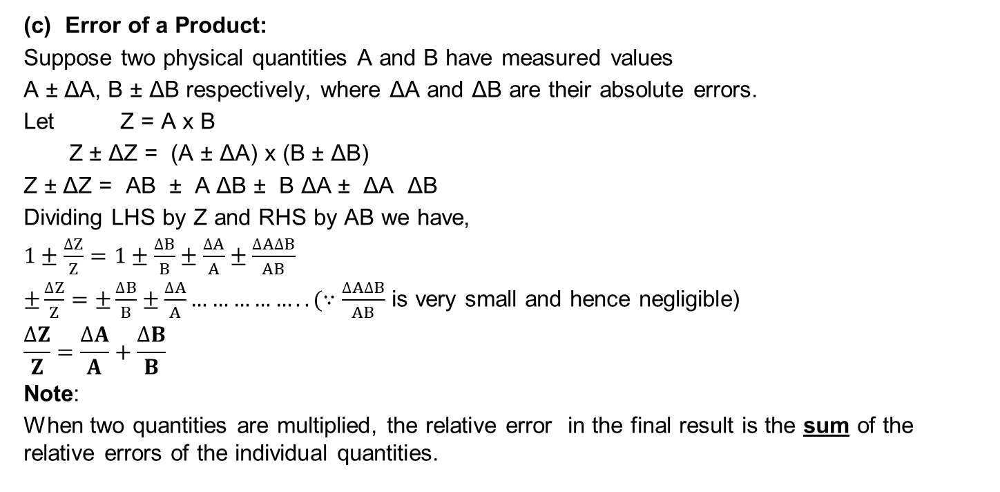
COMBINATION OF ERRORS
(c) Error of a Product:
Suppose two physical quantities A and B have measured values
A ± ΔA, B ± ΔB respectively, where ΔA and ΔB are their absolute errors.
Let Z = A x B
Z ± ΔZ = (A ± ΔA) x (B ± ΔB)
Z ± ΔZ = AB ± A ΔB ± B ΔA ± ΔA ΔB
Dividing LHS by Z and RHS by AB we have,
$1±\frac{∆Z}{Z}=1±\frac{∆B}{B}±\frac{∆A}{A}±\frac{∆A∆B}{AB}$
$±\frac{∆Z}{Z}=±\frac{∆B}{B}±\frac{∆A}{A}……………..(∵\frac{∆A∆B}{AB}$ is very small and hence negligible)
$$\frac{∆Z}{Z}=\frac{∆A}{A}+\frac{∆B}{B}$$
Note:
When two quantities are multiplied, the relative error in the final result is the sum of the relative errors of the individual quantities.

Slide 8
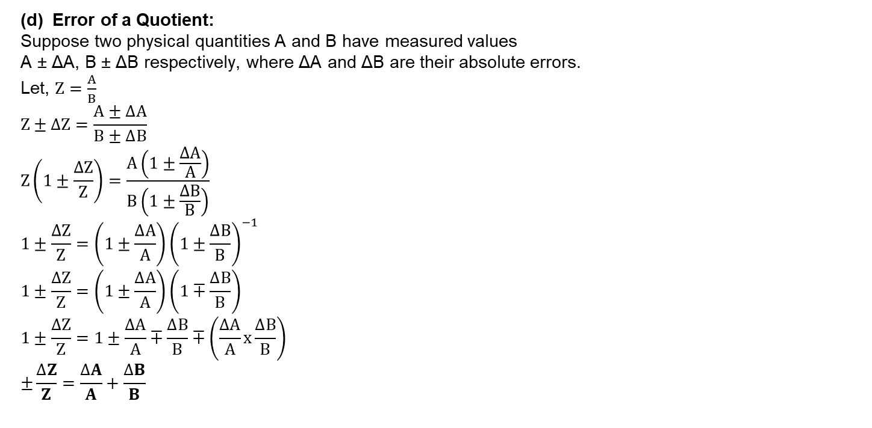
COMBINATION OF ERRORS
(d) Error of a Quotient:
Suppose two physical quantities A and B have measured values
A ± ΔA, B ± ΔB respectively, where ΔA and ΔB are their absolute errors.
Let, $Z=\frac{A}{B}$
$$Z±∆Z=\frac{A±∆A}{B±∆B}$$
$$Z\left(1±\frac{∆Z}{Z}\right)=\frac{A\left(1±\frac{∆A}{A}\right)}{B\left(1±\frac{∆B}{B}\right)}$$
$$1±\frac{∆Z}{Z}=\left(1±\frac{∆A}{A}\right){\left(1±\frac{∆B}{B}\right)}^{−1}$$
$$1±\frac{∆Z}{Z}=\left(1±\frac{∆A}{A}\right)\left(1∓\frac{∆B}{B}\right)$$
$$1±\frac{∆Z}{Z}=1±\frac{∆A}{A}∓\frac{∆B}{B}∓\left(\frac{∆A}{A}x\frac{∆B}{B}\right)$$
$$±\frac{∆Z}{Z}=\frac{∆A}{A}+\frac{∆B}{B}$$

Slide 9

Numerical
Question: The resistance $R=\frac{V}{I}$, $V=\left(100±5\right)V$, $I=\left(10±0.2\right)A$
Find the % error in R.
Solution:
$$\frac{∆R}{R}=\frac{∆V}{V}+\frac{∆I}{I}=\frac{5}{100}+\frac{0.2}{10}=\frac{7}{100}$$
$$\% error=\frac{∆R}{R}x100=\frac{7}{100}x100=7\%$$

Slide 10
COMBINATION OF ERRORS
(f) Error of an Exponent (Power):
Suppose a physical quantity A has measured values A ± ΔA where ΔA is its absolute error.
Let Z = A^{p} where p is a constant.
Applying log on both the sides, we have
log Z = |p| log A
Differentiating, we have
(Whether p is positive or negative errors due to multiple quantities get added up only)
ΔZ
ΔA
|p|
=
Z
A
A^{p} x B^{q}
In general, if , then
Z =
C^{r}
Note:
C^{r} is in Denominator, but the relative error is added up.
ΔZ
ΔA
ΔB
ΔC
=
p
+
q
+
r
Z
A
B
C

Slide 11

Numerical
Question: Find the relative error in Z if $Z=\frac{A^{4}B^{1/3}}{{CD}^{3/2}}$
Solution:
$$4\frac{∆A}{A}+\frac{1}{3}\frac{∆B}{B}+\frac{∆C}{C}+\frac{3}{2}\frac{∆D}{D}$$

Slide 12
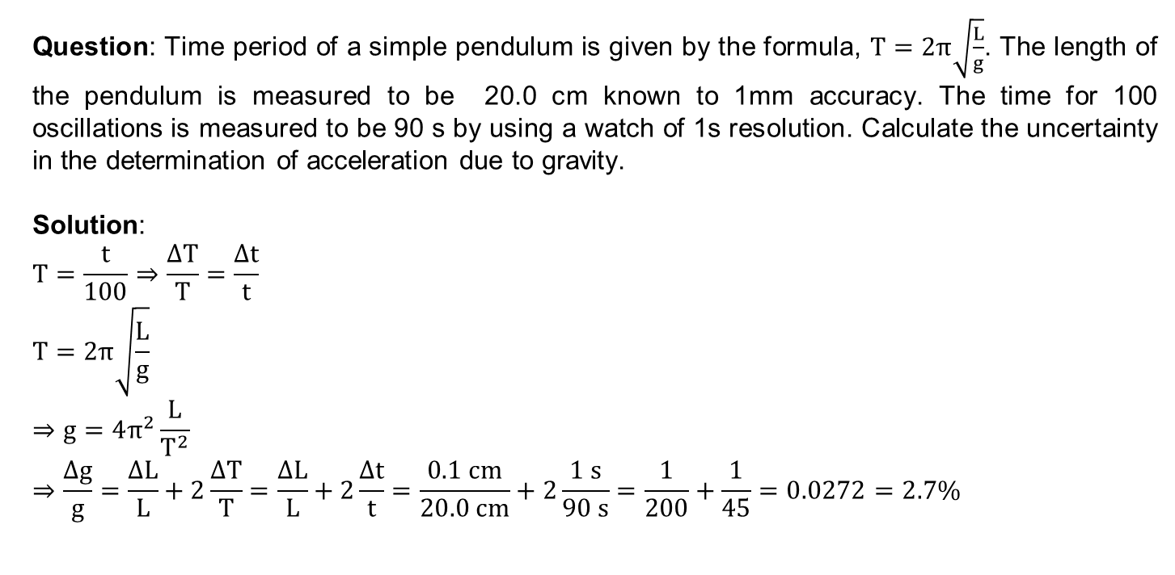
Numerical
Question: Time period of a simple pendulum is given by the formula, $T=2π\sqrt{\frac{L}{g}}$. The length of the pendulum is measured to be 20.0 cm known to 1mm accuracy. The time for 100 oscillations is measured to be 90 s by using a watch of 1s resolution. Calculate the uncertainty in the determination of acceleration due to gravity.
Solution:
$$T=\frac{t}{100}⇒\frac{∆T}{T}=\frac{∆t}{t}$$
$$T=2π\sqrt{\frac{L}{g}}$$
$$⇒g=4π^{2}\frac{L}{T^{2}}$$
$$⇒\frac{∆g}{g}=\frac{∆L}{L}+2\frac{∆T}{T}=\frac{∆L}{L}+2\frac{∆t}{t}=\frac{0.1 cm}{20.0 cm}+2\frac{1 s}{90 s}=\frac{1}{200}+\frac{1}{45}=0.0272=2.7\%$$

Slide 13
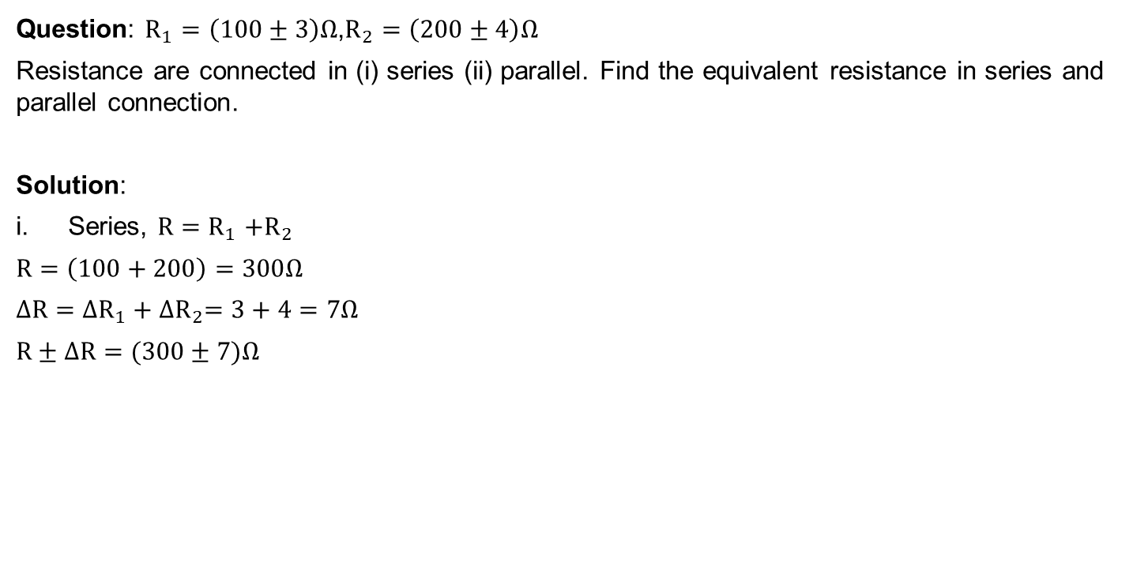
Numerical
Question: $R_{1}=\left(100±3\right)Ω$,$R_{2}=\left(200±4\right)Ω$
Resistance are connected in (i) series (ii) parallel. Find the equivalent resistance in series and parallel connection.
Solution:
Series, $R{=R}_{1}+R_{2}$
$$R=\left(100+200\right)=300Ω$$
$$∆R={∆R}_{1}+{∆R}_{2}=3+4=7Ω$$
$$R±∆R=(300±7)Ω$$

Slide 14

Numerical
Solution:
Parallel, $\frac{1}{R}=\frac{1}{R_{1}}+\frac{1}{R_{2}}$
$R=\frac{R_{1}R_{2}}{R_{1}+R_{2}}=\frac{200}{3}$ =66.7ohm
$$\frac{∆R}{R^{2}}=\frac{∆R_{1}}{{R_{1}}^{2}}+\frac{∆R_{2}}{{R_{2}}^{2}}$$
$$∆R=R^{2}\left(\frac{∆R_{1}}{{R_{1}}^{2}}\right)+R^{2}\left(\frac{∆R_{2}}{{R_{2}}^{2}}\right)$$
$$∆R={\left(\frac{R^{2}}{R_{1}}\right)}^{2}∆R_{1}+{\left(\frac{R^{2}}{R_{2}}\right)}^{2}∆R_{2}$$
$$∆R={\left(\frac{66.7}{100}\right)}^{2}x3+{\left(\frac{66.7}{200}\right)}^{2}x4=1.8$$
$$R±∆R=(66.7±1.8)Ω$$

Slide 15
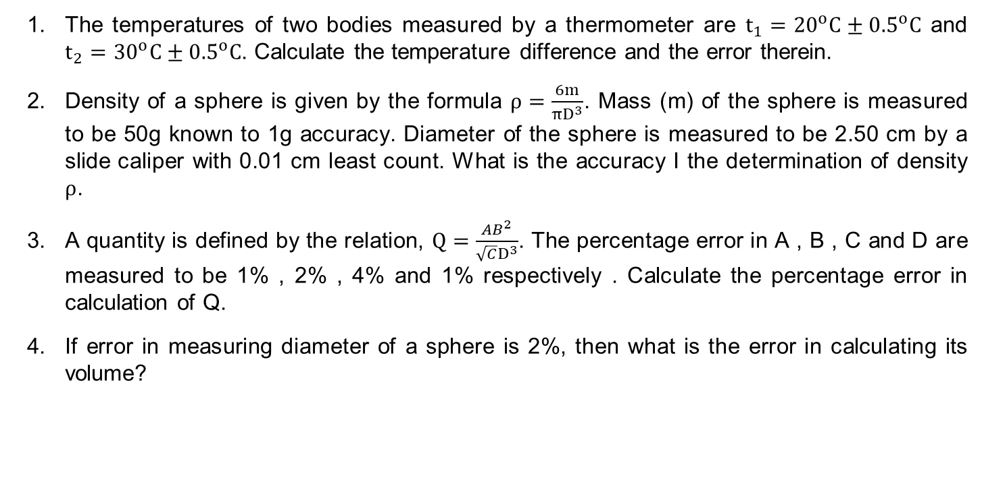
Home Assignment
The temperatures of two bodies measured by a thermometer are $t_{1}={20}^{o}C±{0.5}^{o}C$ and $t_{2}={30}^{o}C±{0.5}^{o}C$. Calculate the temperature difference and the error therein.
Density of a sphere is given by the formula $ρ=\frac{6m}{πD^{3}}$. Mass (m) of the sphere is measured to be 50g known to 1g accuracy. Diameter of the sphere is measured to be 2.50 cm by a slide caliper with 0.01 cm least count. What is the accuracy I the determination of density $ρ$.
A quantity is defined by the relation, $Q=\frac{{AB}^{2}}{\sqrt{C}D^{3}}$. The percentage error in A , B , C and D are measured to be 1% , 2% , 4% and 1% respectively . Calculate the percentage error in calculation of Q.
If error in measuring diameter of a sphere is 2%, then what is the error in calculating its volume?

Slide 16
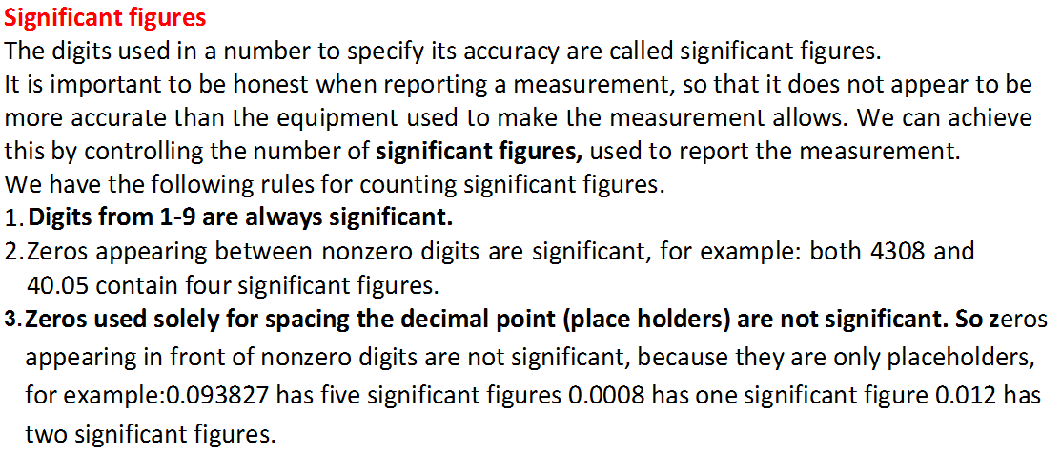
Rules for determining the number of significant figures

Slide 17
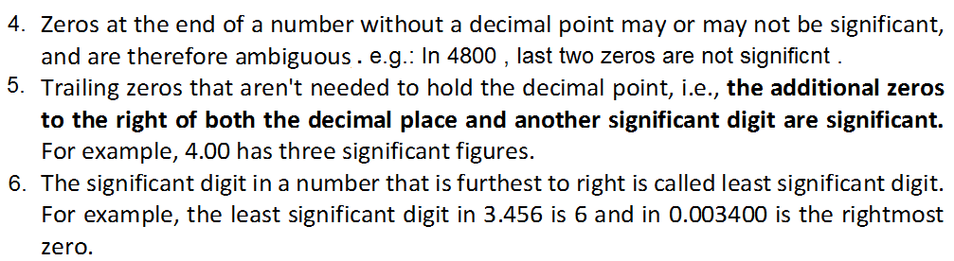
Rules for determining the number of significant figures

Slide 18
Rules for Arithmetic Operations with Significant Figures
In arithmetic operations the final result should not have more significant figures than the original data from which it was obtained.
Multiplication or Division:
The final result should retain as many significant figures as are there in the original number with the least significant figures.
Addition or subtraction:
The final result should retain as many decimal places as are there in the number with the least decimal places.

Slide 19
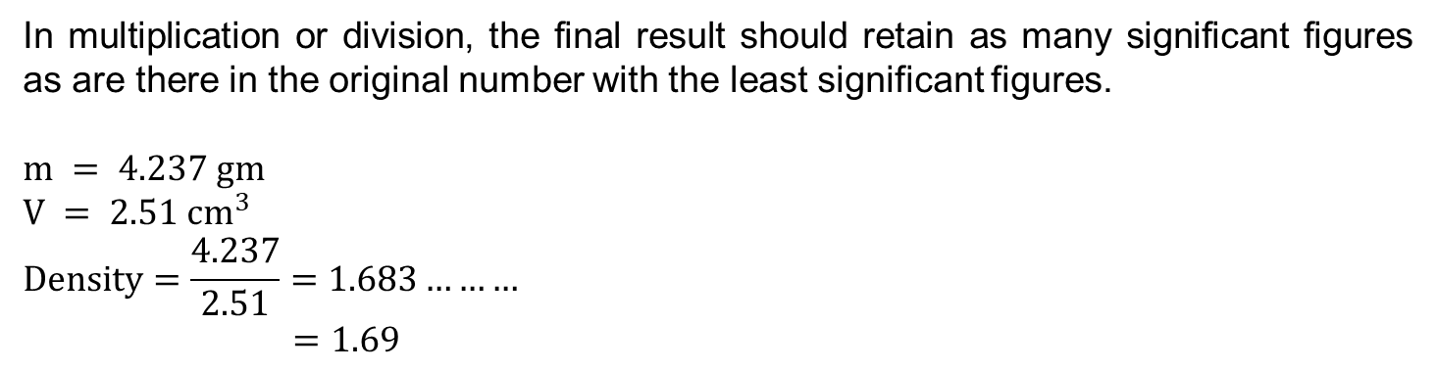
Rules for Arithmetic Operations with Significant Figures
In multiplication or division, the final result should retain as many significant figures as are there in the original number with the least significant figures.
$$m = 4.237 gm$$
$$V = 2.51 {cm}^{3}$$
$$Density=\frac{4.237}{2.51}=1.683………$$
$$=1.69$$

Slide 20
Significant figures.

Slide 21
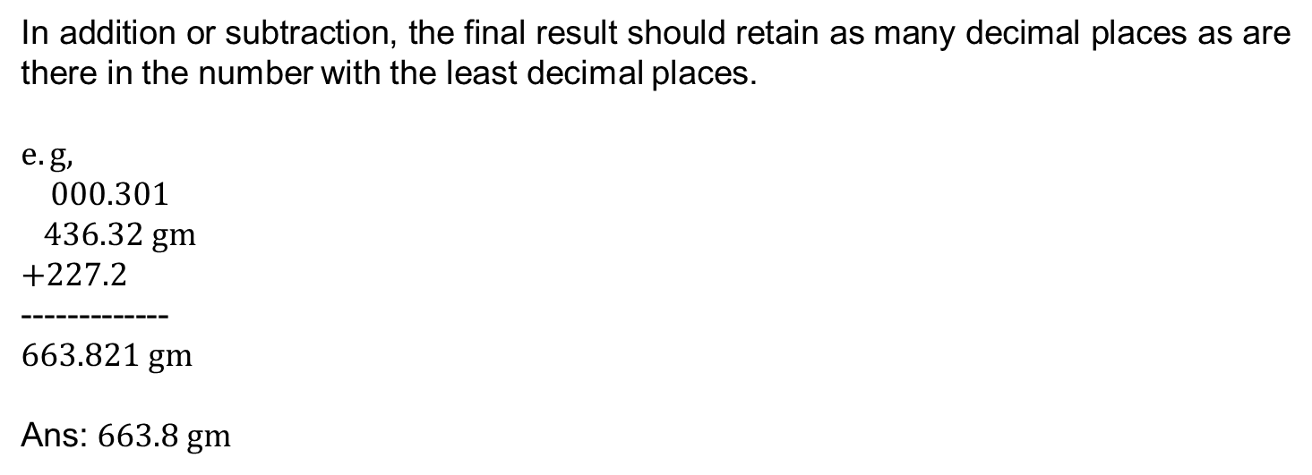
Rules for Arithmetic Operations with Significant Figures
In addition or subtraction, the final result should retain as many decimal places as are there in the number with the least decimal places.
$$e.g,$$
$$000.301$$
$$436.32 gm$$
$$+227.2$$
-------------
$$663.821 gm$$
Ans: $663.8 gm$

Slide 22
Scientific Notation
Any given number can be written in the form of a×10^{b} in many ways;
for example 350 can be written as 3.5×10² or 35×10¹ or 350×10⁰.
a×10^{b} means "a times ten raised to the power of b", where the exponent b is an integer, and the coefficient a is any real number called the significand or mantissa (the term "mantissa" is different from "mantissa" in common logarithm).
If the number is negative then a minus sign precedes a (as in ordinary decimal notation).
In normalized scientific notation, the exponent b is chosen such that the absolute value of a remains at least one but less than ten (1 ≤ |a| < 10).
For example, 350 is written as 3.5×10².
This form allows easy comparison of two numbers of the same sign in a, as the exponent b gives the number's order of magnitude.

Slide 23
Rounding off the Uncertain Digits
Rounding off a number means dropping of digits which are not significant. The following rules are followed for rounding off the number:
If the digits to be dropped are greater than five, then add one to the preceding significant figure.
If the digit to be dropped is less than five then it is dropped without bringing any change in the preceding significant figure.
If the digit to be dropped is five, then the preceding digit will be left unchanged if the preceding digit is even and it will be increased by one if it is odd.
In any involved or complex multi-step calculation, one should retain, in intermediate steps, one digit more than the significant digits and round off to proper significant figures at the end of the calculation.

Slide 24
Home assignment
State the number of significant figures in the following :
(i) 0.007 m² (ii) 2.64 × 10²⁴ kg
(iii) 0.2370 g cm^{–3} (iv) 6.320 J
(v) 6.032 Nm^{–2} (vi) 0.0006032 m².
The length, breadth and thickness of a rectangular sheet of metal are 4.234 m, 11.005 m and 2.01cm respectively. Give the area and volume of the sheet to correct significant figures.
The mass of a box measured by a grocer’s balance is 2.3 kg. Two gold pieces of masses 20.15 g and 20.17 g are added to the box. What is
(a) the total mass of the box,
(b) the difference in the masses of the pieces to correct significant figures ?

Slide 25
Dimensions of physical quantities,
XI- SCIENCE
SUBJECT : PHYSICS
CHAPTER NUMBER: 2
CHAPTER NAME : UNITS AND MEASUREMENTS

Slide 26
Dimensions of Physical Quantities
The nature of a physical quantity is described by its dimensions.
All the physical quantities can be expressed in terms of the seven base or fundamental quantities viz. mass, length, time, electric current, thermodynamic temperature, intensity of light and amount of substance, raised to some power.
The dimensions of a physical quantity are the powers (or exponents) to which the fundamental or base quantities are raised to represent that quantity.
Note:
Using the square brackets [ ] around a quantity means that we are dealing with ‘the dimensions of’ the quantity.
Example:
The dimensions of volume of an object are [L³]
The dimensions of force are [MLT⁻²]
The dimensions of energy are [ML²T⁻²]

Slide 27
Dimensions of Physical Quantities
Dimensional Quantity
Dimensional quantity is a physical quantity which has dimensions.
For example: Speed, acceleration, momentum, torque, etc.
Dimensionless Quantity
Dimensionless quantity is a physical quantity which has no dimensions.
For example: Relative density, refractive index, strain, etc.
Dimensional Constant
Dimensional constant is a constant which has dimensions.
For example: Universal Gravitational constant, Planck’s constant, Hubble constant, Stefan constant, Wien constant, Boltzmann constant, Universal Gas constant, Faraday constant, etc.
Dimensionless Constant
Dimensionless constant is a constant which has no dimensions.
For example: 5, -.0.38, e, π, etc.

Slide 28
Dimensional Formulae and Dimensional Equations
The expression which shows how and which of the base quantities represent the dimensions of a physical quantity is called the dimensional formula of the given physical quantity.
Example:
The dimensional formula of the volume is [M° L³ T°],
The dimensional formula of speed or velocity is [M° L T⁻¹]
The dimensional formula of acceleration is [M° L T^{–2}]
An equation obtained by equating a physical quantity with its dimensional formula is called the dimensional equation of the physical quantity.
Example:
[V] = [M° L³ T°]
[v] = [M° L T⁻¹]
[a] = [M° L T^{–2}]

Slide 29
Quantities having the same Dimensional Formulae
Impulse and momentum
Work, energy, torque, moment of force
Angular momentum, Planck’s constant, rotational impulse
Stress, pressure, modulus of elasticity, energy density
Force constant, surface tension, surface energy
Angular velocity, frequency, velocity gradient
Gravitational potential, latent heat
Thermal capacity, entropy, universal gas constant and Boltzmann’s const.
Force, thrust
Power, luminous flux

Slide 30
Numerical
Question: Find the dimensional formula for G (Universal gravitational constant) from the formula;
Where symbols carry their usual meanings .
Solution:

Slide 31
Numerical
Question: Find the dimensional formula for h ( Planck’s constant ) from the formula;
Where symbols carry their usual meanings.
Solution:
So dimensionally Planck’s constant is same as angular momentum.

Slide 32
Numerical
Question: Find the dimensional formula for coefficient of viscosity (η) from the formula;
Where symbols carry their usual meanings .
Solution:

Slide 33
Numerical
Question: Find the dimensional formula for coefficient of thermal conductivity (K) from the formula; . Where = heat energy flowing in time through a conductor of length , area of cross – section A with temperature difference .
Solution:

Slide 34
Numerical
Question: Taking velocity, time and force as the fundamental quantities, find the dimensions of mass.
Solution:
$$Force=Mass x Acceleration$$
$$Force=Mass x\frac{Velocity}{Time}$$
Or $Mass=\frac{Force x Time}{Velocity}$
$$∴\left[Mass\right]=\left[FTV^{−1}\right]$$

Slide 35
Numerical
Question: If density $ρ$, acceleration due to gravity $g$ and frequency $ν$ are the basic quantities, find the dimensions of force.
Solution:
We have $ρ=ML^{−3},g=LT^{−2},ν=T^{−1}$
Solving for $M$, $L$ and $T$ in terms of $ρ, g$ and $ν$, we get
$$M=ρg^{3}ν^{−6}, L=gν^{−2},T=ν^{−1}$$
$$∴\left[Force\right]=MLT^{−2}=ρg^{3}ν^{−6}.gν^{−2}.ν^{2}$$
$$=\left[ρg^{4}ν^{−6}\right]$$

Slide 36


Home Assignment
Find the dimensions of
Linear momentum (b) Frequency (c) Pressure
Find the dimensions of
angular speed (ω) b) angular acceleration (α)
torque (τ) d) moment of inertia (I)
some of the equations involving these quantities are
The symbols have standard meanings.
Find the dimensions of
Electric field E b) magnetic field B c) magnetic permeability
The relevant equations are;
where F is force, q is charge, v is speed, I is current, and a is distance.

Slide 37
Home Assignment
Find the dimensions of
electric dipole moment p and
magnetic dipole moment M
The defining equations are p = q.d and M = I A, where d is distance, A is area, q is charge and I is current.
Find the dimensions of Planck’s constant h from the equation E = hv where E is the energy and v is the frequency.
Find the dimensions of
electric dipole moment p and
the coefficient of linear expansion and
the gas constant R
Some of the equations involving these quantities are
and PV = nRT

Slide 38
Dimensional analysis and its applications.
XI- SCIENCE
SUBJECT : PHYSICS
CHAPTER NUMBER: 2
CHAPTER NAME : UNITS AND MEASUREMENTS

Slide 39
Dimensional Analysis and its Applications
Dimensional analysis is a tool to find or check relations among physical quantities by using their dimensions.
When magnitudes of two or more physical quantities are multiplied, their units should be treated in the same manner as ordinary algebraic symbols.
We can cancel identical units in the numerator and denominator.
Similarly, physical quantities represented by symbols on both sides of a mathematical equation must have the same dimensions.
Dimensional Analysis can be used:
To check the dimensional consistency of equations (Principle of homogeneity of dimensions).
To convert units in one system into another system.
To derive the relation between physical quantities based on certain reasonable assumptions.

Slide 40
Checking the Dimensional Consistency of Equations
The principle of homogeneity of dimensions:
The magnitudes of physical quantities may be added together or subtracted from one another only if they have the same dimensions.
For example, initial velocity can be added to or subtracted from final velocity because they have same dimensional formula [M⁰LT⁻¹] .
But, force and momentum can not be added because their dimensional formulae are different and are [MLT⁻²] and [MLT⁻¹] respectively.

Slide 41
To Check the Dimensional Consistency of ½ mv² = mgh
The dimensions of the quantities involved in the equation are:
[m] = [ML⁰T⁰]
[v] = [M⁰LT⁻¹]
[g] = [M⁰LT⁻²]
[h] = [M⁰LT⁰]
Substituting the dimensions in the given equation,
[ML⁰T⁰] [M⁰LT⁻¹]² ⁼ [ML⁰T⁰] [M⁰LT⁻²] [M⁰LT⁰]
(Note that the constant ½ in the term ‘½ mv² ’ does not have dimensions)
[ML²T⁻²] = [ML²T⁻²]
Each term of the above equation is having same dimensions.
Therefore, the given equation is dimensionally correct or dimensionally consistent.

Slide 42
Numerical
Question: In an equation,
v = speed , F = force and t = time . Find dimensional formula of a and b
Solution:

Slide 43
Numerical
Question: In an equation,
P = Pressure , V = volume and T =temperature . Find dimensional formula of a , b and R.
Solution:

Slide 44
Numerical
Question: In an equation,
P = Pressure , V = volume and T =temperature . Find dimensional formula of a , b and R.
Solution: By principle of homogeneity

Slide 45
Home Assignment
Question: A book with many printing errors contain four different formulas for the displacement y of a particle undergoing a certain periodic motion
y = a sin ( 2πt / T)
y = a sin ( vt )
y =( a/T) sin ( t / a)
y = a $\sqrt{2}$ { sin ( 2πt / T) + cos ( 2πt / T) }
a = max. displacement of the particle
v = speed of the particle
T = time period of motion
Rule out the wrong formula on dimensional grounds.

Slide 46
Numerical
Question: A dimensionally correct formula may or may not be actually correct, but an actually correct formula must be dimensionally correct. Justify the statement by giving proper example.
Solution:

Slide 47
Home Assignment
Check correctness of the following equations
${mv}^{2}=mgh$
$y=A exp (\frac{ωt}{x})$
$y=A ln (\frac{at}{x})$
Find unit of pressure in a system of units where unit of mass is α kg, unit of length is βm, and unit of time is γ s
NCERT exercise 2.1
NCERT exercise 2.1
NCERT exercise 2.3

Slide 48
Dimensional analysis and its applications.
XI- SCIENCE
SUBJECT : PHYSICS
CHAPTER NUMBER: 2
CHAPTER NAME : UNITS AND MEASUREMENTS

Slide 49
Conversion of Units in one System into another System
Conversion of unit of a quantity from one system of unit to another
Any quantity in any system is given by
In different systems, if same quantity is measured then its value remains unchanged although its numeric value (n) and unit (u) change.
So,
Eg. 1Kg = 1000gm

Slide 50
Conversion of Units in one System into another System
Units are derived from the dimensions and the dimensions are derived from the actual formulae of physical quantities.
If the dimensions are known for a physical quantity, then it is easy to express it in fps, cgs, mks, SI systems or any other arbitrary chosen system.
n₁[M₁ªL₁^{b}T₁^{c}] = n₂[M₂ªL₂^{b}T₂^{c}]
n₁ and n₂ are the magnitudes in the respective systems of units.
Smaller the unit bigger the magnitude of a physical quantity and vice versa.
For example, 1 m = 100 cm (m is the bigger unit and cm is the smaller one)
1 N = 10⁵ dynes (Newton is bigger and dyne is smaller)
1N = ${10}^{5}$ dynes
$n_{1}$= 1
$n_{2}$ = ${10}^{5}$
a=1, b=1, c=-2
a b c
M₁
L₁
T₁
n₂ = n₁
M₂
L₂
T₂

Slide 51
Example
To convert 1 joule in erg
‘joule’ is unit of energy or work in SI system and ‘erg’ is the unit in cgs system.
The dimensional formula of energy or work is [ML²T⁻²].
The units from dimensions in SI and cgs systems are kg m² s⁻² and g cm² s⁻² respectively.
Let n₁ joule = n₂ erg
 | SI System | cgs System
Magnitude | n₁ = 1 | n₂ = ?
Mass (M) | 1 kg (=1000 g) | 1 g
Length (L) | 1 m (= 100 cm) | 1 cm
Time (T) | 1 s | 1 s
[MªL^{b}T^{c}] = [ML²T⁻²] Therefore, a=1, b=2, c=-2

Slide 52
Example
a b c
M₁
L₁
T₁
n₂ = n₁
M₂
L₂
T₂
1 2 -2
1000 g
100 cm
1 s
n₂ = 1
1 g
1 cm
1 s
n₂ = 1 (1000)¹ (100)² (1)⁻²
n₂ = 10⁷
1 joule = 10⁷ erg

Slide 53
Dimensional analysis and its Applications
Conversion of unit of a quantity from one system of unit to another :
Example:
A calorie is a unit of heat energy and it equals about 4.2 J where .
Suppose we employ a system of units in which the unit of mass equals α kg , the unit of length equals βm and the unit of time is γs . Show that a calorie has a magnitude
in terms of the new units.

Slide 54
Example
To convert 1 cal in a system where mass equals α kg , the unit of length equals βm and the unit of time is γs
‘cal’ is unit of energy and the dimensional formula of energy is [ML²T⁻²].
1 cal = 4.2 J
1 J = 1kg$m^{2}s^{−2}$
4.2J = 4.2kg$m^{2}s^{−2}$= $n_{1}$ $u_{1}$
$n_{1}$ $u_{1}$= $n_{2}$ $u_{2}$
 | SI System | New System
Magnitude | n₁ = 4.2 | n₂ = ?
Mass (M) | 1 kg | α
Length (L) | 1 m | β
Time (T) | 1 s | γ
[MªL^{b}T^{c}] = [ML²T⁻²] Therefore, a=1, b=2, c=-2

Slide 55
Example
a b c
M₁
L₁
T₁
n₂ = n₁
M₂
L₂
T₂
1 2 -2
1 kg
1m
1 s
n₂ = 4.2
α kg
βm
γ s
n₂ = 4.2 (α)⁻¹ (β)⁻² (γ)²
1 cal =

Slide 56
Deducing Relation among the Physical Quantities
The method of dimensions can sometimes be used to deduce relation among the physical quantities.
For this we should know the dependence of the physical quantity on other quantities (upto three physical quantities or linearly independent variables) and consider it as a product type of the dependence.
Example:
Consider a simple pendulum, having a bob attached to a string that oscillates under the action of the force of gravity. Suppose that the period of oscillation of the simple pendulum depends on its length (l), mass of the bob (m) and acceleration due to gravity (g). Derive the expression for its time period using method of dimensions.
The dependence of time period T on the quantities l, g and m as a product may be written as:
T = k l^{x} m^{y} g^{z}
where k is dimensionless constant and x, y and z are the exponents.

Slide 57
Deducing Relation among the Physical Quantities
The dimensions of the quantities involved in the equation are:
[m] = [ML⁰T⁰], [l] = [M⁰LT⁰] , [g] = [M⁰LT⁻²] , [T] = [M⁰L⁰T]
By substituting dimensions on both sides of T = k l^{x} m^{y} g^{z}, we have
[M⁰L⁰T] = [M⁰LT⁰]^{x} [ML⁰T⁰]^{y} [M⁰LT⁻²]^{z}
[M⁰L⁰T] = [M]^{y} [L]^{x+z} [T]^{-2z}
On equating the dimensions on both sides, we have
y = 0, x + z = 0, –2z = 1
So that x = ½ , y = 0, z = -½
Then, T = k l^{½} g^{–½}
Or
The value of k is 2π and determined from other methods.
l
l
T = 2π
T = k
g
g

Slide 58
Dimensional analysis and its Applications
Establishment of relation among physical quantities :
Example:
A planet moves around sun in circular orbit. Its time period of revolution only depends upon
the radius (r) of the orbit
mass of the sun (M)
the gravitational constant (G)
Taking proportionality constant as 2π, find the expression for T, using dimensional analysis.

Slide 59
Dimensional analysis and its Applications
Solution:

Slide 60
Dimensional analysis and its Applications
Establishment of relation among physical quantities:
Example:
In a new system of units universal gravitational constant ( G ) , planck’s constant (h) and speed of light ( c ) are taken as the fundamental quantities. Obtain the dimensional formula for mass in the new system.

Slide 61
Dimensional analysis and its Applications
Solution:

Slide 62
Demerits of Dimensional Analysis
The dimensional analysis can not be used in the following cases:
The value of constants in an equation can not be determined as the constants do not have dimensions.
Only dimensional consistency and not the physical consistency can be tested.
Dimensions can be found from the physical quantity, but physical quantity can not be always guessed from dimensions because two or more quantities may have same dimensions.
The equation containing the dependency on more than 3 quantities can not be determined using only M, L and T. (Note that if 4 independent quantities are involved, then 4 variables and hence 4 simultaneous equations are required; hence there must be 4 fundamental dimensions)
The equation containing exponential, trigonometric, logarithmic functions, etc. can not be derived as they do not have dimensions.
The equations having the relations other than products / quotients can not be derived.

Slide 63
Home Assignment
1atm = 101300 Pa and
Now let’s imagine a system in which unit of mass is α kg , unit of length is β m and unit of time is γ s . What is the magnitude of 1 atm in the new system of units ?
Assuming that mass ( M ) of the largest stone that can be moved by a flowing river depends upon the velocity ( v) , density (ρ ) of the water and acceleration due to gravity (g). Show by dimensional analysis method that , M varies with the sixth power of v.
If force (F), energy (E) and time (T) are taken as fundamental quantities in a system, then find the dimensional formula of mass in the new system.
Find the dimensions of ab in the relation;
where ; P is power, x is distance and t is the time .

Slide 64
THANKING YOU
ODM EDUCATIONAL GROUP

