Slide 1


Cartesian Product Of Sets
SUBJECT : MATHEMATICS
CHAPTER NUMBER: 02
CHAPTER NAME : RELATIONS AND FUNCTIONS

Slide 2
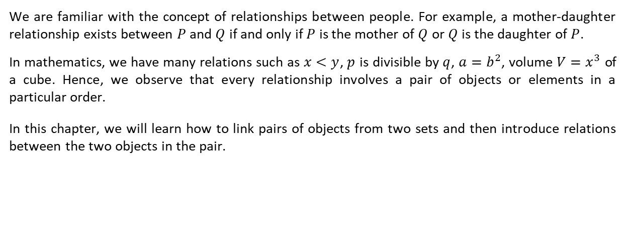
Introduction:
We are familiar with the concept of relationships between people. For example, a mother-daughter relationship exists between $P$ and $Q$ if and only if $P$ is the mother of $Q$ or $Q$ is the daughter of $P$.
In mathematics, we have many relations such as $x<y$, $p$ is divisible by $q$, $a=b^{2}$, volume $V=x^{3}$ of a cube. Hence, we observe that every relationship involves a pair of objects or elements in a particular order.
In this chapter, we will learn how to link pairs of objects from two sets and then introduce relations between the two objects in the pair.
hter

Slide 3
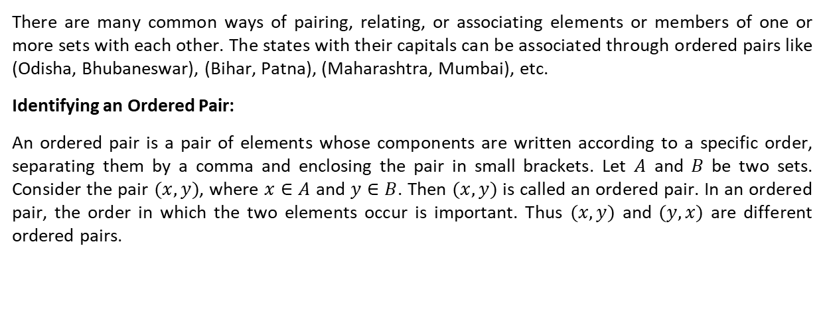
Ordered Pairs:
There are many common ways of pairing, relating, or associating elements or members of one or more sets with each other. The states with their capitals can be associated through ordered pairs like (Odisha, Bhubaneswar), (Bihar, Patna), (Maharashtra, Mumbai), etc.
Identifying an Ordered Pair:
An ordered pair is a pair of elements whose components are written according to a specific order, separating them by a comma and enclosing the pair in small brackets. Let $A$ and $B$ be two sets. Consider the pair $(x, y)$, where $x∈A$ and $y∈B$. Then $(x, y)$ is called an ordered pair. In an ordered pair, the order in which the two elements occur is important. Thus $(x, y)$ and $(y, x)$ are different ordered pairs.
We are familiar with the concept of relationship between people. For example, a mother – daughter

Slide 4
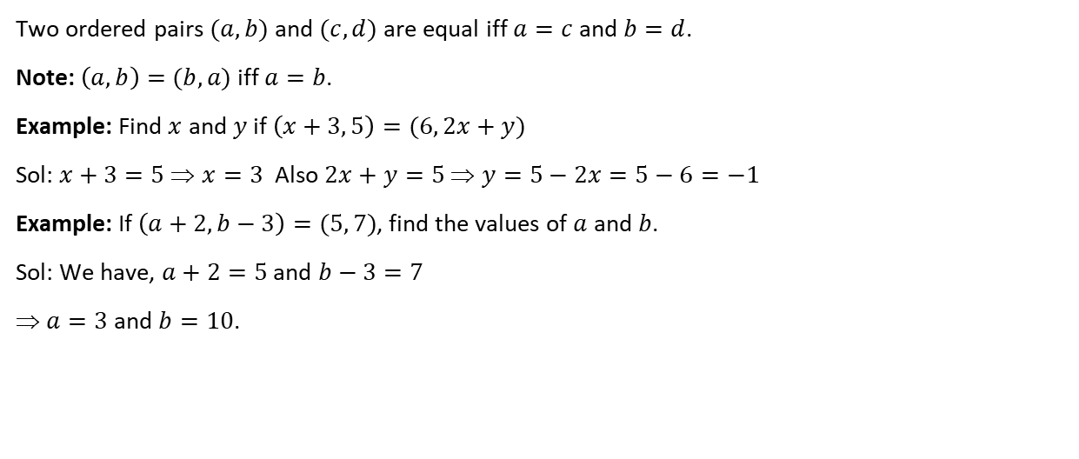
Equality of Ordered Pairs:
Two ordered pairs $(a, b)$ and $(c, d)$ are equal iff $a=c$ and $b=d$.
Note: $\left(a, b\right)=(b, a)$ iff $a=b$.
Example: Find $x$ and $y$ if $\left(x+3, 5\right)=(6, 2x+y)$
Sol: $x+3=5$ ⇒ $x=3$ Also $2x+y=5$ ⇒ $y=5−2x=5−6=−1$
Example: If $\left(a+2, b−3\right)=(5, 7)$, find the values of $a$ and $b$.
Sol: We have, $a+2=5$ and $b−3=7$
⇒ $a=3$ and $b=10$.
We are familiar with the concept of relationship between people. For example, a mother – daughter

Slide 5
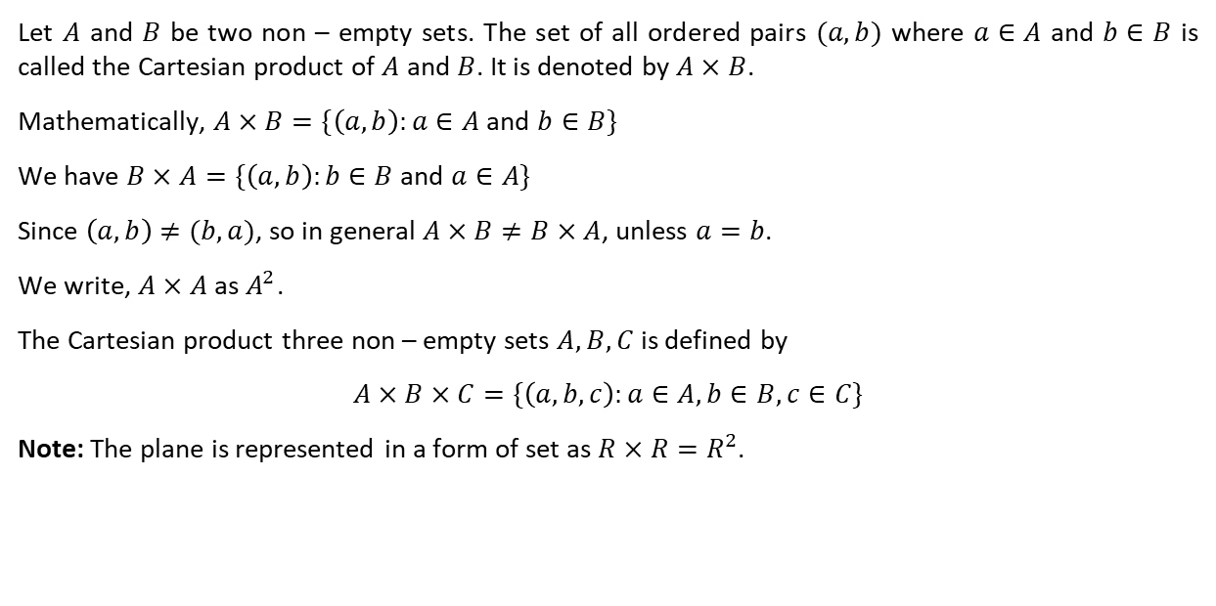
Cartesian Product of Sets:
Let $A$ and $B$ be two non – empty sets. The set of all ordered pairs $(a, b)$ where $a∈A$ and $b∈B$ is called the Cartesian product of $A$ and $B$. It is denoted by $A×B$.
Mathematically, $A×B=\{\left(a, b\right):a∈A$ and $b∈B\}$
We have $B×A=\{\left(a, b\right):b∈B$ and $a∈A\}$
Since $\left(a, b\right)≠(b, a)$, so in general $A×B≠B×A$, unless $a=b$.
We write, $A×A$ as $A^{2}$.
The Cartesian product three non – empty sets $A, B, C$ is defined by
$$A×B×C=\{\left(a, b, c\right):a∈A, b∈B, c∈C\}$$
Note: The plane is represented in a form of set as $R×R=R^{2}$.
We are familiar with the concept of relationship between people. For example, a mother – daughter

Slide 6
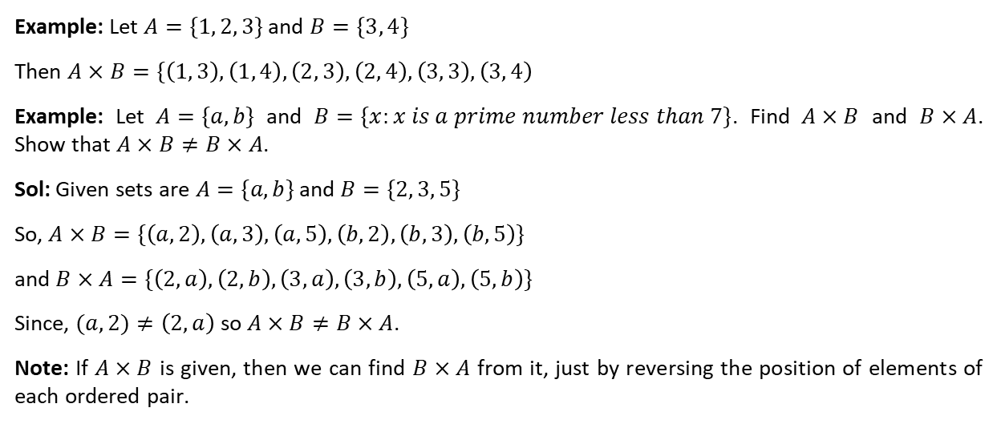
Example: Let $A=\{1, 2, 3\}$ and $B=\{3, 4\}$
Then $A×B=\{\left(1, 3\right), \left(1, 4\right), \left(2, 3\right), \left(2, 4\right), \left(3, 3\right), \left(3, 4\right)$
Example: Let $A=\{a, b\}$ and $B=\{x:x is a prime number less than 7\}$. Find $A×B$ and $B×A$. Show that $A×B≠B×A$.
Sol: Given sets are $A=\{a, b\}$ and $B=\{2, 3, 5\}$
So, $A×B=\{\left(a, 2\right), \left(a, 3\right), \left(a, 5\right), \left(b, 2\right), \left(b, 3\right), \left(b, 5\right)\}$
and $B×A=\{\left(2, a\right), \left(2, b\right), \left(3, a\right), \left(3, b\right), \left(5, a\right), \left(5, b\right)\}$
Since, $(a, 2)≠\left(2, a\right)$ so $A×B≠B×A$.
Note: If $A×B$ is given, then we can find $B×A$ from it, just by reversing the position of elements of each ordered pair.

Slide 7
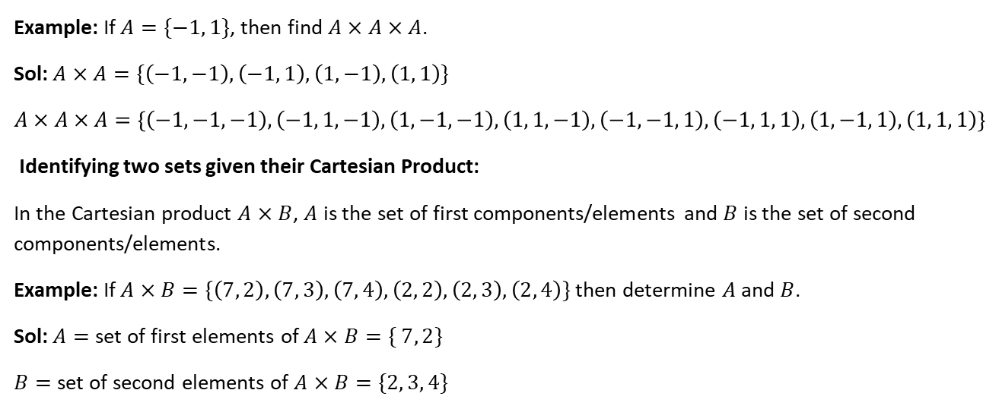
Example: If $A=\{−1, 1\}$, then find $A×A×A$.
Sol: $A×A=\{\left(−1,−1\right), \left(−1, 1\right), \left(1, −1\right), \left(1, 1\right)\}$
$$A×A×A=\{\left(−1,−1, −1\right), \left(−1, 1, −1\right), \left(1, −1,−1\right), \left(1, 1, −1\right), \left(−1, −1, 1\right), \left(−1, 1, 1\right), \left(1, −1, 1\right), \left(1, 1, 1\right)\}$$
Identifying two sets given their Cartesian Product:
In the Cartesian product $A×B$, $A$ is the set of first components/elements and $B$ is the set of second components/elements.
Example: If $A×B=\{\left(7, 2\right), \left(7, 3\right), \left(7, 4\right), \left(2, 2\right), \left(2, 3\right), \left(2, 4\right)\}$ then determine $A$ and $B$.
Sol: $A=$ set of first elements of $A×B=\{ 7, 2\}$
$B=$ set of second elements of $A×B=\{2, 3, 4\}$

Slide 8
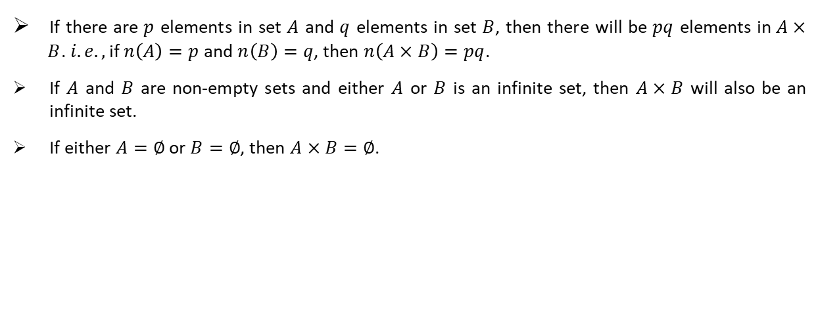
Number of Elements in Cartesian Product of two Sets:
If there are $p$ elements in set $A$ and $q$ elements in set $B$, then there will be $pq$ elements in $A× B$. $i.e.,$ if $n\left(A\right)=p$ and $n\left(B\right)=q$, then $n\left(A×B\right)=pq$.
If $A$ and $B$ are non-empty sets and either $A$ or $B$ is an infinite set, then $A×B$ will also be an infinite set.
If either $A=∅$ or $B=∅$, then $A×B=∅$.
We are familiar with the concept of relationship between people. For example, a mother – daughter

Slide 9
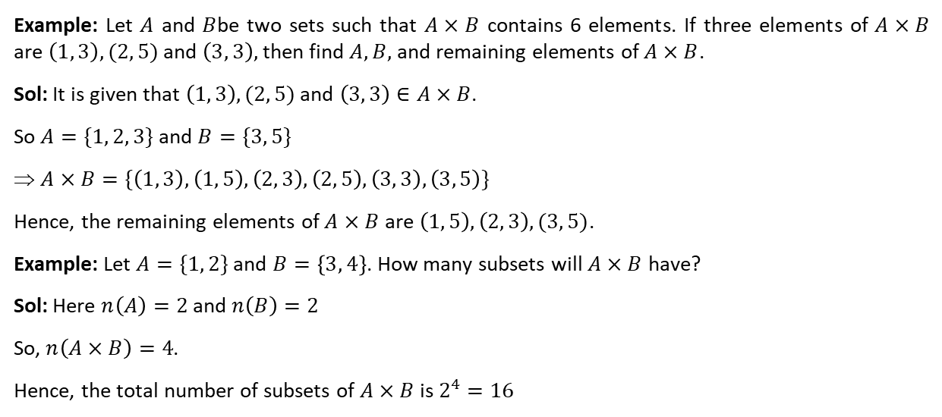
Example: Let $A$ and $B$be two sets such that $A×B$ contains 6 elements. If three elements of $A×B$ are $\left(1, 3\right), (2, 5)$ and $\left(3, 3\right),$ then find $A, B,$ and remaining elements of $A×B$.
Sol: It is given that $\left(1, 3\right), (2, 5)$ and $\left(3, 3\right)∈A×B$.
So $A=\{1, 2, 3\}$ and $B=\{3, 5\}$
⇒ $A×B=\{\left(1, 3\right), \left(1, 5\right), \left(2, 3\right), \left(2, 5\right), \left(3, 3\right), \left(3, 5\right)\}$
Hence, the remaining elements of $A×B$ are $\left(1, 5\right), \left(2, 3\right), (3, 5)$.
Example: Let $A=\{1, 2\}$ and $B=\left\{3, 4\right\}$. How many subsets will $A×B$ have?
Sol: Here $n\left(A\right)=2$ and $n\left(B\right)=2$
So, $n\left(A×B\right)=4$.
Hence, the total number of subsets of $A×B$ is $2^{4}=16$

Slide 10
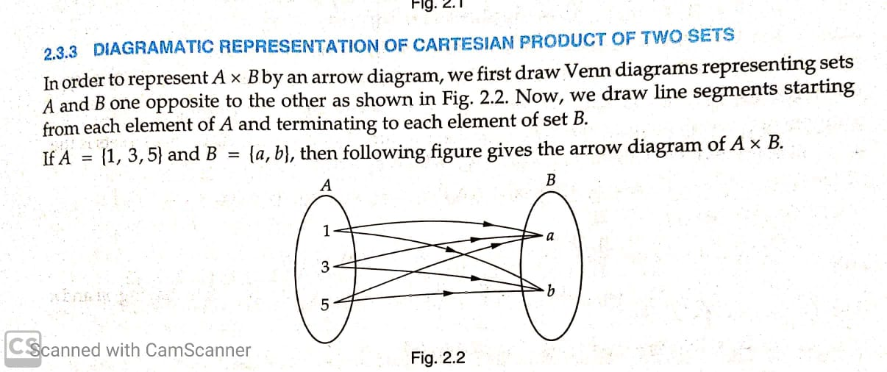
We are familiar with the concept of relationship between people. For example, a mother – daughter

Slide 11
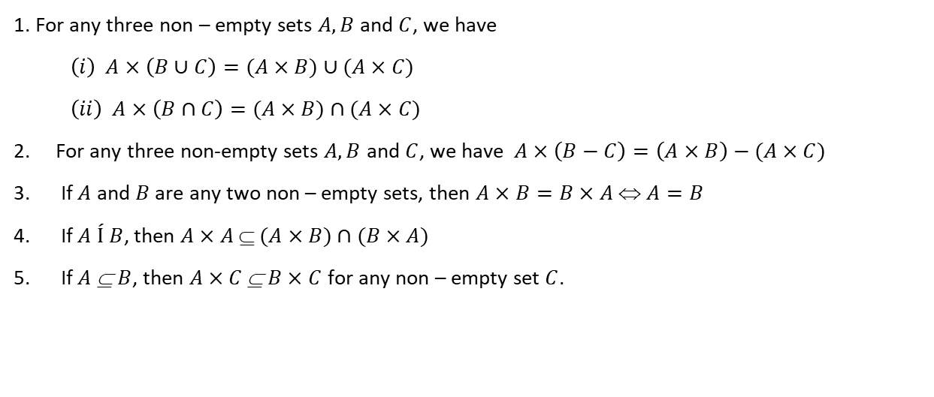
Some Theorems on Cartesian Product of Sets:
1. For any three non – empty sets $A, B$ and $C$, we have
$$\left(i\right) A×\left(B∪C\right)=(A×B)∪(A×C)$$
$$\left(ii\right) A×\left(B∩C\right)=(A×B)∩(A×C)$$
For any three non-empty sets $A, B$ and $C$, we have $A×\left(B−C\right)=\left(A×B\right)−(A×C)$
If $A$ and $B$ are any two non – empty sets, then $A×B=B×A$ ⇔ $A=B$
If $A Í$ $B$, then $A×A$ ⊆ $(A×B)∩(B×A)$
If $A$ ⊆ $B$, then $A×C$ ⊆ $B×C$ for any non – empty set $C$.
We are familiar with the concept of relationship between people. For example, a mother – daughter

Slide 12
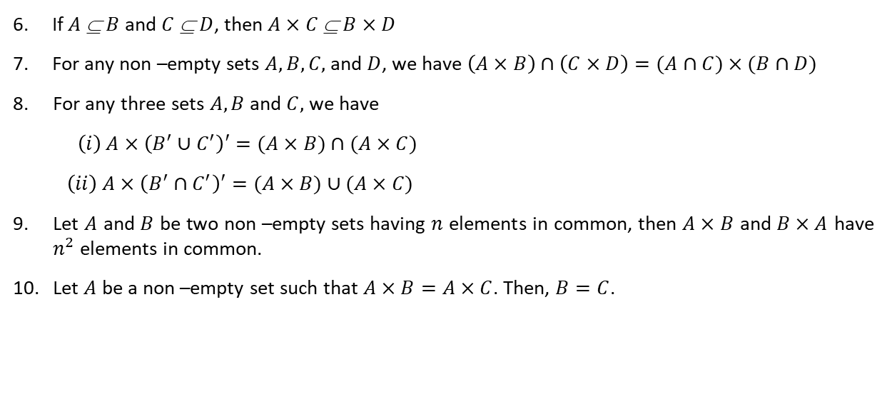
6. If $A$ ⊆ $B$ and $C$ ⊆ $D$, then $A×C$ ⊆ $B×D$
7. For any non –empty sets $A, B, C,$ and $D$, we have $\left(A×B\right)∩\left(C×D\right)=(A∩C)×(B∩D)$
For any three sets $A, B$ and $C,$ we have
$$\left(i\right) A×\left(B^{′}∪C^{′}\right)′=(A×B)∩(A×C)$$
$$\left(ii\right) A×\left(B^{′}∩C^{′}\right)′=(A×B)∪(A×C)$$
Let $A$ and $B$ be two non –empty sets having $n$ elements in common, then $A×B$ and $B×A$ have $n^{2}$ elements in common.
Let $A$ be a non –empty set such that $A×B=A×C$. Then, $B=C$.
We are familiar with the concept of relationship between people. For example, a mother – daughter

Slide 13
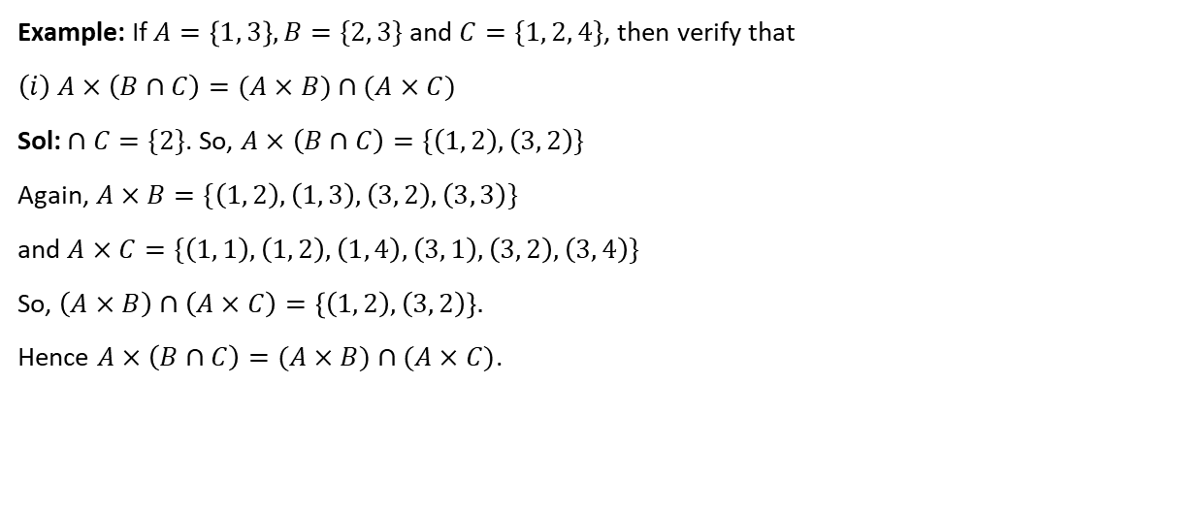
Example: If $A=\left\{1, 3\right\}, B=\{2, 3\}$ and $C=\{1, 2, 4\}$, then verify that
$$\left(i\right) A×\left(B∩C\right)=(A×B)∩(A×C)$$
Sol: $∩C=\{2\}$. So, $A×\left(B∩C\right)=\{\left(1, 2\right), \left(3, 2\right)\}$
Again, $A×B=\{\left(1, 2\right), \left(1, 3\right), \left(3, 2\right), \left(3, 3\right)\}$
and $A×C=\{\left(1, 1\right), \left(1, 2\right), \left(1, 4\right), \left(3, 1\right), \left(3, 2\right), \left(3, 4\right)\}$
So, $\left(A×B\right)∩\left(A×C\right)=\left\{\left(1, 2\right), \left(3, 2\right)\right\}.$
Hence $A×\left(B∩C\right)=(A×B)∩(A×C)$.
We are familiar with the concept of relationship between people. For example, a mother – daughter

Slide 14

$$\left(ii\right) A×\left(B−C\right)=\left(A×B\right)−(A×C)$$
Sol: B $−C=\{3 \}$. So, $A×\left(B−C\right)=\{\left(1, 3\right), \left(3, 3\right)\}$
Again, $A×B=\{\left(1, 2\right), \left(1, 3\right), \left(3, 2\right), \left(3, 3\right)\}$
and $A×C=\{\left(1, 1\right), \left(1, 2\right), \left(1, 4\right), \left(3, 1\right), \left(3, 2\right), \left(3, 4\right)\}$
So, $\left(A×B\right)−\left(A×C\right)= \{\left(1, 3\right), \left(3, 3\right)\}$
Hence, $A×\left(B−C\right)=\left(A×B\right)−(A×C)$
We are familiar with the concept of relationship between people. For example, a mother – daughter

Slide 15
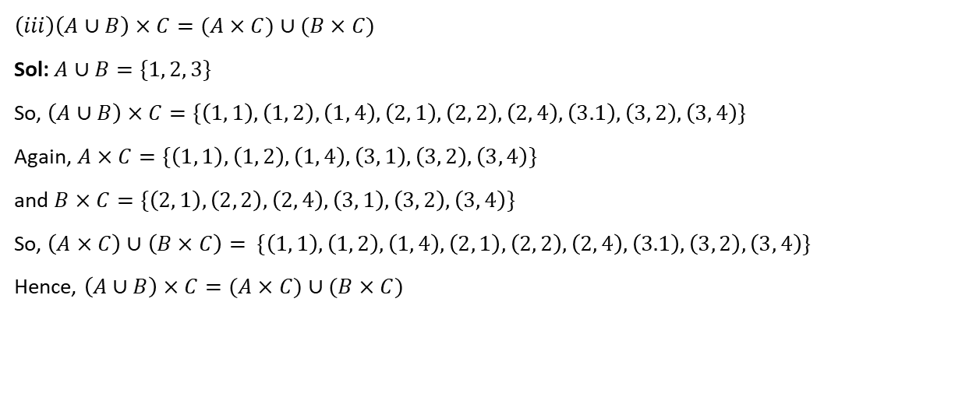
$$\left(iii\right)\left(A∪B\right)×C=(A×C)∪(B×C)$$
Sol: $A∪B=\{1, 2, 3\}$
So, $\left(A∪B\right)×C=\{\left(1, 1\right), \left(1, 2\right), \left(1, 4\right), \left(2, 1\right), \left(2, 2\right), \left(2, 4\right), \left(3.1\right), \left(3, 2\right), \left(3, 4\right)\}$
Again, $A×C=\{\left(1, 1\right), \left(1, 2\right), \left(1, 4\right), \left(3, 1\right), \left(3, 2\right), \left(3, 4\right)\}$
and $B×C=\{\left(2, 1\right), \left(2, 2\right), \left(2, 4\right), \left(3, 1\right), \left(3, 2\right), \left(3, 4\right)\}$
So, $\left(A×C\right)∪\left(B×C\right)=$ $\{\left(1, 1\right), \left(1, 2\right), \left(1, 4\right), \left(2, 1\right), \left(2, 2\right), \left(2, 4\right), \left(3.1\right), \left(3, 2\right), \left(3, 4\right)\}$
Hence, $\left(A∪B\right)×C=(A×C)∪(B×C)$
We are familiar with the concept of relationship between people. For example, a mother – daughter

Slide 16
THANKING YOU
ODM EDUCATIONAL GROUP

Slide 17
RELATIONS
Definition of Relation, Pictorial diagrams
SUBJECT : MATHEMATICS
CHAPTER NUMBER: 02
CHAPTER NAME : RELATIONS AND FUNCTIONS

Slide 18
Definition of a Relation
Let $A$ and $B$ be two sets. Then a relation $R$ from $A$ to $B$ is a subset of $A×B$.
Thus $R$ is a relation from $A$ to $B$ ⇔ $R$ ⊆ $A×B$.
The subset is derived by describing a relationship between the first element and the second element of the ordered pairs in $A×B$. The second element is called the image of the first element.
If $R$ is a relation from a non – empty set $A$ to a non – empty set $B$ and if $(x, y)∈R$, then we write $x R y$ and we say that $x$ is related to $y$ by the relation $R$.
If $(x, y)$ ∉ $R$, then we write $x$ $R$ $y$ and we say that $x$ is not related to $y$ by the relation $R$.
If $A=B i.e. R$ ⊆ $A×A$, then $R$ is a relation defined on $A$.

Slide 19
Example: Let $A=\{0, 1, 2, 3\}$ and $B=\{1, 3, 4\}$
Then $A×B=\{ \left(0,1\right), \left(0,3\right), \left(0, 4\right), ……\left(3, 4\right)\}$
$R_{1}=Equal to=\left\{ \left(1, 1\right), \left(3, 3\right)\right\}$ $R_{2}=greater than=\{\left(2, 1\right), \left(3, 1\right)\}$
Example: If $A=\{1, 2, 3\}$ and $B=\{a, b, c\}$, then $R=\{\left(1, a\right), \left(2, c\right), \left(1, a\right), \left(3, a\right)\}$, being a subset of $A×B$, is a relation from $A$ to $B$. Here $(1, a)∈R$, so we write $1 R a.$

Slide 20
Example: If $A=\{1, 2, 3, 4\}$ and $B=\{5, 6, 7, 8\}$, then which of the following are relations from $A$ to $B$ ? Answer.
$\left(i\right) R_{1}=\{\left(1, 5\right), \left(2, 7\right), \left(3, 8\right)\}$ $\left(ii\right){ R}_{2}=\{\left(6, 2\right), \left(3, 7\right), \left(4, 7\right)\}$
Sol: Here $A×B=\{\left(1, 5\right),\left(1, 6\right), \left(1, 7\right), \left(1, 8\right),\left(2, 5\right), \left(2,6\right), \left(2, 7\right), \left(2, 8\right), \left(3, 5\right), \left(3, 6\right), \left(3, 7\right), \left(3, 8\right),$
$$\left(4, 5\right), \left(4, 6\right), \left(4, 7\right), (4, 8)\}$$
$(i)$ Since, $R_{1}$ ⊆ $A×B$, therefore $R_{1}$ is a relation from $A$ to $B$.
$(ii)$ Since, $(6, 2)∈R_{2}$ but $(6, 2)$∉ $A×B$, therefore $R_{2}$ is not a relation from $A$ to $B$.

Slide 21
Number of Relations
Let $A$ and $B$ be any two finite sets containing $m$ and $n$ elements respectively. Since each relation from $A$ to $B$ is a subset of $A×B$, so the number of relations defined from $A$ to $B$ is $2^{mn}$.
Example: If $A=\{a, b\}$ and $B=\{2, 3, 4\}$, then find the number of relations from $A$ to $B$.
Sol: We have $n\left(A\right)=2$ and $n\left(B\right)=3$.
So, the number of relations from $A$ to $B$ is $2^{2×3}=2^{6}=64$.

Slide 22
Types of Relations
1. Empty / Void Relation: Since $∅$ ⊆ $A×B$, so $∅$ is a relation from $A$ to $B$, which is called an empty relation. It is the smallest relation in $A×B$.
2. Universal Relation: since $A×B$ ⊆ $A×B$, so $A×B$ is a relation from $A$ to $B$, which is called the
universal relation. It is the largest relation in $A×B$.
3. Identity Relation: Let $A=\{x. y, z\}$. So $I_{A}=\{\left(x, x\right), \left(y, y\right), \left(z, z\right)\}$ is called the identity relation on $A$.

Slide 23
Representation of a Relation
A relation from a set $A$ to a set $B$ can be represented in any one of the following forms:
Roster Form: In this form, a relation is represented by the set of all ordered pairs belonging to $R$.
Example: A relation $R$ is defined from a set $A=\{2, 3, 4, 5\}$ to a set $B=\{3, 6, 7, 10\}$ as follows $\left(x, y\right)∈R$ ⇔ $x$ divides $y$. Express $R$ as a set of ordered pairs and determine the domain and range of $R$.
Solution: Here $R=\{\left(2, 6\right), \left(2, 10\right), \left(3, 3\right), \left(3, 6\right), \left(5, 10\right)\}$
So, $dom−R=\{2, 3, 5\}$ and $rng−R=\{3, 6, 10\}$

Slide 24
2. Set – builder Form: In this form, we represent the relation $R$ from set $A$ to set $B$ as $R=\{\left(x, y\right):x∈A, y∈B$ and the rule which relates the elements of $A$ and $B$}
For example, if $R$ is a relation from set $A=\{1, 2, 4, 5\}$ and $B=\left\{1,\frac{1}{2},\frac{1}{4},\frac{1}{5}\right\}$ such that $R=\left\{\left(1.1\right), \left(2,\frac{1}{2}\right), \left(4,\frac{1}{4} \right), \left(5,\frac{1}{5}\right)\right\}$, then in set-builder form, $R$ can be written as $R=\{\left(x, y\right):x∈A, y∈B,$ and $y=\frac{1}{x} \}$

Slide 25
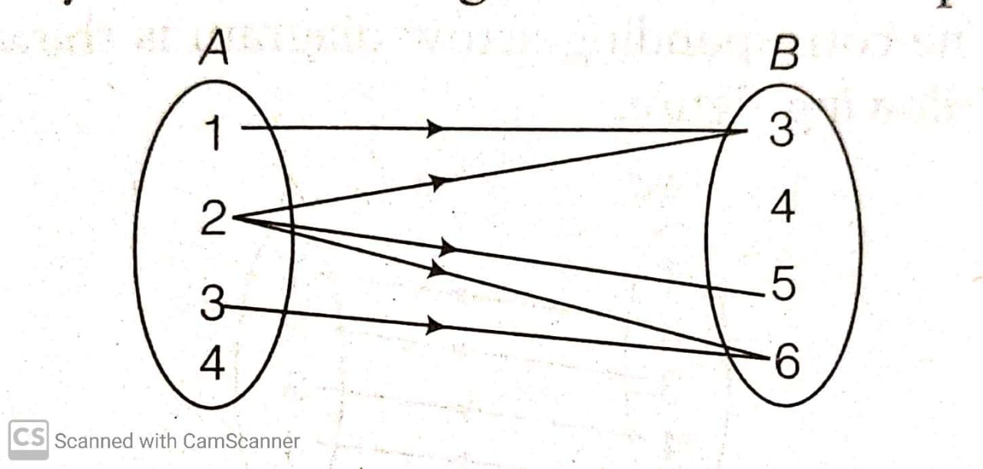
3. Arrow diagram: To represent a relation by an arrow diagram, we draw arrows from the first component to the second component of all ordered pairs belonging to relation $R$.
For example, a relation $R=\{\left(1,3\right), \left(2, 5\right), \left(3, 6\right), \left(2, 6\right), \left(2, 3\right)\}$ from set $A=\{1, 2, 3, 4\}$ to set $B=\{3, 4, 5, 6\}$ can be represented by the following arrow diagram.

Slide 26
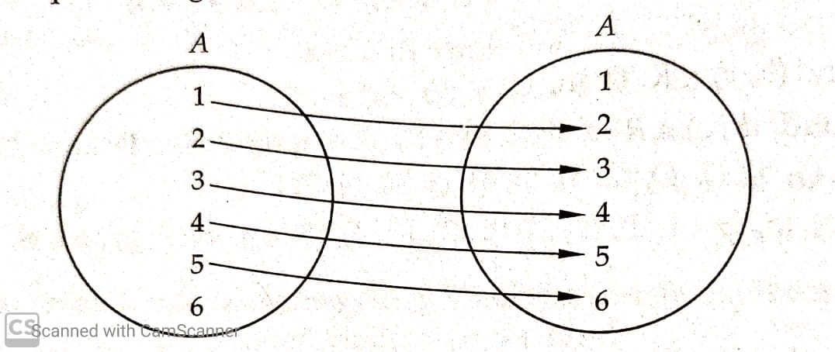
Example: Let $A=\{1, 2, 3, 4, 5, 6\}$. Define a relation $R$ on set $A$ by $R=\{\left(x, y\right):y=x+1\}$
Depict this relation using an arrow diagram
Sol: Putting $x=1,2,3, 4,5, 6$ respectively in $y=x+1$, we get $y=2, 3,4, 5, 6, 7$ respectively. But $7$ ∉ $A$.
Hence $R=\{\left(1, 2\right), \left(2, 3\right), \left(3,4\right), \left(4, 5\right), \left(5, 6\right)\}$ . The arrow diagram representing $R$ is as follows.

Slide 27
Example: Let $A=\{1, 2, 3, 5\}$ and $B=\{4, 6, 9\}$. Define a relation $R$ from $A$ to $B$ by $R=\{\left(x, y\right):$ the difference between $x$ and $y$ is odd ; $x∈A, y∈B\}$. Write $R$ in roster form.
Sol: $R=\{\left(1, 4\right), \left(1, 6\right), \left(2, 9\right), \left(3, 4\right), \left(3, 6\right), \left(5, 4\right), \left(5, 6\right)\}$
Example: If $R=\{\left(x, y\right):x, y∈Z$ and $x^{2}+y^{2}=64\}$ is a relation. Then find $R$.
Sol: $R=\{\left(0, 8\right), \left(0, −8\right), \left(8, 0\right), \left(−8, 0\right)\}$
Example: Given $A=\left\{1, 2, 3, 4, 5\right\}, S=\{\left(x, y\right) :x∈A, y∈A\}$. Find the ordered pairs which satisfy the condition $x+y>8$.
Sol: $S=\{ \left(4, 5\right), \left(5, 4\right), \left(5, 5\right)\}$

Slide 28
THANKING YOU
ODM EDUCATIONAL GROUP

Slide 29
RELATIONS
Domain, Co-domain and Range
SUBJECT : MATHEMATICS
CHAPTER NUMBER: 02
CHAPTER NAME : RELATIONS AND FUNCTIONS

Slide 30
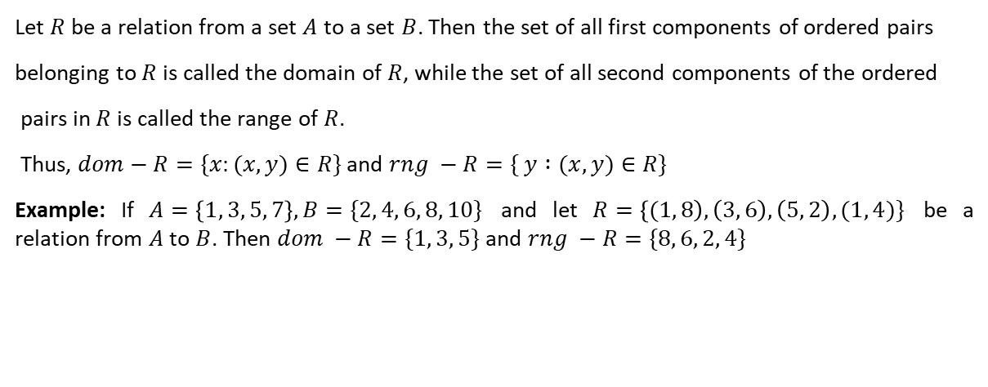
Domain and Range of a Relation
Let $R$ be a relation from a set $A$ to a set $B$. Then the set of all first components of ordered pairs
belonging to $R$ is called the domain of $R$, while the set of all second components of the ordered
pairs in $R$ is called the range of $R$.
Thus, $dom−R=\{x:(x, y)∈R\}$ and $rng −R=\{ y :(x, y)∈R\}$
Example: If $A=\left\{1, 3, 5, 7\right\}, B=\{2, 4, 6, 8, 10\}$ and let $R=\left\{(1, 8\right), \left(3, 6\right), \left(5, 2\right), (1, 4)\}$ be a relation from $A$ to $B$. Then $dom −R=\{1, 3, 5\}$ and $rng −R=\{8, 6, 2, 4\}$

Slide 31

The inverse of a Relation:
Let $A, B$ be two sets and let $R$ be a relation from a set $A$ to a set $B.$ Then the inverse of $R,$ denoted by $R^{−1}$, is a relation from $B$ to $A$ and is defined by $R^{−1}=\{\left(y, x\right):(x, y)∈R\}$.
From the above example, we get $R^{−1}=\{\left(8, 1\right), \left(6, 3\right), \left(2, 5\right), \left(4, 1\right)\}$
So, $dom−R^{−1}=\{8, 6, 2, 4\}$ and $rng−R^{−1}=\{1, 3, 5\}$

Slide 32

Remember:
If $R$ ⊆ $A×B$, then $R^{−1}$ ⊆ $B×A$.
$dom−R=rng−R^{−1}$ and $rng−R=dom−{ R}^{−1}$.
$domain$ ⊆ $A$ and $range$⊆ $B$.
The set $B$ is called the co-domain of the relation $R$.
$range$ ⊆ $co−domain$

Slide 33
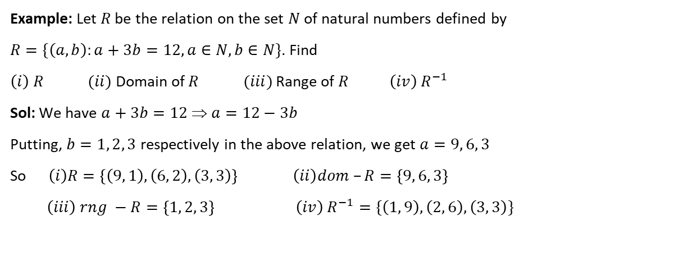
Example: Let $R$ be the relation on the set $N$ of natural numbers defined by
$R=\{\left(a, b\right):a+3b=12, a∈N, b∈N\}$. Find
$\left(i\right) R$ $(ii)$ Domain of $R$ $(iii)$ Range of $R$ $\left(iv\right) R^{−1}$
Sol: We have $a+3b=12$ ⇒ $a=12−3b$
Putting, $b=1, 2, 3$ respectively in the above relation, we get $a=9, 6, 3$
So $\left(i\right)R=\left\{\left(9, 1\right), \left(6, 2\right), \left(3, 3\right)\right\} \left(ii\right)dom –R=\left\{9, 6, 3\right\}$
$$\left(iii\right) rng −R=\left\{1, 2, 3\right\} \left(iv\right) R^{−1}=\{\left(1, 9\right), \left(2, 6\right), \left(3, 3\right)\}$$

Slide 34
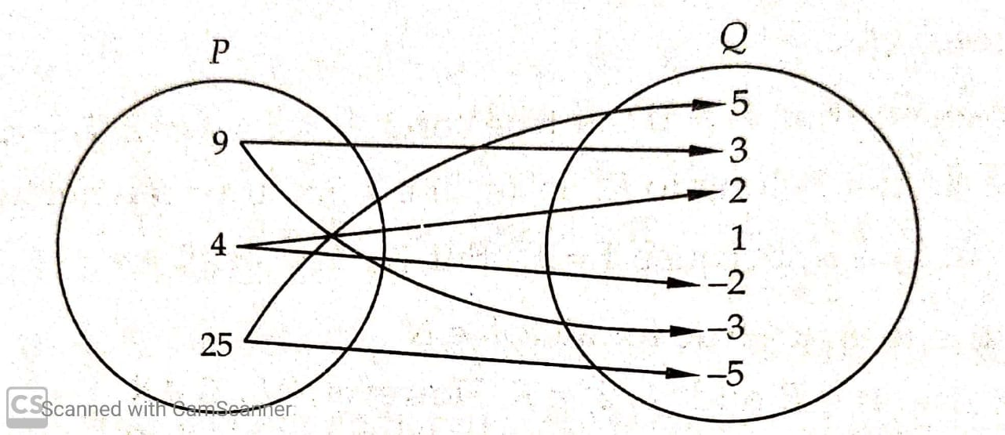
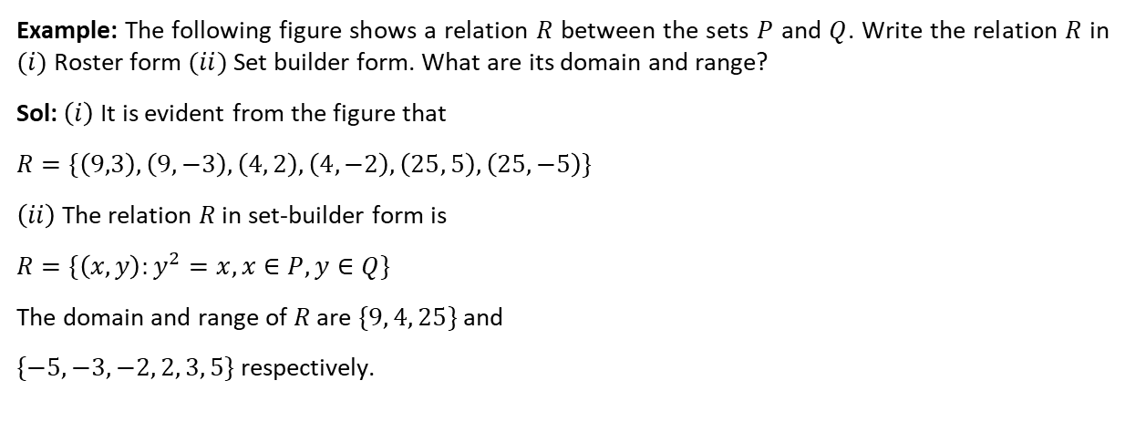
Example: The following figure shows a relation $R$ between the sets $P$ and $Q$. Write the relation $R$ in $(i)$ Roster form $(ii)$ Set builder form. What are its domain and range?
Sol: $\left(i\right)$ It is evident from the figure that
$$R=\{\left(9,3\right), \left(9,−3\right), \left(4, 2\right), \left(4, −2\right), \left(25, 5\right), \left(25, −5\right)\}$$
$\left(ii\right)$ The relation $R$ in set-builder form is
$$R=\{\left(x, y\right):y^{2}=x, x∈P, y∈Q\}$$
The domain and range of $R$ are $\{9, 4, 25\}$ and
$\{−5, −3, −2, 2, 3, 5\}$ respectively.

Slide 35
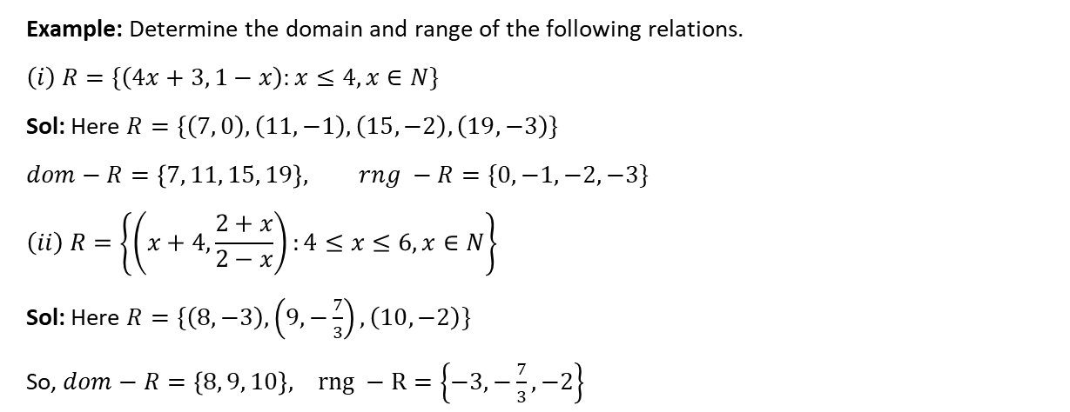
Example: Determine the domain and range of the following relations.
$$\left(i\right) R=\{\left(4x+3, 1−x\right):x≤4, x∈N\}$$
Sol: Here $R=\{\left(7, 0\right), \left(11, −1\right), \left(15, −2\right), \left(19, −3\right)\}$
$$dom−R=\left\{7, 11, 15, 19\right\}, rng −R=\{0, −1, −2, −3\}$$
$$\left(ii\right) R=\left\{\left(x+4, \frac{2+x}{2−x}\right):4≤x≤6, x∈N\right\}$$
Sol: Here $R=\{\left(8, −3\right), \left(9, −\frac{7}{3}\right), \left(10, −2\right)\}$
So, $dom−R=\left\{8, 9, 10\right\}, rng −R=\left\{−3, −\frac{7}{3}, −2\right\}$

Slide 36

Example: Let $A$ and $B$ be the sets of real numbers. Define a relation $R$ from $A$ to $B$ by
$R=\{(x, y)∈A×B : x^{2}+y^{2}=1$ and $\left|x−y\right|=1\}$. Find the domain and range of $R$.
Sol: Here $R=\{\left(1,0\right), \left(−1, 0\right), \left(0, 1\right), \left(0, −1\right)\}$
So, $dom−R=\left\{−1, 0, 1\right\}, rng −R=\{−1, 0, 1\}$.

Slide 37
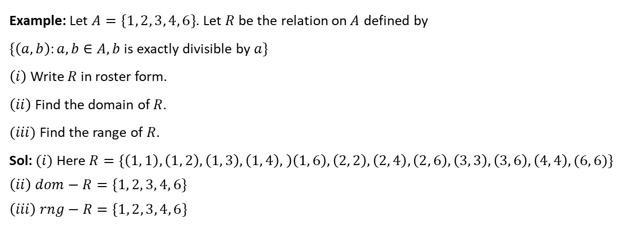
Example: Let $A=\{1, 2, 3, 4, 6\}$. Let $R$ be the relation on$A$ defined by
$\{\left(a, b\right):a, b∈A, b$is exactly divisible by $a\}$
$\left(i\right)$ Write $R$ in roster form.
$\left(ii\right)$ Find the domain of $R$.
$(iii)$ Find the range of $R$.
Sol: $(i)$ Here $R=\left\{\left(1, 1\right), \left(1, 2\right), \left(1, 3\right), \left(1, 4\right), \right)\left(1, 6\right), \left(2, 2\right), \left(2, 4\right), \left(2, 6\right), \left(3, 3\right), \left(3, 6\right), \left(4, 4\right), (6, 6)\}$
$$\left(ii\right) dom−R=\{1, 2, 3, 4, 6\}$$
$$\left(iii\right) rng−R=\{1, 2, 3, 4, 6\}$$

Slide 38
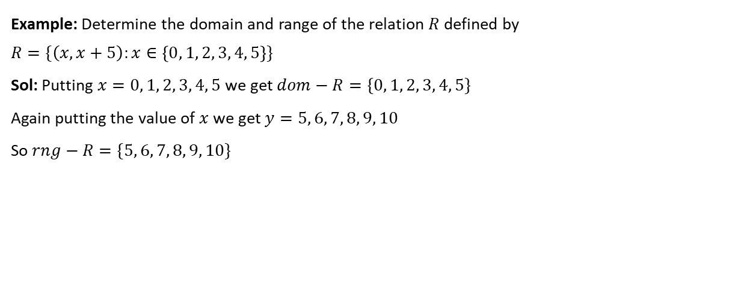
Example: Determine the domain and range of the relation $R$ defined by
$$R=\{\left(x, x+5\right):x∈\left\{0, 1, 2, 3, 4, 5\right\}\}$$
Sol: Putting $x=0, 1, 2, 3, 4, 5$ we get $dom−R=\{0, 1, 2, 3, 4, 5\}$
Again putting the value of $x$ we get $y=5, 6, 7, 8, 9, 10$
So $rng−R=\{5, 6, 7, 8, 9, 10\}$

Slide 39
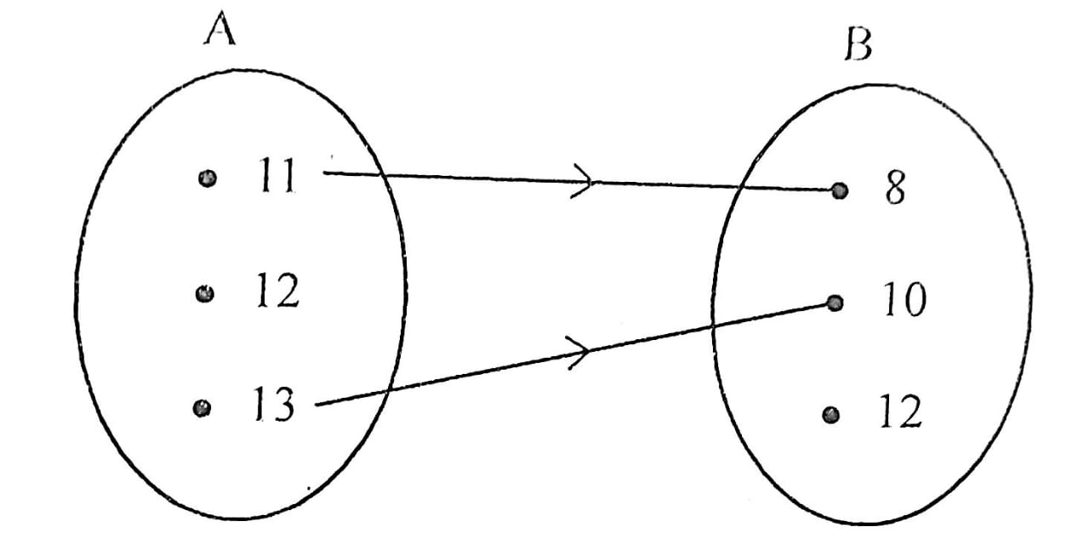

Example: Let $A=\{11, 12, 13\}$ and $B=\{8, 10, 12\}$. Define a relation $R$ from $A$ to $B$ by
$$R=\{\left(x, y\right):x−y=3, x∈A, y∈B\}$$
$(i)$ Depict this relation by an arrow diagram.
$(ii)$ Write down domain, co-domain and range of $R$.
Sol: Here $R=\{\left(11, 8\right), \left(13, 10\right)\}$
The arrow diagram is shown in figure.
$$\left(ii\right) dom−R=\{11, 13\}$$
$$rng −R=\{8, 10\}$$
$$co−domain of R=\{8, 10, 12\}$$

Slide 40
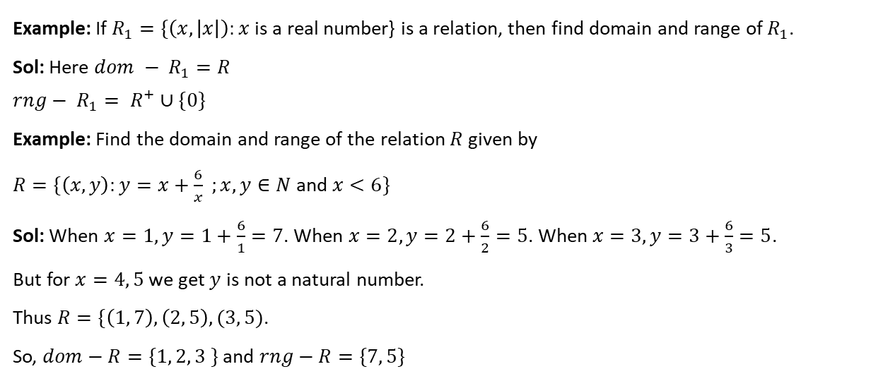
Example: If $R_{1}=\{\left(x, \left|x\right|\right):x$ is a real number} is a relation, then find domain and range of $R_{1}$.
Sol: Here $dom − R_{1}=R$
$$rng− R_{1}= R^{+}∪\{0\}$$
Example: Find the domain and range of the relation $R$ given by
$R=\{\left(x, y\right):y=x+\frac{6}{x} ;x, y∈N$ and $x<6\}$
Sol: When $x=1, y=1+\frac{6}{1}=7$. When $x=2, y=2+\frac{6}{2}=5$. When $x=3, y=3+\frac{6}{3}=5$.
But for $x=4, 5$ we get $y$ is not a natural number.
Thus $R=\{\left(1, 7\right), \left(2, 5\right), (3, 5)$.
So, $dom−R=\{1, 2, 3 \}$ and $rng−R=\{7, 5\}$

Slide 41
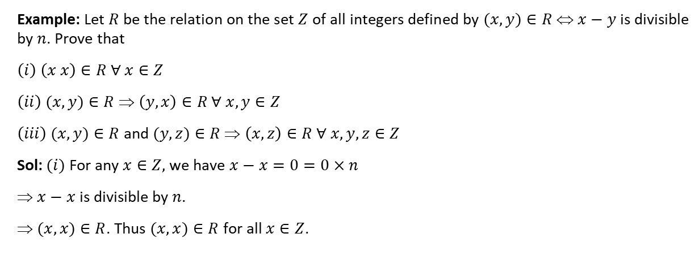
Example: Let $R$ be the relation on the set $Z$ of all integers defined by $(x, y)∈R$ ⇔ $x−y$ is divisible by $n$. Prove that
$$\left(i\right) \left(x x\right)∈R ∀ x∈Z$$
$\left(ii\right) (x, y)∈R$ ⇒ $\left(y, x\right)∈R ∀ x, y∈Z$
$\left(iii\right) (x, y)∈R$ and $(y, z)∈R$ ⇒ $\left(x, z\right)∈R ∀ x, y, z∈Z$
Sol: $(i)$ For any $x∈Z,$ we have $x−x=0=0×n$
⇒ $x−x$ is divisible by $n$.
⇒ $(x, x)∈R$. Thus $(x, x)∈R$ for all $x∈Z$.

Slide 42

$(ii)$ Let $(x, y)∈R$. Then $(x, y)∈R$
⇒ $x−y$ is divisible by $n$ ⇒ $x−y=kn$ for some $k∈Z$
⇒ $y−x=\left(−k\right)n$ ⇒ $y−x$ is divisible by $n$ ⇒ $(y, x)∈R$
Thus, $(x,y)∈R$ ⇒ $(y, x)∈R$ for all $x, y∈Z$.

Slide 43
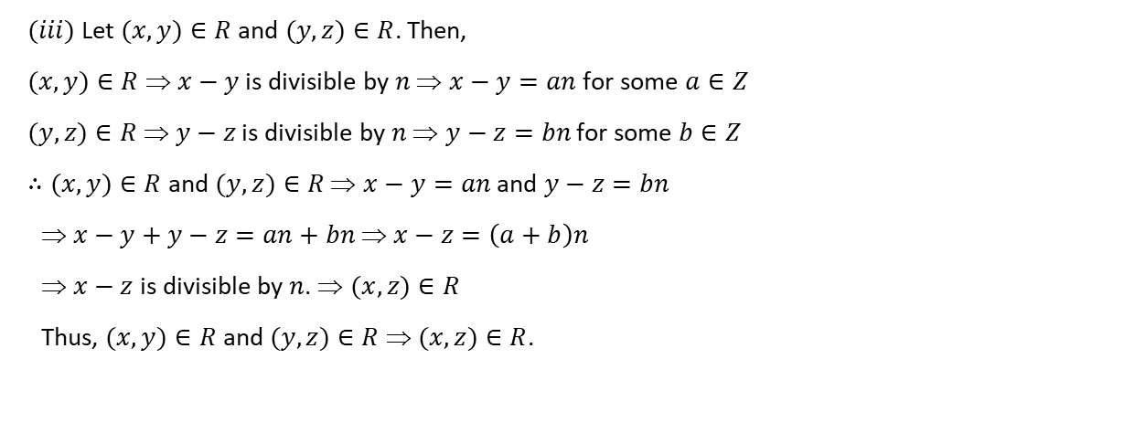
$(iii)$ Let $(x,y)∈R$ and $(y,z)∈R$. Then,
$(x,y)∈R$ ⇒ $x−y$ is divisible by $n$ ⇒ $x−y=an$ for some $a∈Z$
$(y,z)∈R$ ⇒ $y−z$ is divisible by $n$ ⇒ $y−z=bn$ for some $b∈Z$
$∴(x,y)∈R$ and $(y,z)∈R$ ⇒ $x−y=an$ and $y−z=bn$
⇒ $x−y+y−z=an+bn$ ⇒ $x−z=\left(a+b\right)n$
⇒ $x−z$ is divisible by $n$. ⇒ $(x,z)∈R$
Thus, $(x,y)∈R$ and $(y,z)∈R$ ⇒ $(x,z)∈R$.

Slide 44
THANKING YOU
ODM EDUCATIONAL GROUP

Slide 45
FUNCTIONS
Pictorial Representation, Domain and Range
SUBJECT : MATHEMATICS
CHAPTER NUMBER: 02
CHAPTER NAME : RELATIONS AND FUNCTIONS

Slide 46
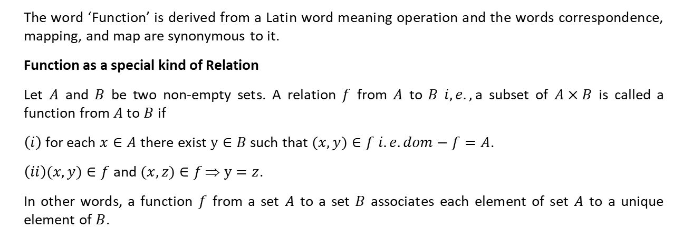
The word ‘Function’ is derived from a Latin word meaning operation and the words correspondence, mapping, and map are synonymous to it.
Function as a special kind of Relation
Let $A$ and $B$ be two non-empty sets. A relation $f$ from $A$ to $B$ $i,e.,$a subset of $A×B$ is called a function from $A$ to $B$ if
$\left(i\right)$ for each $x∈A$ there exist $y∈B$ such that $(x,y)∈f$ $i.e. dom−f=A$.
$\left(ii\right)(x, y)∈f$ and $(x, z)∈f$ ⇒ $y=z$.
In other words, a function $f$ from a set $A$ to a set $B$ associates each element of set $A$ to a unique element of $B$.

Slide 47
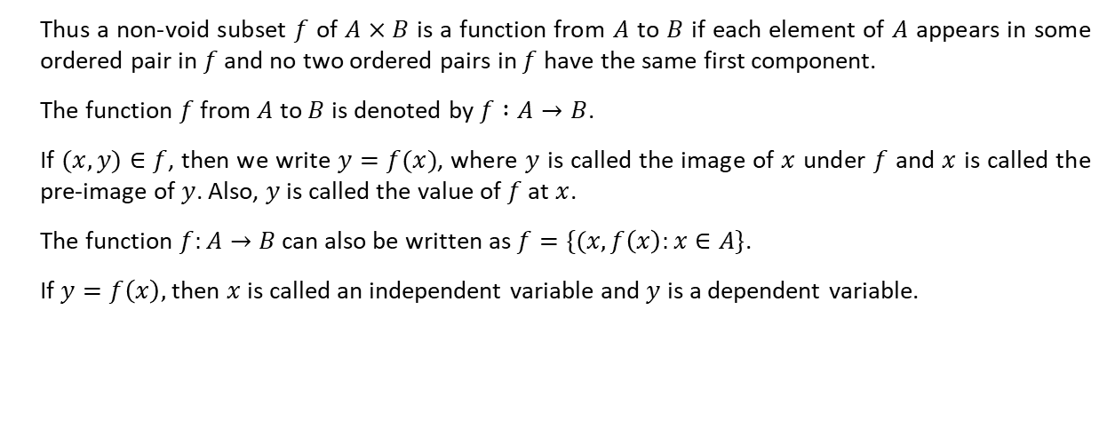
Thus a non-void subset $f$ of $A×B$ is a function from $A$ to $B$ if each element of $A$ appears in some ordered pair in $f$ and no two ordered pairs in $f$ have the same first component.
The function $f$ from $A$ to $B$ is denoted by $f :A→B$.
If $(x, y)∈f$, then we write $y=f(x)$, where $y$ is called the image of $x$ under $f$ and $x$ is called the pre-image of $y$. Also, $y$ is called the value of $f$ at $x$.
The function $f:A→B$ can also be written as $f=\{(x, f\left(x\right):x∈A\}$.
If $y=f\left(x\right),$ then $x$ is called an independent variable and $y$ is a dependent variable.

Slide 48
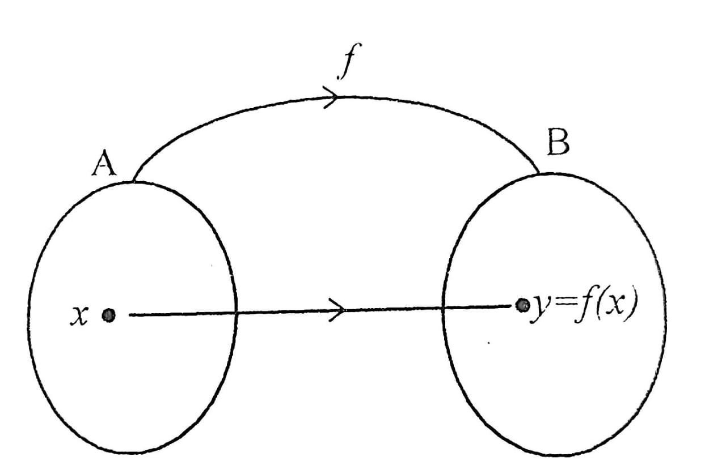

Slide 49
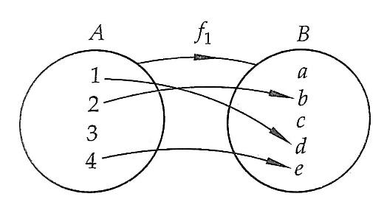
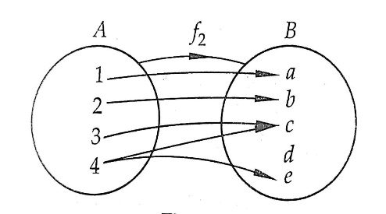

Let $A=\{1, 2, 3, 4\}$ and $B=\{a, b, c, d, e\}$ be two sets and let $f_{1}, f_{2}, f_{3}$ and $f_{4}$ be rules associating elements of $A$ to elements of $B$ as shown in the following figures:

Slide 50
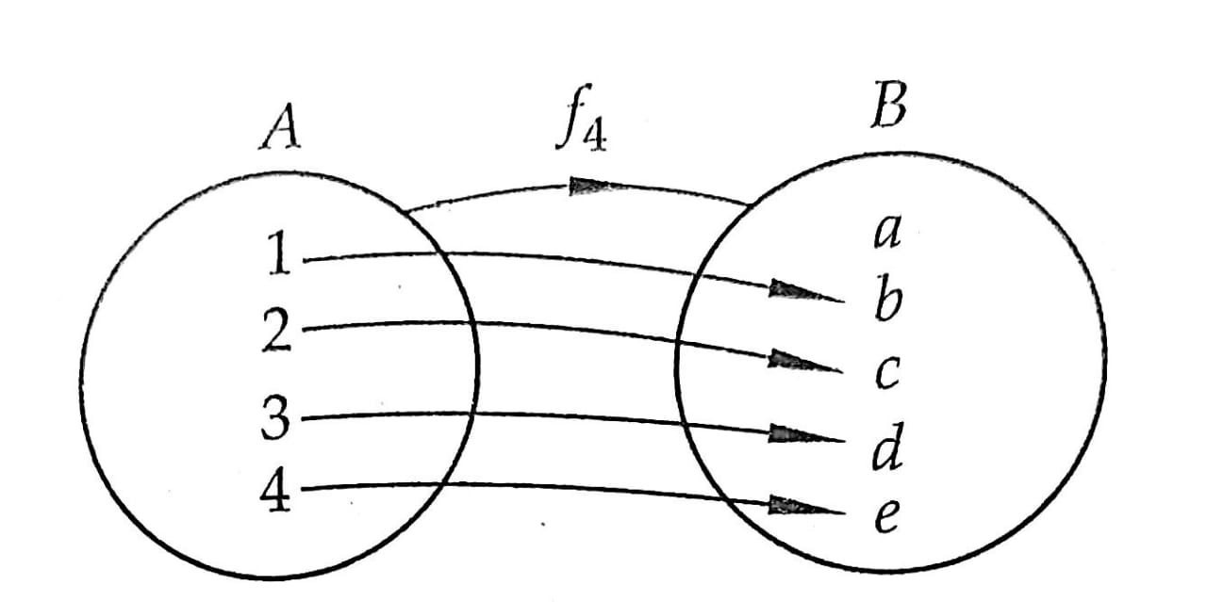
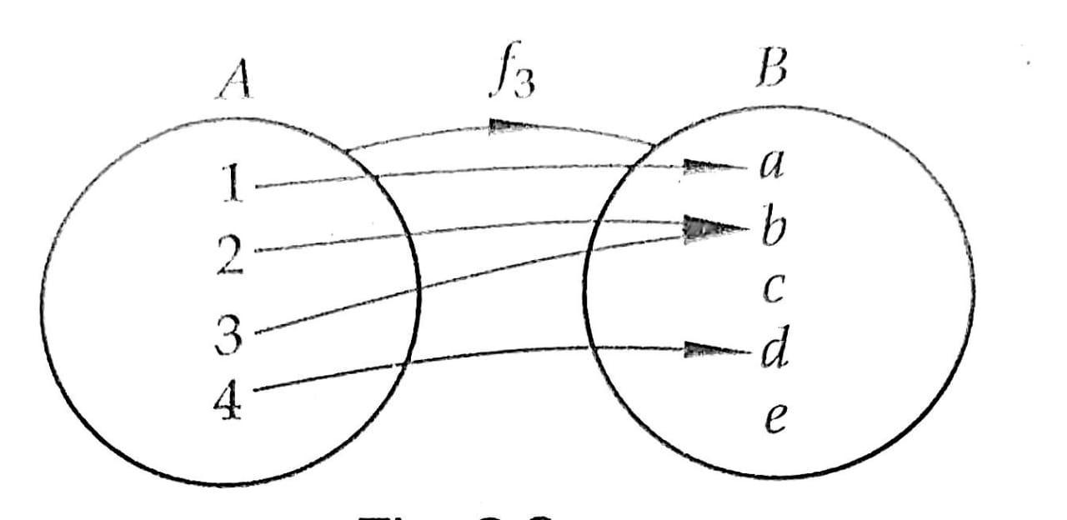
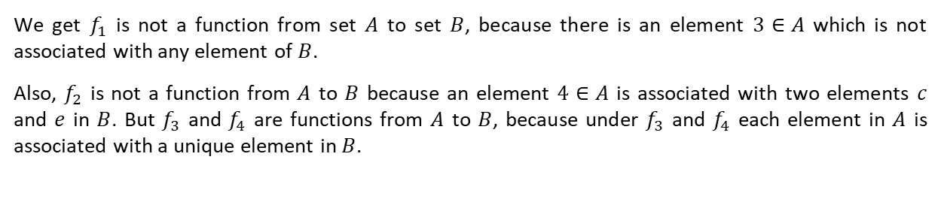
We get $f_{1}$ is not a function from set $A$ to set $B$, because there is an element $3∈A$ which is not associated with any element of $B$.
Also, $f_{2}$ is not a function from $A$ to $B$ because an element $4∈A$ is associated with two elements $c$ and $e$ in $B$. But $f_{3}$ and $f_{4}$ are functions from $A$ to $B$, because under $f_{3}$ and $f_{4}$ each element in $A$ is associated with a unique element in $B$.

Slide 51
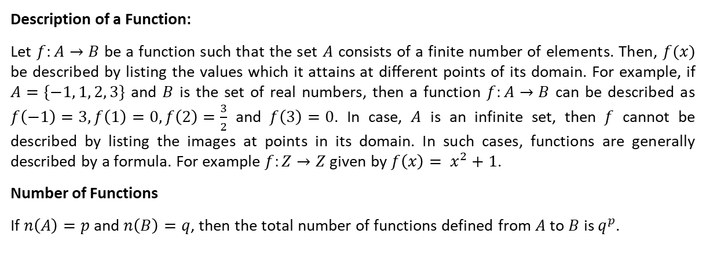
Description of a Function:
Let $f:A→B$ be a function such that the set $A$ consists of a finite number of elements. Then, $f(x)$ be described by listing the values which it attains at different points of its domain. For example, if $A=\{−1, 1, 2, 3\}$ and $B$ is the set of real numbers, then a function $f:A→B$ can be described as $f\left(−1\right)=3, f\left(1\right)=0, f\left(2\right)=\frac{3}{2}$ and $f\left(3\right)=0$. In case, $A$ is an infinite set, then $f$ cannot be described by listing the images at points in its domain. In such cases, functions are generally described by a formula. For example $f:Z→Z$ given by $f\left(x\right)= x^{2}+1$.
Number of Functions
If $n\left(A\right)=p$ and $n\left(B\right)=q$, then the total number of functions defined from $A$ to $B$ is $q^{p}$.

Slide 52
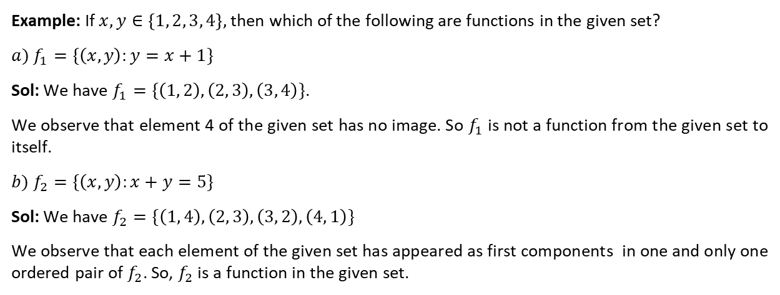
Example: If $x, y∈\left\{1, 2, 3, 4\right\},$ then which of the following are functions in the given set?
$$a) f_{1}=\{\left(x, y\right):y=x+1\}$$
Sol: We have $f_{1}=\{\left(1, 2\right), \left(2, 3\right), \left(3, 4\right)\}$.
We observe that element 4 of the given set has no image. So $f_{1}$ is not a function from the given set to itself.
$$b) f_{2}=\{\left(x, y\right):x+y=5\}$$
Sol: We have $f_{2}=\{\left(1, 4\right), \left(2, 3\right), \left(3, 2\right), \left(4, 1\right)\}$
We observe that each element of the given set has appeared as first components in one and only one ordered pair of $f_{2}$. So, $f_{2}$ is a function in the given set.

Slide 53
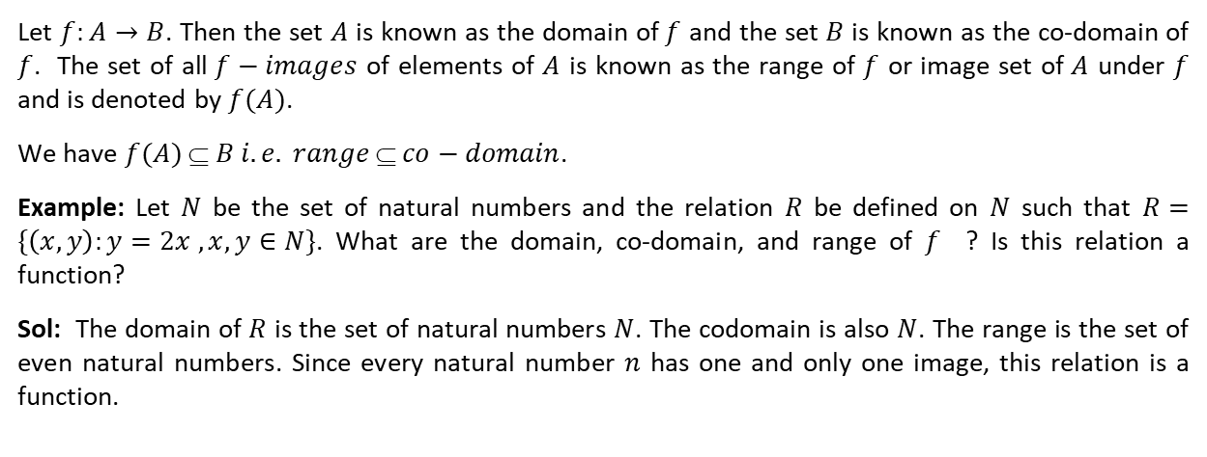
Domain, Co-domain, and Range of a Function:
Let $f:A→B$. Then the set $A$ is known as the domain of $f$ and the set $B$ is known as the co-domain of $f$. The set of all $f−images$ of elements of $A$ is known as the range of $f$ or image set of $A$ under $f$ and is denoted by $f(A)$.
We have $f(A)$ ⊆ $B i.e. range$⊆ $co−domain$.
Example: Let $N$ be the set of natural numbers and the relation $R$ be defined on $N$ such that $R=\{\left(x, y\right):y=2x , x, y∈N\}$. What are the domain, co-domain, and range of $f$ ? Is this relation a function?
Sol: The domain of $R$ is the set of natural numbers $N$. The codomain is also $N$. The range is the set of even natural numbers. Since every natural number $n$ has one and only one image, this relation is a function.

Slide 54
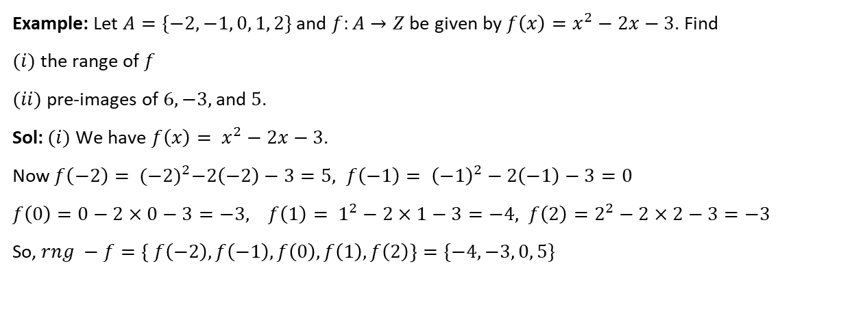
Example: Let $A=\{−2, −1, 0, 1, 2\}$ and $f:A→Z$ be given by $f\left(x\right)=x^{2}−2x−3$. Find
$(i)$ the range of $f$
$(ii)$ pre-images of $6, −3,$ and $5$.
Sol: $(i)$ We have $f\left(x\right)= x^{2}−2x−3$.
Now $f\left(−2\right)= {(−2)}^{2}−2\left(−2\right)−3=5, f\left(−1\right)= {\left(−1\right)}^{2}−2\left(−1\right)−3=0$
$f\left(0\right)=0−2×0−3=−3, f\left(1\right)= 1^{2}−2×1−3=−4, f\left(2\right)=2^{2}−2×2−3=−3$
So, $rng −f=\left\{ f\left(−2\right),f\left(−1\right), f\left(0\right), f\left(1\right), f\left(2\right)\right\}=\{−4, −3, 0, 5\}$

Slide 55
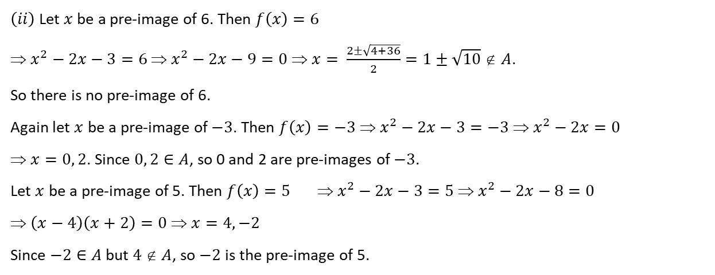
$\left(ii\right)$ Let $x$ be a pre-image of 6. Then $f\left(x\right)=6$
⇒ $x^{2}−2x−3=6$ ⇒ $x^{2}−2x−9=0$ ⇒ $x= \frac{2±\sqrt{4+36}}{2}=1±\sqrt{10}$∉ $A$.
So there is no pre-image of 6.
Again let $x$ be a pre-image of $−3$. Then $f\left(x\right)=−3$ ⇒ $x^{2}−2x−3=−3$ ⇒ $x^{2}−2x=0$
⇒ $x=0, 2$. Since $0, 2∈A$, so 0 and 2 are pre-images of $−3$.
Let $x$ be a pre-image of 5. Then $f\left(x\right)=5$ ⇒ $x^{2}−2x−3=5$ ⇒ $x^{2}−2x−8=0$
⇒ $\left(x−4\right)\left(x+2\right)=0$ ⇒ $x=4, −2$
Since $−2∈A$ but $4$ ∉ $A$, so $−2$ is the pre-image of 5.

Slide 56
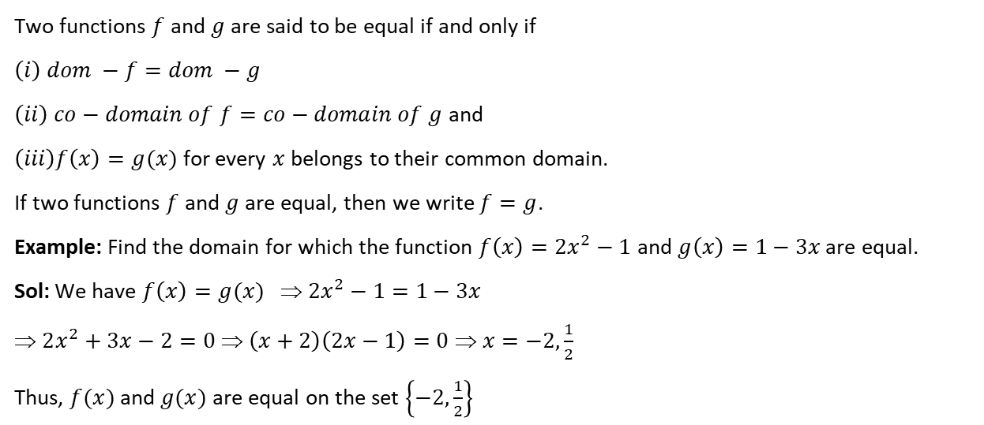
Equal Functions:
Two functions $f$ and $g$are said to be equal if and only if
$$\left(i\right) dom −f=dom −g$$
$\left(ii\right) co−domain of f=co−domain of g$ and
$\left(iii\right)f\left(x\right)=g(x)$ for every $x$ belongs to their common domain.
If two functions $f$ and $g$ are equal, then we write $f=g$.
Example: Find the domain for which the function $f\left(x\right)=2x^{2}−1$ and $g\left(x\right)=1−3x$ are equal.
Sol: We have $f\left(x\right)=g(x)$ ⇒ $2x^{2}−1=1−3x$
⇒ $2x^{2}+3x−2=0$ ⇒ $\left(x+2\right)\left(2x−1\right)=0$ ⇒ $x=−2, \frac{1}{2}$
Thus, $f(x)$ and $g(x)$ are equal on the set $\left\{−2,\frac{1}{2}\right\}$

Slide 57
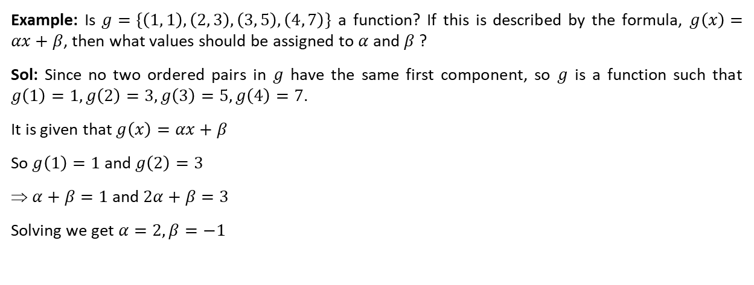
Example: Is $g=\{\left(1, 1\right), \left(2, 3\right), \left(3, 5\right), \left(4, 7\right)\}$ a function? If this is described by the formula, $g\left(x\right)=αx+β$, then what values should be assigned to $α$ and $β$ ?
Sol: Since no two ordered pairs in $g$ have the same first component, so $g$ is a function such that $g\left(1\right)=1, g\left(2\right)=3, g\left(3\right)=5, g\left(4\right)=7$.
It is given that $g\left(x\right)=αx+β$
So $g\left(1\right)=1$ and $g\left(2\right)=3$
⇒ $α+β=1$ and $2α+β=3$
Solving we get $α=2, β=−1$

Slide 58
THANKING YOU
ODM EDUCATIONAL GROUP

Slide 59
FUNCTIONS
Real Valued Function , Domain and Range
SUBJECT : MATHEMATICS
CHAPTER NUMBER: 02 (Period – 05)
CHAPTER NAME : RELATIONS AND FUNCTIONS

Slide 60
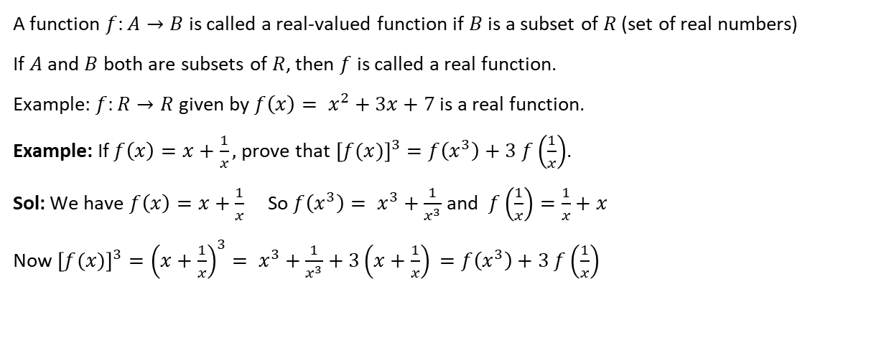
Real functions
A function $f:A→B$ is called a real-valued function if $B$ is a subset of $R$ (set of real numbers)
If $A$ and $B$ both are subsets of $R$, then $f$ is called a real function.
Example: $f:R→R$ given by $f\left(x\right)= x^{2}+3x+7$ is a real function.
Example: If $f\left(x\right)=x+\frac{1}{x},$ prove that ${\left[f(x)\right]}^{3}=f\left(x^{3}\right)+3 f\left(\frac{1}{x}\right)$.
Sol: We have $f\left(x\right)=x+\frac{1}{x}$ So $f\left(x^{3}\right)= x^{3}+\frac{1}{x^{3}}$ and $f\left(\frac{1}{x}\right)=\frac{1}{x}+x$
Now ${\left[f(x)\right]}^{3}={\left(x+\frac{1}{x}\right)}^{3}= x^{3}+\frac{1}{x^{3}}+3\left(x+\frac{1}{x}\right)$ $=f\left(x^{3}\right)+3 f\left(\frac{1}{x}\right)$

Slide 61
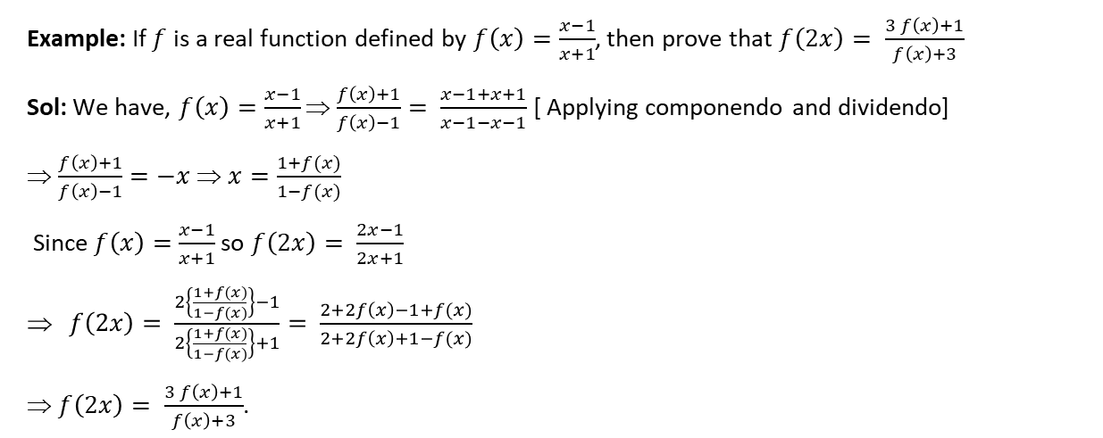
Example: If $f$ is a real function defined by $f\left(x\right)=\frac{x−1}{x+1}$, then prove that $f\left(2x\right)= \frac{3 f\left(x\right)+1}{f\left(x\right)+3}$
Sol: We have, $f\left(x\right)=\frac{x−1}{x+1}$ ⇒ $\frac{f\left(x\right)+1}{f\left(x\right)−1}= \frac{x−1+x+1}{x−1−x−1}$ [ Applying componendo and dividendo]
⇒ $\frac{f\left(x\right)+1}{f\left(x\right)−1}=−x$ ⇒ $x=\frac{1+f(x)}{1−f(x)}$
Since $f\left(x\right)=$ $\frac{x−1}{x+1}$ so $f\left(2x\right)= \frac{2x−1}{2x+1}$
$f\left(2x\right)= \frac{2\left\{\frac{1+f(x)}{1−f(x)}\right\}−1}{2\left\{\frac{1+f(x)}{1−f(x)}\right\}+1}= \frac{2+2f\left(x\right)−1+f(x)}{2+2f\left(x\right)+1−f(x)}$
⇒ $f\left(2x\right)= \frac{3 f\left(x\right)+1}{f\left(x\right)+3}$.

Slide 62

Example: If for non –zero$, a f\left(x\right)+b f\left(\frac{1}{x}\right)=\frac{1}{x}−5$, where $a≠b$, then find $f(x)$.
Sol: We have $a f\left(x\right)+b f\left(\frac{1}{x}\right)=\frac{1}{x}−5$ ….. $(i)$
Replacing $x$ by $\frac{1}{x}$ we get $a f\left(\frac{1}{x}\right)+b f\left(x\right)=x−5$ ….. $(ii)$
Multiplying $(i)$ by $a$ and $(ii)$ by $b$ and then subtracting, we get
$$a^{2} f\left(x\right)+ab f\left(\frac{1}{x}\right)−ab f\left(\frac{1}{x}\right)−b^{2} f\left(x\right)=a\left(\frac{1}{x}−5\right)−b(x−5)$$
$\left(a^{2}−b^{2}\right)f\left(x\right)=\frac{a}{x} −5a −bx+5b$
$f\left(x\right)= \frac{\frac{a}{x} −5a −bx+5b }{\left(a^{2}−b^{2}\right)}=\frac{1}{\left(a^{2}−b^{2}\right)}\left(\frac{a}{x}−bx\right)−\frac{5}{a+b}$

Slide 63

Domain and Range of Real Functions
The domain of the real function $f(x)$ is the set of all those real numbers for which the expression for $f(x)$ assumes real values only. In other words, the domain of $f(x)$ is the set of all those real numbers for which $f(x)$ is meaningful.
The range of a real function $y=f(x)$ is the set of all real values taken by $f(x)$ at points in its domain. To find the range of $f(x)$, we may use the following algorithm.
Step-I: Put $y=f(x)$
Step –II: Solve the equation $y=f(x)$ for $x.$ Let $x=g(y)$
Step-III: Find the values of $y$ for which $x$ is real. The set of values of $y$ is the range of $f$.

Slide 64

Example: Find the domain of the following functions:
$$\left(i\right) f\left(x\right)=\frac{1}{x+2}$$
Sol: Here $f(x)$ assumes real values for all real values of $x$ except for the values of $x$ satisfying $x+2=0 i.e. x=−2$.
Hence $dom−f=R−\{−2\}$
$$\left(ii\right)f\left(x\right)= x^{2}+2x+7$$
Sol: Here $f(x)$ is real or can be defined for all real values of $x$.
So $dom−f=R$.

Slide 65

$$\left(iii\right) f\left(x\right)= \frac{x^{2}+3x+5}{x^{2}−3x+2}$$
Sol: Here $f(x)$ is a rational function of $x$. We get $f(x)$ assumes real values for all $x$ except for all those values of $x$ for which $x^{2}−3x+2=0 i.e. \left(x−1\right)\left(x−2\right)=0 i.e. x=1, 2$.
Hence $dom−f=R−\{1, 2\}$.
$$\left(iv\right)f\left(x\right)= \sqrt{x−2}$$
Sol: Here $f(x)$ assumes real values for all $x$ satisfying $x−2≥0$ ⇒ $x≥2$
⇒ $x∈[2, ∞)$
Hence, $dom−f=[2, ∞)$

Slide 66

$$\left(v\right) f\left(x\right)= \sqrt{4−x^{2}}$$
Sol: Here $f(x)$ assumes real values for all $x$ satisfying $4−x^{2}≥0$ ⇒ $x^{2}≤4$
⇒ $\left(x−2\right)\left(x+2\right)≤0$ ⇒ $x∈[−2, 2]$
Hence, $dom−f=[−2, 2]$
$$\left(vi\right) f\left(x\right)= \frac{1}{\sqrt{x^{2}−9}}$$
Sol: Here $f(x)$ assumes real values for all $x$ satisfying $x^{2}−9>0$ ⇒ $x^{2}>9$
⇒ $x<−3$ or $x>3$ ⇒ $x∈(−∞,−3)$ or $x∈(3, ∞)$ ⇒ $x∈(−∞,−3)∪(3, ∞)$
Hence $dom−f=(−∞,−3)∪(3, ∞)$

Slide 67

Example: Find the domain and range of the following functions:
$$\left(i\right) f\left(x\right)=\frac{x−2}{3−x}$$
Sol: Here $f(x)$ is defined for all $x$ satisfying $3−x≠0 i.e. x≠3$.
Hence $dom−f=R−\{3\}$
Let $y=f(x)$ ⇒ $y=\frac{x−2}{3−x}$ ⇒ $3y−xy=x−2$ ⇒ $x\left(y+1\right)=3y+2$
⇒ $x=\frac{3y+2}{y+1}$
Here $x$ assumes real values for all $y$ except $y+1=0 i.e. y=−1$.
Hence, $rng−f=R−\{−1\}$.

Slide 68

$$\left(ii\right)f\left(x\right)= \frac{x}{1+x^{2}}$$
Sol: Here $f(x)$ takes real values for all $x∈R$. Hence, $dom−f=R$.
Let $y=f(x)$. Then
$y=f(x)$ ⇒ $y= \frac{x}{1+x^{2}}$ ⇒ $x^{2}y−x+y=0$ ⇒ $x= \frac{1±\sqrt{1−4y^{2}}}{2y}$
So, $x$ will assume real values, if $1−4y^{2}≥0$ and $y≠0$
⇒ $4y^{2}−1≤0$ and $y≠0$
⇒ $y^{2}−\frac{1}{4} ≤0$ and $y≠0$

Slide 69

⇒ $−\frac{1}{2} ≤y≤\frac{1}{2}$ and $y≠0$
⇒ $y∈\left[−\frac{1}{2},\frac{1}{2}\right]−\{ 0 \}$
Also, $y=0$ for $x=0$
Hence $rng−f=\left[−\frac{1}{2},\frac{1}{2}\right]$

Slide 70

$$\left(iii\right) f\left(x\right)= \frac{x^{2}−9}{x−3}$$
Sol: We have $f\left(x\right)= \frac{x^{2}−9}{x−3}$
Here $f(x)$ is not defined for $x−3=0 i.e. x=3$.
Therefore, $dom−f=R−\{3\}$
Let $f\left(x\right)=y$
Then $y=\frac{x^{2}−9}{x−3}$ ⇒ $y=x+3$
We get $y$ takes all real values except 6 when $x$ takes values in the set $R−\{3\}$.
Therefore $rng−f=R−\{6\}$

Slide 71

$$\left(iv\right) f\left(x\right)= \frac{3}{2−x^{2}}$$
Sol: For $f(x)$ to be real, we have $2−x^{2}≠0$ ⇒ $x≠±\sqrt{2}$
So, $dom−f=R−\{−\sqrt{2}, \sqrt{2} \}$
Let $f\left(x\right)=y$. Then $y=f(x)$ ⇒ $y= \frac{3}{2−x^{2}}$ ⇒ $2y−x^{2}y=3$
⇒ $x^{2}y=2y−3$ ⇒ $x= ±\sqrt{\frac{2y−3}{y}}$
We get $x$ will take real values other than $−\sqrt{2}$ and $\sqrt{2}$, if $\frac{2y−3}{y}>0$ ⇒ $y∈\left(−∞, 0\right)∪\left[\frac{3}{2} , ∞\right)$
Hence $rng−f=\left(−∞, 0\right)∪\left[\frac{3}{2} ,∞\right)$

Slide 72

$$\left(vii\right)f\left(x\right)= \frac{x^{2}}{1+x^{2}}$$
Sol: We have, $f\left(x\right)= \frac{x^{2}}{1+x^{2}}$
Clearly, $f(x)$ is defined for all $x∈R$ as $x^{2}+1≠0$ for any $x∈R$.
So, $dom−f=R$.
Let $f\left(x\right)=y.$ Then $y=\frac{x^{2}}{1+x^{2}}$ ⇒ $y+x^{2}y=x^{2}$
⇒ $x^{2}\left(1−y\right)=y$ ⇒ $x^{2}=\frac{y}{1−y}$ ⇒ $x=±\sqrt{\frac{y}{1−y}}$
Here $x$ will take real values, if $\frac{y}{1−y}≥0$ ⇒ $0≤y<1$ ⇒$y ∈[0, 1)$
Hence, $rng−f=[0, 1)$

Slide 73
THANKING YOU
ODM EDUCATIONAL GROUP

Slide 74
FUNCTIONS
Different Real Functions and their Domain ,Range with Graphs
SUBJECT : MATHEMATICS
CHAPTER NUMBER: 02 (Period – 06)
CHAPTER NAME : RELATIONS AND FUNCTIONS

Slide 75

Some Real Functions and their Graphs:
1. Identity Function:
The function $f:R→R$ defined by $f\left(x\right)=x$ for all $x∈R$ is called the identity function.
Here $dom−f=rng−f=R$.
The graph of the identity function is a
straight line passing through the
origin and equally inclined to the
coordinate axes.

Slide 76

2. Constant Function:
If $k$ is a fixed real number, then a function $f\left(x\right)=k$ for all $x∈R$ is called a constant function.
Here $dom−f=R$ and $rng−f=\{ k \}$
The graph of a constant function is a straight line
parallel to $x−axis$, which is above or below
$x−axis$ according as $k$ is positive or negative.
If $k=0$,then the straight line is coincident
to $x−axis$.

Slide 77
3. Polynomial Function:
A function $f:R→R$ defined by $f\left(x\right)= a_{0}+a_{1}x+a_{2}x^{2}+ …+ a_{n}x^{n},$ where $n∈N$ and $a_{0}, a_{1}, …, a_{n}$ are real constants and $a_{0}≠0$ is called a polynomial function in $x$ of degree $n$.
If $n=1, f\left(x\right)= a_{o}+a_{1}x , a_{0}≠0$ is called linear function.
If $n=2, f\left(x\right)= a_{0}+a_{1}x+a_{2}x^{2}, a_{2}≠0$ is called a quadratic function.
The functions defined by $f\left(x\right)=2x^{4}−x^{2}+5$, $g\left(x\right)= x^{5}+\sqrt{3}x^{2}−3$ are examples of polynomial functions, whereas the function defined by $h\left(x\right)= x^{\frac{5}{2}}+3x−2$ is not a polynomial function.

Slide 78


Consider $f\left(x\right)=4x−2$ $f\left(x\right)=x^{2}+2y−3x+5$

Slide 79
4. Rational Functions:
A function which can be expressed as the quotient of two polynomial functions, is called rational function $i.e., r\left(x\right)= \frac{f(x)}{g(x)}$, where $f(x)$ and $g(x)$ are polynomial functions of $x$ defined in a domain and $g(x)≠0,$ is a rational function.
For example, $f\left(x\right)= \frac{1}{x}\left(x≠0\right), \frac{x^{3}+2x+3}{x^{2}+x+1}, \frac{2x+1}{x^{2}+4}$ are rational functions.

Slide 80

Graph of $f\left(x\right)=\frac{1}{x}$ is shown in the figure.

Slide 81

5. Modulus Function:
The function $f\left(x\right)$ defined by $f\left(x\right)=\left|x\right|= \left\{\begin{aligned}x, when x≥0 \\ −x, when x<0\end{aligned}\right.$ is called the modulus function or absolute value function.
Here $dom−f=R$ and
$rng−f= R^{+}=\{x∈R :x≥0\}$.
The graph consists of two half – lines, one
in the first quadrant bisecting the axes
and the other in the second quadrant,
bisecting the axes where the origin is
included in the graph.

Slide 82
Properties of Modulus Function:
$\left(i\right)$For any $x∈R$ , $\sqrt{x^{2}}=\left|x\right|$.
$\left(ii\right)$If $a$ is a positive real number then
$x^{2}≤a^{2}$ ⇔ $\left|x\right|≤a$ ⇔ $−a≤x≤a$ and $x^{2}≥a^{2}$ ⇔ $\left|x\right|≥a$ ⇔ $x≤−a$ or $x≥a$.
$(iii)$ $\left|x±y\right|≤ \left|x\right|+\left|y\right|$
$$\left(iv\right) \left|x±y\right|≥ \left|\left|x\right|−\left|y\right|\right|$$
$\left(v\right) {\left|x\right|}^{2}= x^{2}$.

Slide 83

6. Signum Function:
The function $f:R→R$ defined by $f\left(x\right)=\left\{\begin{aligned}\frac{\left|x\right|}{x}, x≠0 \\ 0, x=0\end{aligned}= \left\{\begin{aligned}1, if x>0 \\ 0, if x=0 \\ −1, if x<0\end{aligned}\right.\right.$ is called the signum function.
It is also denoted by $sgn (x)$.
Here $dom−f=R$ and $rng −f=\{ −1, 0, 1\}$.
The graph of the signum function is as shown below.

Slide 84
7. Greatest Integer Function:
A function $f:R→R$ be defined by $f\left(x\right)=\left[x\right]$ is called a greatest integer function,
where $\left[x\right]=n , n≤x<n+1, n∈Z$.
Here $dom−f=R$ and $rng−f=Z$

Slide 85

The graph of the greatest integer
function is shown in the figure.

Slide 86
Properties:
$\left(i\right) x$and $\left[x\right]$ have same sign for all $x$.
$(ii)$ The graph lies within the first and third quadrant.
$$\left(iii\right) \left[x\right]≤x<\left[x\right]+1 , x∈R$$
$\left(iv\right) n≤x<n+1$ ⇔ $\left[x\right]=n, n∈Z$and $x∈R$.
$\left(v\right)$ $x−1<\left[x\right]≤x , x∈R$.
$$\left(vi\right)\left[−n\right]=−\left[n\right], n∈Z$$
$$\left(vii\right) \left[−x\right]=−\left[x\right]−1, x∈R$$
$$\left(viii\right)\left[x+n\right]=\left[x\right]+n, n∈Z, x∈R$$
$$\left(ix\right) \left[\left[x\right]\right]= \left[x\right]$$
$$\left(x\right) \left[x\right]+\left[−x\right]= \left\{\begin{aligned}0,x∈Z \\ −1,x∉Z\end{aligned}\right.$$

Slide 87
Example: If $f$ be a real valued function defined by $f\left(x\right)=x−\left[x\right]$, then compute
$$\left(i\right) f\left(2.5\right)=2.5− \left[2.5\right]=2.5−2=0.5$$
$$\left(ii\right)f\left(−3.7\right)=−3.7 − \left[−3.7\right]=−3.7 −\left(−4\right)=−3.7+4=0.3$$
Example: State true or false. If ${\left[x\right]}^{2}−5\left[x\right]+6=0$, then $x$ lies in the interval $[2, 3]$.
Sol: True
Example: Draw the graph of the following functions. Also, determine their domain and range.
$$\left(i\right) f\left(x\right)=2 \left(ii\right)f\left(x\right)=−2 \left(iii\right)f\left(x\right)=\left|x−3\right|$$
Example: Let $f:R→R$ defined by $f\left(x\right)=1−x^{2}$ for all $x∈R^{+}$. Find its domain and range. Also, draw its graph.
Example: Draw the graph of $f\left(x\right)=\frac{x^{3}}{2}$. Also, find its domain and range.

Slide 88
THANKING YOU
ODM EDUCATIONAL GROUP

Slide 89
FUNCTIONS
Sum, Difference, Product and Quotient of Functions
SUBJECT : MATHEMATICS
CHAPTER NUMBER: 02
CHAPTER NAME : RELATIONS AND FUNCTIONS

Slide 90

Algebra of Real Functions
Let $f:A→R$and $g:B→R$ be two real functions. Let $D=A∩B$. Then, we define addition, subtraction, multiplication, and quotient of two real functions as follows:
$\left(i\right)$ Addition: $\left(f+g\right):D→R$ be defined by $\left(f+g\right)\left(x\right)=f\left(x\right)+g(x)$ for all $x∈D$.
$\left(ii\right)$Subtraction: $\left(f−g\right):D→R$ be defined by $\left(f−g\right)\left(x\right)=f\left(x\right)−g(x)$ for all $x∈D$.
$(iii)$ Scalar Multiplication : $\left(αf\right):A→R$ be defined by $\left(αf\right)\left(x\right)= α f(x)$ for all $x∈A$.
$(iv)$ Multiplication: $\left(f.g\right):D→R$ be defined by $\left(f.g\right)\left(x\right)=f\left(x\right).g(x)$ for all $x∈D$.
$(v)$Reciprocal : $\left(\frac{1}{f}\right):C→R$ be defined by $\left(\frac{1}{f}\right)\left(x\right)= \frac{1}{f\left(x\right)}$ for all $x∈C=A−\{x:f\left(x\right)=0\}$
$\left(vi\right)$ Quotient: $\left(\frac{f}{g}\right):D_{1}→R$ be defined by $\left(\frac{f}{g}\right)\left(x\right)= \frac{f(x)}{g(x)}$ for all $x∈D_{1}=D−\{x:g\left(x\right)=0\}$

Slide 91

Example: Let $f, g:R→R$ be defined by $f\left(x\right)=2x+5, g\left(x\right)=x+3$, find $f±g, 2f, \frac{f}{g}, \frac{1}{f},\frac{1}{g}$.
Sol: $\left(f+g\right)\left(x\right)=f\left(x\right)+g\left(x\right)=2x+5+x+3=3x+8$
$$\left(f−g\right)\left(x\right)=f\left(x\right)−g\left(x\right)=2x+5−x−3=x+2$$
$$\left(2f\right)\left(x\right)=2 f\left(x\right)=2\left(2x+5\right)=4x+10$$
$$\left(\frac{f}{g}\right)\left(x\right)=\frac{f\left(x\right)}{g\left(x\right)}=\frac{2x+5}{x+3}, x≠−3 i.e., x∈R−\{−3\}$$
$$\left(\frac{1}{f}\right)\left(x\right)=\frac{1}{f\left(x\right)}=\frac{1}{2x+5} ∀ x∈R−\left\{−\frac{5}{2}\right\}$$
$$\left(\frac{1}{g}\right)\left(x\right)=\frac{1}{g\left(x\right)}=\frac{1}{x+3} ∀x∈R−\{−3\}$$

Slide 92

Example: Let $f$ and $g$ be real functions defined by $f\left(x\right)= \sqrt{x+2}$ and $g\left(x\right)= \sqrt{4−x^{2}}$. Then, find each of the following functions:
$\left(i\right)f+g$ $\left(ii\right) fg$ $(iii)$ $\frac{f}{g}$ $\left(iv\right) ff$
Sol: Here $f(x)$ is defined for all $x$ satisfying $x+2≥0$ ⇒ $x≥−2$ ⇒ $x∈[−2, ∞)$
So, $dom−f=\left[−2, ∞\right)=A$(say)
Again, $g(x)$ is defined for all $x$ satisfying $4−x^{2}≥0$ ⇒ $x^{2}≤4$ ⇒ $x∈[−2, 2]$
So, $dom−g=\left[−2, 2\right]=B$ (say)
Now $D=A∩B=[−2, 2]$

Slide 93

$(i)$ $\left(f+g\right)\left(x\right)=f\left(x\right)+g\left(x\right)= \sqrt{x+2}+\sqrt{4−x^{2}} , x∈D$
$\left(ii\right) \left(fg\right)\left(x\right)=f\left(x\right).g\left(x\right)= \sqrt{x+2}×\sqrt{4−x^{2}}=\left(x+2\right)\sqrt{2−x}, x∈D$
$$\left(iii\right) \left(\frac{f}{g}\right)\left(x\right)=\frac{f\left(x\right)}{g\left(x\right)}= \frac{\sqrt{x+2}}{\sqrt{4−x^{2}}}= \frac{1}{\sqrt{2−x}} , x∈D−\left\{−2, 2\right\}=(−2, 2)$$
$$\left(iv\right) \left(ff\right)\left(x\right)=f\left(x\right)f\left(x\right)= {\{f\left(x\right)\}}^{2}= {\left(\sqrt{x+2}\right)}^{2}=x+2 , x∈[−2, ∞)$$

Slide 94

Example: Let $f\left(x\right)=\sqrt{x}$ and $g\left(x\right)=x$ be two functions defined over the set of non – negative real numbers. Find $\left(f+g\right)\left(x\right), \left(f−g\right)\left(x\right), \left(fg\right)\left(x\right)$, and $\left(\frac{f}{g}\right)(x)$.
Sol: We have $\left(f+g\right)\left(x\right)=f\left(x\right)+g\left(x\right)=\sqrt{x}+x$
$$\left(f−g\right)\left(x\right)=f\left(x\right)−g\left(x\right)=\sqrt{x}+x$$
$$\left(fg\right)\left(x\right)=f\left(x\right). g\left(x\right)= \sqrt{x} .x= x^{\frac{3}{2}}$$
$\left(\frac{f}{g}\right)\left(x\right)= \frac{f(x)}{g(x)}= \frac{\sqrt{x}}{x}= x^{−\frac{1}{2}}, x≠0$.

Slide 95
THANKING YOU
ODM EDUCATIONAL GROUP

Slide 96
FUNCTIONS
Concept of Exponential and Logarithmic Functions
SUBJECT : MATHEMATICS
CHAPTER NUMBER: 02
CHAPTER NAME : RELATIONS AND FUNCTIONS

Slide 97

Exponential Function:
A function $f:R→R$ defined by $f\left(x\right)= a^{x} (a>0, a≠1)$ is called the exponential function.
Here $dom−f=R$ and $rng−f= R_{+}=(0, ∞)$.
$2^{x} , 3^{x}, \frac{1}{2^{x}}$ , … etc. are examples of exponential functions.
As $a>0$ and $a≠1$, so have the following cases.

Slide 98


Case – I : When $a>1$.
We get the values of $y=f\left(x\right)=a^{x}$
increase as the values of $x$ increase.

Slide 99


Case II : When $0<a<1$.
In this case, the values of $y=f\left(x\right)= a^{x}$
decrease with the increase in $x$ and
$y>0$ for all $x∈R$.

Slide 100

Note: We have $2<e<3$. $(e=2.718281 ….,$is an irrational number$)$
Therefore, the graph of $f\left(x\right)= e^{x}$ is identical to that of $f\left(x\right)= a^{x}$ for $a>1$ and the graph of $f\left(x\right)= e^{−x}$ is identical to that of $f\left(x\right)=a^{x}$ for $0<a<1$.
Properties: Let $f\left(x\right)= a^{x}, (a>0, a≠1)$
$$\left(i\right) f\left(x+y\right)= a^{x+y}= a^{x}.a^{y}=f\left(x\right). f\left(y\right)$$
$$\left(ii\right)f\left(x−y\right)= a^{x−y}= \frac{a^{x}}{a^{y}}= \frac{f(x)}{f(y)}$$
$$\left(iii\right){\{f\left(x\right)\}}^{y}= {\left(a^{x}\right)}^{y}= a^{xy}=f(xy)$$
$\left(iv\right) f\left(x\right)=1$ ⇔ $x=0$
$$\left(v\right)f\left(x\right)f\left(−x\right)=f\left(0\right)=1$$

Slide 101

Logarithmic Function:
A function $f:\left(0,∞\right)→R$ defined by $f\left(x\right)= \log_{a}{x} (a>0, a≠1)$ is called logarithmic function.
We have $\log_{a}{x}=y$ if and only if $a^{y}=x$.
Here $dom−f= R_{+}$ and $rng−f=R$.
As $a>0$ and $a≠1$, so we have the following cases.

Slide 102


Case I : When $a>1$

Slide 103


Case II : When $0<a<1$

Slide 104

Properties:
$\left(i\right)\log_{a}{1}=0,$ where $a>0, a≠1$
$\left(ii\right) \log_{a}{a}=1$, where $a>0, a≠1$
$\left(iii\right) \log_{a}\left(xy\right)= \log_{a}\left|x\right|+ \log_{a}\left|y\right|,\text{where} a>0, a≠1$ and $xy>0$
$\left(iv\right)\log_{a}\left(\frac{x}{y}\right)= \log_{a}\left|x\right|− \log_{a}\left|y\right|,\text{where} a>0, a≠1$ and $\frac{x}{y}>0$
$\left(v\right)\log_{a}\left(x^{n}\right)=n \log_{a}\left|x\right|$, $\text{where} a>0, a≠1$ and $x^{n}>0$
$\left(vi\right)$ $\log_{a_{}^{n}}{x^{m}=\frac{m}{n} \log_{a}{x}},$ $\text{where} a>0, a≠1$ and $x>0$
$\left(vii\right)x^{\log_{a}{y}}= y^{\log_{a}{x}}$, $\text{where} a>0, a≠1 , x>0, y>0$
$\left(viii\right) \log_{a}{x}= \frac{1}{\log_{x}{a}}$, $\text{where} a>0, a≠1$and $x>0, x≠1$.

Slide 105

Notes:
$\left(i\right)$Functions $f\left(x\right)= \log_{a}{x}$ and $g\left(x\right)= a^{x}$ are inverse of each other. So, their graphs are mirror images of each other in the line mirror $y=x$.
$(ii)$ If $a=e$, then $\log_{e}{x}$ (written as $lnx)$ is the inverse of an exponential function to the base $e.$
$i.e., lnx=y$ ⇔ $x=e^{y}$.
Example: If $f\left(x\right)= 2^{x}$, then what is the range of $f$?
Sol: Here $rng−f= R_{+}$
Example: Fill in the blank. If $f\left(x\right)= \log_{2}{x}$, then $f\left(x\right)<0$ for $x$ lies in the interval _____ .
Sol: $(0, 1)$.

Slide 106
THANKING YOU
ODM EDUCATIONAL GROUP

