Slide 1


INTRODUCTION and CONCLUSION
Adventure, Ambition, and conquest
SUBJECT : (ENGLISH)
CHAPTER NUMBER: 2
CHAPTER NAME :We are not Afraid to Die... by Gordon Cook and Alan East

Slide 2
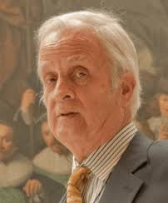
FACTS ABOUT THE WRITER – GORDON COOK
Gordon Cook (born December 3, 1978, in Toronto)
He is a two-time Canadian Olympic sailor.
He sails for the Royal Canadian Yacht Club.
He is the son of Stephen Cook and Linda Cook.
He had a great interest in writing stories too.

Slide 3
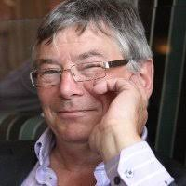
FACTS ABOUT THE WRITER – ALAN EAST
Alan East was admitted to the Roll of Solicitors in 2003.
He has gained extensive experience as a litigator, manager and legal trainer.
In 2010 Alan joined Coventry University as a Senior Lecturer in Law.

Slide 4
THEME OF THE LESSON
Endurance
Perseverance
The importance of keeping near and dear one
The fact that courage, bravery, and togetherness can be a remedy for any illness of the world.

Slide 5
BACKGROUND INFORMATION OF THE LESSON
Had dreamt of sailing
To duplicate the round-the-world voyage (a long journey by sea or space) made 200 years earlier by Captain James Cook.
It describes their thrilling journey across the sea and their close encounter with death during their voyage.
The plot talks about their possible attempts to save their lives.

Slide 6
SUB-CONCEPTS
Hard work, determination and power of perseverance can overcome all the problems
Feasibility of triumph over the fear of death
Realizing the importance of individual in the journey
Optimism as an antidote to negativity
“Where there is a will, there is a way.”

Slide 7
CHARACTERS INVOLVED
The narrator: He is a 37-year-old businessman. He wants to duplicate the round-the-world journey made by Captain James Cook 200 years earlier. He spends a long time improving his sea skills and finally begins his journey with his wife Mary, six-year-old son Jonathan and seven-year-old daughter Suzanne.
Mary: She is the narrator’s wife. She supports her husband’s dream and improves her sea skills. She joins her husband on their planned three-year voyage.
Larry Vigil: An American who joins the narrator and Mary at Cape Town to help them tackle one of the world’s roughest seas.

Slide 8
CHARACTERS INVOLVED
Herb Seigler: A Swiss who also joins them at Cape Town to help them cross the southern Indian Ocean.
Suzanne: The narrator’s seven-year-old daughter who displays immense courage throughout their voyage.
Jonathan: He is the narrator’s six-year-old son who shows immense strength and optimism even in difficult times.

Slide 9
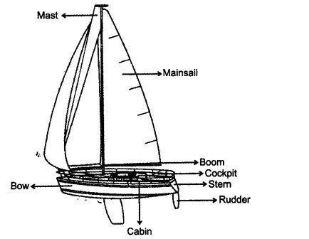
YACHT- A slick and light ship for making pleasure trip or racing on water

Slide 10
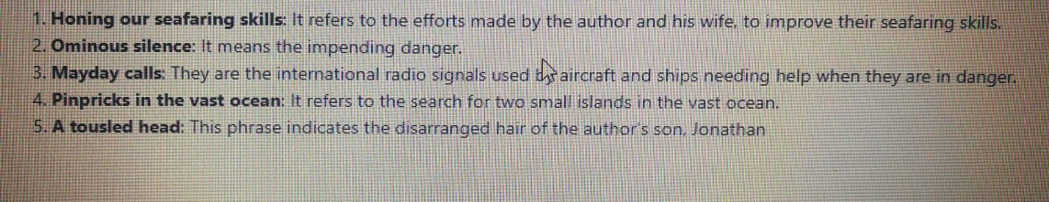
NOTICE THESE EXPRESSIONS IN THE TEXT:
page- 13

Slide 11
  INTRODUCTION
Written by Gordon Cook and Alan East, the story is about a 37-year-old businessman who is the narrator of the story. He has a wife named Mary and two children, Jonathan, aged 6 and Suzanne, aged 7. He and his wife both dream of a voyage around the world on their ship ‘Wave walker’ which is a 23 meter long, 30 ton wooden-hulled, just like that of the famous Captain James Cook.
The whole family started sailing from Plymouth, England in July 1976. The initial phase of the three-year-long journey was from Africa to Cape Town. It was pleasant. While heading east, along with two newly hired crewmen, strong waves hit them and their survival became a question. The story tells us about how they fought each day and survived untill the end.

Slide 12
LESSON-CONTENTS
And the Lesson B E G I N S…
“IN July 1976, my wife Mary, son Jonathan, 6, daughter Suzanne, 7, and I set sail from Plymouth, England, to duplicate the round the- world voyage made 200 years earlier by Captain James Cook. For the longest time, Mary and I — a 37-year-old businessman — had dreamt of sailing in the wake of the famous explorer, and for the past 16 years we had spent all our leisure time honing our seafaring skills in British waters.” [page -13]
…Speaking about –
- Narrator’s intention to duplicate the round-the-world voyage
- The narrator spends his time in learning seafaring

Slide 13
THE VOYAGE BEGINS
The narrator with his wife Mary and two children Jonathan and Suzanne set sail from Plymouth, England, to duplicate the round-the-world voyage made by Captain James Cook 200 years ago.
Wavewalker, a professionally built boat, had been tested for months in the roughest weather.
The initial period of the three-year planned journey priced to be quite pleasant.
American Larry Vigil and Swiss Herb Seigler joined them at Cape Town to help them tackle one of the world’s roughest seas, the southern Indian Ocean.

Slide 14
THE PROBLEMS BEGIN DURING THE VOYAGE
December 25, 1976
Voyagers reaches 3,500 km east of Cape town
The weather was still atrocious.
Celebrated Christmas
New year’s Day saw no improvement in the weather.
January 2, 1977
Gigantic waves in the morning
Sailing with only a small storm jib and were still making eight knots
The ship rises to the top of each wave
Endless, enormous seas rolling towards the ship
The screaming of the wind and spray painful to ears
Prepared to face the sea’s fury
The storm jib dropped
A heavy mooring rope in a loop across the stern lashed
Double lashed everything
Went through life –raft drill
Attached lifelines
Donned oilskins and life jackets

Slide 15
DISASTER STRIKES
January 2, 1977, 6 pm
Waves higher than the ship, chase the ship
The wave hits the back of the ship
The wave breaks the starboard
The narrator’s head smashed against the steering wheel of the boat and before he knew it, he was thrown into the sea.
He was going to die but suddenly his head popped out of water.
The ship was about to sink.
A wave hurled it upright and the narrator was tossed onto the boat.
His left ribs were cracked, his mouth was filled with blood and some teeth were broken
Somehow he managed to find the wheel, lined up the stern for the next wave and hung on.

Slide 16
FRANTIC SURVIVAL ATTEMPTS
The narrator knew that the boat was flooding with water, but he dared not abandon the wheel to investigate. Suddenly, Mary came and informed him that the boat was sinking as the water was pouring in. He handed the wheel to her and crawled towards the hatch. Larry and Herb pumped the water out like madmen. The wooden beams had broken. The whole starboard side had bulged inwards. Clothes, crockery, charts, tins and toys moved around noisily in water.
The boat had been damaged. He somehow managed to reach the children. Sue had a big bump on her head to which he did not pay much attention. He found a hammer, screws and canvas.
Somehow he managed to stretch the canvas and secure waterproof hatch covers across the gaping holes. Some water continued to come in but most of it could be prevented from entering the boat. But this was not the end of their troubles.

Slide 17
DAMAGED AND LOST EQUIPMENT
The hand pumps started jamming with the trash floating around the cabins. Soon their electric pump got short-circuited and the water rose threateningly.
He found that their two spare hand pumps had been pulled away by currents along with the forestay sail, the jib, the lifeboats and the main anchor.
He managed to find another electric pump to drain out the water. The night was an endless, bitterly cold routine of pumping, steering and working the radio. However, there was no response to their Mayday calls as they were in a remote corner of the world. Sue’s head had swollen alarmingly. She had two black eyes and a deep cut on her arm. She didn’t tell the narrator more of her injuries as she didn’t want to worry him when he was trying to save them all.

Slide 18
PINPRICKS IN THE VAST OCEAN
On the morning of January 3, the pumps had reduced the amount of water on board. Each of them took rest for two hours by turns. They had survived for 15 hours since the wave hit the Wavewalker, but the boat was not strong enough to take them to Australia.
The narrator knew that the boat wouldn’t hold together long enough. He checked his charts and calculated that the only one hopes for them as if they could reach lie Amsterdam, a French scientific base, one of the two pinpricks in the vast ocean. Mary found some corned beef and cracker biscuits and they ate their first meal in almost two days.
However, their relief was short-lived. The weather again started deteriorating and by the dawn on 5th January, their situation was again desperate.

Slide 19
“WE AREN’T AFRAID TO DIE… IF WE CAN ALL BE TOGETHER”
The narrator went to comfort the children. He tried to assure them that they were going to make it. Jon said that they were not afraid of dying if they can all be together. This gave the narrator hope and a reason to fight the sea. He tried his best to protect the weakened starboard side of the boat. However, later in the evening, as more water came into the boat, they felt defeated again. On 6th January, the weather improved. The narrator again tried to calculate their position. While he was at work, Sue came to him and gave him a card. She had drawn caricatures of Mary and the narrator.
The card said that she loved them both and hoped for the best. The narrator was filled with optimism. Somehow they had to make it.

Slide 20
THE MOST BEAUTIFUL ISLAND IN THE WORLD!
The narrator made several calculations using a spare compass, made some adjustments and asked Larry to steer a course of 185 degrees. He said that, if they were lucky, they would see the island at about 5 pm. Dejected, he went down to his bunk and fell asleep.
It was about 6 pm when he woke up. He thought that they must have missed the island. Just then, Jon and Sue came to him and hugged him because he was the “best daddy in the world”. The narrator was confused. Sue announced that the island was just in front of them. He rushed out to the deck and saw the most beautiful island in the world! It was lie Amsterdam, a piece of volcanic rock with little vegetation.
When his feet touched land the next day, he thought of the cheerfulness and optimism of all the people on the boat which made them pass through the worst stress.

Slide 21
MESSAGE
The tile of the story "We are not afraid to die...if we can all be together." is about the positive attitude and endurance shown by the courageous family of the author in the face of the storm that had endangered their survival.

Slide 22
MORAL OF THE STORY
The most important lesson that we learn from such hazardous experiences when we are face-to-face with death, is not to lose hope under any circumstances. At times, life presents very dire situations but if one is optimistic about finding a solution and overcomes the odds, one will always be successful

Slide 23
BROWSING THROUGH VOCABULARY
( OF HITHERTO PORTION OF THE LESSON)
Wavewalker – the name of their boat
wooden-hulled
beauty – beautiful boat made of wood
fitting it out – furnishing it
leg – part
crewmen – men to work on the ship
Swiss – from Switzerland
tackle – handle
out of – after starting from
atrocious – very unpleasant
storm jib – small sail used at the time of a storm
making – going at the speed of
knots – nautical miles per hour
lashed – fastened
mooring – used for tying the boat to a fixed object
stern – the back part
life-raft drill – practising how to climb into a lifeboat if the main boat sinks
lifelines – ropes fixed around the bodies of persons to
keel – long wood/steel piece fixed vertically at the bottom of the boat to keep it vertical
rigging – ropes that balance the mast of the boat
sextant – instrument measuring angles and distances used for calculating the position of a boat
compass – an instrument used for checking the direction
tousled head-head with hair not arranged
offshore – near the shore

Slide 24
MAY I CHECK UP YOUR COMPREHENSION?
What did the narrator plan to do? What preparations did he make for it?
Give a brief description of the narrator’s boat. How had the narrator equipped and tested it?
How long did the narrator plan his voyage to last?
When and with whom did the narrator begin his voyage?
Whom did the narrator employ and why? When did he do so?
What happened on their second day out of Cape Town? What worried the narrator and why?
How did they celebrate the Christmas holidays?
How did the weather change on January 2? How did they feel?
What efforts were made to face the rough weather?
What sort of wave hit the ship? How did the narrator react?

Slide 25
AN ADVICE
Please read the lesson thoroughly at home.
Doubts, if any, should be asked for clearance in the next period.
Attempt answering the questions.
NOW RELAX!
SEE YOU NEXT TIME !!
BYE !!!

Slide 26
THANKING YOU
ODM EDUCATIONAL GROUP

