Slide 1


The Address
Marga Minco
SUBJECT : (ENGLISH)
CHAPTER NUMBER:2(Snapshot)

Slide 2
The Author
Marga Minco is the pen name of Sara Menco.
She was born in Ginneken to an Orthodox Jewish family
In the early part of World War II Minco lived in Breda, Amersfoort, and Amsterdam. She contracted a mild form of tuberculosis and ended up being treated in hospitals in Utrecht and Amersfoort. In the autumn of 1942 she returned to Amsterdam and her parents, who were forced by the German occupiers to move into the city's Jewish Quarter.
Later in the war, Minco's parents, her brother, and her sister were all deported, but having escaped arrest herself she spent the rest of the war in hiding and was the family's only survivor. She also received a new name, Marga Faes, the first part of which she continued to use.
Minco married the poet and translator Bert Voeten (who died in 1992) whom she had met in 1938 and with whom she hid during the war. After the war, they worked on a number of newspapers and magazines. They have two daughters, one of whom is the writer Jessica Voeten. She turned 100 in March 2020.
In 1942, her parents were forced to move into the city's Jewish Quarter. The parents, her brother and sister were all deported and Marga/Sara managed to survive the war in hiding. Thus, her stories often revolve around the existential problems often faced by survivors.
In 1957 Minco published her first book, "The bitter herb". The title of her later book was "An empty house".

Slide 3
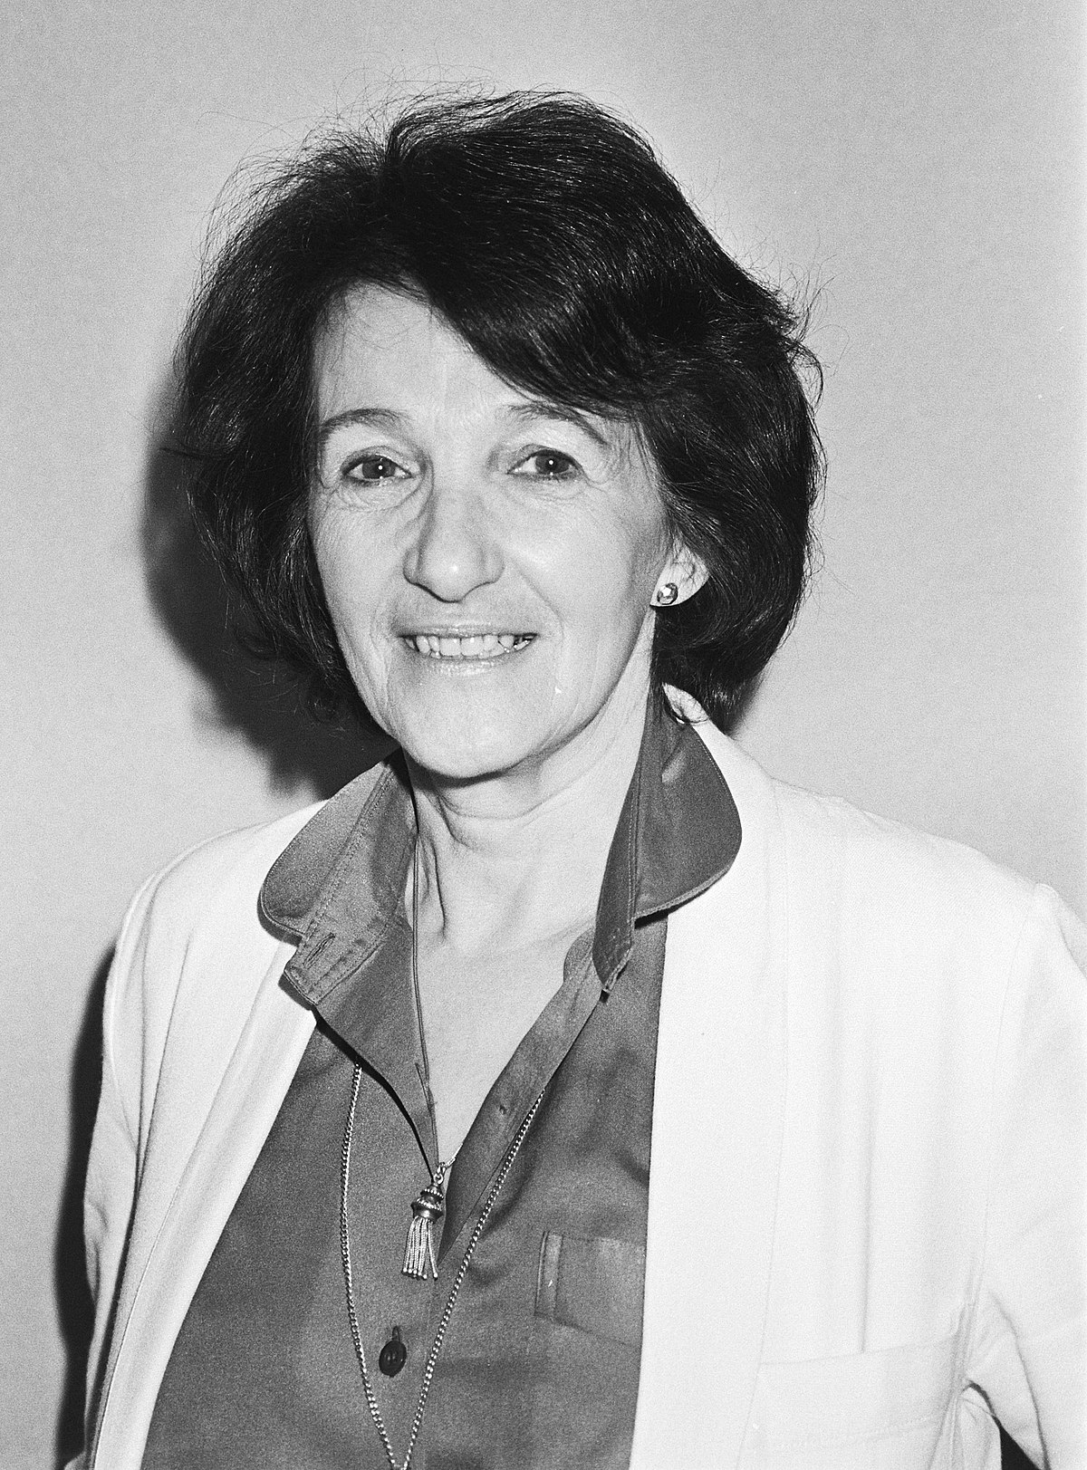
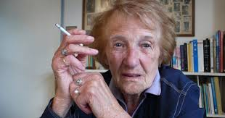

Slide 4
The Background
World War II ran its course from 1939 - 1945. Most of the nations of the world divided themselves into two groups: the Allies and the Axis. The Allies initially comprised of France, Poland and UK but soon became the group led by "the big three" - USA, the British Commonwealth, the Soviet Union. Other allies were China, Australia, Canada, New Zealand, South Africa and other third world nations. The axis were formed of Germany, Italy, Japan and the areas they presided over (Parts of Europe, Africa, East and South East Asia and islands of the Pacific). The Allies eventually won but in the interim, about 50-70 million lives were lost.
The most devastating aspects of this war were the Holocaust and the Bombing of Hiroshima and Nagasaki. The Holocaust was the genocide of about six million European Jews under the Nazi reign of Adolf Hitler. The holocaust began with laws being established to remove Jews from civil society. They were sent to concentration camps and used as labour or for medical experiments unto death. Often mass shootouts took lives. Some were sent to extermination camps by freight train to be killed in the now infamous gas chamber

Slide 5
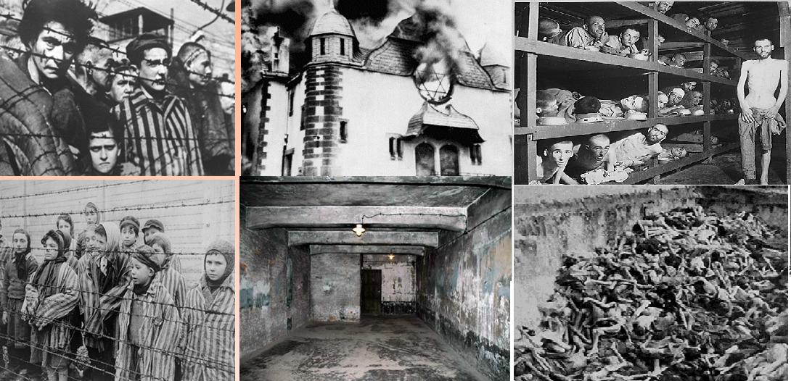

Slide 6
Characters:
The Narrator-She is a brave and courageous person who has to learn to live on her own. She was very much attached to her belongings and wanted them back so that she could feel closer to her mother.
Her Mother-A gullible lady who was easily deceived by Mrs Dorling
Mrs Dorling-Wicked ,greedy and selfish woman who tricked Mrs S by her cunning trick.
Mrs Dorling’s Daughter-An innocent girl who has no idea about her mother’s deed.

Slide 7
Theme
Dehumanizing effect of war in human lives.
-Explanation: Marga Minco's short story 'The Address' discusses the pain and sufferings brought by war to the individuals and the challenges they had to face in order to bring resolutions to the situation of crisis.
-The key idea that the author emphasizes is to portray the disruption and the catastrophic impact that war has brought to the life of narrator and her mother.
-However, the author also comments upon the memories by saying that they 'lose their value when seen again or detached from the context' and suggest that such painful past must be 'retrieved' and they need to move on in life.
Yet, the central idea that the story discusses is the emotional distortion caused by war.
-The theme of The Address deals revolves around the personal challenges that all of us have to encounter as individuals while resolving crisis in our own lives.
-With war comes death, destruction and a dehumanising effect on human beings. This story unfolds to its readers the disruption caused in the narrator and her mother’s lives due to the war. On a deeper level, it is also a story about memories.

Slide 8
The story is about the human predicament that follows the pre-War and Post-War period. Mrs. S who was a Jews was a rich lady. Whereas, Mrs Dorling was a non-Jews. The girl, daughter of Mrs. S, had lost her house and her mother during the war and now she had decided to come back to take her possessions from Mrs. Dorling, an acquaintance whose address was given by her mother years ago. When she reached the house, the woman treated her with a cold reception and didn’t let her into the house. She decided to go back anyway and then she met her daughter who let her in and told her to wait inside. When she saw all the possessions in front of her, she couldn’t connect with them and decided to leave the house.
The story begins after the Holocaust when our narrator, a Jewish survivor who had lost her entire family, had returned to find her mother's things at 46, Marconi Street………….

Slide 9
Do you still know me?’ I asked.
The woman looked at me searchingly. She had opened the door a chink. I came closer and stood on the step.
‘No, I don’t know you.’
‘I’m Mrs S’s daughter.’……
The protagonist asked the woman standing at the door if she still knew her. The lady had opened the door a little, the protagonist came closer to the door and stood there. The women responded negatively and the protagonist still gave her introduction. She said she was Mrs. S’s daughter. The woman had held the door tightly as she didn’t want her to enter the house. She kept staring at the protagonist though she couldn’t recognize her.
The protagonist thought maybe she had come to the wrong house. She had seen the woman only for a short time years ago. The woman who answered the door stepped aside and let go of the door. The protagonist recognized her mother’s green knitted cardigan that the women was wearing. The wooden buttons had become pale because of the washing. The woman noticed the protagonist looking at the cardigan. She hid behind the door. Now, the protagonist knew she had come to the right house.

Slide 10
Well, you knew my mother?’ I asked.
‘Have you come back?’ said the woman. ‘I thought that no one had come back.’
‘Only me.’
A door opened and closed in the passage behind her. A musty smell emerged.
‘I regret I cannot do anything for you.’…….
The protagonist asked the woman about her mother.
The woman asked her if she had come back, she replied only to her and no one else came with her. The woman opened the door and a passage was behind her.
A stale smell occurred all over. The woman told her that she could not do anything for her.
The protagonist told her that she had come from far place on the train just to talk to her.
The woman told her it is not convenient to talk right now and asked her to come back later.
The woman closed the door as she didn’t want anyone to get disturbed in the house. The protagonist was still standing on the step.
She saw a curtain moving on the window bay. Someone was staring at her from inside the house. She thought it was nothing as the woman would have told her.

Slide 11
I looked at the name-plate again. Dorling it said, in black letters on white enamel. And on the jamb, a bit higher, the number. Number 46………
The protagonist looked at the number plate again, it said Number 46. Dorling was written on the plate on white enamel.
As she was going back to the station, she was thinking about her mother who gave her the address.
It was the first half of the war. She was home for a few days and suddenly, it struck her that the room was different now. Various things were missing.
Her mother was surprised that she noticed the changes a little later.
It was that time when she told her about this woman, Mrs. Dorling. She was an old contact of hers whom she hadn’t seen for years.
Suddenly, she came to visit her and since then they had been in regular contact.

Slide 12
‘Every time she leaves here she takes something home with her,’ said my mother. ‘She took all the table silver in one go. And then the antique plates that hung there…….
Her mother told her that whenever that woman came to visit her, she took something from the house with her. Table silvers, antique plates and she had trouble over carrying the large vase. She told her that the cramp in her back came from the crockery. Her mother shook her head in sorrow. The woman kept telling the protagonist’s mother that she wanted to save her precious things. If they had to leave the place someday, they would lose everything.
She asked her mother if she really wanted her to take all the things with her. Her mother replied that even if she didn’t, it would be an insult to ask her not to. She was going out with a risk herself, a suitcase full of items.

Slide 13
My mother seemed to notice that I was not entirely convinced. She looked at me reprovingly and after that we spoke no more about it.
Meanwhile I had arrived at the station without having paid much attention to things on the way. I was walking in familiar places again for the first time since the War, but I did not want to go further than was necessary. I didn’t want to upset myself with the sight of streets and houses full of memories from a precious time…….
Her mother noticed that she wasn’t convinced and looked at her critically. After that day, they never talked about the incident again. She reached the station without noticing any details on the way. She passed the familiar things after the war for the first time. She didn’t want to upset herself with the familiar sights of houses and streets that reminded her of all the precious times.
Back in the time, she saw Mrs Dorling in person a day after her mother told her daughter about her. She woke up late that morning and as she was going downstairs, she saw her ‘the lady with broad back’. Her mother was seeing her out. Her mother introduced the protagonist to the lady. She signalled to her and the women responded with a nod. She picked the suitcase under the coat rack. She was wearing a brown coat and a shapeless hat. The protagonist asked her mother if she lived far away. The mother told her the address, ’Marconi Street, Number 46’. She remembered it.

Slide 14
‘Yes,’ I said, ‘you get so used to touching all these lovely things in the house, you hardly look at them any more. You only notice when something is missing, because it has to be repaired or because you have lent it, for example.’……
The protagonist said yes and told her that when you are so used to touching things into your house, you hardly notice anything. You only notice when something is missing or it needs to be repaired or because you have lent it.
She again found her voice to be unnatural. She continued, she told the girl that once her mother asked her if she would help her polish the silver. It was a long time ago and she was bored that day.
She had to stay that day maybe as she was ill. She asked her mother what silver she is talking about? Her mother said it was the spoons, knives, and forks. But she didn’t know that it was silver.
The girl laughed and said that she bet, she didn’t know it was either with what they ate with. The protagonist asked if she knew. The girl hesitated and walked to the sideboard and opened a drawer. She said she would see if it was there.

Slide 15
I had remembered it. But I had waited a long time to go there. Initially after the Liberation I was absolutely not interested in all that stored stuff, and naturally I was also rather afraid of it……..
She remembered the address but she took too long to visit the place. After the freedom, she was on one hand, not interested and on the other, was afraid. She was afraid of getting confronted with the past memories and connections that no longer existed. Connections were hidden in cupboards and boxes. It seemed that those memories were waiting in vain to put them back to their places as they had suffered all these years because they were only things.
Things were getting normal in the Protagonist’s life, but one day, she got curious about all the things that were still at that address. She wanted to see them and touch them. After the first hopeless visit, she decided to try one more time. When she reached Mrs Morling’s home, a girl of fifteen years opened the door. Protagonist asked her about her mother. She told her that she was outside doing some errands to which the protagonist decided that she would wait for her.

Slide 16
I followed the girl along the passage. An old-fashioned iron Hanukkah1 candle-holder hung next to a mirror. We never used it because it was much more cumbersome than a single candlestick.
‘Won’t you sit down?’ asked the girl……
The protagonist followed the girl along the passage. There was a Hanukkah candle-holder hung next to a mirror. She remembered that she never used it as it was unmanageable.
The girl asked her to sit down as she opened the door for the living room. She stopped and she was disturbed. She was standing in a room which she knew and she didn’t.
She was standing in the middle of things which she didn’t want to see and they burdened her. Maybe because of the way things were arranged, or the humid smell in the room, or the ugly furniture, she was scared to look at everything. She sat down on a chair which the girl pulled out for her.
She looked at the woollen table cloth. She rubbed it and her fingers felt warm. As she followed the lines of the pattern, she remembered a burn mark that was never repaired.
The girl told her that her mother would be back soon and asked if she would like to have a cup of tea. She answered thank you.

Slide 17
I jumped up. ‘I was forgetting the time. I must catch my train.’
She had her hand on the drawer. ‘Don’t you want to wait for my mother?’……
The protagonist jumped and said she forgot the time as she had to catch the train. The girl asked her if she did not want to wait for her mother? The protagonist still replied with a no and said she must leave. The girl pulled the drawer open. The protagonist said she could find her way out and walked down the passage as she heard the ringing spoon of spoons and forks.
When she reached the corner of the road, she looked at the name-plate again. It said Marconi Street and she was standing at 46. The address was correct but she doesn’t want to remember it anymore. She didn’t want to go back as the things in there reminded her of memories linked with the familiar life of old times.
But they lose the value when you are separated from them and you see them again in a strange environment. She thought of what she would have done with a small rented room where black-out paper hung over the window and no cutlery fitted in the narrow drawer. She finally resolved on forgetting the address as it would be easiest.

Slide 18
The impact of war on civilians:
The theme has been portrayed in several books and movies including 'The Diary of a Young Girl: Anne Frank', 'Sarah's Key' by Tatiana de Rodney, 'The Boy in the Striped Pyjamas' by John Boyne and movies such as 'Schindler's List'. The torture of the concentration camps, the loss of loved ones left a painful ever-lasting impact. The narrator's observation of the light-coloured bread, familiar views and unthreatened sleep implies the coarse stale food of the camps, the view of barren land and barbed wires and a sleep forever threatened with pain and death.

Slide 19
VOCABULARY
Musty – stale
Enamel – an opaque or semi-transparent substance that is a type of glass
Jamb – side post of a window, fireplace or doorway
Acquaintance – stranger or social contact
Lugging – carry a heavy object with great effort
Pityingly – feeling sorrow
Crick – cramp or spasm in muscles
Reprovingly – critically
Beckoned – signalled
Liberation – Liberty or Freeing
Endured – suffered
Vain – hopeless
Hanukkah – The Feast of Lights, a Hebrew festival in December
Cumbersome – unmanageable
Midst – middle
Muggy – humid
Jingling – ringing

Slide 20
QUESTION BANK:
Q.1. Why did the narrator, Mrs S’s daughter ,specially made a trip to 46,Marconi street ? Did she achieve her purpose?
Q.2. Describe the second visit of Mrs S’s daughter to the house of Mrs Dorling.Why did she not wait to meet Mrs Dorling?
Q.3. Why did the narrator say that forgetting Mrs Dorling’s address would be easy?
Q.4. Compare the lifestyle of Mrs S before the war with her daughter’s after the war?
Q.5. Justify the title of the story “The Address”
Q.6. Who was Mrs Dorling? Why did she visit Mrs S’s house frequently?
Q.7. What were the narrator’s feelings initially about the things that had been left with Mrs Dorling?
Q.8. Why did the narrator say ‘I was in a room I knew and did not know’?
Q.9. What is the impact of war on civilians?
Q.10. Could Mrs. S’s daughter get back to her old life after she come back to the city where she lived before the war

Slide 21
THANKING YOU
ODM EDUCATIONAL GROUP

