Slide 1


Mother’s Day
J.B. Priestley
SUBJECT : (ENGLISH)
CHAPTER-5
CLASS-XI

Slide 2
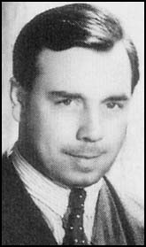
About the author-
John Boynton Priestley
1894-1984
Educated at Trinity Hall, Cambridge
Novelist, Playwright, Critic
Major Works: Novels- The Good Companions, Angel Pavement;
Plays: “Dangerous Corner”, “I Have Been Here Before”

Slide 3
Introduction
The play written by J.B. Priestly reveals how a mother’s efforts are ignored by her family.
It narrates how the family members who work eight hour shifts a day look upon her although she works for the whole day and all week.
After all she does for them, they take her for granted. They make her feel obligated to provide for them and do not even appreciate her efforts.
It revolves around how her friend Mrs Fitzgerald who is a fortune teller helps her earn the place and respect she deserves as the woman of the house.

Slide 4
Mother’s Day Theme
1.This humorous play portrays the status of a mother in the family.
2.The author brings out the plight of the mother very realistically in the play.
3.Mrs Annie Pearson, the mother, is not treated well by her husband and children.
4.With the help of her neighbour Mrs. Fitzgerald and a magic spell which temporarily allows them to interchange their roles, she stands up for her rights.
5.Mrs Annie Pearson’s family is shocked at the change, but they learn to behave properly with her so that she gets the respect that she deserved.

Slide 5
Characters
Mrs Fitzgerald-Mrs Annie Pearson’s neighbour. She is quite strong-willed, knows magic and helps Mrs Pearson to reform the spoilt members of her family.
Mrs Annie Pearson: She is a pleasant but nervous type of woman whose excessive love and care has spoilt her two children and husband.
Doris Pearson: She is Mrs Pearson’s daughter. She fails to understand her mother’s struggle and doesn’t help her in household work.
Mr George Pearson: He is Mrs Pearson’s proud husband who is not as respected in society as expected. He dominates his wife, but he is ridiculed in the club where he is a member.
Cyril Pearson: He is Mrs Annie Pearson’s son who is equally demanding and never sympathises with his mother.

Slide 6
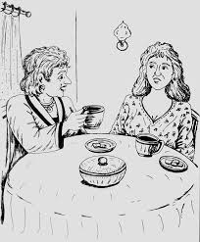
SUMMARY
-Mrs. Pearson the mother, works hard for family and gets no respect in return
-She was helped by Mrs. Fitzgerald.
-They two exchange bodies by the tricks and spells done by Mrs. Fitzgerald.
-Mrs. Fitzgerald as Mrs. Pearson reforms the Pearson family one by one.
-A lot of humor generated when the family finds the mother not working but drinking, smoking and playing cards instead.
-Doris finds her yellow dress not ironed.

Slide 7
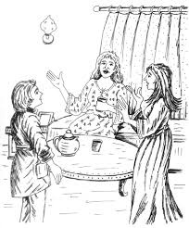
-Cyril finds his tea not ready.
-George is told how his friends at the club laugh at him.
-The real Mrs. Pearson enters and requests Mrs. Fitzgerald to stop the game.
-The play ends with the children getting ready to cook supper while the parents sit and talk.

Slide 8
Glossary
Sinister- suggesting evil
Flurried- nervous
Put your foot down- be firm
Astounded- shocked
Clot-idiot
Guffaw- laugh loudly
At sixes and sevens-in confusion
Laconic-using as few words as possible

Slide 9
Assignment
Mrs. Pearson: You all do talk like that. If there’s something at home you don’t want to do, you don’t do it, If it is something at your work, you get the Union to bar it. Now all that’s happened is that I’ve joined the movement.
What movement does Mrs. Pearson refer to? How and why has she joined it?
What change do you notice in Mrs. Pearson’s character when she is back in her own self at the end of the play?

Slide 10
THANKING YOU
ODM EDUCATIONAL GROUP

