Slide 1


Discovering Tut : The Saga Continues..
By A. R. Williams
SUBJECT : ENGLISH
CHAPTER NUMBER:3
CHAPTER NAME : Discovering Tut : The Saga Continues…

Slide 2
Early life of A. R. Williams
AR Williams lives in Virginia.
A.R. Williams developed a love for reading at a very young age and in the fourth grade, when an assignment to write their own works of fiction was given(A R Williams wrote a book called journey to planet X), it occurred to him that he too could have the ability to craft tales for others to enjoy. The heroes of his story were him and his four friends of his neighborhood.
Although A.R. did not pursue this desire right away, he continued to have a voracious appetite for reading from the amazing comics of Spider-Man, The X-Men, and Elf Quest, to the fantasy stories of Weiss and Hickman in the "Dragonlance Chronicles", and the science fiction adventures of Miles and Aral Vorkosigan in Lois McMaster Bujold's stories about Barrayar.
During a membership in a book club, A.R. discovered that there were books dedicated to teaching amateur writers more about the craft of writing. He snatched up a twin pack written by Phyllis A. Whitney.
To improve his skills, A.R. Williams joined the Science Fiction and Fantasy Online Writing Workshop when it was still hosted by Del Rey. The critiques he received and gave helped to further hone his developing talent. At this time A.R. was writing more, but not submitting his work to the markets. With the advancement of the internet and the ability to find new markets from sites such as Ralan s and Duotrope Digest.

Slide 3
THEME OF THE TOPIC
Discovering Tut: the Saga Continues’ gives an insight into the mystery surrounding the life and death of Tutankhamen, the last teenage ruler of the powerful Pharaoh dynasty that had ruled Egypt for centuries. He was the last of his family’s line, and his funeral brought an end to this powerful dynasty.
The story deals with the mysteries and various theories regarding the life and death of the youngest ruler of ancient Egypt -Tutankhamen. His tomb was discovered in 1922 by the famous archaeologist Howard Carter and since then his mummy has been subjected to a X-ray and later a CT scan. These investigations have answered a lot of questions and offered new clues on his life and death.

Slide 4
Tut’s life
Reign : Given his age, the king probably had very powerful advisers, presumably including General Horemheb and the Vizier Ay. Horemheb records that the king appointed him ‘Lord of the land’ as hereditary prince to maintain law. He also noted his ability to calm the young king when his temper flared.
Domestic policy : In his third regnal year, Tutankhamun reversed several changes made during his father's reign. He ended the worship of the god Aten and restored the god Amun to supremacy. The ban on the cult of Amun was lifted and traditional privileges were restored to its priesthood. The capital was moved back to Thebes and the city of Akhetaten abandoned.
This is when he changed his name to Tutankhamun, “Living Image of of Amun”, reinforcing the restoration of Amun.

Slide 5
Tut’s life
As part of his restoration, the king Initiated building projects, in particular at Thebes and Karnak where he dedicated a temple to Amun.
Many monuments were erected, and an Inscription on his tomb door declares the king had "spent his life In fashioning the Images of the gods". The traditional festivals are celebrated again, including those related the
Apis bull Horemarket, and Opet
His restoration stela says: "The temples of the gods and goddesses... were in ruins. Their shrines were deserted and overgrown. Their sanctuaries were as non-existent and their courts were used as roads…the gods turned their backs upon this land…If anyone made a prayer to a god for advice he would never respond."

Slide 6
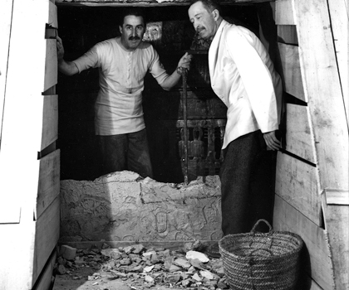
Discovery of Tut’s Tomb
The discovery of Tut's tomb by Howard Carter in 1922 is considered the most Important archaeological find of the century.
After years of painstaking work in the Valley of the Kings, Carter's patron, lord Carnarvon, had warned him that would be the last season of work because nothing significant had been found. On November 22 of that year, Carter's persistence finally paid off.
Valley of Kings Tutankhamun became a household name, and his magnificent treasures became the measuring stick for all future archaeological discoveries.
The mysteries surrounding his life and death are gradually being solved. And his story continues to unfold as new theories are proposed in an attempt to explain what really happened to the boy behind the golden mask.

Slide 7
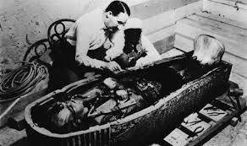
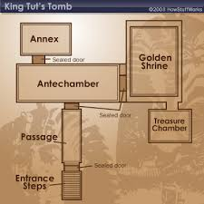
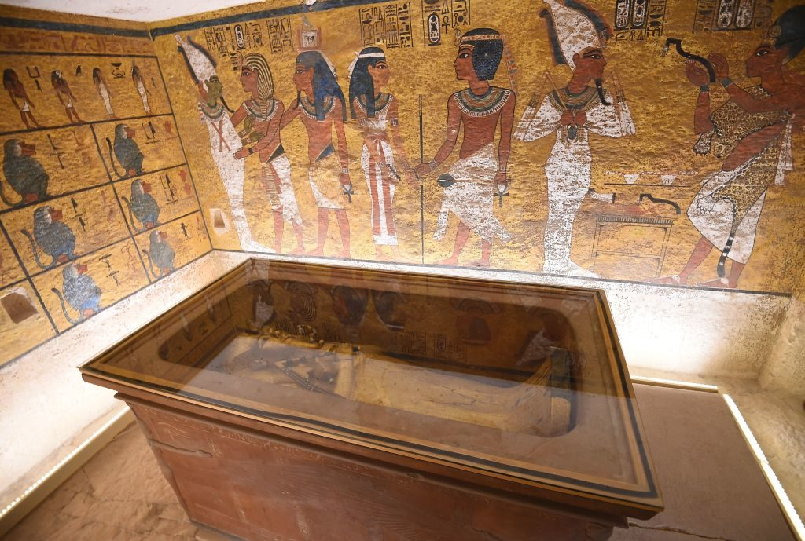
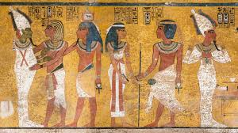

Slide 8
Burial Treasures of Tut
The treasures of Tutankhamun have been marveled at since their discovery by Howard Carter on November 4, 1922. It was the first, and to this day the only, royal tomb In the history of Egyptology to be found practically untouched, even though In ancient times It had been the object of no less than two attempts at robbery. The emptying of Tutankhamun's tomb lasted several years and made possible the recovery of about 3500 articles, confirming the tomb as the most exceptional archeological discovery ever made in Egypt.
Tutankhamun's second Innermost coffin, also referred to as the Intermediate coffin is made of gilded, laminated wood with Inlays of polychrome glass pastes.
Tutankhamun's third coffin is made of solid, hammered gold and weighs about 450 pounds. The royal mummy of Tutankhamun was found Inside this coffin.

Slide 9
Burial Treasures of Tut
Tutankhamun's famous gold funerary mask rested directly on the pharaoh's mummy Inside the third coffin. The pharaoh wears the classic names headdress striped with transversal bands of glass paste Imitating lapis lazuli and is adorned with a wide collar composed of streaks of semi precious stones and colored glasses. The eyes are made of quartz and obsidian. As on the coffins, the lapis-lazuli outline of the eyes reproduces the distinctive kohl eye make-up originally applied to protect against the sun's glare but increasingly employed for its beautifying effect.
The foremost and furthermost gilded wood statuettes portray Tutankhamun hunting hippopotamus with a harpoon from a boat made of papyrus.
One of the two calcite lamps found in Tutankhamun's burial chamber. The cup takes the form of an open lotus flower and Is flanked on both sides by rich, openwork decoration in which the god Heh is depicted kneeling on a number of papyrus plants with his arms raised.
Three models of luxury ships (left) were found in Tutankhamun's tomb. The baldachins at the bow and stern are decorated with symbols of the sphinx and the bull. Thirty-two model boats were placed in the tomb for Tutankhamun’s use in the afterworld.

Slide 10
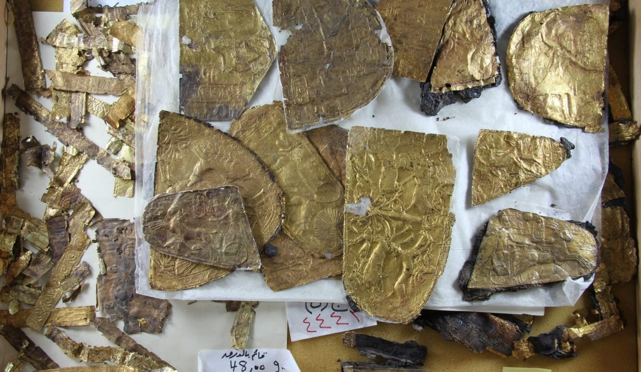
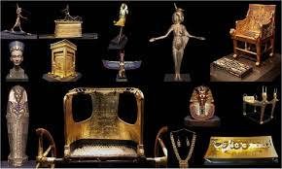
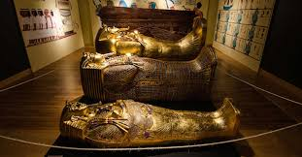
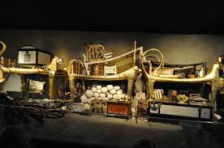

Slide 11
The Curse
A cobra killed Howard Carter's pet canary after the discovery of King Tut's tomb.
Lord Carnarvon, the person who funded the dig of King Tut's Tomb, died shortly after the discovery, due to a mosquito bite which turned into an infection. At that exact moment the lights in Cairo mysteriously went out.
Lord Carnarvon's dog howled and dropped dead at two in the morning when Carnarvon died.
What is interesting is that Howard Carter lived a decade after this major discovery.
In 1923, another man involved in the opening of the tomb, George Jay Gould, died as a result of a fever followed by Carnarvon's half-brother Aubrey Herbert in 1923; Egyptologist H.E. Evelyn-White; radiologist Sir Archibald Douglas-Reid; Howard Carter's assistant Richard Bethel; his father Lord Westbury; Egyptologist A.C. Mace; Egyptologist James Breasted in 1935; and finally Howard Carter in March of 1939.
Although some believe that the deaths may just be coincidental, many believe that the deaths were a result of the mummy's curse.
It is believed several of the deaths could be linked to a released mold that had been trapped in the tomb and released.
New findings are showing that bacteria on the wall of the tomb might have been the cause of the curse. The bacteria would release spores into the air allowing it to be breathed. This in turn caused people who came into contact with these pores to become ill.

Slide 12
Zahi Hawass’ Word
To me the story of Tutankhamun is like a play whose ending is still being written. The first act of the drama begins in about 1390 B.C., several decades before Tutankhamun's birth, when the great pharaoh Amenhotep III assumes the throne of Egypt. Controlling an empire stretching 1,200 miles from the Euphrates in the north to the Fourth Cataract of the Nile in the south, this king of the 18th dynasty is rich beyond imagining. Along with his powerful queen Tiye, Amenhotep III rules for 37 years, worshipping the gods of his ancestors, above all Amun, while his people prosper and vast wealth flows into the royal coffers from Egypt's foreign holdings.
Here he lives with his great wife, the beautiful Nefertiti, and together they serve as the high priests of the Aten, assisted in their duties by their six cherished daughters. All power and wealth is stripped from the Amun priesthood, and the Aten reigns supreme. The art of this period is also infused with a revolutionary new naturalism, the pharaoh has himself depicted not with an idealized face and youthful, muscular body as were pharaohs before him, but as strangely effeminate, with a potbelly and a thick lipped, elongated face. The end of Akhenaten's reign is cloaked in confusion-a scene acted out behind closed curtains. One or possibly two kings rule for short periods of time, either alongside Akhenaten, after his death, or both.

Slide 13
Zahi Hawass’ Word
If Act I is about tradition and stability, Act Il is revolt. When Amenhotep III dies, he is succeeded by his second son, Amenhotep IV-a bizarre visionary who turns away from Amun and the other gods of the state pantheon and worships instead a single deity known as the Aten, the disk of the sun. In the fifth year of his reign, he changes his name to Akhenaten - "he who is beneficial to the Aten." He elevates himself to the status of a living god and abandons the traditional religious capital at Thebes, building a great ceremonial city 180 miles to the north, at a place now called Amarna.
Like many other Egyptologists, I believe the first of these "kings" is actually Nefertiti. The second is a mysterious figure called Smenkhkare, about whom we know almost nothing. What we know for sure is that when the curtain opens on Act III, the throne is occupied by a young boy: the nine-year-old Tutankhaten ("the living image of the Aten"). Within the first two years of his tenure on the throne, he and his wife, Ankhesenpaaten (a daughter of Akhenaten and Nefertiti), abandon Amarna and return to Thebes, reopening the temples and restoring their wealth and glory. They change their names to Tutankhamun and Ankhesenamun, proclaiming their rejection of Akhenaten’s heresy and their renewed dedication to the cult of Amun.

Slide 14
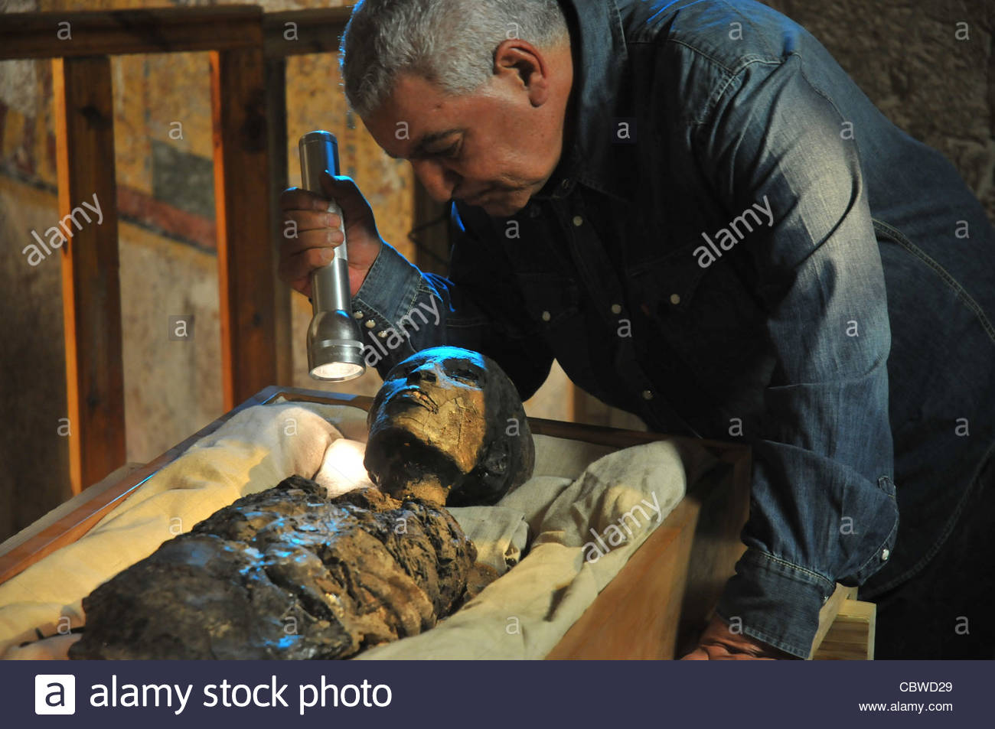
Zahi Hawass’ Word
Then the curtain falls. Ten years after ascending the throne, Tutankhamun is dead, leaving no heirs to succeed him. He is hastily buried in a small tomb, designed originally for a private person rather than a king. In a backlash against Akhenaten's heresy, his successors manage to delete from history nearly all traces of the Amarna kings, including Tutankhamun.
More than 5,000 artifacts were found inside the tomb. But the archaeological record has so far failed to illuminate the young king's most intimate family relationships. Who were his mother and father? What became of his widow, Ankhesenamun? Are the two mummified fetuses found in his tomb King Tutankhamun's own prematurely born children, or tokens of purity to accompany him into the afterlife?
With this discovery, we now know that it is unlikely that either of Akhenaten's known wives, Nefertiti and a second wife named Kiya, was Tutankhamun's mother, since there is no evidence from the historical record that either was his full sister. We know the names of five daughters of Amenhotep III and Tiye, but we will probably never know which of Akhenaten's sisters bore him a child. But to me, knowing her name is less important than the relationship with her brother. Incest was not uncommon among ancient Egyptian royalty.

Slide 15
The role of Science & Technology in the discovery of Tut
Egypt's famed King Tutankhamun suffered from a cleft palate and club foot, likely forcing him to walk with a cane, and died from complications from a broken leg exacerbated by malaria, according to the most extensive study ever of his mummy.
The findings were from two years of DNA testing and CT scans on 16 mummies, including those of Tutankhamun and his family.
It also established the clearest yet family tree for Tut. The study said his father was most likely Akhenaten, the pharaoh who tried to revolutionize ancient Egyptian religion to worship one god-while his mother was a still unidentified sister of Akhenaten.
Tut, who became pharaoh at the age of 10 in 1333 B.C., ruled for just nine years at a pivotal time In Egypt's history. While a comparatively minor king, the 1922 discovery of his tomb filled with stunning artifacts, including the famed golden funeral mask, made him known the world over.
Speculation had long swirled over why the boy king died at such a young age. A hole in his skull long fueled speculation he was murdered, until an X-ray scan in 2005 ruled that out, finding that the whole was likely from the mummification process. The scan also uncovered the broken leg.

Slide 16
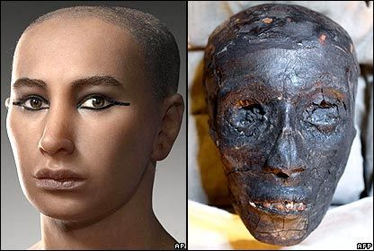
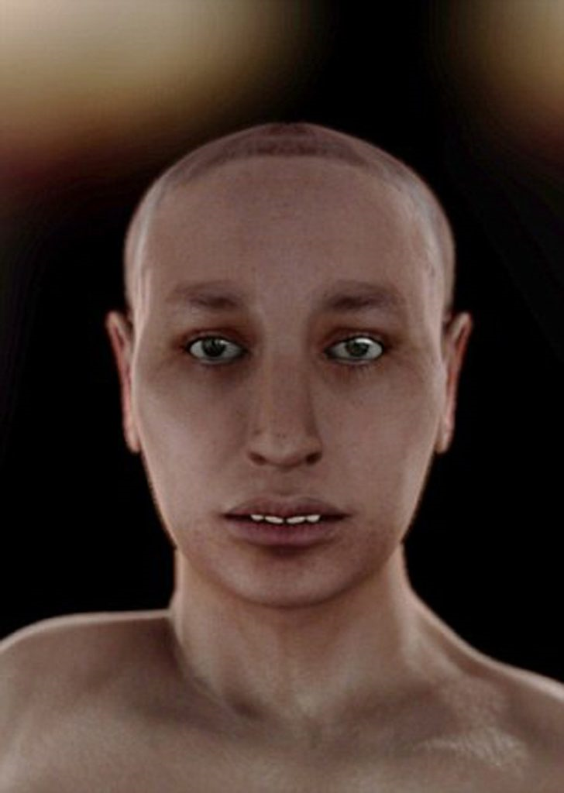

Slide 17
Word Meanings
-forensic – process of reconstruction of the face and
-pharaoh – Egyptian king
-murals – paintings on the wall
-gilded – thinly covered with gold
-coffin – box in which dead body is kept
-antiquities – very old objects
-archaeologist – a scientist who studies ancient objects dug up from the ground
-legend – an old story handed down through generations
-artefacts – objects of art made by hands
-resurrection – rebirth
-nested – fitted one inside another.
-shroud – cover of the dead body
-willow – soft wood
-wild celery – a wild plant
-cornflowers – bluish-purple flowers of a wild plant
-resins – a sticky flammable organic substance, insoluble in water
-chiselled away – separated with a chisel
-collars – necklaces
-bracelets – ornaments of the wrist
-amulets – ornaments worn round the neck or arm or waist
-sheaths – coverings to keep the sword in
-adornments – items used for decoration and make-up
-archaeology – science of studying ancient sites / buildings
-tomography – a technique for displaying a representation of a cross section using X-Rays or ultrasound
-cross section – parts seen when an object is cut in the middle
-pallbearers – those who carry coffins

Slide 18
-cases – boxes
-treasures – collections of valuable objects
-nested – fitted one inside another.
-shroud – cover of the dead body
-willow – soft wood
-wild celery – a wild plant
-cornflowers – bluish-purple flowers of a wild plant
-resins – a sticky flammable organic substance, insoluble in water
-chiselled away – separated with a chisel
-collars – necklaces
-bracelets – ornaments of the wrist
-amulets – ornaments worn round the neck or arm or waist (Taaveez) to keep away the evil
-sheaths – coverings to keep the sword in
-adornments – items used for decoration and make-up
-archaeology – science of studying ancient sites / buildings
-tomography – a technique for displaying a representation of a cross section using X-Rays or ultrasound
-dynasty – family line
-cross section – parts seen when an object is cut in the middle
-pallbearers – those who carry coffins

Slide 19
Comprehension check
Which questions still linger about Tut?
Why was Tut’s dead body subjected to CT scrutiny?
In 1968 what was the startling fact revealed by a professor of anatomy about king Tut?
What did the tourists do at that time?
Who did point out that the mummy was in a bad condition? Who was held responsible for it?
What was the fate of the contents of Tut’s mummy?
Why did the artefacts cause a sensation at the time of discovery?
What was king Tut’s demise a big event, even by royal standards?
Why did some people think the King Tut’s untimely death as the Pharaoh’s curse?
What problem did Carter face when he reached the mummy of King Tut? How did he find a way out?

Slide 20
THANKING YOU
ODM EDUCATIONAL GROUP

