Slide 1


INTRODUCTION and CONCLUSION
Appeal to save planet Earth, Human responsibility
SUBJECT : (ENGLISH)
CHAPTER NUMBER: 5
CHAPTER NAME : The Ailing Planet by Nani Palkhivala

Slide 2
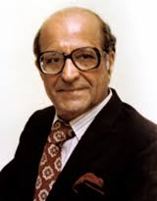
ABOUT THE AUTHOR
Nani Palkhivala was born in 1920 in Bombay to blue collar, middle-class Parsi parents.
He was educated at Masters Tutorial High School, and later at St. Xavier's College, both in Bombay.
He was a dedicated scholar and excelled even though he was hampered by a bad stammer.
At college, he earned a master's degree in English literature and thus, overcame his speech impediment.

Slide 3
Theme
The article ‘The Ailing Planet: the Green Movement’s Role’ discusses various environmental issues. It was written in 1994 but is relevant to this day due to the continuous deterioration in the health of the planet Earth. This article shows Earth as an ailing patient whose condition is getting critical day by day. It also focuses on the activities of human beings which contribute to the depletion of the environment. You will learn about the Green Movement and its role in conserving the environment.
There is also a focus laid on the human race being the most dangerous and destructive force in the world. A large number of species are there on the Earth and everyone has an equal right to live on this planet but the point is raised about the domination of the human race over other species. The concept of coexistence is lost. There are industrialisation, urbanisation and modernisation at the cost of a healthy environment.
This article also highlights the facts and statistics about the trees being cut and the growing deforestation either to acquire land or for the purpose of industrialisation. The chapter brings to light various important yet neglected issues which might cause devastation if not addressed immediately.
In this chapter, you will understand the importance of conserving natural resources and how this planet is a place to live for everyone and not just humans alone. It brings the true yet harsh reality of the destruction by human beings in the name of modernisation and improvement. The article also talks about the problem of over-population which is also responsible for the imbalance in the environment.

Slide 4
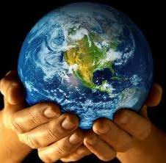
INTRODUCTION
This chapter is based upon degrading position of mother earth. The present scenario of India is highly deplorable as a report of parliament’s estimates committee highlights near catastrophic depletion of India's forests at the rate of 3.7 million acres a year. The article “ The Ailing planet: The Green movement's role“ was written by Nani Palkhivala and published in "The Indian Express" on 24th November 1994.

Slide 5

GREEN MOVEMENT’S ROLE
The green movement, a term that includes
the conservation and green politics, is a diverse scientific, social, and political movement for addressing environmental issues.
Environmentalists advocate the sustainable management of resources and stewardship of the environment through changes in public policy and individual behaviour.
In its recognition of humanity as a participant in ecosystems, the movement is cantered on ecology, health, and human rights.

Slide 6
A CHANGE IN THE HUMAN PERCEPTION
A revolutionary change has come in the perception of the human beings bringing in a ‘”holistic and ecological’ view of the world.
There has been a shift from the understanding developed by Copernicus to the people’s belief that the earth is a living organism whose needs must be respected and preserved by us.
According to the writer, our earth is like a “patient in declining healthy,”. Thus, we have to realise our ethical responsibility of guarding the planet.

Slide 7
SUSTAINABLE DEVELOPMENT
The World Commission on Environment and Development propagated the concept of “sustainable development’ in 1987.
Sustainable development calls for a well-balanced development so as to meet the demands of the present and not to deprive our future generations from the natural world of resources.

Slide 8
MAN AND THE OTHER LIVING-SPECIES
Man has been considered as the most dangerous being on the planet.
However, due to the efforts of a number of agencies all over the world, man is learning to live in harmony with the other living species on the planet.
Man’s existence is shifting from the system of domination to that of partnership.

Slide 9
THE DEPLETION OF THE PRINCIPAL BIOLOGICAL SYSTEMS
There are still many millions of living species that have not been catalogued.
The author mentions the ecological concern pointed out by Mr. Lester R. Brown in his book “The Golden Economic Prospect”.
Mr. Brown points out four principal biological systems – fisheries, forests, grasslands and croplands.
These form the foundation of the global economic system as they supply food and provide raw materials for industries except minerals and petroleum-derived synthetics.
The demand of the human beings on these systems is increasing to such an ‘unsustainable’ extent that the productivity of these systems is being hampered.
The excessive demand result in deterioration and depletion of resources leading to the breakdown of fisheries, disappearance of forests, deterioration of croplands and turning of grasslands into barren lands.

Slide 10
DEFORESTATION
The forests are being destroyed in large proportions to obtain firewood in poor countries.
Depletion of tropical forests has led to the extinction of several species.
In fact, the tropical forests or “the powerhouse of evolution” are eroding at the rate of forty to fifty million acres per year.
Besides, the increasing use of dung for burning deprives the soil of important natural fertilizers.
According to our Parliament’s Estimates Committee, a near “catastrophic depletion” has been marked in the number of the forests of India over the last four decades.
Ironically, article 48A of the Indian Constitution states that the state shall “protect and improve the environment and safeguard the forests and wildlife of the country.
However, India is losing its forests at the rate of 3.7 million acres a year.
The condition of the environment is ‘critical’ as per a study conducted by the United Nations.

Slide 11
THE PROBLEM OF OVER-POPULATION
One of the major factors adding to the deforming future of the human society is the fast-growing world population.
The present world population is estimated at 5.7 billion.
With this ever-increasing population, development seems a far-fetched dream.
As per the author, the best contraceptive to control the population is development.
Voluntary family planning with an element of coercion is the only alternative.
Rise in income, spread of education and improved health would lead to fall in fertility.
Population and poverty are directly proportional to each other.
Thus, control of the population should be our top-most priority.

Slide 12
“ERA OF RESPONSIBILITY”
The author now re-mentions the “holistic view” of the basis of our existence.
He points that it is an “Era of Responsibility” that calls tor “seeing the world as an integrated whole rather than a dissociated collection of parts”.
Industry plays an important role in this responsibility.
Excellence in environmental performance is required for the manufacturers to continue their existence.
Our earth belongs as much to the future generation as much to us.
We should soon realise our duty towards our planet and should not treat it solely as our property.

Slide 13
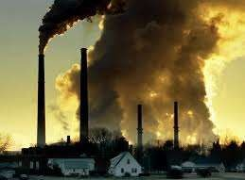
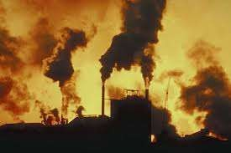
REASONS
Mankind is now the number one cause of all the destruction happening on Earth.
As well as trying to destroy each other on the battle-field, we are the cause of a series of other disasters, beginning with the industrial exploitation of the resources of the Earth.
The seas and oceans are being poisoned by chemical products, oils, industrial and
human waste.

Slide 14
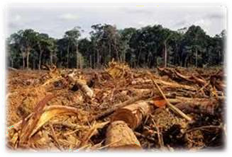
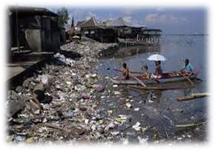
REASONS
On land, especially in the industrial countries where most waste is actually "manufactured", there is increasingly little room to bury it and even when buried, noxious elements leech out and destroy the health of the area.
An even greater problem is the disposal of Atomic waste, unsafe to dump into the sea and even more unsafe to bury under the land.
Forests are cut down for many reasons, but most of them are related to money or to people’s need to provide for their families.

Slide 15
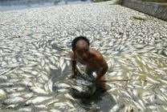
CONSEQUENCE
This has resulted in a widespread, ongoing extinction of other species during the present geological epoch, now known as the Holocene extinction.
The large-scale loss of species caused by human influence since the 1950s has been called a biotic crisis, with an estimated 10% of the total species lost as of 2007.
At current rates, about 30% of species are at risk of extinction in the next hundred years.

Slide 16
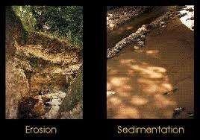
CONSEQUENCE
In the present day, human activity has had a significant impact on the surface of the planet. More than a third of the land surface has been modified by human actions, and humans use about 20% of global primary production.
The Holocene extinction event is the result of habitat destruction, the widespread distribution of invasive species, hunting, and climate change.
The concentration of carbon dioxide in the atmosphere has increased by close to 30% since the start of the Industrial Revolution

Slide 17
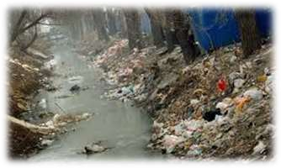
PRESENT CONDITION OF EARTH
Earth's present condition is that it is in a damaged state and under threat from dangers including those arising from global warming.
These threats include greenhouse gases, droughts and floods, hunger and famine and devastating diseases such as malaria and aids.
Some experts scientists are calling for carbon taxes to cut the risk. Damage from flooding alone could run into billions of dollars as creeks and estuaries begging to fill up and more ice melts.

Slide 18
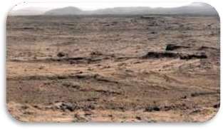
PRESENT CONDITION OF EARTH
Climate change is seen by some scientists to present the biggest threat to our world today. The whole world needs to effect remedial strategies by cooperating.
Levels of gases such as carbon dioxide are rising still and we are still at risk from deforestation and the burning of fossil fuels.
Greenhouse gases may cause the world to warm up as heat cannot escape effectively from the surface of the planet. All of this might throw the natural rhythms of our world's climate. That's where we're at right now!

Slide 19
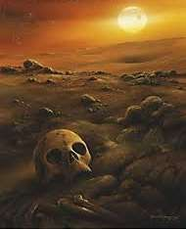

FUTURE OF EARTH
As the world consumes ever more fossil fuel energy, greenhouse gas concentrations will continue to rise and Earth's average temperature will rise with them.
Global warming will result in more hot days and fewer cool days, with the greatest warming happening over land. Longer, more intense heat waves will happen more often.
High latitudes and generally wet places will tend to receive more rainfall, while tropical regions and generally dry places will probably receive less rain.

Slide 20
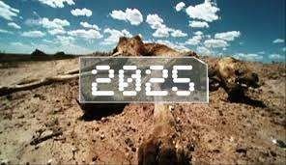
FUTURE OF EARTH
Increases in rainfall will come ecosystems will shift as those plants and animals that adapt the quickest will move into new areas to compete with the currently established species.
Those species that cannot adapt quickly enough will face extinction
Scientists note with increasing concern the 21st century could see one of the greatest periods of mass extinction of species in Earth's entire history.

Slide 21
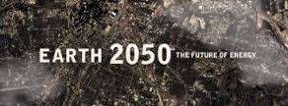
FUTURE OF EARTH
Ultimately, global warming will impact life on Earth in many ways.
But the extent of the change is up to us.
The form of bigger, wetter storms, rather than in the form of more rainy days.
In between those larger storms will be longer periods of light or no rain, so the frequency and severity of drought will increase.

Slide 22
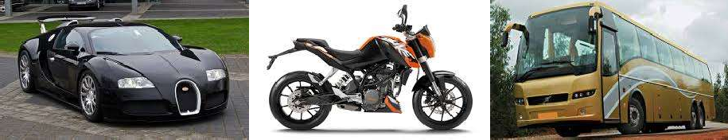
DRIVE LESS AND DRIVE SMART
Less driving means fewer emissions.
Besides saving gasoline, walking and biking are great forms of exercise.
Explore your community mass transit system, and check out options for carpooling to work or school.
When you do drive, make sure your car is running efficiently.
For example, keeping your tires properly inflated can improve your gas mileage by more than 3 percent. Every gallon of gas you save not only helps your budget, it also keeps 20 pounds of carbon dioxide out of the atmosphere.

Slide 23
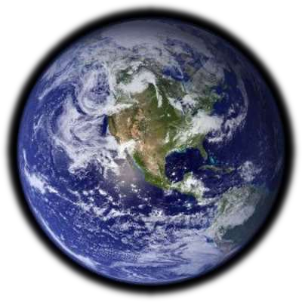
MESSAGE OF THE STORY
“The future of humanity will depend on how we steward the resources of
land, of soil, of water and seeds, and pass them on to future generations.”

Slide 24
DRILLING OF NEW/DIFFICULT WORDS :
Gripped – clutch; hold
Green Movement – It is a movement which stresses people to follow environmentally friendly practices.
Irrevocably – in a way that cannot be changed or reversed
Holistic and Ecological View – It means a view for the preservation of the environment. It also refers to the understanding of importance of earth’s resources for the use of future generations
Revolutionary – evolving a complete change
Metabolic needs – needs of a living organism that enables them to have a chemical process that causes food to be used for growth and energy
Ethical Obligation – when someone is required to do something based on a righteous standard of rules
Stewards – manage or to look after
Sustainable Development – economic development without depletion of natural resources
Dawned – begin
Catalogued – classify; characterise
Reckon – calculate
Languish – lose or lack of vitality of a person or plant or animal; grow weak
Ignominious darkness – disgraced as no one has knowledge about them

Slide 25
MAY I CHECK UP YOUR COMPREHENSION?
Locate the lines in the text that support the title ‘The Ailing Planet’.
What does the notice ‘The world’s most dangerous animal’ at a cage in the zoo at Lusaka, Zambia, signify?
How are the earth’s principal biological systems being depleted?
Why does the author aver that the growth of world population is one of the strongest factors distorting the future of human society?
Discuss - Laws are never respected nor enforced in India.
Discuss - “Are we to leave our successors a scorched planet of advancing deserts, impoverished landscapes and an ailing environment?”
Discuss - “We have not inherited this earth from our forefathers; we have borrowed it from our children”.
Discuss - The problems of overpopulation that directly affect our everyday life.

Slide 26
AN ADVICE
Please read the lesson thoroughly at home.
Doubts , if any, should be asked for clearance in the next period.
Attempt answering the questions.
NOW RELAX !
SEE YOU NEXT TIME !!
BYE !!!

Slide 27
THANKING YOU
ODM EDUCATIONAL GROUP

