Slide 1

WELCOME TO ONLINE CLASS
CLASS : UKG
SUBJECT : ENGLISH
CHAPTER : 7
TOPIC : P SOUND WORDS

Slide 2
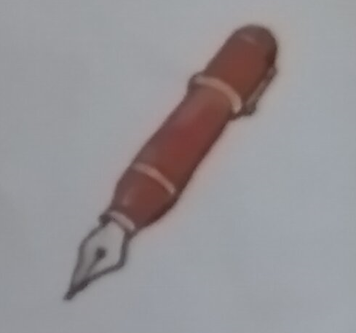
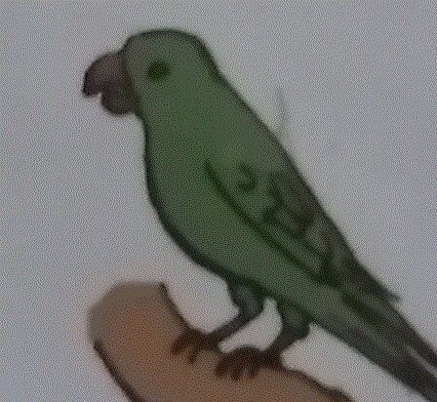
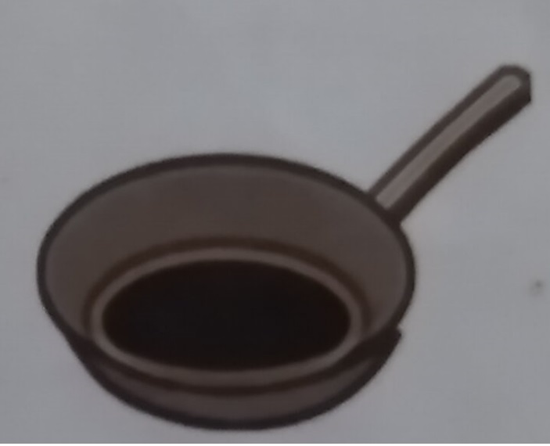
‘P’ SOUND WORDS
PARROT
PEN
PAN

Slide 3
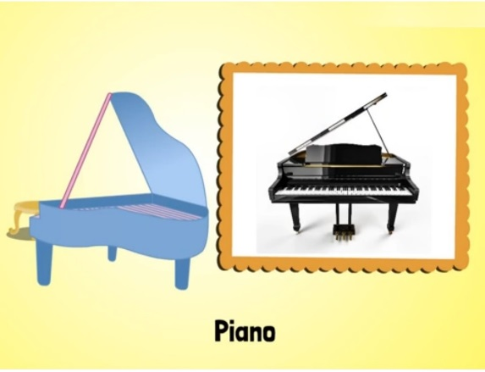

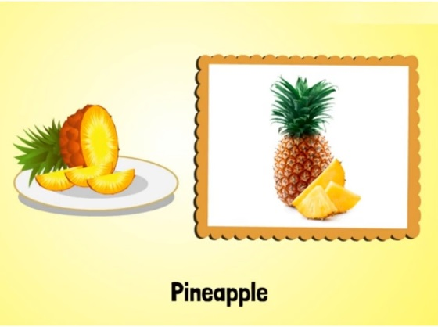

Slide 4


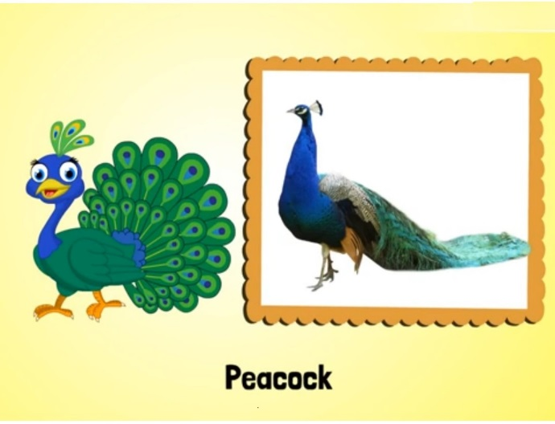

Slide 5
LETS READ THE FOLLOWING WORDS
pan
parrot
pet
picture
pup
park
pen
pencil

Slide 6
HOME ASSIGNMENT
1.Read book page – 36
2. Paste / Draw the picture of P sound words in your Eng note book .

Slide 7

THANKING YOU
ODM EDUCATIONAL GROUP

