Slide 1

WELCOME TO ONLINE CLASS
SUBJECT-ENGLISH
CHAPTER- 4
TOPIC - Uses of 'These' and 'This'

Slide 2
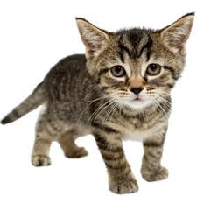
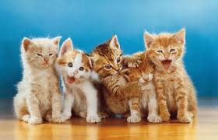
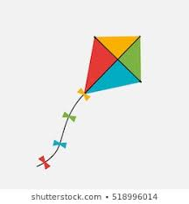


One -This
Many -These

Slide 3



This is….
These are…

Slide 4
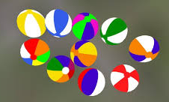
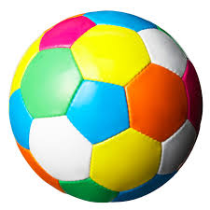
Uses of 'These' and 'This'
These are balls.
This is a ball.

Slide 5
This is a cat.
These are cats.

Slide 6
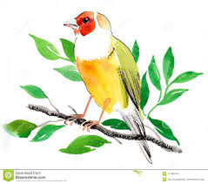
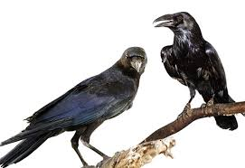
This is a bird.
These are birds.

Slide 7

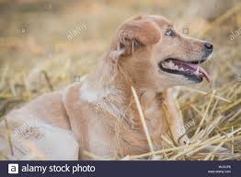
These are pups.
This is a dog.

Slide 8
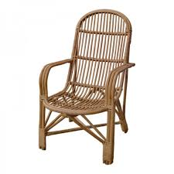
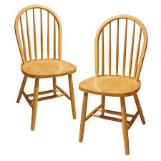
This is a chair.
These are chairs.

Slide 9
CLASS ASSIGNMENT
LET’S DO BOOK PAGE -22

Slide 10
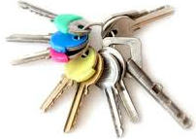
Circle the correct word-HOME ASSIGNMENT
______ are keys.
(This, These)
______ is a ball. (This, These)

Slide 11
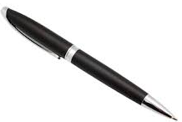
Circle the correct word-
_______ is a pen. (This, These)
_______ are crows. (This, These )

Slide 12

THANKING YOU
ODM EDUCATIONAL GROUP

