Slide 1


Kirchhoff’s laws and Wheatstone bridge
CLASS-XII
SUBJECT : PHYSICS
CHAPTER NUMBER: 03
CHAPTER NAME : CURRENT ELECTRICITY

Slide 2
KIRCHHOFF’S LAWS:
I Law or Current Law or Junction Rule:
The algebraic sum of electric currents at a junction in any electrical network is always zero.
I₁
I₂
I₃
I₁ - I₂ - I₃ + I₄ - I₅ = 0
O
I₅
I₄
Sign Conventions:
The incoming currents towards the junction are taken positive.
The outgoing currents away from the junction are taken negative.
Note: The charges cannot accumulate at a junction. The number of charges that arrive at a junction in a given time must leave in the same time in accordance with conservation of charges.

Slide 3
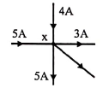
Numerical
Question: In the given figure what is the current through the arm shown
Solution :
Unknown current = 5A+4A-5A-3A=1A

Slide 4
II Law or Voltage Law or Loop Rule:
The algebraic sum of all the potential drops and emf’s along any closed path in an electrical network is always zero.
I₁
E₁
I₁
R₁
A
B
Loop ABCA:
- E₁ = - I₁.R₁ - (I₁ + I₂).R₂
R₂
I₂
I₁ + I₂
I₁
Loop ACDA:
E₂ = (I₁ + I₂).R₂ + I₂.R₃
D
C
I₂
R₃
I₂
E₂
Sign Conventions:
The emf is taken negative when we traverse from positive to negative terminal of the cell through the electrolyte.
The emf is taken positive when we traverse from negative to positive terminal of the cell through the electrolyte.
Note: The path can be traversed in clockwise or anticlockwise direction of the loop.

Slide 5
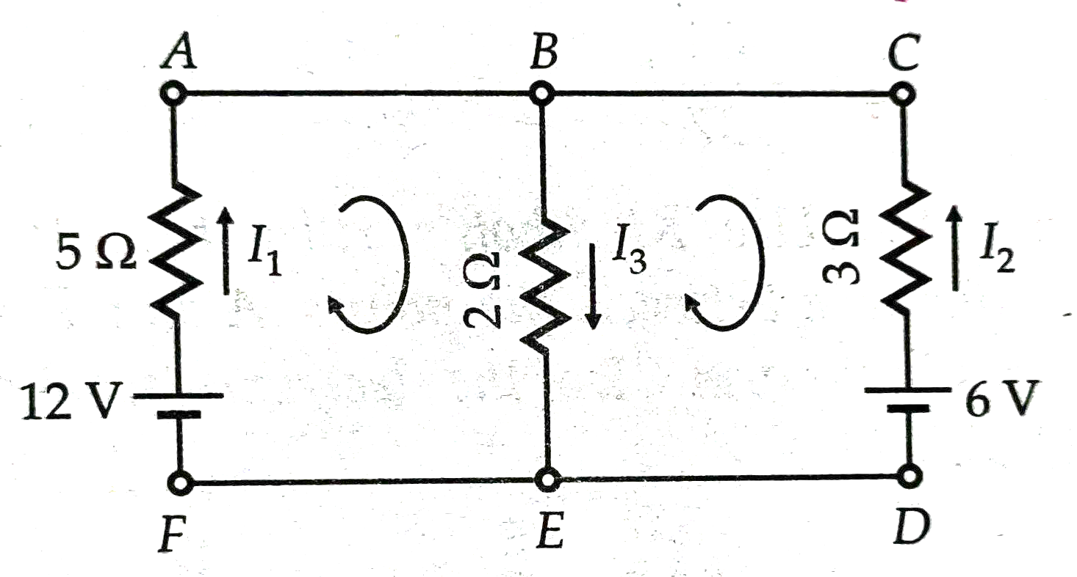
Numerical
Question: Using Kirchhoff’s laws obtain the values of $I_{1},I_{2}andI_{3}$ , as in the given figure.

Slide 6
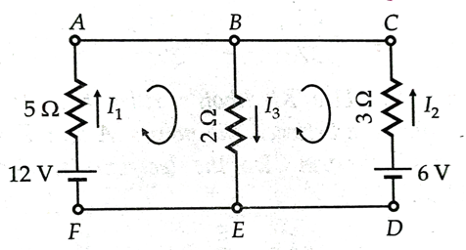
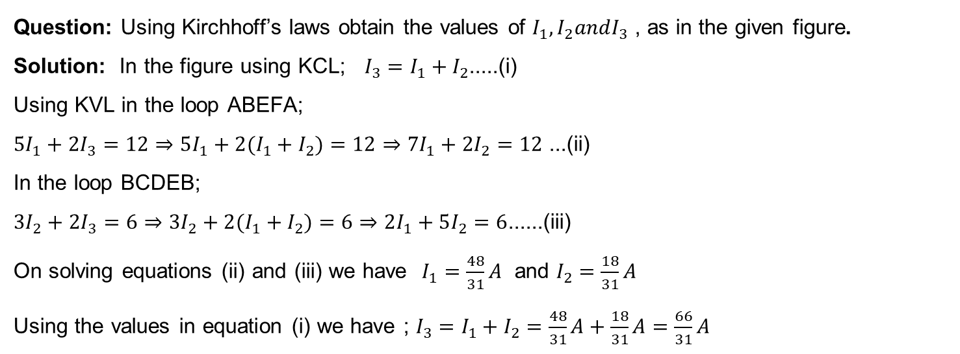
Numerical
Question: Using Kirchhoff’s laws obtain the values of $I_{1},I_{2}andI_{3}$ , as in the given figure.
Solution: In the figure using KCL; $I_{3}=I_{1}+I_{2}$.....(i)
Using KVL in the loop ABEFA;
$5I_{1}+2I_{3}=12⇒5I_{1}+2(I_{1}+I_{2})=12⇒7I_{1}+2I_{2}=12$ ...(ii)
In the loop BCDEB;
$3I_{2}+2I_{3}=6⇒3I_{2}+2(I_{1}+I_{2})=6⇒2I_{1}+5I_{2}=6$......(iii)
On solving equations (ii) and (iii) we have $I_{1}=\frac{48}{31}A$ and $I_{2}=\frac{18}{31}A$
Using the values in equation (i) we have ; $I_{3}=I_{1}+I_{2}=\frac{48}{31}A+\frac{18}{31}A=\frac{66}{31}A$

Slide 7
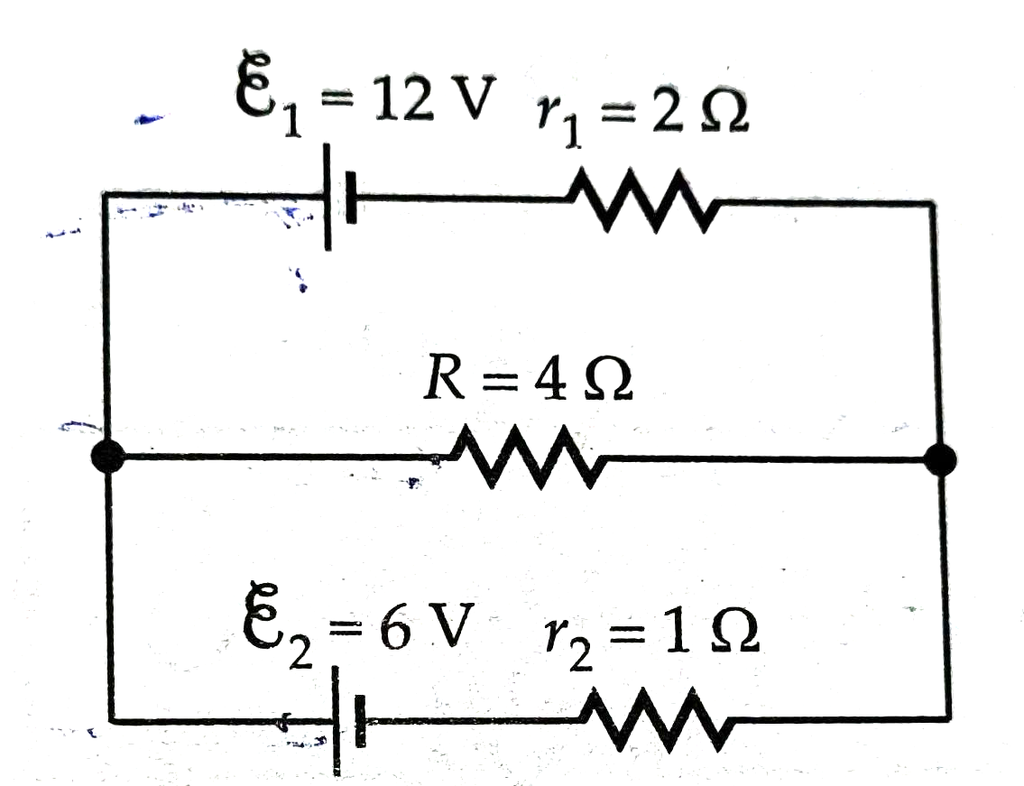
Numerical
Question: Using Kirchhoff’s laws obtain the potential difference across each cell and also find the rate of energy dissipation in R.

Slide 8
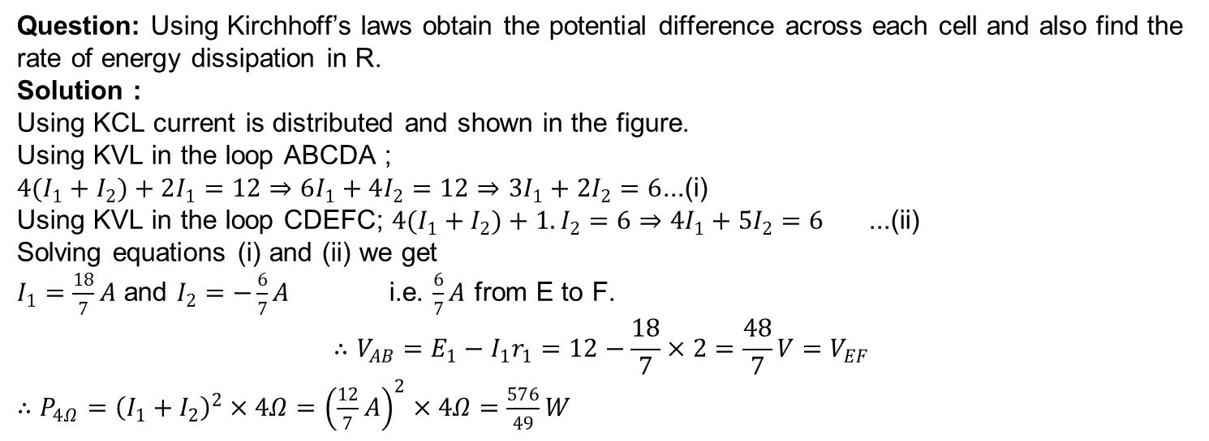
Numerical
Question: Using Kirchhoff’s laws obtain the potential difference across each cell and also find the rate of energy dissipation in R.
Solution :
Using KCL current is distributed and shown in the figure.
Using KVL in the loop ABCDA ;
$4(I_{1}+I_{2})+2I_{1}=12⇒6I_{1}+4I_{2}=12⇒3I_{1}+2I_{2}=6$...(i)
Using KVL in the loop CDEFC; $4(I_{1}+I_{2})+1.I_{2}=6⇒4I_{1}+5I_{2}=6$ ...(ii)
Solving equations (i) and (ii) we get
$I_{1}=\frac{18}{7}A$ and $I_{2}=−\frac{6}{7}A$ i.e. $\frac{6}{7}A$ from E to F.
$$∴V_{AB}=E_{1}−I_{1}r_{1}=12−\frac{18}{7}×2=\frac{48}{7}V=V_{EF}$$
$∴P_{4Ω}={\left(I_{1}+I_{2}\right)}^{2}×4Ω={\left(\frac{12}{7}A\right)}^{2}×4Ω=\frac{576}{49}W$

Slide 9
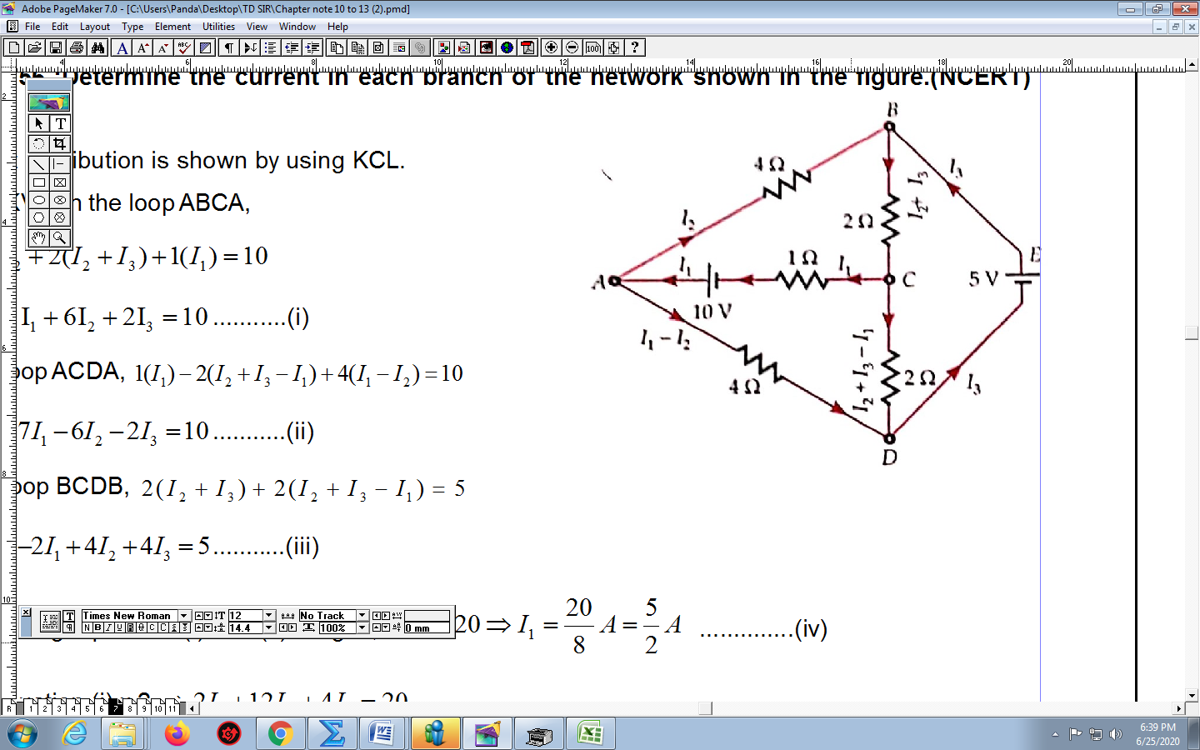
Numerical
Question:- Determine the current in each branch of the network shown in the figure.

Slide 10
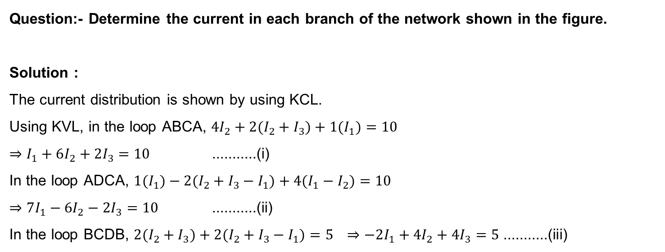
Numerical
Question:- Determine the current in each branch of the network shown in the figure.
Solution :
The current distribution is shown by using KCL.
Using KVL, in the loop ABCA, $4I_{2}+2(I_{2}+I_{3})+1(I_{1})=10$
$⇒I_{1}+6I_{2}+2I_{3}=10$ ...........(i)
In the loop ADCA, $1(I_{1})−2(I_{2}+I_{3}−I_{1})+4(I_{1}−I_{2})=10$
$⇒7I_{1}−6I_{2}−2I_{3}=10$ ...........(ii)
In the loop BCDB, $2(I_{2}+I_{3})+2(I_{2}+I_{3}−I_{1})=5$ $⇒−2I_{1}+4I_{2}+4I_{3}=5$ ...........(iii)

Slide 11
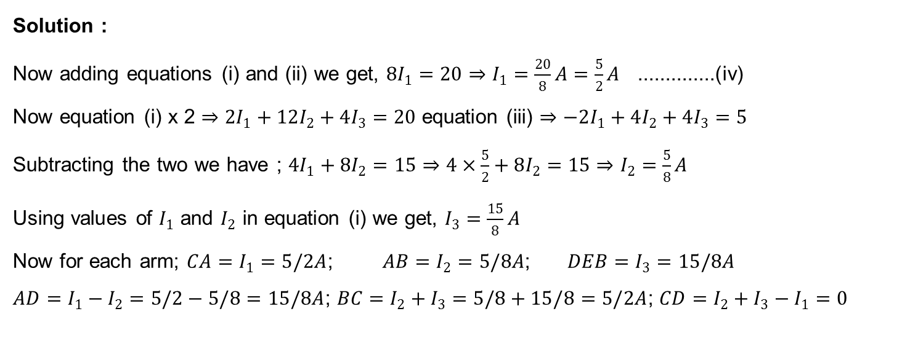
Numerical
Solution :
Now adding equations (i) and (ii) we get, $8I_{1}=20⇒I_{1}=\frac{20}{8}A=\frac{5}{2}A$ ..............(iv)
Now equation (i) x 2 $⇒2I_{1}+12I_{2}+4I_{3}=20$ equation (iii) $⇒−2I_{1}+4I_{2}+4I_{3}=5$
Subtracting the two we have ; $4I_{1}+8I_{2}=15⇒4×\frac{5}{2}+8I_{2}=15⇒I_{2}=\frac{5}{8}A$
Using values of $I_{1}$ and $I_{2}$ in equation (i) we get, $I_{3}=\frac{15}{8}A$
Now for each arm; $CA=I_{1}=5/2A$; $AB=I_{2}=5/8A$; $DEB=I_{3}=15/8A$
$AD=I_{1}−I_{2}=5/2−5/8=15/8A$; $BC=I_{2}+I_{3}=5/8+15/8=5/2A$; $CD=I_{2}+I_{3}−I_{1}=0$

Slide 12
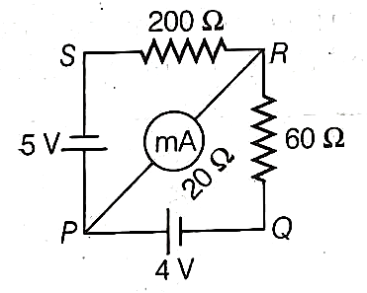
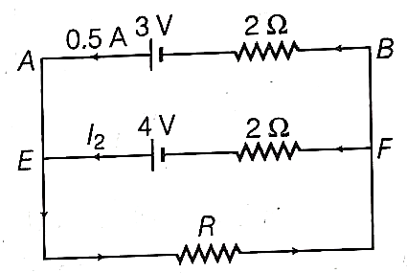
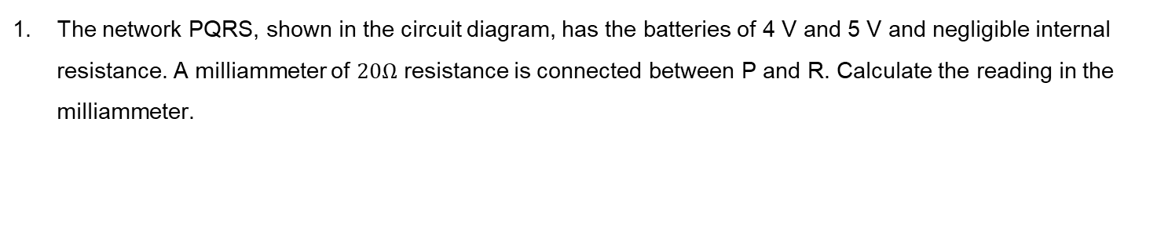
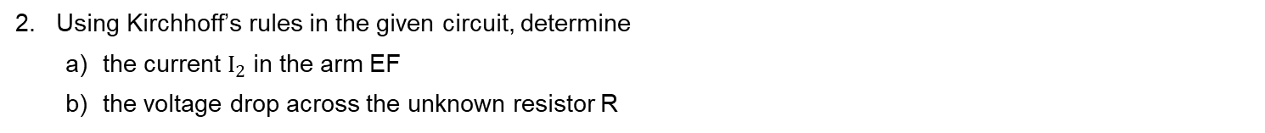
HOME ASSIGNMENT
The network PQRS, shown in the circuit diagram, has the batteries of 4 V and 5 V and negligible internal resistance. A milliammeter of $20Ω$ resistance is connected between P and R. Calculate the reading in the milliammeter.
2. Using Kirchhoff’s rules in the given circuit, determine
  the current $I_{2}$ in the arm EF
  the voltage drop across the unknown resistor R

Slide 13
THANKING YOU
ODM EDUCATIONAL GROUP

