Slide 1


Combination of cells in series and parallel
CLASS-XII
SUBJECT : PHYSICS
CHAPTER NUMBER: 03
CHAPTER NAME : CURRENT ELECTRICITY

Slide 2
Cells in Series combination:
Cells are connected in series when they are joined end to end so that the same quantity of electricity must flow through each cell.
NOTE:
The emf of the battery is the sum of the individual emfs
The current in each cell is the same and is identical with the current in the entire arrangement.
The total internal resistance of the battery is the sum of the individual internal resistances.
E
r
E
r
E
r
I
I
R
V
Total emf of the battery = nE (for n no. of identical cells)
Total Internal resistance of the battery = nr
Total resistance of the circuit = nr + R
If R << nr, then I = E / r (ii) If nr << R, then I = n (E / R)
nE
Current I =
Conclusion: When internal resistance is negligible in comparison to the external resistance, then the cells are connected in series to get maximum current.
nr + R

Slide 3
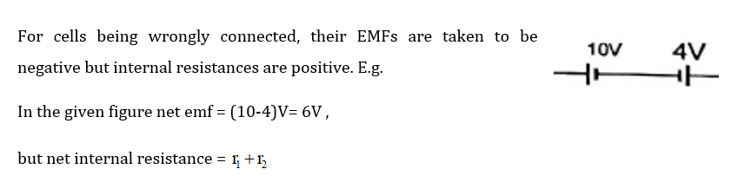
NOTE

Slide 4

NUMERICAL
In the given circuit cells E₁ and E₂ have EMFs 3V and 5V respectively and internal resistances 0.3$Ω$ and 1.2$Ω$ respectively. Find the current through the circuit.

Slide 5
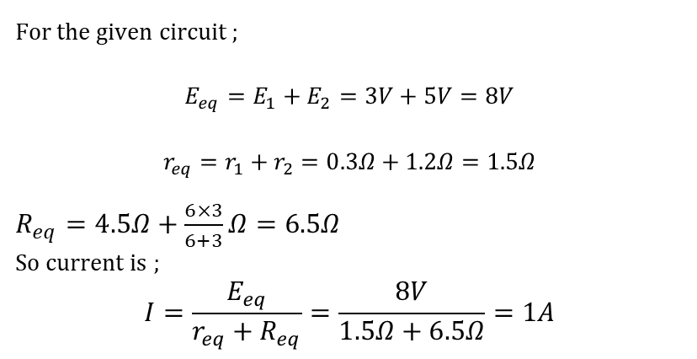
NUMERICAL
In the given circuit cells E₁ and E₂ have EMFs 3V and 5V respectively and internal resistances 0.3$Ω$ and 1.2$Ω$ respectively. Find the current through the circuit.
SOLUTION
For the given circuit ;
$$E_{eq}=E_{1}+E_{2}=3V+5V=8V$$
$$r_{eq}=r_{1}+r_{2}=0.3Ω+1.2Ω=1.5Ω$$
$R_{eq}=4.5Ω+\frac{6×3}{6+3}Ω=6.5Ω$
So current is ;
$$I=\frac{E_{eq}}{r_{eq}+R_{eq}}=\frac{8V}{1.5Ω+6.5Ω}=1A$$

Slide 6
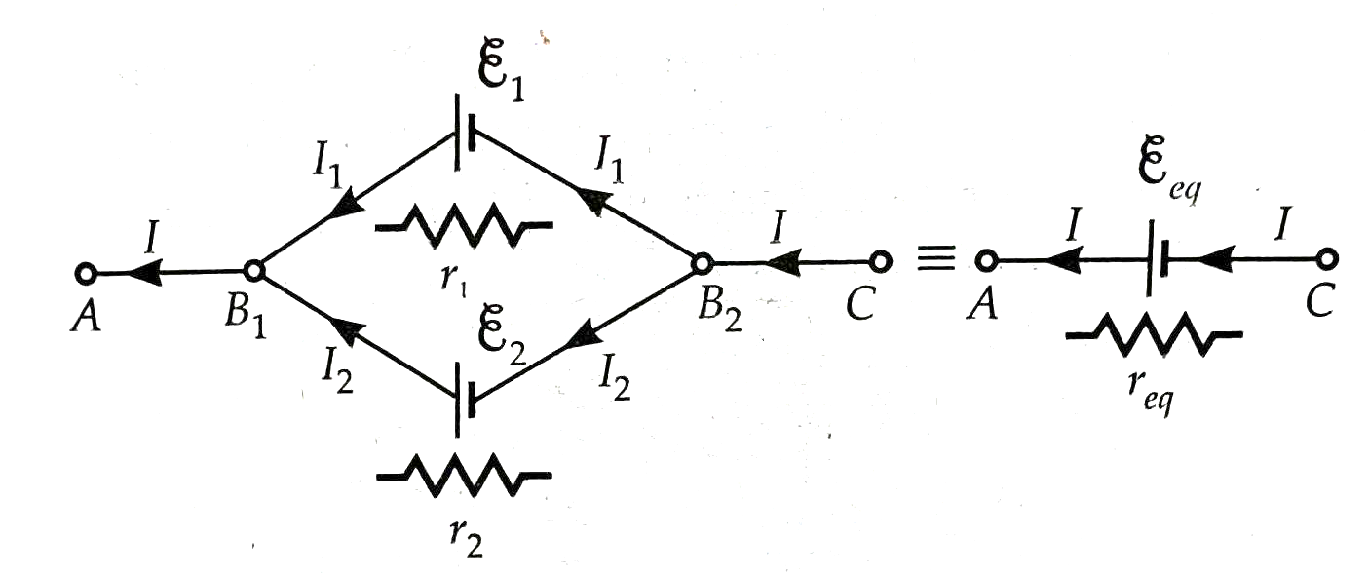
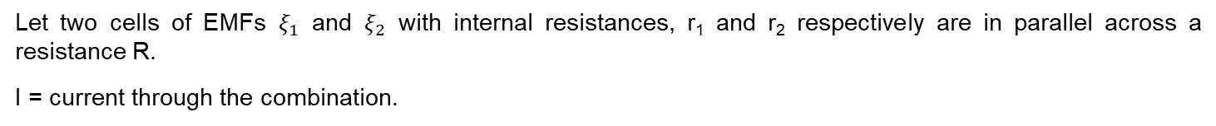
Cells in Parallel combination
In a parallel combination of cells, the potential difference of each cell is the same, and current through the combination is equal to the sum of the current through individual cells.
Let two cells of EMFs $ξ_{1}$ and $ξ_{2}$ with internal resistances, r₁ and r₂ respectively are in parallel across a resistance R.
I = current through the combination.

Slide 7
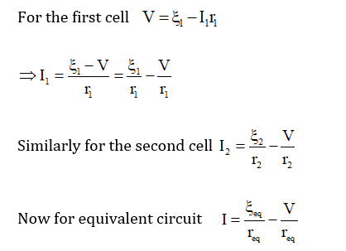
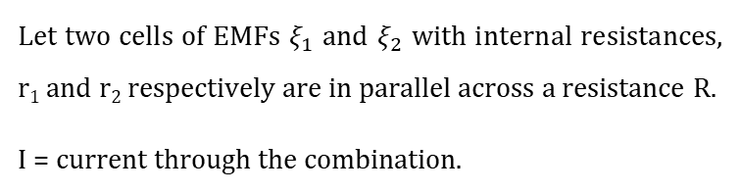
Cells in Parallel combination
In a parallel combination of cells, the potential difference of each cell is the same, and current through the combination is equal to the sum of the current through individual cells.
Let two cells of EMFs $ξ_{1}$ and $ξ_{2}$ with internal resistances, r₁ and r₂ respectively are in parallel across a resistance R.
I = current through the combination.

Slide 8
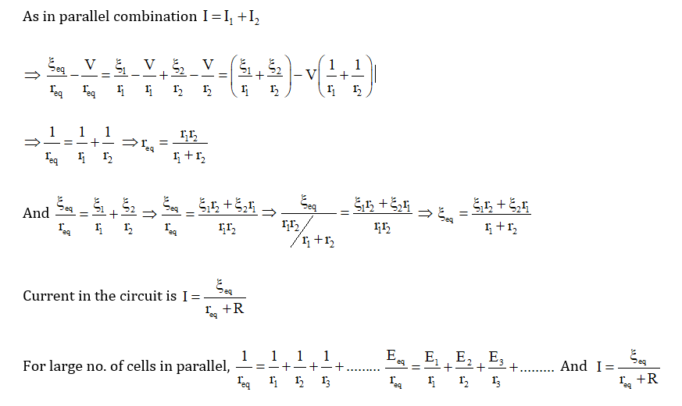
Cells in Parallel combination

Slide 9
Cells in Parallel combination:
Cells are said to be connected in parallel when they are joined positive to positive and negative to negative such that current is divided between the cells.
E
r
NOTE:
The emf of the battery is the same as that of a single cell.
The current in the external circuit is divided equally among the cells.
The reciprocal of the total internal resistance is the sum of the reciprocals of the individual internal resistances.
E
r
E
r
I
I
Total emf of the battery = E
Total Internal resistance of the battery = r / n
Total resistance of the circuit = (r / n) + R
R
V
If R << r/n, then I = n(E / r) (ii) If r/n << R, then I = E / R
nE
Current I =
Conclusion: When external resistance is negligible in comparison to the internal resistance, then the cells are connected in parallel to get maximum current.
nR + r

Slide 10
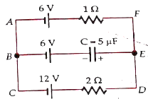
Numerical
Question: In the given circuit find the charge and energy stored in the capacitor at a steady state

Slide 11
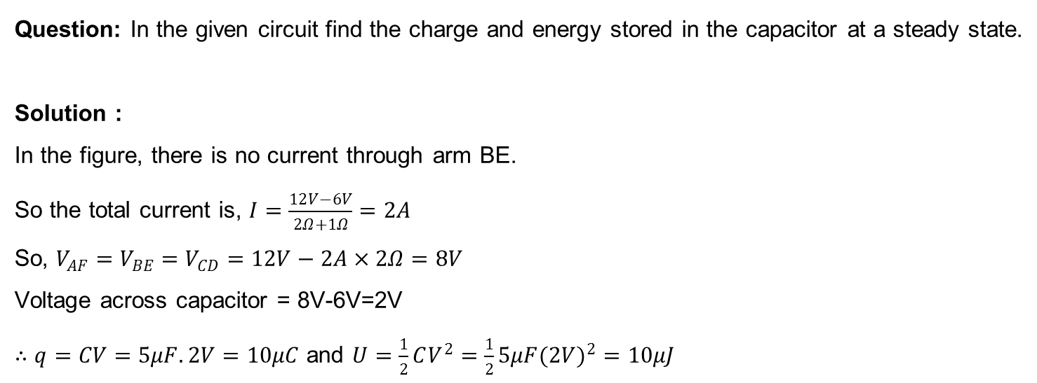
Numerical
Question: In the given circuit find the charge and energy stored in the capacitor at a steady state.
Solution :
In the figure, there is no current through arm BE.
So the total current is, $I=\frac{12V−6V}{2Ω+1Ω}=2A$
So, $V_{AF}=V_{BE}=V_{CD}=12V−2A×2Ω=8V$
Voltage across capacitor = 8V-6V=2V
$∴q=CV=5μF.2V=10μC$ and $U=\frac{1}{2}CV^{2}=\frac{1}{2}5μF(2V)^{2}=10μJ$

Slide 12
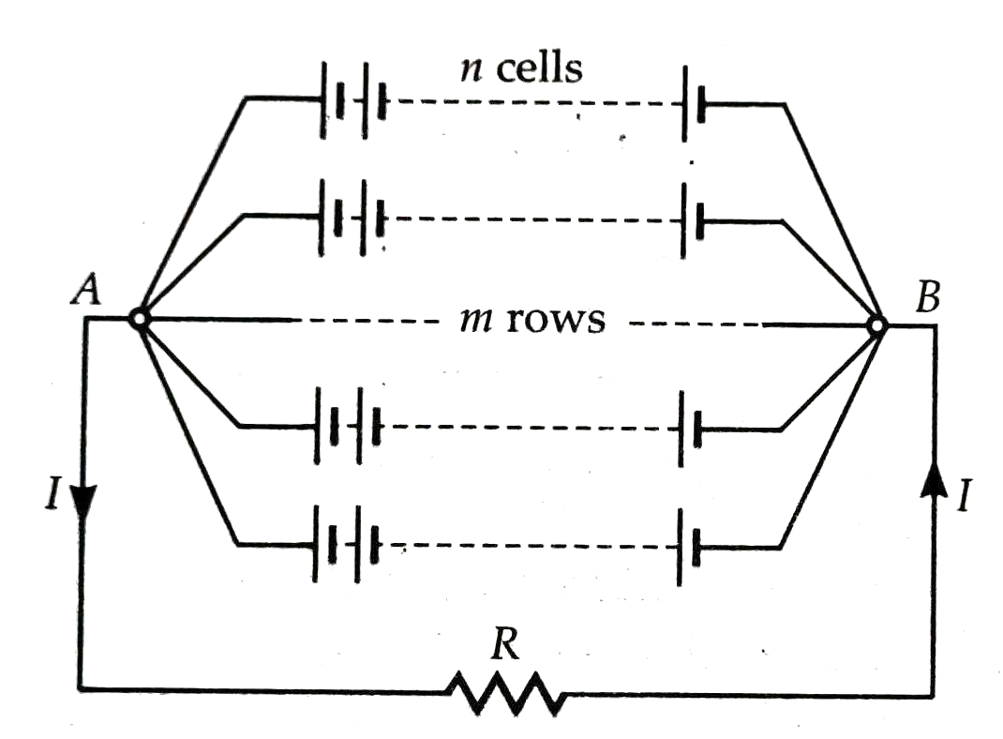
Mixed grouping
Mixed grouping of m x n identical cells each of emf $ξ$ and internal resistance r in m rows with each row carrying n cells :

Slide 13
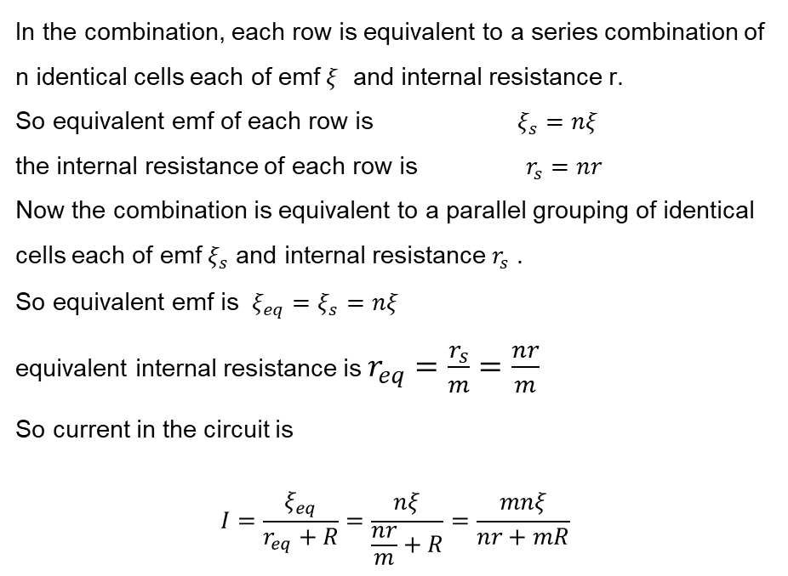
Mixed grouping
Mixed grouping of m x n identical cells each of emf $ξ$ and internal resistance r in m rows with each row carrying n cells :
In the combination, each row is equivalent to a series combination of n identical cells each of emf $ξ$ and internal resistance r.
So equivalent emf of each row is $ξ_{s}=nξ$
the internal resistance of each row is $r_{s}=nr$
Now the combination is equivalent to a parallel grouping of identical cells each of emf $ξ_{s}$ and internal resistance $r_{s}$ .
So equivalent emf is $ξ_{eq}=ξ_{s}=nξ$
equivalent internal resistance is $r_{eq}=\frac{r_{s}}{m}=\frac{nr}{m}$
So current in the circuit is
$$I=\frac{ξ_{eq}}{r_{eq}+R}=\frac{nξ}{\frac{nr}{m}+R}=\frac{mnξ}{nr+mR}$$

Slide 14
Mixed grouping
Condition for maximum current :

Slide 15

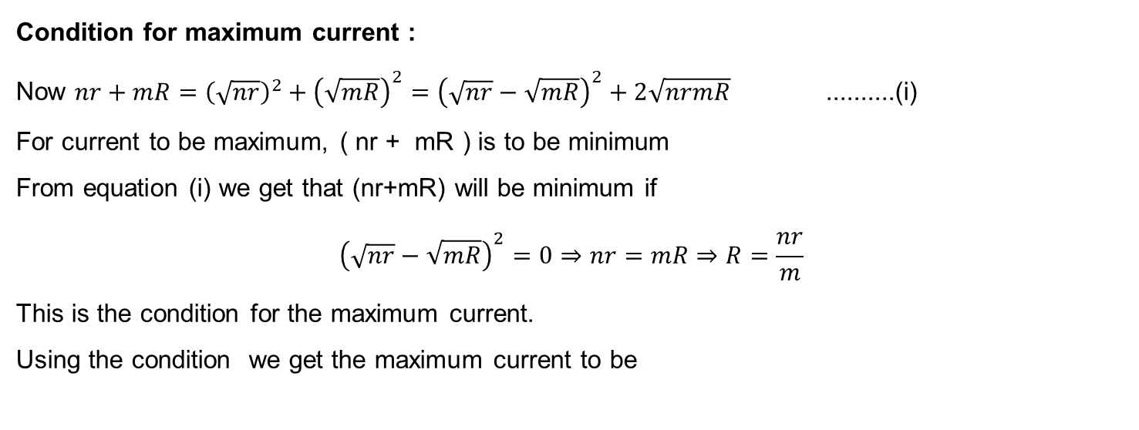
Mixed grouping
Condition for maximum current :
Now $nr+mR={\left(\sqrt{nr}\right)}^{2}+{\left(\sqrt{mR}\right)}^{2}={\left(\sqrt{nr}−\sqrt{mR}\right)}^{2}+2\sqrt{nrmR}$ ..........(i)
For current to be maximum, ( nr + mR ) is to be minimum
From equation (i) we get that (nr+mR) will be minimum if
$${\left(\sqrt{nr}−\sqrt{mR}\right)}^{2}=0⇒nr=mR⇒R=\frac{nr}{m}$$
This is the condition for the maximum current.
Using the condition we get the maximum current to be

Slide 16
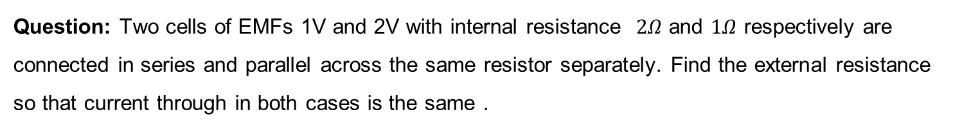
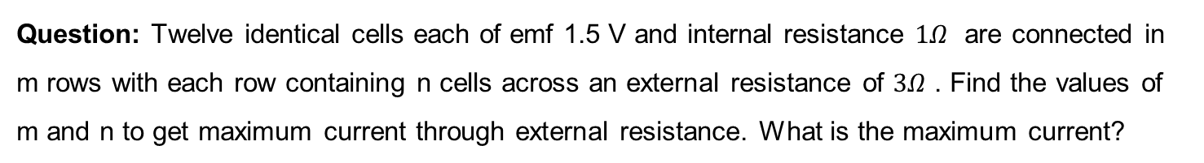
HOME ASSIGNMENT
Question: Two cells of EMFs 1V and 2V with internal resistance $2Ω$ and $1Ω$ respectively are connected in series and parallel across the same resistor separately. Find the external resistance so that current through in both cases is the same .
Question: Twelve identical cells each of emf 1.5 V and internal resistance $1Ω$ are connected in m rows with each row containing n cells across an external resistance of $3Ω$ . Find the values of m and n to get maximum current through external resistance. What is the maximum current?

Slide 17
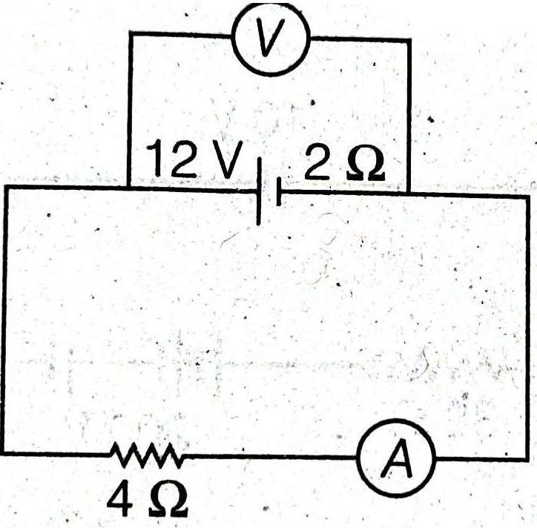
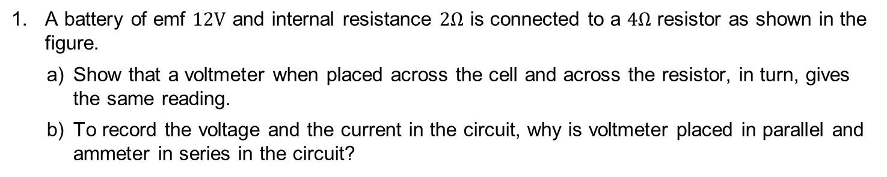
Home Assignment
A battery of emf $12V$ and internal resistance $2Ω$ is connected to a $4Ω$ resistor as shown in the figure.
Show that a voltmeter when placed across the cell and across the resistor, in turn, gives the same reading.
To record the voltage and the current in the circuit, why is voltmeter placed in parallel and ammeter in series in the circuit?

Slide 18
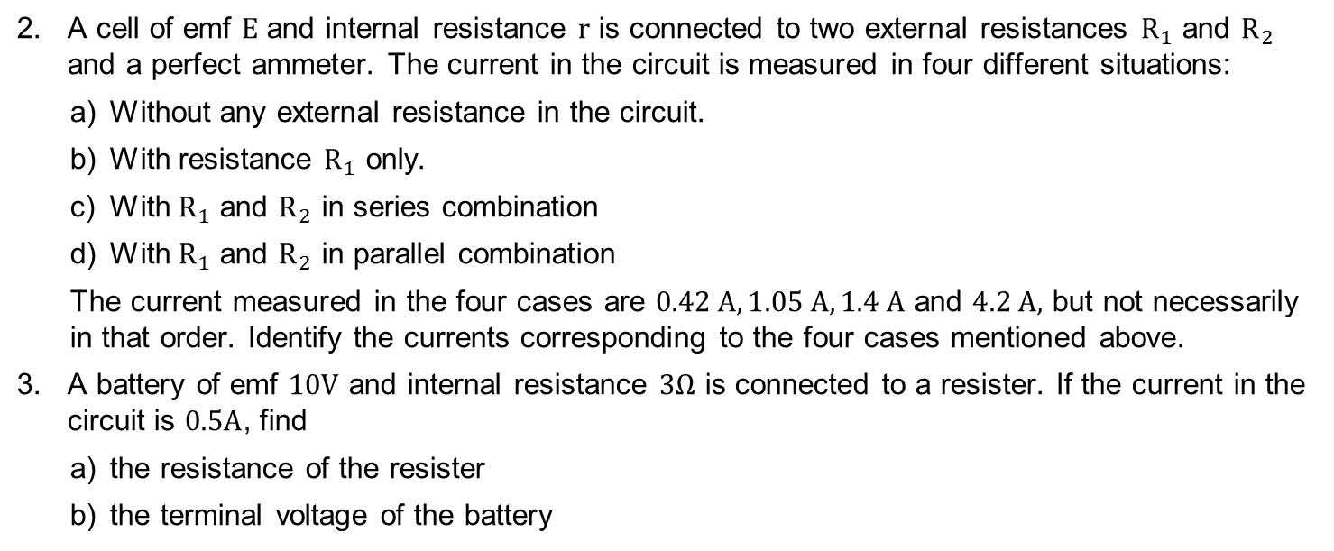
HOME ASSIGNMENT
A cell of emf $E$ and internal resistance $r$ is connected to two external resistances $R_{1}$ and $R_{2}$ and a perfect ammeter. The current in the circuit is measured in four different situations:
Without any external resistance in the circuit.
With resistance $R_{1}$ only.
With $R_{1}$ and $R_{2}$ in series combination
With $R_{1}$ and $R_{2}$ in parallel combination
The current measured in the four cases are $0.42 A, 1.05 A, 1.4 A$ and $4.2 A,$ but not necessarily in that order. Identify the currents corresponding to the four cases mentioned above.
A battery of emf $10V$ and internal resistance $3Ω$ is connected to a resister. If the current in the circuit is $0.5A$, find
the resistance of the resister
the terminal voltage of the battery

Slide 19
THANKING YOU
ODM EDUCATIONAL GROUP

