Slide 1


Internal resistance of a cell,
Potential difference
and EMF of a cell
CLASS-XII
SUBJECT : PHYSICS
CHAPTER NUMBER: 03
CHAPTER NAME : CURRENT ELECTRICITY

Slide 2
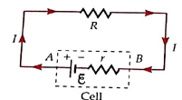
Cell
Cell:- Cell is a device that is used in electric dc circuits to supply electrical power or current to maintain a constant potential difference across the resistances. Its circuit symbol is as shown in the circuit between A and B. A group of cells is called a battery.

Slide 3
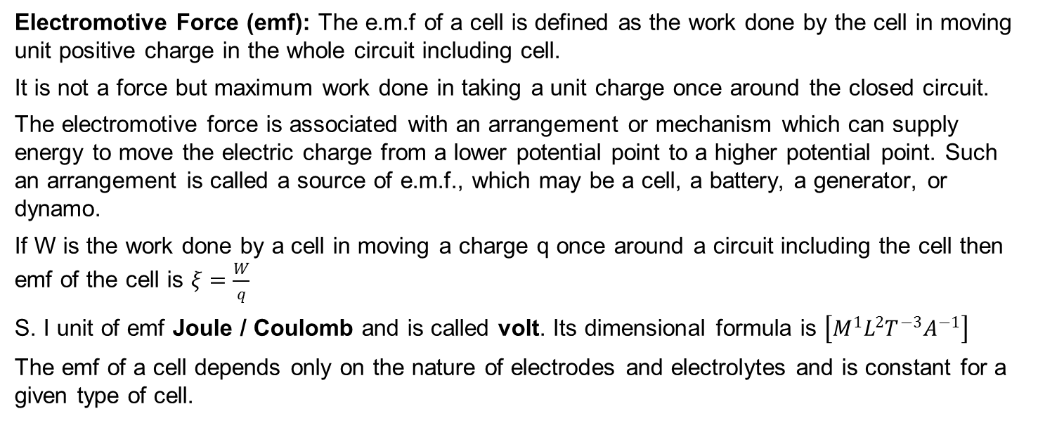
Electromotive Force
Electromotive Force (emf): The e.m.f of a cell is defined as the work done by the cell in moving unit positive charge in the whole circuit including cell.
It is not a force but maximum work done in taking a unit charge once around the closed circuit.
The electromotive force is associated with an arrangement or mechanism which can supply energy to move the electric charge from a lower potential point to a higher potential point. Such an arrangement is called a source of e.m.f., which may be a cell, a battery, a generator, or dynamo.
If W is the work done by a cell in moving a charge q once around a circuit including the cell then emf of the cell is $ξ=\frac{W}{q}$
S. I unit of emf Joule / Coulomb and is called volt. Its dimensional formula is $\left[M^{1}L^{2}T^{−3}A^{−1}\right]$
The emf of a cell depends only on the nature of electrodes and electrolytes and is constant for a given type of cell.

Slide 4
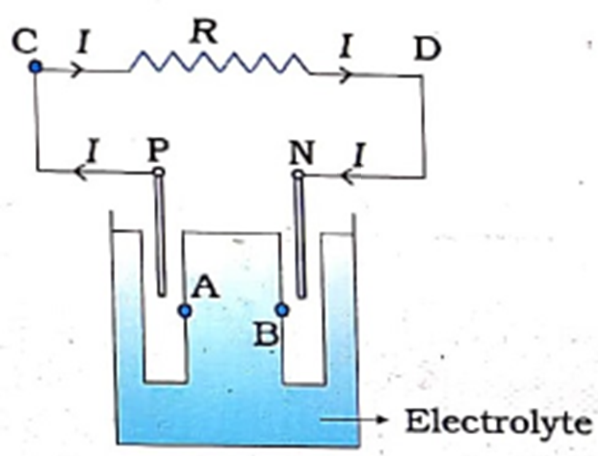
Mechanism of emf
Let P be the positive electrode and N be the negative electrode.
A is a point of electrolyte very close to P and B is a point of electrolyte very close to N.

Slide 5
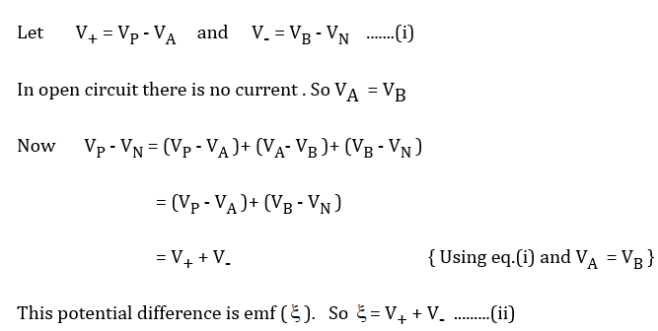
Mechanism of emf
Let P be the positive electrode and N be the negative electrode.
A is a point of electrolyte very close to P and B is a point of electrolyte very close to N.
As the electrolyte is dissociated then positive ions and negative ions are formed. Due battery force +ve ions move towards P and gathered there and -ve ions move towards N and gathered there. So the potential of P becomes greater than A and the potential of N becomes less than that of N.

Slide 6
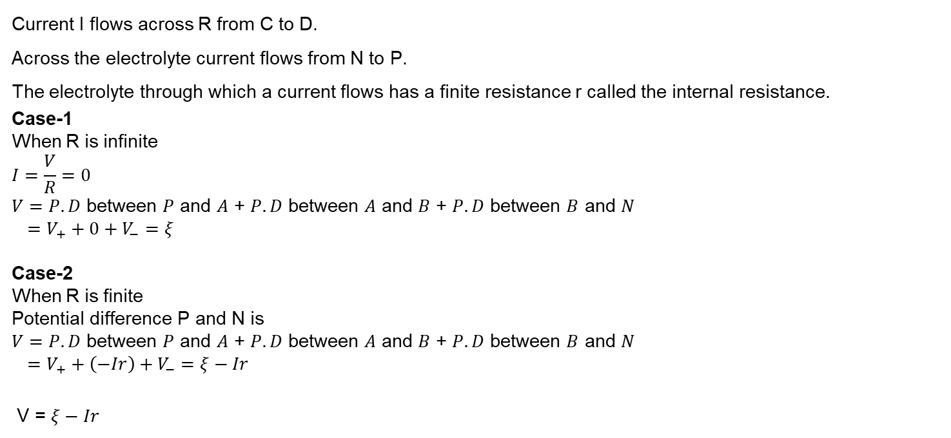
Mechanism of emf
Current I flows across R from C to D.
Across the electrolyte current flows from N to P.
The electrolyte through which a current flows has a finite resistance r called the internal resistance.
Case-1
When R is infinite
$$I=\frac{V}{R}=0$$
$V=P.D$ between $P$ and $A$ + $P.D$ between $A$ and $B$ + $P.D$ between $B$ and $N$
$=V_{+}+0+V_{−}=ξ$
Case-2
When R is finite
Potential difference P and N is
$V=P.D$ between $P$ and $A$ + $P.D$ between $A$ and $B$ + $P.D$ between $B$ and $N$
$=V_{+}+\left(−Ir\right)+V_{−}=ξ−Ir$
V = $ξ−Ir$

Slide 7
Internal Resistance of a cell:
The opposition offered by the electrolyte of the cell to the flow of electric current through it is called the internal resistance of the cell.
Factors affecting Internal Resistance of a cell:
Larger the separation between the electrodes of the cell, more the length of the electrolyte through which current has to flow and consequently a higher value of internal resistance.
Greater the conductivity of the electrolyte, lesser is the internal resistance of the cell. i.e. internal resistance depends on the nature of the electrolyte.
The internal resistance of a cell is inversely proportional to the common area of the electrodes dipping in the electrolyte.
The internal resistance of a cell depends on the nature of the electrodes.
E = V + v
= IR + Ir
= I (R + r)
I = E / (R + r)
This relation is called circuit equation.
E
r
v
I
I
R
V

Slide 8
Internal Resistance of a cell in terms of E,V and R:
E = V + v
= V + Ir
Ir = E - V
Dividing by IR = V,
Ir E – V
=
IR V
E
r
v
I
I
R
E
r = ( - 1) R
V
V
Determination of Internal Resistance of a cell by voltmeter method:
V
V
+
+
r
r
I
I
R.B (R)
R.B (R)
K
K
Open circuit (No current is drawn)
EMF (E) is measured
Closed circuit (Current is drawn)
Potential Difference (V) is measured

Slide 9
Sources of emf:
The electro motive force is the maximum potential difference between the two electrodes of the cell when no current is drawn from the cell.
Comparison of EMF and P.D:
 | EMF | Potential Difference
1 | EMF is the maximum potential difference between the two electrodes of the cell when no current is drawn from the cell i.e. when the circuit is open. | P.D is the difference of potentials between any two points in a closed circuit.
2 | It is independent of the resistance of the circuit. | It is proportional to the resistance between the given points.
3 | The term ‘emf’ is used only for the source of emf. | It is measured between any two points of the circuit.
4 | It is greater than the potential difference between any two points in a circuit. | However, p.d. is greater than emf when the cell is being charged.

Slide 10
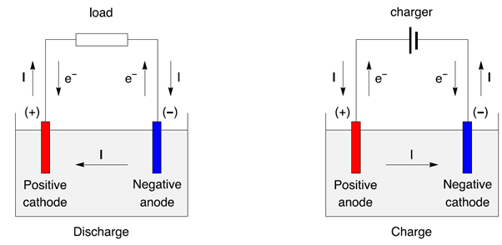
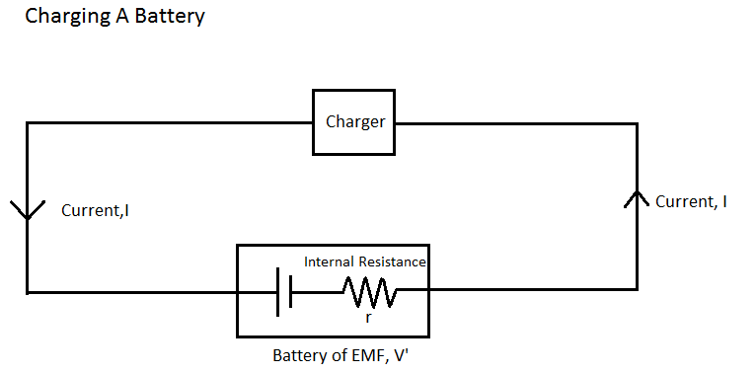
Charging and discharging of cells
During discharging of cells the electrodes are connected by a resistance R.
During the charging of cells, the electrodes are connected by a charging source of high voltage V.

Slide 11
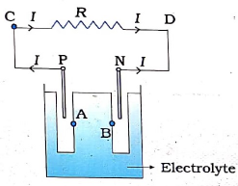
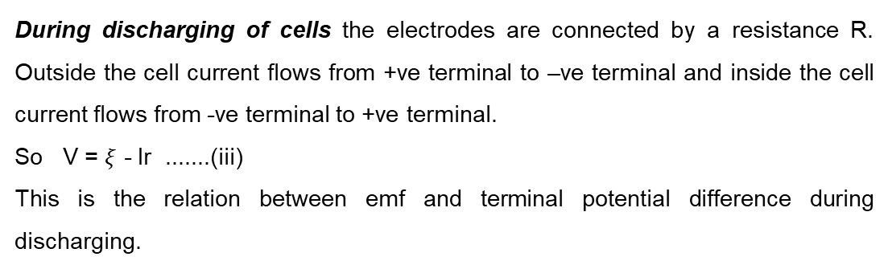
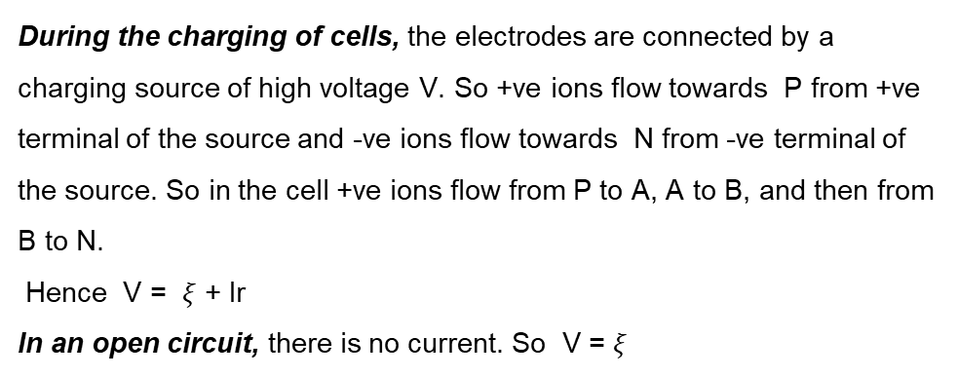
Charging and discharging of cells
During discharging of cells the electrodes are connected by a resistance R. Outside the cell current flows from +ve terminal to –ve terminal and inside the cell current flows from -ve terminal to +ve terminal.
So V = $ξ$ - Ir .......(iii)
This is the relation between emf and terminal potential difference during discharging.
During the charging of cells, the electrodes are connected by a charging source of high voltage V. So +ve ions flow towards P from +ve terminal of the source and -ve ions flow towards N from -ve terminal of the source. So in the cell +ve ions flow from P to A, A to B, and then from B to N.
Hence V = $ξ$ + Ir
In an open circuit, there is no current. So V = $ξ$

Slide 12
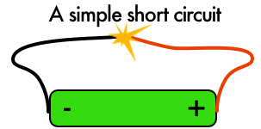
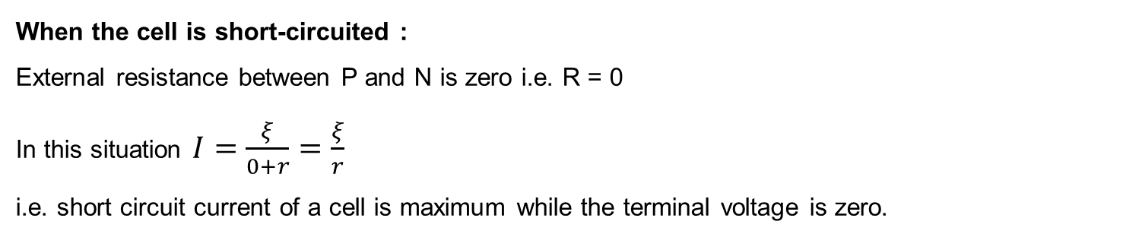
During the charging of cells
When the cell is short-circuited :
External resistance between P and N is zero i.e. R = 0
In this situation $I=\frac{ξ}{0+r}=\frac{ξ}{r}$
i.e. short circuit current of a cell is maximum while the terminal voltage is zero.

Slide 13
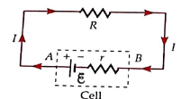
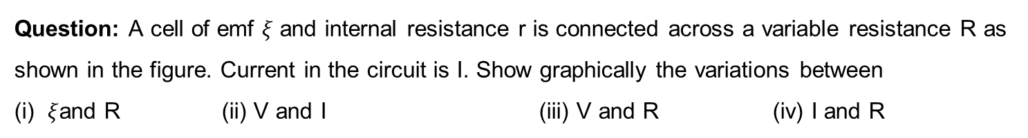
Numerical
Question: A cell of emf $ξ$ and internal resistance r is connected across a variable resistance R as shown in the figure. Current in the circuit is I. Show graphically the variations between
(i) $ξ$and R (ii) V and I (iii) V and R (iv) I and R

Slide 14
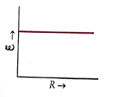
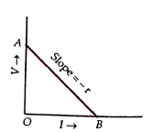

Numerical
Solution:
As $ξ$ is independent of R, so the graph is
(ii) Since $V=ξ−Ir=−rI+ξ$
So the graph between $V$ and $I$ is a straight line
with slope = $−r$
y-intercept = $ξ$
x-intercept = $\frac{ξ}{r}$

Slide 15
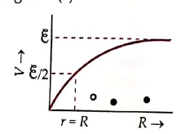
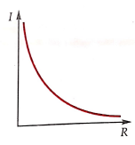

Numerical
Solution:
(iii) Since $V=IR=\frac{ξR}{r+R}=\frac{ξ}{1+\frac{r}{R}}$
For $R=0⇒V=\frac{ξ}{1+\frac{r}{0}}=\frac{ξ}{∞}=0$
For $R=∞⇒V=\frac{ξ}{1+\frac{r}{∞}}=ξ$
(iv) Since $I=\frac{ξ}{r+R}$
For $R=0⇒I=\frac{ξ}{r+0}=\frac{ξ}{r}$
For $R=∞⇒I=\frac{ξ}{r+∞}=\frac{ξ}{∞}=0$

Slide 16
Numerical
Question: The storage battery of a car has an emf of 12 V. If the internal resistance of the battery is 0.4 $Ω$ , what is the maximum current that can be drawn from the battery? (NCERT)

Slide 17

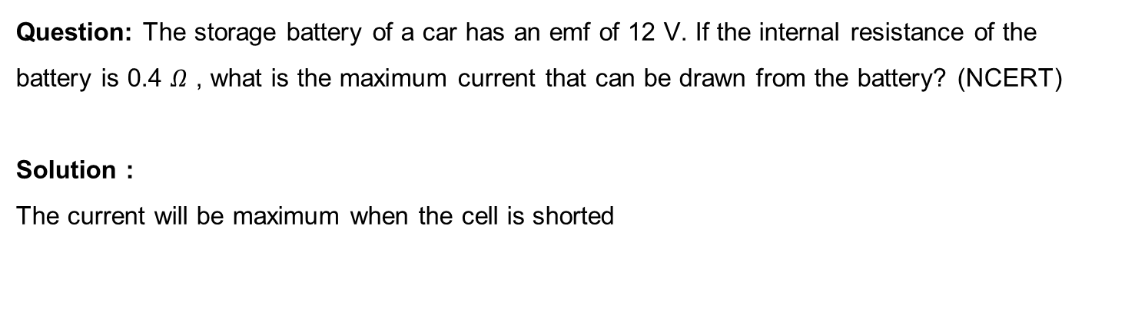
Numerical
Question: The storage battery of a car has an emf of 12 V. If the internal resistance of the battery is 0.4 $Ω$ , what is the maximum current that can be drawn from the battery? (NCERT)
Solution :
The current will be maximum when the cell is shorted

Slide 18
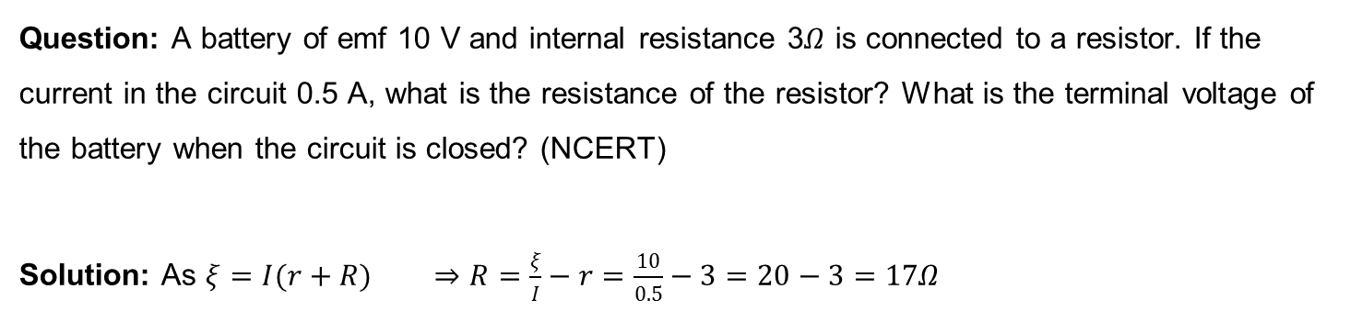
Numerical
Question: A battery of emf 10 V and internal resistance 3$Ω$ is connected to a resistor. If the current in the circuit 0.5 A, what is the resistance of the resistor? What is the terminal voltage of the battery when the circuit is closed? (NCERT)
Solution: As $ξ=I(r+R)$ $⇒R=\frac{ξ}{I}−r=\frac{10}{0.5}−3=20−3=17Ω$

Slide 19
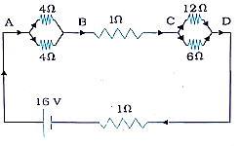
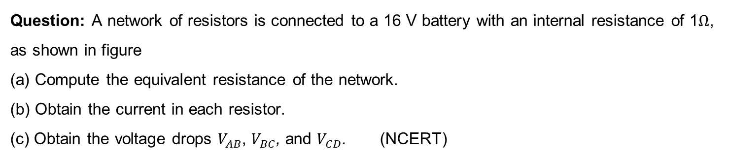
Numerical
Question: A network of resistors is connected to a 16 V battery with an internal resistance of 1$Ω$, as shown in figure
(a) Compute the equivalent resistance of the network.
(b) Obtain the current in each resistor.
(c) Obtain the voltage drops $V_{AB}$, $V_{BC}$, and $V_{CD}$. (NCERT)

Slide 20
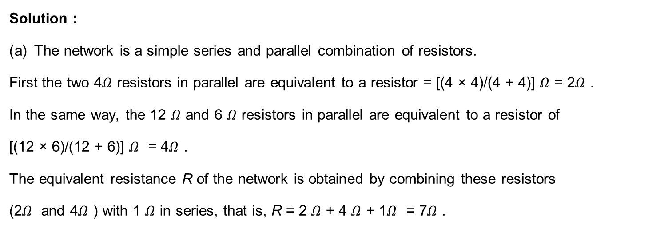
Numerical
Solution :
The network is a simple series and parallel combination of resistors.
First the two 4$Ω$ resistors in parallel are equivalent to a resistor = [(4 × 4)/(4 + 4)] $Ω$ = 2$Ω$ .
In the same way, the 12 $Ω$ and 6 $Ω$ resistors in parallel are equivalent to a resistor of
[(12 × 6)/(12 + 6)] $Ω$ = 4$Ω$ .
The equivalent resistance R of the network is obtained by combining these resistors
(2$Ω$ and 4$Ω$ ) with 1 $Ω$ in series, that is, R = 2 $Ω$ + 4 $Ω$ + 1$Ω$ = 7$Ω$ .

Slide 21
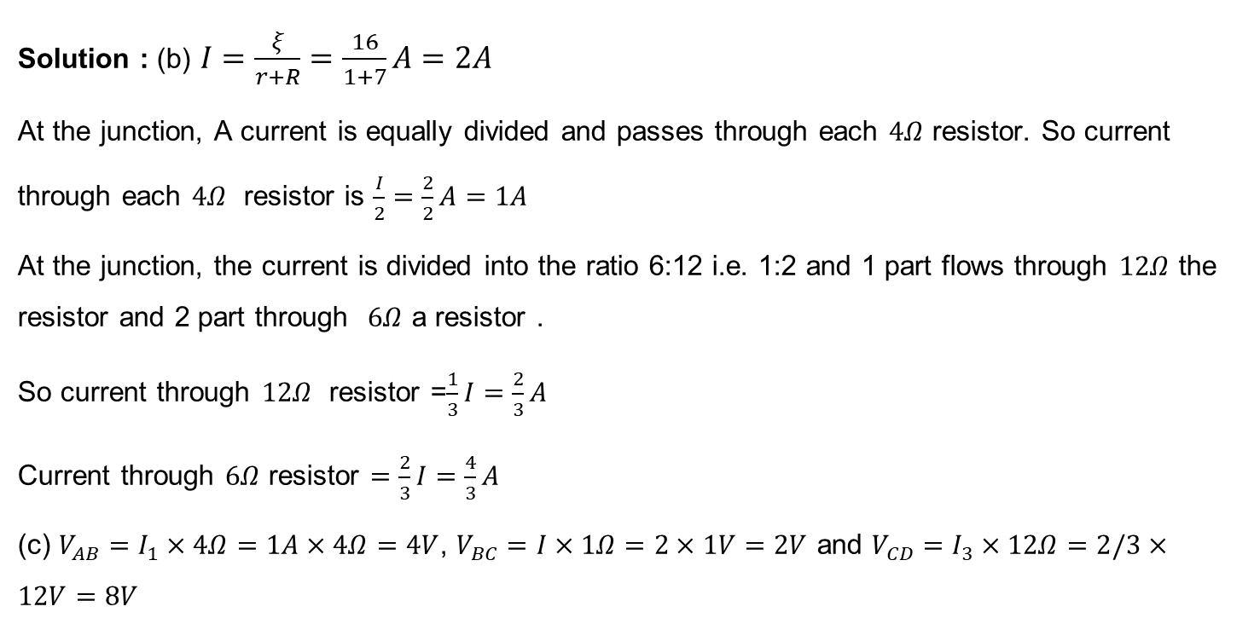
Numerical
Solution : (b) $I=\frac{ξ}{r+R}=\frac{16}{1+7}A=2A$
At the junction, A current is equally divided and passes through each $4Ω$ resistor. So current through each $4Ω$ resistor is $\frac{I}{2}=\frac{2}{2}A=1A$
At the junction, the current is divided into the ratio 6:12 i.e. 1:2 and 1 part flows through $12Ω$ the resistor and 2 part through $6Ω$ a resistor .
So current through $12Ω$ resistor =$\frac{1}{3}I=\frac{2}{3}A$
Current through $6Ω$ resistor $=\frac{2}{3}I=\frac{4}{3}A$
(c) $V_{AB}=I_{1}×4Ω=1A×4Ω=4V$, $V_{BC}=I×1Ω=2×1V=2V$ and $V_{CD}=I_{3}×12Ω=2/3×12V=8V$

Slide 22
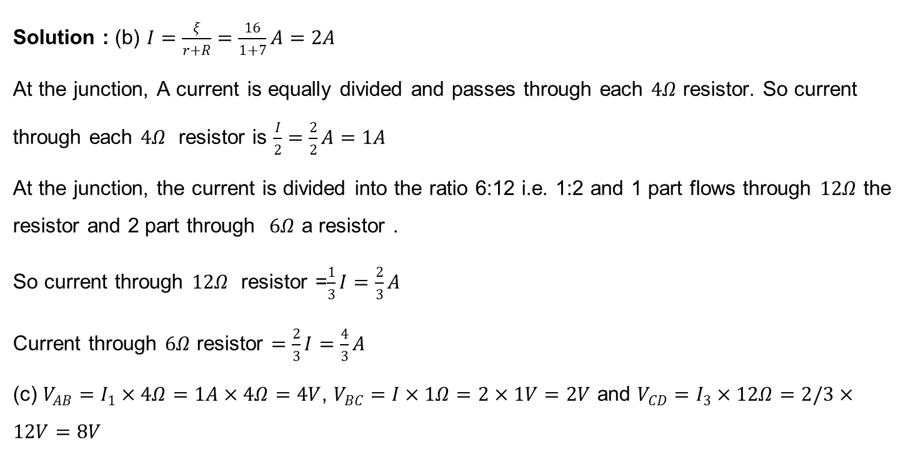
Numerical
Solution : (b) $I=\frac{ξ}{r+R}=\frac{16}{1+7}A=2A$
At the junction, A current is equally divided and passes through each $4Ω$ resistor. So current through each $4Ω$ resistor is $\frac{I}{2}=\frac{2}{2}A=1A$
At the junction, the current is divided into the ratio 6:12 i.e. 1:2 and 1 part flows through $12Ω$ the resistor and 2 part through $6Ω$ a resistor .
So current through $12Ω$ resistor =$\frac{1}{3}I=\frac{2}{3}A$
Current through $6Ω$ resistor $=\frac{2}{3}I=\frac{4}{3}A$
(c) $V_{AB}=I_{1}×4Ω=1A×4Ω=4V$, $V_{BC}=I×1Ω=2×1V=2V$ and $V_{CD}=I_{3}×12Ω=2/3×12V=8V$

Slide 23
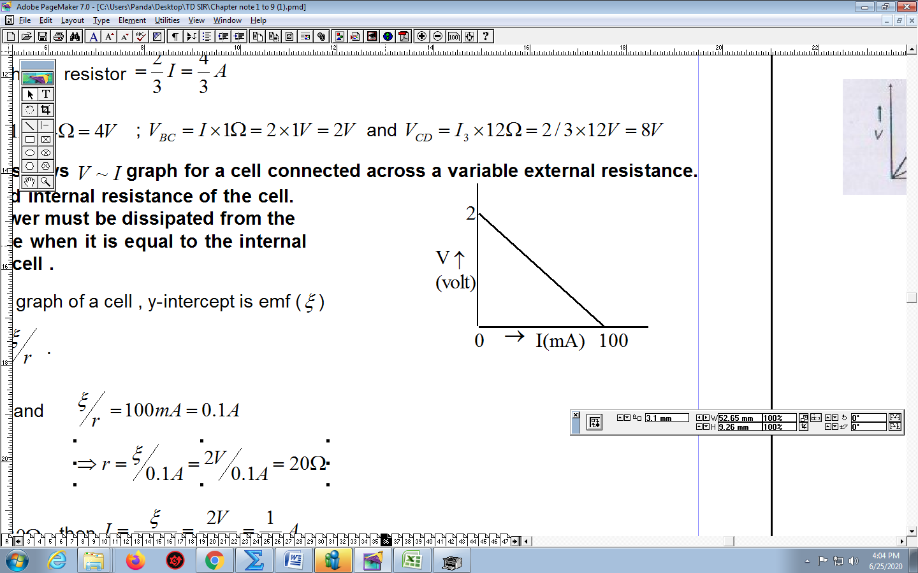

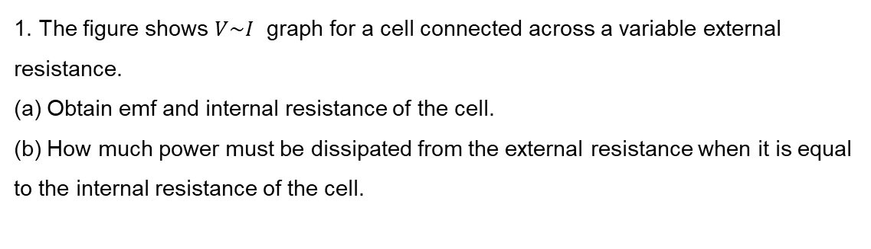
HOME ASSIGNMENT
1. The figure shows $V\sim I$ graph for a cell connected across a variable external resistance.
(a) Obtain emf and internal resistance of the cell.
(b) How much power must be dissipated from the external resistance when it is equal to the internal resistance of the cell.
2. A variable resistance R is connected across a cell of emf E and internal resistance r.
(a) Obtain an expression for current through R and power dissipated from R.
(b) When will the current be minimum? Find the minimum current. What is the power dissipation in this case?
(c) When will the power dissipation be maximum? What is the maximum power dissipated? What is the current in this case?
3. In the given circuit cells E₁ and E₂ have EMFs 3V and 5V respectively and internal resistances 0.3$Ω$ and 1.2$Ω$ respectively. Find the current through the circuit

Slide 24
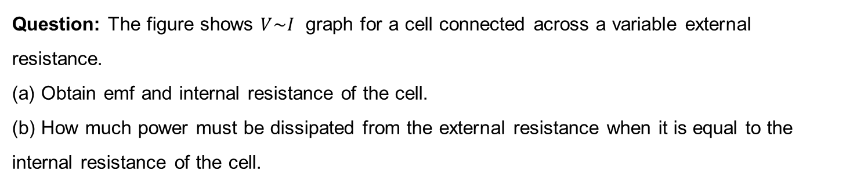
Numerical
Question: The figure shows $V\sim I$ graph for a cell connected across a variable external resistance.
(a) Obtain emf and internal resistance of the cell.
(b) How much power must be dissipated from the external resistance when it is equal to the internal resistance of the cell.

Slide 25
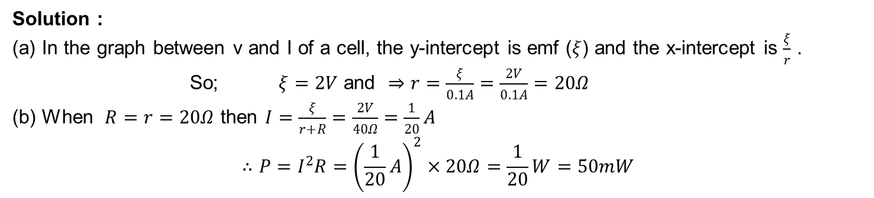
Numerical
Solution :
(a) In the graph between v and I of a cell, the y-intercept is emf ($ξ$) and the x-intercept is $\frac{ξ}{r}$ .
So; $ξ=2V$ and $⇒r=\frac{ξ}{0.1A}=\frac{2V}{0.1A}=20Ω$
(b) When $R=r=20Ω$ then $I=\frac{ξ}{r+R}=\frac{2V}{40Ω}=\frac{1}{20}A$
$$∴P=I^{2}R={\left(\frac{1}{20}A\right)}^{2}×20Ω=\frac{1}{20}W=50mW$$

Slide 26
Numerical
Question: A variable resistance R is connected across a cell of emf E and internal resistance r.
(a) Obtain an expression for current through R and power dissipated from R.
(b) When will the current be minimum? Find the minimum current. What is the power dissipation in this case?
(c) When will the power dissipation be maximum? What is the maximum power dissipated? What is the current in this case?

Slide 27
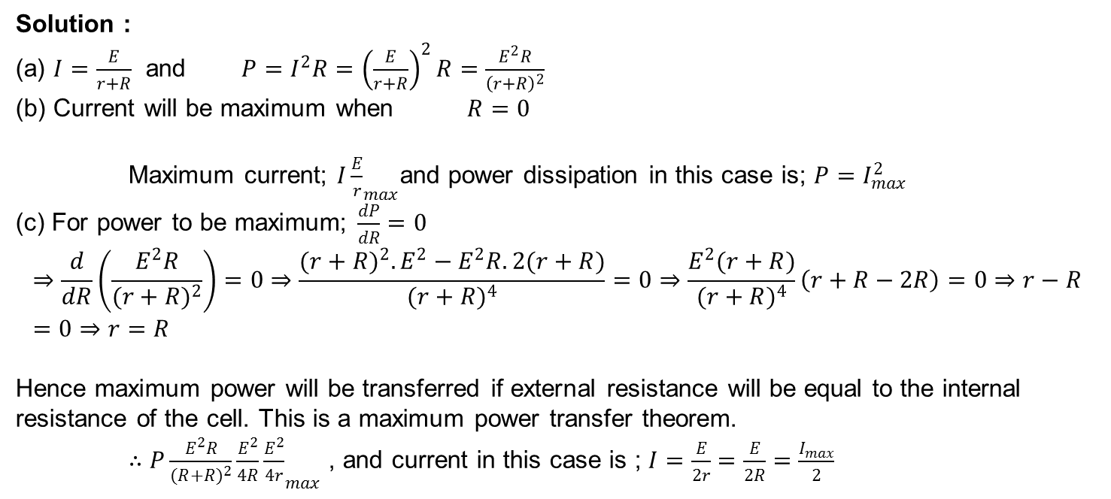
Numerical
Solution :
(a) $I=\frac{E}{r+R}$ and $P=I^{2}R={\left(\frac{E}{r+R}\right)}^{2}R=\frac{E^{2}R}{{\left(r+R\right)}^{2}}$
(b) Current will be maximum when $R=0$
Maximum current; ${I\frac{E}{r}}_{max}$and power dissipation in this case is; $P=I_{max}^{2}$
(c) For power to be maximum; $\frac{dP}{dR}=0$
$$⇒\frac{d}{dR}\left(\frac{E^{2}R}{(r+R)^{2}}\right)=0⇒\frac{(r+R)^{2}.E^{2}−E^{2}R.2(r+R)}{(r+R)^{4}}=0⇒\frac{E^{2}(r+R)}{(r+R)^{4}}\left(r+R−2R\right)=0⇒r−R=0⇒r=R$$
Hence maximum power will be transferred if external resistance will be equal to the internal resistance of the cell. This is a maximum power transfer theorem.
$∴{P\frac{E^{2}R}{(R+R)^{2}}\frac{E^{2}}{4R}\frac{E^{2}}{4r}}_{max}$ , and current in this case is ; $I=\frac{E}{2r}=\frac{E}{2R}=\frac{I_{max}}{2}$

Slide 28
Numerical
Question: What is the efficiency of a cell? What will be its efficiency while delivering maximum power?

Slide 29
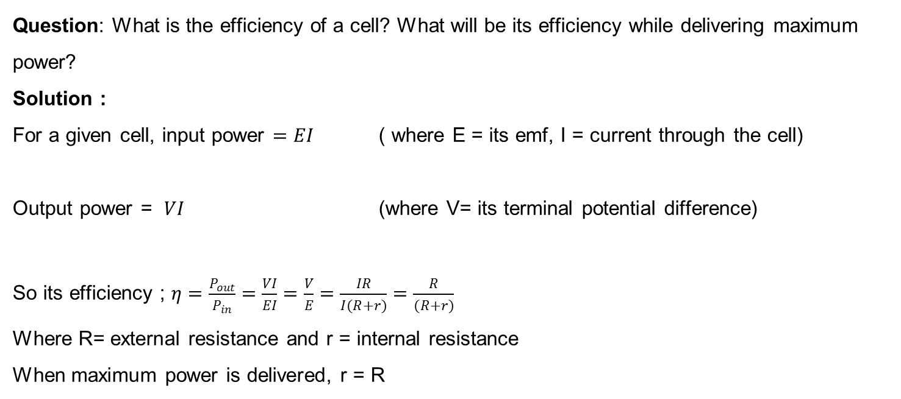
Numerical
Question: What is the efficiency of a cell? What will be its efficiency while delivering maximum power?
Solution :
For a given cell, input power $=EI$ ( where E = its emf, I = current through the cell)
Output power = $VI$ (where V= its terminal potential difference)
So its efficiency ; $η=\frac{P_{out}}{P_{in}}=\frac{VI}{EI}=\frac{V}{E}=\frac{IR}{I(R+r)}=\frac{R}{(R+r)}$
Where R= external resistance and r = internal resistance
When maximum power is delivered, r = R

Slide 30
Numerical
Question: Answer the following questions :
(a) A steady current flows in a metallic conductor of a non-uniform cross-section. Which of the quantities is constant along the conductor: current, current density, electric field, drift speed?
(b) Is Ohm’s law universally applicable for all conducting elements? If not, give examples of elements that don’t obey Ohm’s law.
(c) A low voltage supply from which one needs high currents must have very low internal resistance. Why?
(d) A high tension (HT) supply of , say 6 kV must have a very large internal resistance . Why ?

Slide 31
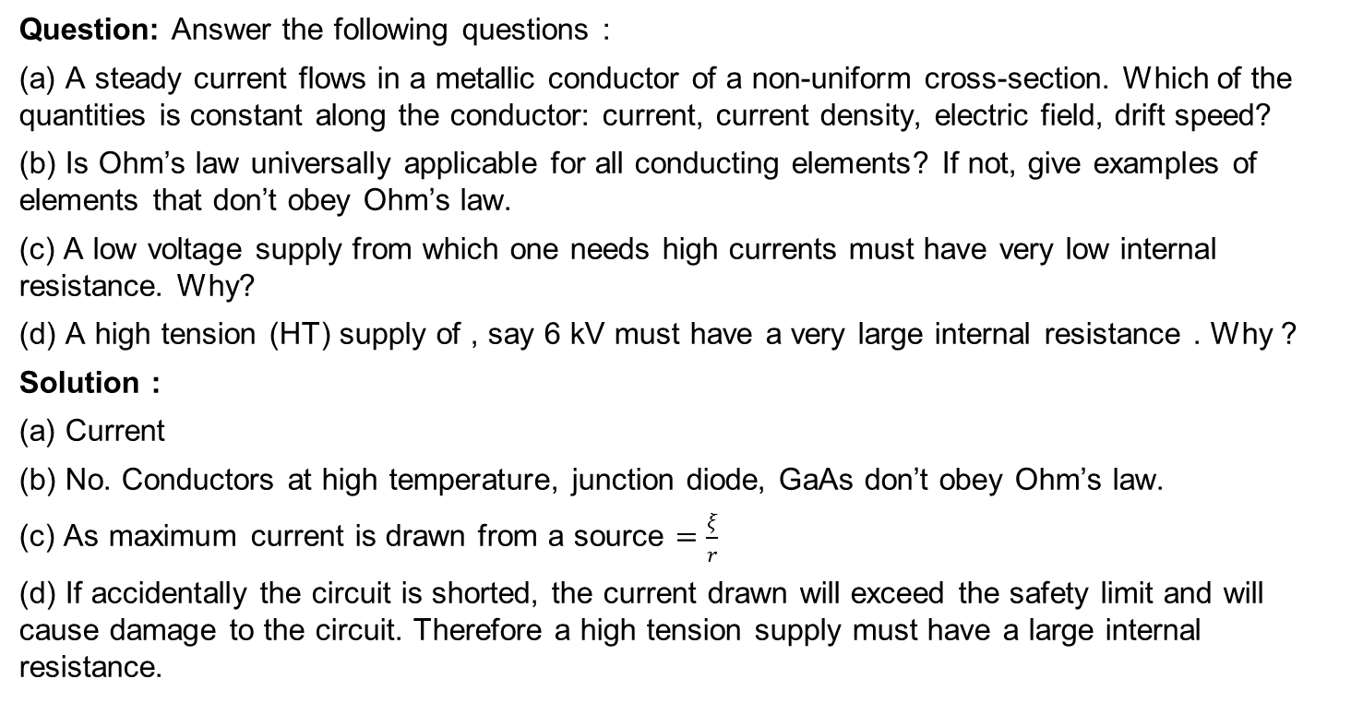
Numerical
Question: Answer the following questions :
(a) A steady current flows in a metallic conductor of a non-uniform cross-section. Which of the quantities is constant along the conductor: current, current density, electric field, drift speed?
(b) Is Ohm’s law universally applicable for all conducting elements? If not, give examples of elements that don’t obey Ohm’s law.
(c) A low voltage supply from which one needs high currents must have very low internal resistance. Why?
(d) A high tension (HT) supply of , say 6 kV must have a very large internal resistance . Why ?
Solution :
(a) Current
(b) No. Conductors at high temperature, junction diode, GaAs don’t obey Ohm’s law.
(c) As maximum current is drawn from a source $=\frac{ξ}{r}$
(d) If accidentally the circuit is shorted, the current drawn will exceed the safety limit and will cause damage to the circuit. Therefore a high tension supply must have a large internal resistance.

Slide 32
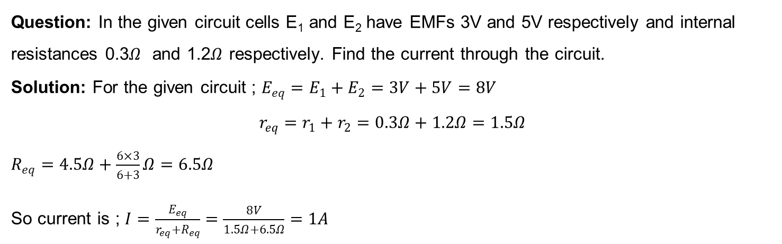
Numerical
Question: In the given circuit cells E₁ and E₂ have EMFs 3V and 5V respectively and internal resistances 0.3$Ω$ and 1.2$Ω$ respectively. Find the current through the circuit.
Solution: For the given circuit ; $E_{eq}=E_{1}+E_{2}=3V+5V=8V$
$$r_{eq}=r_{1}+r_{2}=0.3Ω+1.2Ω=1.5Ω$$
$R_{eq}=4.5Ω+\frac{6×3}{6+3}Ω=6.5Ω$
So current is ; $I=\frac{E_{eq}}{r_{eq}+R_{eq}}=\frac{8V}{1.5Ω+6.5Ω}=1A$

Slide 33

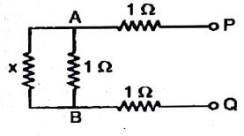
Numerical
Question: Determine the current and power drawn from a 12 V supply with internal resistance $0.5Ω$ by infinite network shown in the figure.

Slide 34
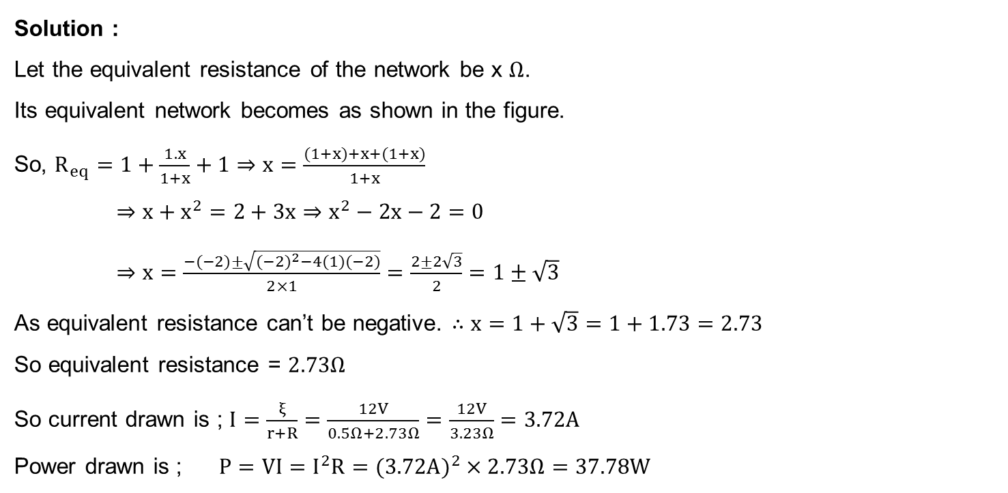
Numerical
Solution :
Let the equivalent resistance of the network be x $Ω$.
Its equivalent network becomes as shown in the figure.
So, $R_{eq}=1+\frac{1.x}{1+x}+1⇒x=\frac{(1+x)+x+(1+x)}{1+x}$
$⇒x+x^{2}=2+3x⇒x^{2}−2x−2=0$
$⇒x=\frac{−(−2)±\sqrt{(−2)^{2}−4(1)(−2)}}{2×1}=\frac{2±2\sqrt{3}}{2}=1±\sqrt{3}$
As equivalent resistance can’t be negative. $∴x=1+\sqrt{3}=1+1.73=2.73$
So equivalent resistance = $2.73Ω$
So current drawn is ; $I=\frac{ξ}{r+R}=\frac{12V}{0.5Ω+2.73Ω}=\frac{12V}{3.23Ω}=3.72A$
Power drawn is ; $P=VI=I^{2}R=(3.72A)^{2}×2.73Ω=37.78W$

Slide 35
THANKING YOU
ODM EDUCATIONAL GROUP

