Slide 1


Temperature Dependence of Resistance
CLASS-XII
SUBJECT : PHYSICS
CHAPTER NUMBER: 03
CHAPTER NAME : CURRENT ELECTRICITY

Slide 2
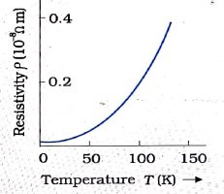
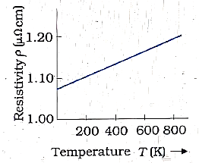
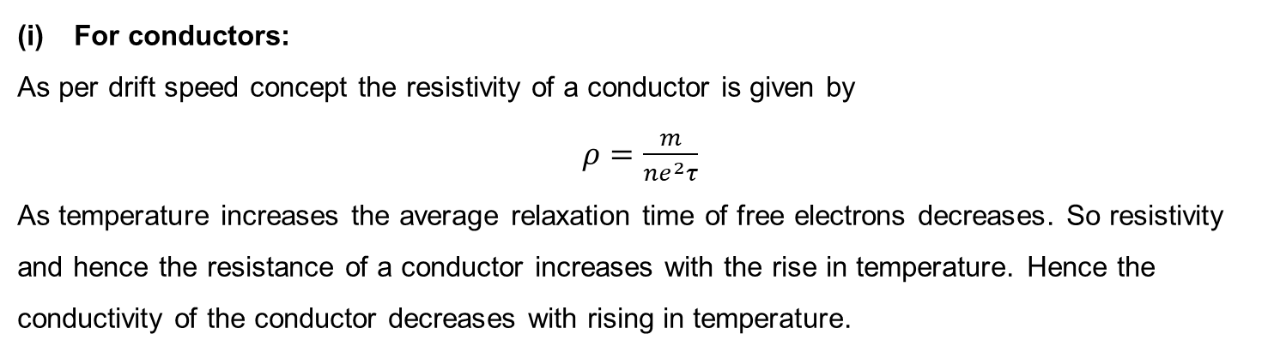
Temperature dependence of resistance
For conductors:
As per drift speed concept the resistivity of a conductor is given by
$ρ=\frac{m}{ne^{2}τ}$
As temperature increases the average relaxation time of free electrons decreases. So resistivity and hence the resistance of a conductor increases with the rise in temperature. Hence the conductivity of the conductor decreases with rising in temperature.
For metals (like copper)
For Alloys (like nichrome)

Slide 3
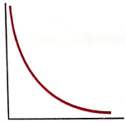
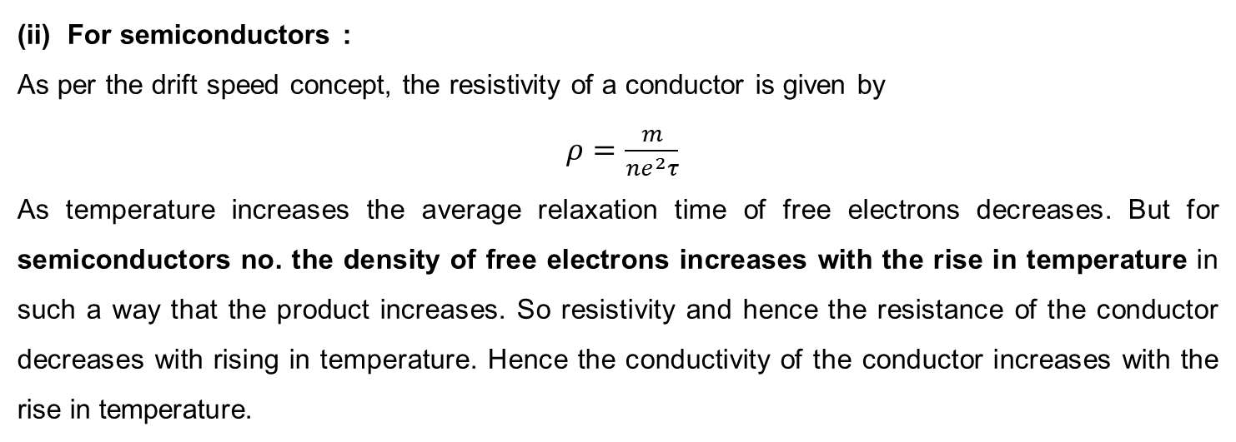
Temperature dependence of resistance
(ii) For semiconductors :
As per the drift speed concept, the resistivity of a conductor is given by
$ρ=\frac{m}{ne^{2}τ}$
As temperature increases the average relaxation time of free electrons decreases. But for semiconductors no. the density of free electrons increases with the rise in temperature in such a way that the product increases. So resistivity and hence the resistance of the conductor decreases with rising in temperature. Hence the conductivity of the conductor increases with the rise in temperature.

Slide 4
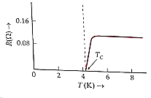
Temperature dependence of resistance
(iii) For insulators: For insulators, the resistivity decreases with rise in temperature.
(iv) Superconductor: There exist some materials whose resistivity decreases on lowering the temperature and below a temperature called the critical temperature the resistivity becomes 0. This property is called superconductivity.

Slide 5
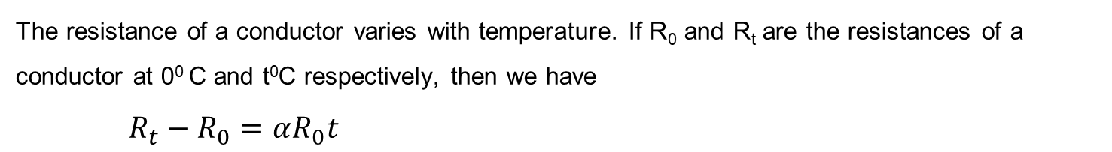
Temperature coefficient of resistance
The resistance of a conductor varies with temperature. If R₀ and R_{t} are the resistances of a conductor at 0⁰ C and t⁰C respectively, then we have
$R_{t}−R_{0}=αR_{0}t$

Slide 6
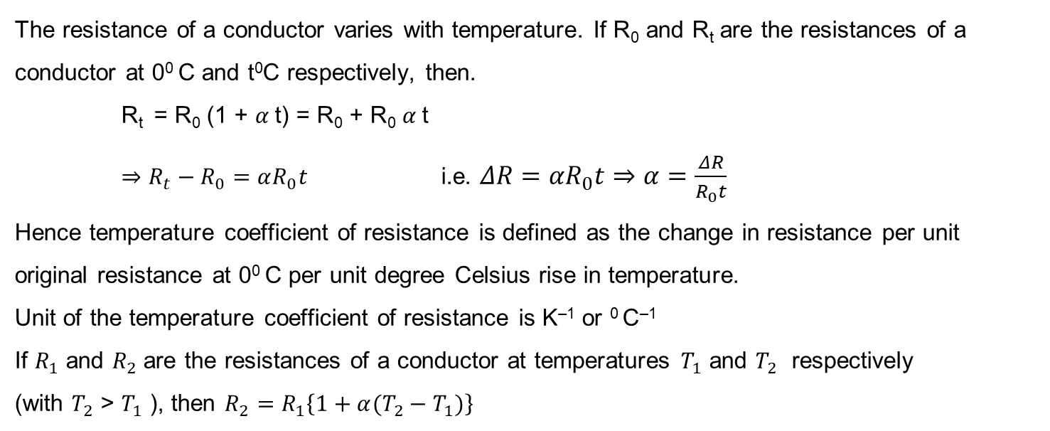
Temperature coefficient of resistance
The resistance of a conductor varies with temperature. If R₀ and R_{t} are the resistances of a conductor at 0⁰ C and t⁰C respectively, then.
R_{t} = R₀ (1 + $α$t) = R₀ + R₀ $α$t
$⇒R_{t}−R_{0}=αR_{0}t$ i.e. $ΔR=αR_{0}t⇒$ $α=\frac{ΔR}{R_{0}t}$
Hence temperature coefficient of resistance is defined as the change in resistance per unit original resistance at 0⁰ C per unit degree Celsius rise in temperature.
Unit of the temperature coefficient of resistance is K^{–1} or ⁰ C^{–1}
If $R_{1}$ and $R_{2}$are the resistances of a conductor at temperatures $T_{1}$ and $T_{2}$ respectively
(with $T_{2}$ > $T_{1}$ ), then $R_{2}=R_{1}\left\{1+α(T_{2}−T_{1})\right\}$

Slide 7
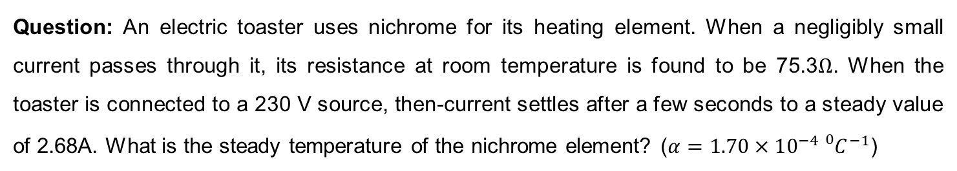
Numerical
Question: An electric toaster uses nichrome for its heating element. When a negligibly small current passes through it, its resistance at room temperature is found to be 75.3$Ω$. When the toaster is connected to a 230 V source, then-current settles after a few seconds to a steady value of 2.68A. What is the steady temperature of the nichrome element? ($α=1.70×10^{−4}{{}_{}^{0}C}^{−1}$)

Slide 8
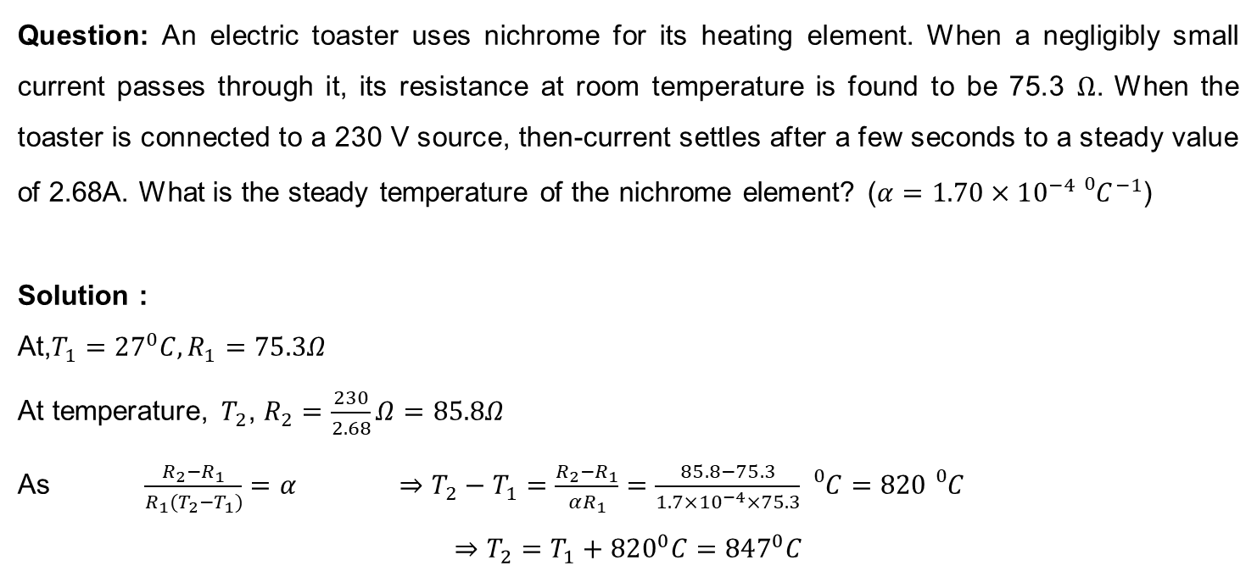
Numerical
Question: An electric toaster uses nichrome for its heating element. When a negligibly small current passes through it, its resistance at room temperature is found to be 75.3 $Ω$. When the toaster is connected to a 230 V source, then-current settles after a few seconds to a steady value of 2.68A. What is the steady temperature of the nichrome element? ($α=1.70×10^{−4}{{}_{}^{0}C}^{−1}$)
Solution :
At,$T_{1}=27^{0}C, R_{1}=75.3Ω$
At temperature, $T_{2}$, $R_{2}=\frac{230}{2.68}Ω=85.8Ω$
As $\frac{R_{2}−R_{1}}{R_{1}(T_{2}−T_{1})}=α$ $⇒T_{2}−T_{1}=\frac{R_{2}−R_{1}}{αR_{1}}=\frac{85.8−75.3}{1.7×10^{−4}×75.3}{}_{}^{0}C=820{}_{}^{0}C$
$$⇒T_{2}=T_{1}+820^{0}C=847^{0}C$$

Slide 9
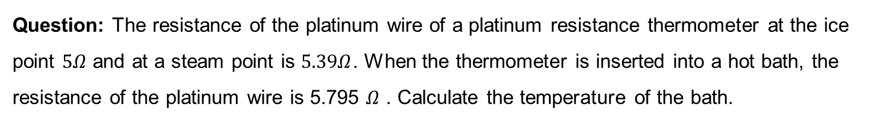
Numerical
Question: The resistance of the platinum wire of a platinum resistance thermometer at the ice point $5Ω$ and at a steam point is $5.39Ω$. When the thermometer is inserted into a hot bath, the resistance of the platinum wire is 5.795 $Ω$ . Calculate the temperature of the bath.

Slide 10
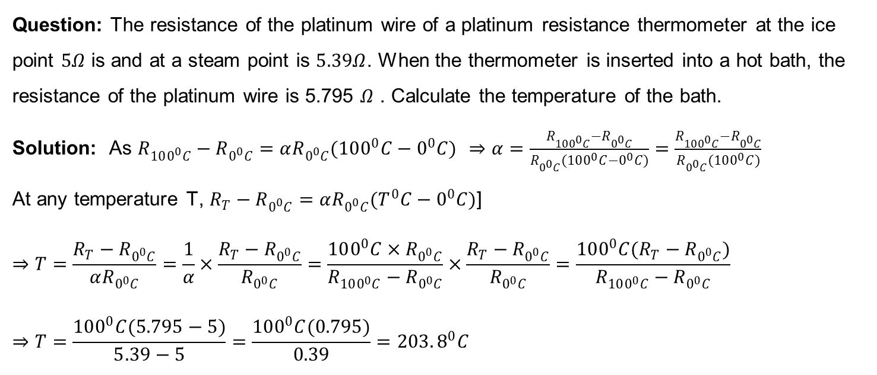
Numerical
Question: The resistance of the platinum wire of a platinum resistance thermometer at the ice point $5Ω$ is and at a steam point is $5.39Ω$. When the thermometer is inserted into a hot bath, the resistance of the platinum wire is 5.795 $Ω$ . Calculate the temperature of the bath.
Solution: As $R_{100^{0}C}−R_{0^{0}C}=αR_{0^{0}C}(100^{0}C−0^{0}C)$ $⇒α=\frac{R_{100^{0}C}−R_{0^{0}C}}{R_{0^{0}C}(100^{0}C−0^{0}C)}=\frac{R_{100^{0}C}−R_{0^{0}C}}{R_{0^{0}C}(100^{0}C)}$
At any temperature T, $R_{T}−R_{0^{0}C}=αR_{0^{0}C}(T^{0}C−0^{0}C)$]
$$⇒T=\frac{R_{T}−R_{0^{0}C}}{αR_{0^{0}C}}=\frac{1}{α}×\frac{R_{T}−R_{0^{0}C}}{R_{0^{0}C}}=\frac{100^{0}C×R_{0^{0}C}}{R_{100^{0}C}−R_{0^{0}C}}×\frac{R_{T}−R_{0^{0}C}}{R_{0^{0}C}}=\frac{100^{0}C(R_{T}−R_{0^{0}C})}{R_{100^{0}C}−R_{0^{0}C}}$$
$$⇒T=\frac{100^{0}C(5.795−5)}{5.39−5}=\frac{100^{0}C(0.795)}{0.39}=203.8^{0}C$$

Slide 11
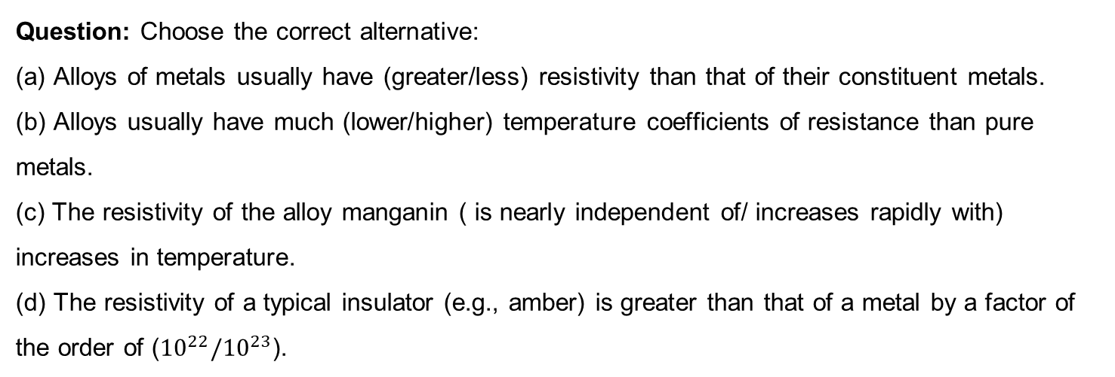
Numerical
Question: Choose the correct alternative:
(a) Alloys of metals usually have (greater/less) resistivity than that of their constituent metals.
(b) Alloys usually have much (lower/higher) temperature coefficients of resistance than pure metals.
(c) The resistivity of the alloy manganin ( is nearly independent of/ increases rapidly with) increases in temperature.
(d) The resistivity of a typical insulator (e.g., amber) is greater than that of a metal by a factor of the order of (${10}^{22}/{10}^{23}$).

Slide 12
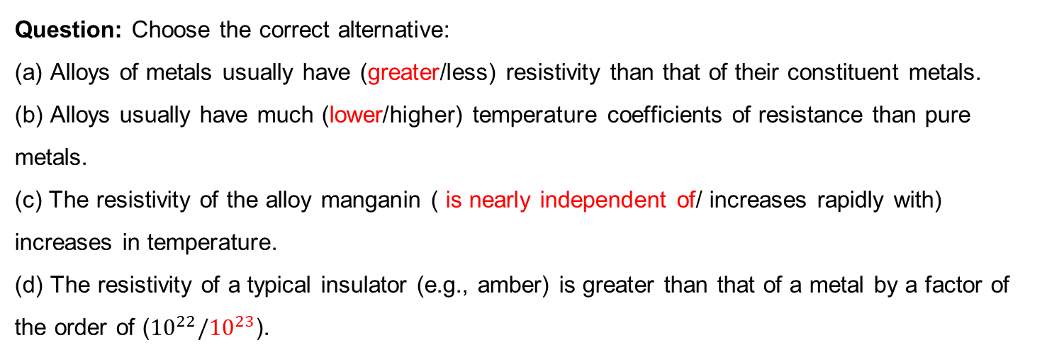
Numerical
Question: Choose the correct alternative:
(a) Alloys of metals usually have (greater/less) resistivity than that of their constituent metals.
(b) Alloys usually have much (lower/higher) temperature coefficients of resistance than pure metals.
(c) The resistivity of the alloy manganin ( is nearly independent of/ increases rapidly with) increases in temperature.
(d) The resistivity of a typical insulator (e.g., amber) is greater than that of a metal by a factor of the order of (${10}^{22}/{10}^{23}$).

Slide 13
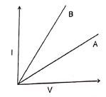


Numerical
Question: The figure shows $I\sim V$ graphs A and B for a conductor at temperatures $T_{1}$ and $T_{2}$ respectively. Which is greater out of $T_{1}$ and $T_{2}$ ? Why?
$$T_{2}$$
$$T_{1}$$

Slide 14
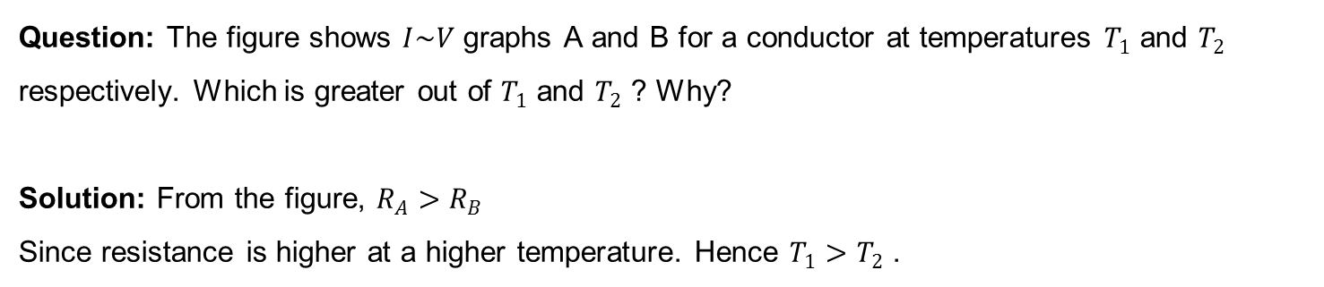
Numerical
Question: The figure shows $I\sim V$ graphs A and B for a conductor at temperatures $T_{1}$ and $T_{2}$ respectively. Which is greater out of $T_{1}$ and $T_{2}$ ? Why?
Solution: From the figure, $R_{A}>R_{B}$
Since resistance is higher at a higher temperature. Hence $T_{1}>T_{2}$ .

Slide 15
HOME ASSIGNMENT
How is the drift velocity in a conductor affected with the rise in temperature?
2. Show on a plot, variation of resistivity of
A conductor and
A typical semiconductor as a function of temperature
Using the expression for the resistivity in terms of number density and relaxation time between the collision, explain how resistivity in the case of a conductor increases while it decreases in a semiconductor, with the rise of temperature.
Two materials Si and Cu, are cooled from 300K to 60K. What will be the effect on their resistivity?

Slide 16
THANKING YOU
ODM EDUCATIONAL GROUP

