Slide 1


Series and Parallel combinations of resistors
CLASS-XII
SUBJECT : PHYSICS
CHAPTER NUMBER: 03
CHAPTER NAME : CURRENT ELECTRICITY

Slide 2

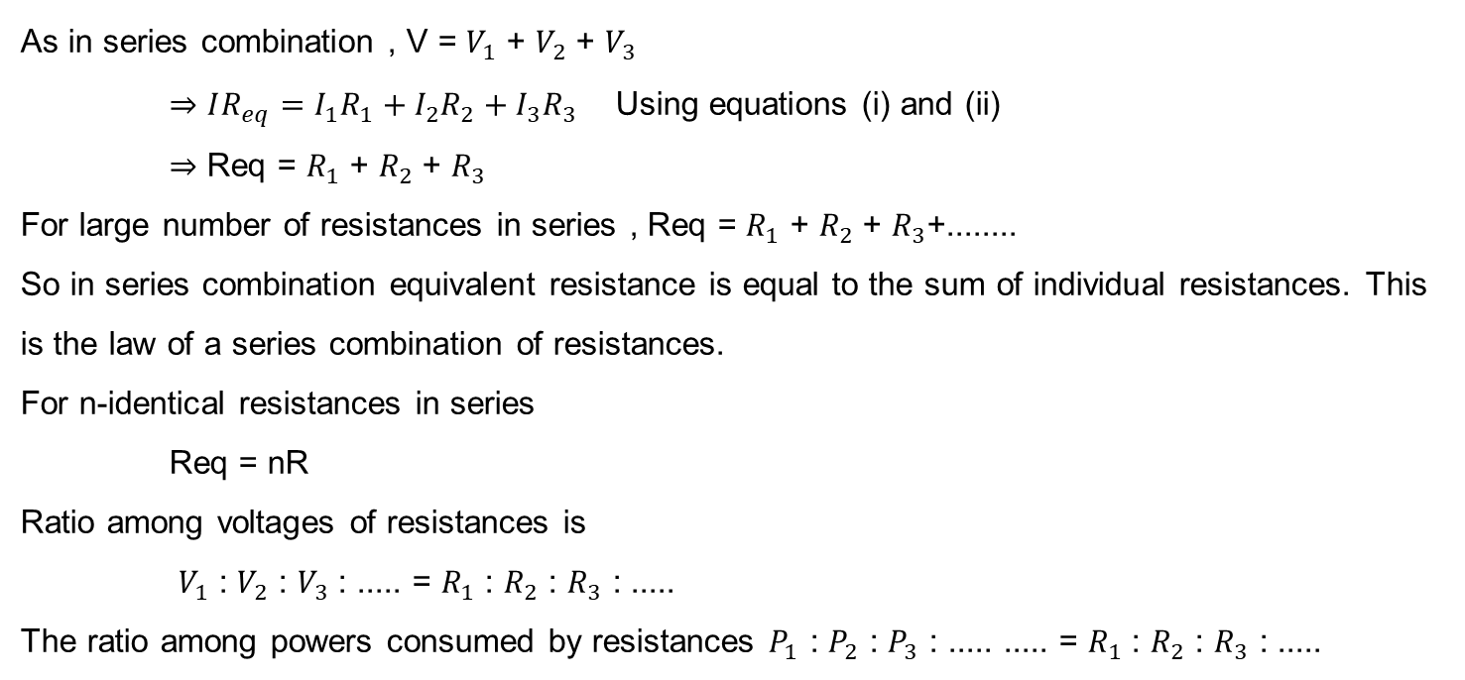
Series Combination of resistances
As in series combination , V = $V_{1}$ + $V_{2}$ + $V_{3}$
$⇒IR_{eq}=I_{1}R_{1}+I_{2}R_{2}+I_{3}R_{3}$ Using equations (i) and (ii)
$⇒$ Req = $R_{1}$ + $R_{2}$+ $R_{3}$
For large number of resistances in series , Req = $R_{1}$ + $R_{2}$+ $R_{3}$+........
So in series combination equivalent resistance is equal to the sum of individual resistances. This is the law of a series combination of resistances.
For n-identical resistances in series
Req = nR
Ratio among voltages of resistances is
$V_{1}$ : $V_{2}$ : $V_{3}$ : ..... = $R_{1}$ : $R_{2}$ : $R_{3}$ : .....
The ratio among powers consumed by resistances $P_{1}$ : $P_{2}$ : $P_{3}$ : ..... ..... = $R_{1}$ : $R_{2}$ : $R_{3}$ : .....

Slide 3
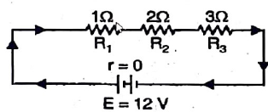
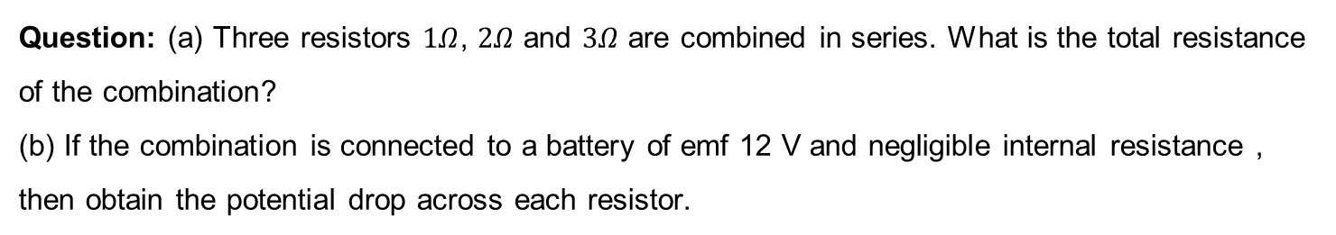
Numerical
Question: (a) Three resistors $1Ω$, $2Ω$ and $3Ω$ are combined in series. What is the total resistance of the combination?
(b) If the combination is connected to a battery of emf 12 V and negligible internal resistance , then obtain the potential drop across each resistor.

Slide 4
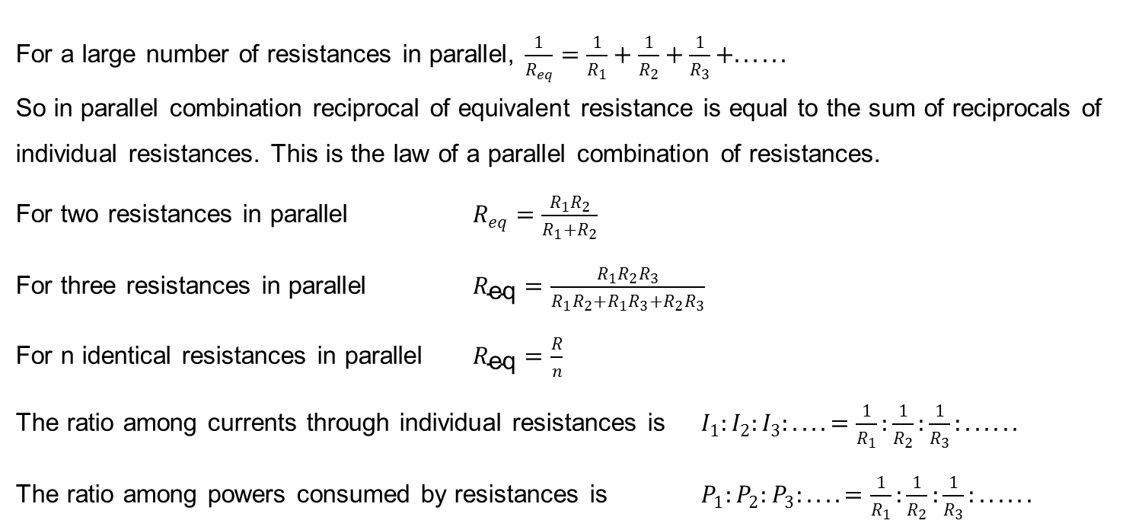
Parallel Combination of resistances
For a large number of resistances in parallel, $\frac{1}{R_{eq}}=\frac{1}{R_{1}}+\frac{1}{R_{2}}+\frac{1}{R_{3}}+......$
So in parallel combination reciprocal of equivalent resistance is equal to the sum of reciprocals of individual resistances. This is the law of a parallel combination of resistances.
For two resistances in parallel $R_{eq}=\frac{R_{1}R_{2}}{R_{1}+R_{2}}$
For three resistances in parallel $R_{\text{eq}}=\frac{R_{1}R_{2}R_{3}}{R_{1}R_{2}+R_{1}R_{3}+R_{2}R_{3}}$
For n identical resistances in parallel $R_{\text{eq}}=\frac{R}{n}$
The ratio among currents through individual resistances is $I_{1}:I_{2}:I_{3}:....=\frac{1}{R_{1}}:\frac{1}{R_{2}}:\frac{1}{R_{3}}:......$
The ratio among powers consumed by resistances is $P_{1}:P_{2}:P_{3}:....=\frac{1}{R_{1}}:\frac{1}{R_{2}}:\frac{1}{R_{3}}:......$

Slide 5
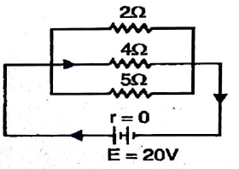

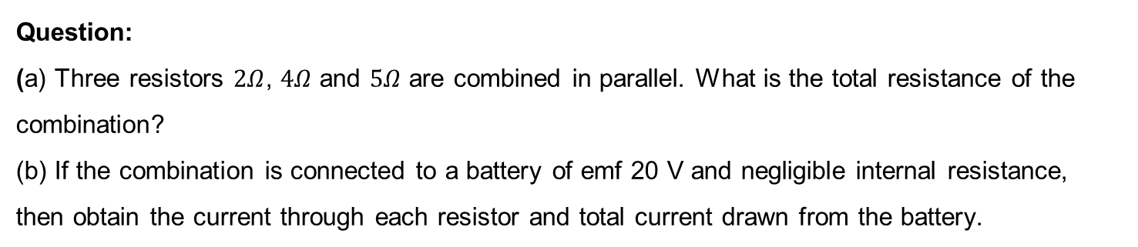
Numerical
Question:
(a) Three resistors $2Ω$, $4Ω$ and $5Ω$ are combined in parallel. What is the total resistance of the combination?
(b) If the combination is connected to a battery of emf 20 V and negligible internal resistance, then obtain the current through each resistor and total current drawn from the battery.

Slide 6
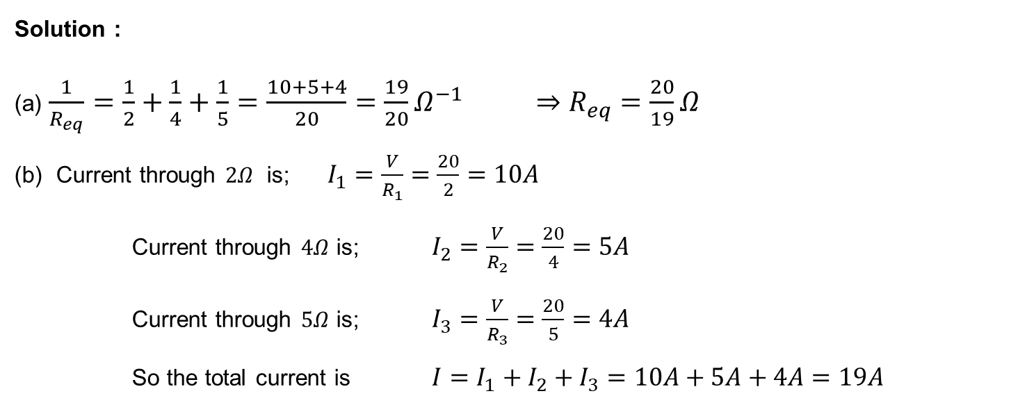
Numerical
Solution :
(a) $\frac{1}{R_{eq}}=\frac{1}{2}+\frac{1}{4}+\frac{1}{5}=\frac{10+5+4}{20}=\frac{19}{20}Ω^{−1}$ $⇒$ $R_{eq}=\frac{20}{19}Ω$
(b) Current through $2Ω$ is; $I_{1}=\frac{V}{R_{1}}=\frac{20}{2}=10A$
Current through $4Ω$ is; $I_{2}=\frac{V}{R_{2}}=\frac{20}{4}=5A$
Current through $5Ω$ is; $I_{3}=\frac{V}{R_{3}}=\frac{20}{5}=4A$
So the total current is $I=I_{1}+I_{2}+I_{3}=10A+5A+4A=19A$

Slide 7
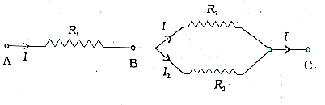
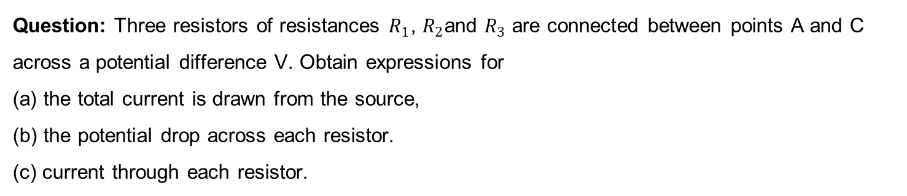
Numerical
Question: Three resistors of resistances $R_{1}$, $R_{2}$and $R_{3}$ are connected between points A and C across a potential difference V. Obtain expressions for
(a) the total current is drawn from the source,
(b) the potential drop across each resistor.
(c) current through each resistor.

Slide 8
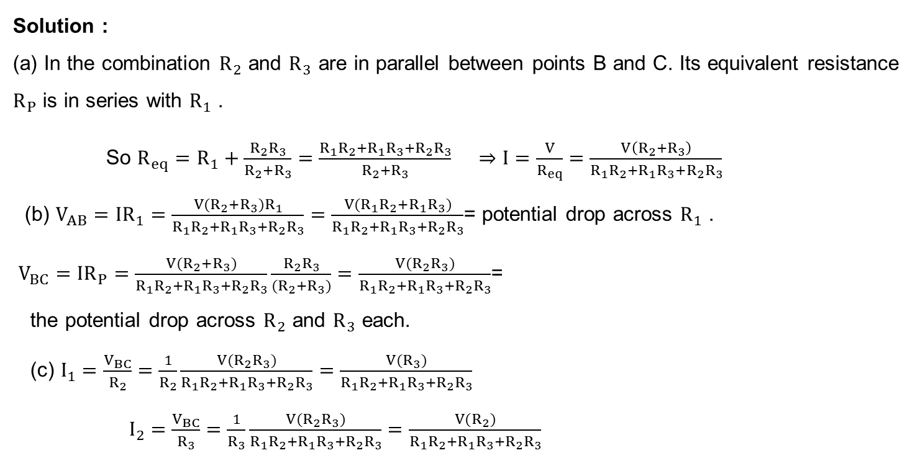
Numerical
Solution :
(a) In the combination $R_{2}$ and $R_{3}$ are in parallel between points B and C. Its equivalent resistance $R_{P}$ is in series with $R_{1}$ .
So $R_{eq}=R_{1}+\frac{R_{2}R_{3}}{R_{2}+R_{3}}=\frac{R_{1}R_{2}+R_{1}R_{3}+R_{2}R_{3}}{R_{2}+R_{3}}$ $⇒$ $I=\frac{V}{R_{eq}}=\frac{V\left(R_{2}+R_{3}\right)}{R_{1}R_{2}+R_{1}R_{3}+R_{2}R_{3}}$
(b) $V_{AB}=IR_{1}=\frac{V(R_{2}+R_{3})R_{1}}{R_{1}R_{2}+R_{1}R_{3}+R_{2}R_{3}}=\frac{V(R_{1}R_{2}+R_{1}R_{3})}{R_{1}R_{2}+R_{1}R_{3}+R_{2}R_{3}}$= potential drop across $R_{1}$ .
$V_{BC}=IR_{P}=\frac{V(R_{2}+R_{3})}{R_{1}R_{2}+R_{1}R_{3}+R_{2}R_{3}}\frac{R_{2}R_{3}}{(R_{2}+R_{3})}=\frac{V(R_{2}R_{3})}{R_{1}R_{2}+R_{1}R_{3}+R_{2}R_{3}}$=
the potential drop across $R_{2}$ and $R_{3}$ each.
(c) $I_{1}=\frac{V_{BC}}{R_{2}}=\frac{1}{R_{2}}\frac{V(R_{2}R_{3})}{R_{1}R_{2}+R_{1}R_{3}+R_{2}R_{3}}=\frac{V(R_{3})}{R_{1}R_{2}+R_{1}R_{3}+R_{2}R_{3}}$
$I_{2}=\frac{V_{BC}}{R_{3}}=\frac{1}{R_{3}}\frac{V(R_{2}R_{3})}{R_{1}R_{2}+R_{1}R_{3}+R_{2}R_{3}}=\frac{V(R_{2})}{R_{1}R_{2}+R_{1}R_{3}+R_{2}R_{3}}$

Slide 9
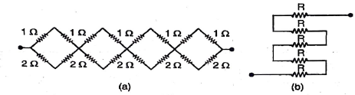
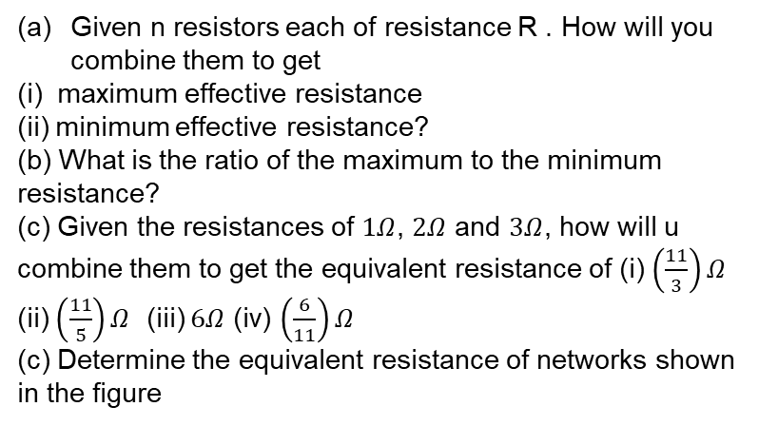
Numerical
Given n resistors each of resistance R . How will you combine them to get
(i) maximum effective resistance
(ii) minimum effective resistance?
(b) What is the ratio of the maximum to the minimum resistance?
(c) Given the resistances of $1Ω$, $2Ω$ and $3Ω$, how will u combine them to get the equivalent resistance of (i) $\left(\frac{11}{3}\right)Ω$ (ii) $\left(\frac{11}{5}\right)Ω$ (iii) $6Ω$ (iv) $\left(\frac{6}{11}\right)Ω$
(c) Determine the equivalent resistance of networks shown in the figure

Slide 10
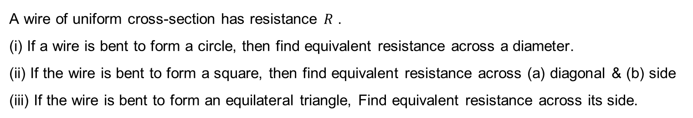
Numerical
A wire of uniform cross-section has resistance $R$ .
(i) If a wire is bent to form a circle, then find equivalent resistance across a diameter.
(ii) If the wire is bent to form a square, then find equivalent resistance across (a) diagonal & (b) side
(iii) If the wire is bent to form an equilateral triangle, Find equivalent resistance across its side.

Slide 11
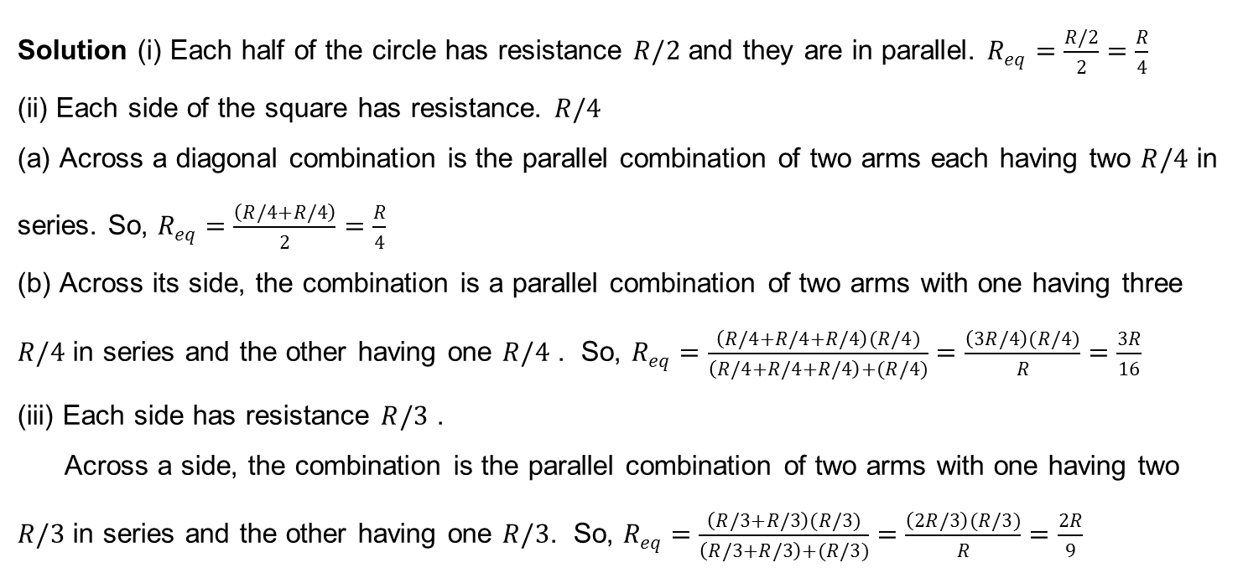
Numerical
Solution (i) Each half of the circle has resistance $R/2$ and they are in parallel. $R_{eq}=\frac{R/2}{2}=\frac{R}{4}$
(ii) Each side of the square has resistance. $R/4$
(a) Across a diagonal combination is the parallel combination of two arms each having two $R/4$ in series. So, $R_{eq}=\frac{\left(R/4+R/4\right)}{2}=\frac{R}{4}$
(b) Across its side, the combination is a parallel combination of two arms with one having three $R/4$ in series and the other having one $R/4$ . So, $R_{eq}=\frac{\left(R/4+R/4+R/4\right)(R/4)}{\left(R/4+R/4+R/4\right)+(R/4)}=\frac{\left(3R/4\right)(R/4)}{R}=\frac{3R}{16}$
(iii) Each side has resistance $R/3$ .
Across a side, the combination is the parallel combination of two arms with one having two $R/3$ in series and the other having one $R/3$. So, $R_{eq}=\frac{\left(R/3+R/3\right)(R/3)}{\left(R/3+R/3\right)+(R/3)}=\frac{\left(2R/3\right)(R/3)}{R}=\frac{2R}{9}$

Slide 12

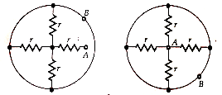
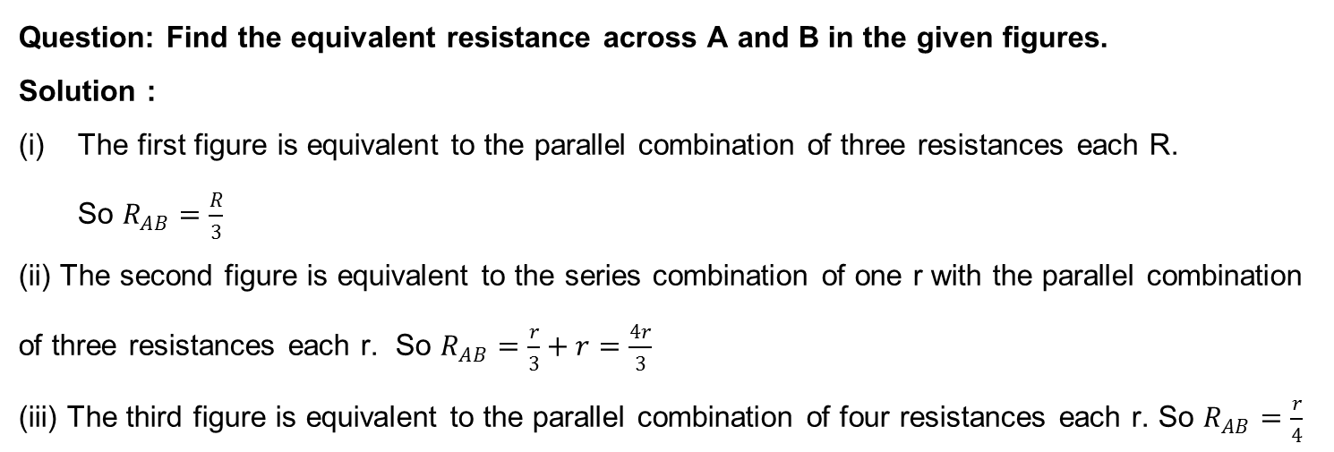
Numerical
Question: Find the equivalent resistance across A and B in the given figures.
Solution :
The first figure is equivalent to the parallel combination of three resistances each R.
So $R_{AB}=\frac{R}{3}$
(ii) The second figure is equivalent to the series combination of one r with the parallel combination of three resistances each r. So $R_{AB}=\frac{r}{3}+r=\frac{4r}{3}$
(iii) The third figure is equivalent to the parallel combination of four resistances each r. So $R_{AB}=\frac{r}{4}$

Slide 13
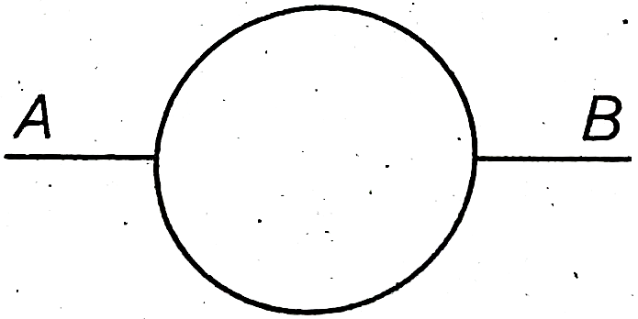
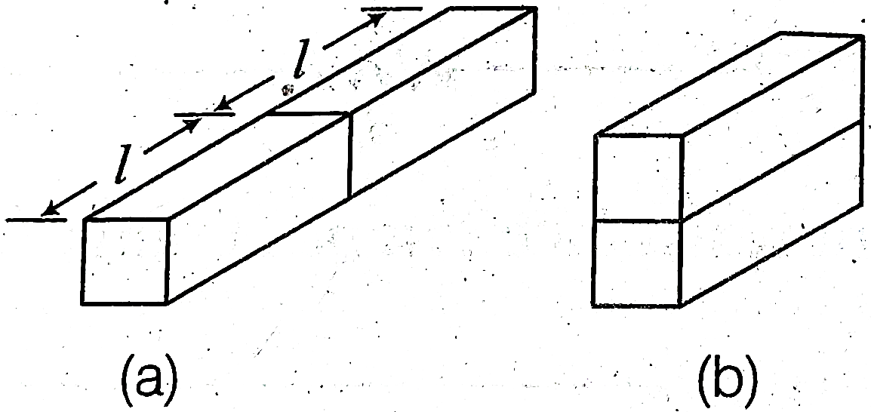
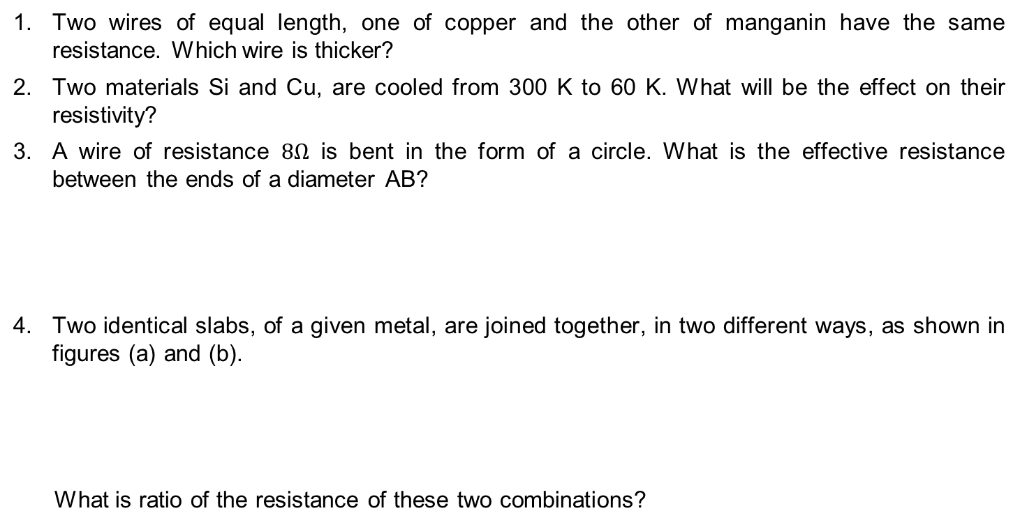
HOME ASSIGNMENT
Two wires of equal length, one of copper and the other of manganin have the same resistance. Which wire is thicker?
Two materials Si and Cu, are cooled from 300 K to 60 K. What will be the effect on their resistivity?
A wire of resistance $8Ω$ is bent in the form of a circle. What is the effective resistance between the ends of a diameter AB?
Two identical slabs, of a given metal, are joined together, in two different ways, as shown in figures (a) and (b).
What is ratio of the resistance of these two combinations?

Slide 14
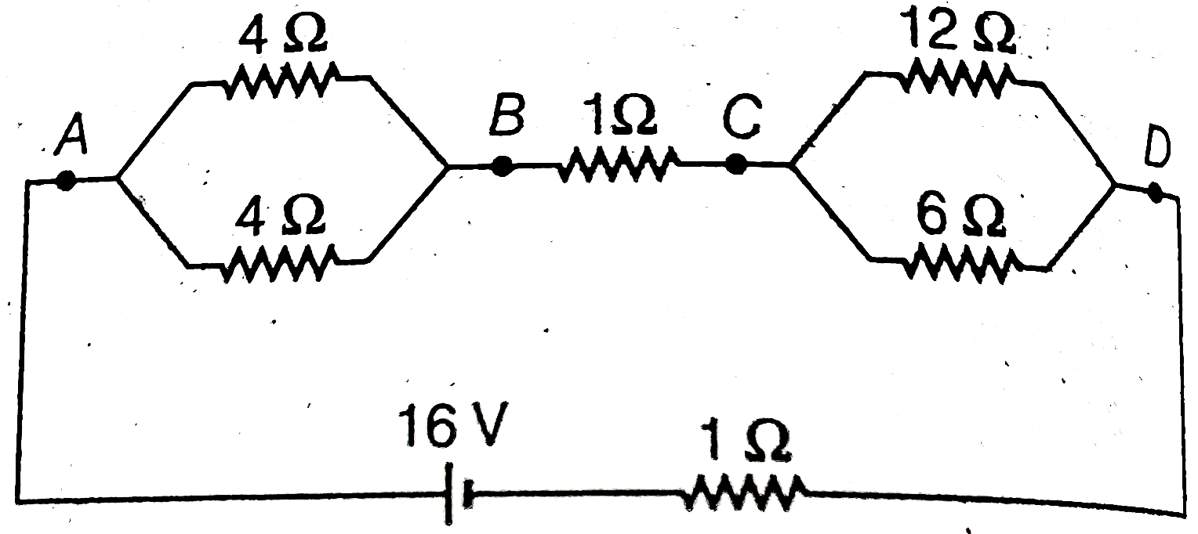
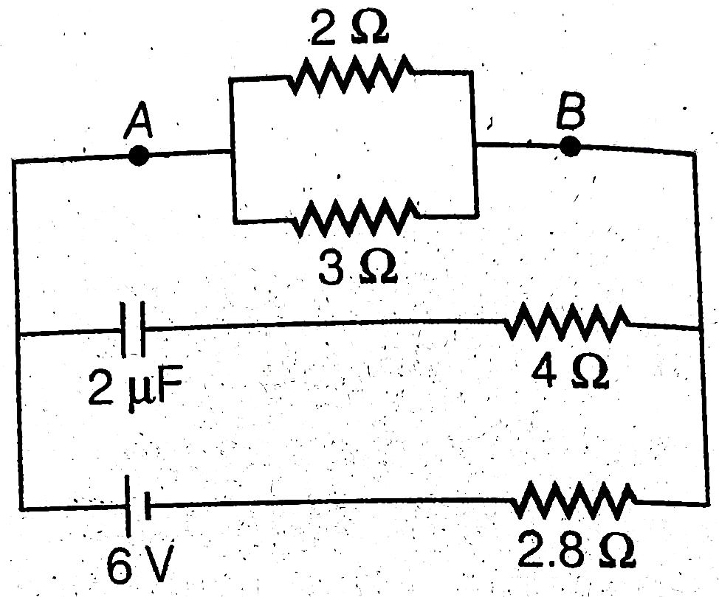
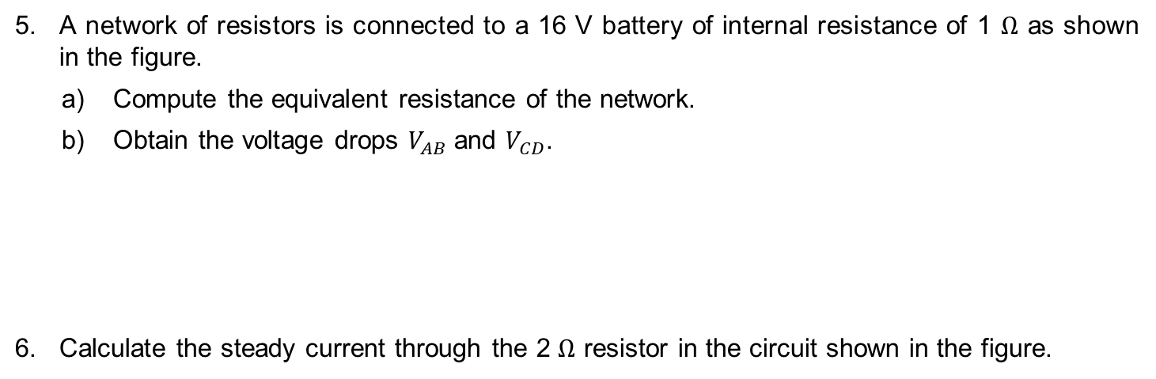
HOME ASSIGNMENT
A network of resistors is connected to a 16 V battery of internal resistance of 1 $Ω$ as shown in the figure.
  Compute the equivalent resistance of the network.
  Obtain the voltage drops $V_{AB}$ and $V_{CD}$.
Calculate the steady current through the 2 $Ω$ resistor in the circuit shown in the figure.

Slide 15
THANKING YOU
ODM EDUCATIONAL GROUP

