Slide 1


CHROMOSOMAL DISORDERS
DOWN’S SYNDROME , TURNER’S SYNDROME &
SUBJECT : BIOLOGY
CHAPTER NUMBER: 05
CHAPTER NAME : PRINCIPLE OF INHERITANCE AND VARIATION

Slide 2
CHROMOSOMAL DISORDERS :
The chromosomal disorders are caused due to absence or excess or abnormal arrangement of one or more chromosomes.
The aneuploidy and polyploidy conditions mainly cause chromosomal aberrations.

Slide 3
DOWN’S SYNDROME:
The cause of this genetic disorder is the presence of an additional copy of the chromosome number 21(autosome)
(trisomy of 21 ). It is caused by an occasional non-disjunction during meiosis when a gamete comes to possess an
extra chromosome.
Fusion with normal gamete produces trisomy [n+(n+1)].
This disorder was first described by Langdon Down (1866).
The affected individual is short statured with small round head, partially open mouth, broad forehead, protruding
furrowed tongue, short neck, short phalanges, small ears, projecting lower lips and congenital heart diseases .
Palm is broad with characteristic palm crease. Physical, psychomotor and mental development is retarded.
Under developed gonads with short life expectancy is also observed.

Slide 4
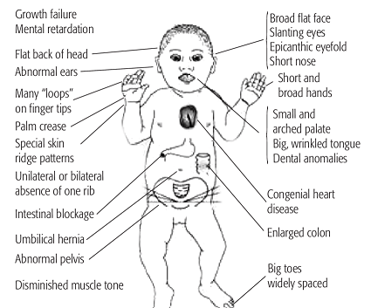
DOWN’S SYNDROME:
.

Slide 5
TURNER’S SYNDROME :
Changes in sex chromosomes lead to abnormalities like Turner’s syndrome.
The individual appears phenotypically female .
The effect app]ears due to fusion of a gamete without sex chromosome (A+0) and a gamete with one X-
chromosome (A+X).

Slide 6
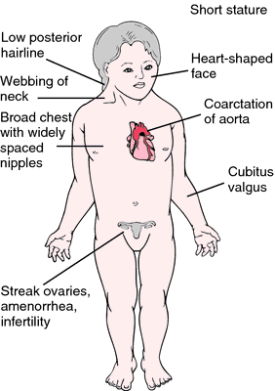
TURNER’S SYNDROME :

Slide 7
KLINEFELTER’S SYNDROME :
This genetic disorder is also caused due to the presence of an additional copy of xchromosome resulting into a
karyotype of 47, XXY.
The individuals are phenotypically males.
The defect appears due to fusion of egg having unreduced sex complement (A+XX) with normal sperm (A+Y).
Other examples: In cucumber and melon, day lights length, temperature etc also differentiate sex.

Slide 8
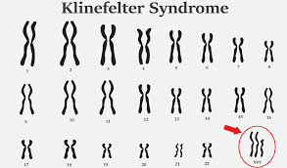
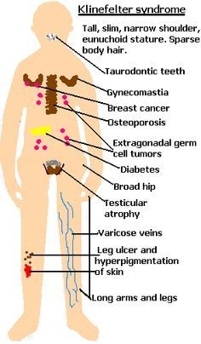
KLINEFELTER’S SYNDROME :

Slide 9
THANKING YOU
ODM EDUCATIONAL GROUP

