Slide 1


MENDELIAN DISORDERS
HAEMOPHILIA, SICKLE-CELL ANAEMIA, PHENYLKETONURIA, COLOUR
BLINDNESS,THALASSEMIA
SUBJECT : BIOLOGY
CHAPTER NUMBER: 05
CHAPTER NAME : PRINCIPLE OF INHERITANCE AND VARIATION

Slide 2
MENDELIAN DISORDERS :
There are many diseases in man due to gene mutations (dominant or recessive) .
They are transmitted to the offspring as per Mendelian principles.
Some of the Mendelian disorders are :
Haemophilia.
Sickle-cell anaemia.
Phenylketonuria.
Colour blindness.
Thalassemia.

Slide 3
HAEMOPHILIA :
This is a sex linked recessive blood disease. It shows its transmission from unaffected carrier
female to some of the male progeny has been widely studied.
In this disease a single protein that is a part of the cascade of proteins involved in the clotting of
blood is affected.
It is caused due to absence of factor-VIII and plasma thromboplastin.

Slide 4
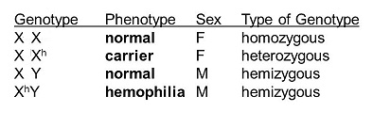
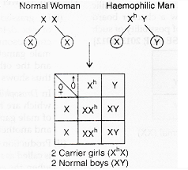
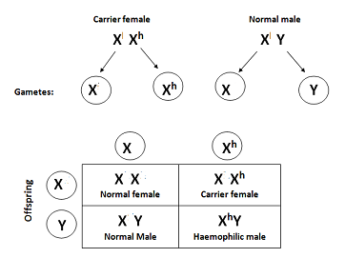
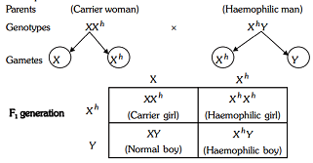
GENOTYPES & CROSSES IN CASE OF HAEMOPHILIA :

Slide 5
SICKLE-CELL ANAEMIA:
This is an autosome linked recessive trait that can be transmitted from parents to the offspring when both the
partners are carrier for the gene (or heterozygous).
The disease is controlled by a single pair of allele HbA and HbS which is located upon chromosome- 11.
Out of the three possible genotypes only homozygous individuals for Hb^{S} (Hb^{S}Hb^{S}) show the diseased phenotype.
Heterozygous (Hb^{A}Hb^{S}) appear apparently unaffected but they are carrier of the disease as there is 50 percent
probability of transmission of the mutant gene to the progeny. Thus exhibiting sickle -cell trait.
The defect is caused by the substitution of Glutamic acid (Glu) by valine (Val) at the sixth position of the beta-
globln chain of the haemoglobln molecule.
The substitution of amino acld in the globin protein results due to the Single base substitution at the sixth codon
of the beta-globin gene from GAG to GUG.

Slide 6
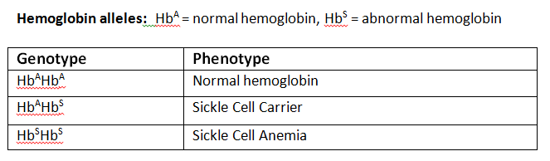
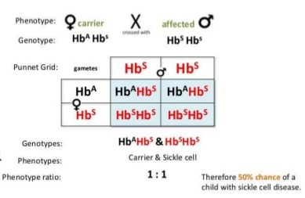
GENOTYPES & CROSS IN CASE OF SICKLE-CELL ANAEMIA :
.

Slide 7
PHENYL KETONURIA:
This inborn error of metabolism is also inherited is the autosomal recessive trait present upon chromosome-12
The affected individual lacks an enzyme phenyl alanine hydroxylase that converts the amino acld
phenylalanine to tyrosine.
This lack of enzyme is due to mutation of gene upon chromosome-12
As a result of this phenylalanine is accumulated and converted into phenyl pyruvic acid and other derivatives.
Three genotypes of this disorder are AA- normal, Aa-heterozygous/carrier , aa- affected individual
Accumulation of these amino acid derivatives in brain results in mental retardation.

Slide 8
COLOURBLINDNESS :
Colour blindness is a sex linked recessive trait in which the eye fails to distinguish red and green colours.
The gene for normal vision is dominant and is located upon X chromosome.
The defect is due to mutation the gene located upon X chromosome.
It occurs near about in 8 percent of males and 0.4 percent of females.
This disorder is also known as Daltonism as famous physicist John Dalton was colourblind.

Slide 9
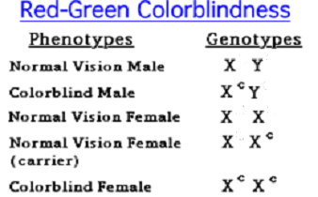
GENOTYPES OF COLOURBLINDNESS :

Slide 10
THALASSEMIA:
This defect can occur due to mutation or deletion of genes controlling the formation of globin chains (alpha and
beta)of haemoglobin.
Thalassemia is a quantitative disorder as it is related to synthesis of globin molecule.
Thalassemia is classified according to which molecule of globin is affected.
Alpha thalasemia : it is caused by the defective formation of alpha globin and is controlled by two genes present on chromosome -16.
Beta thalassemia : it is caused by decreased synthesis of beta globin.
The defect is due to alleles of HBB gene present on chromosome-11 on each parent due to mutation of one or both alleles.

Slide 11
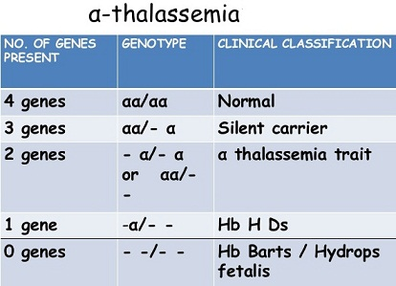
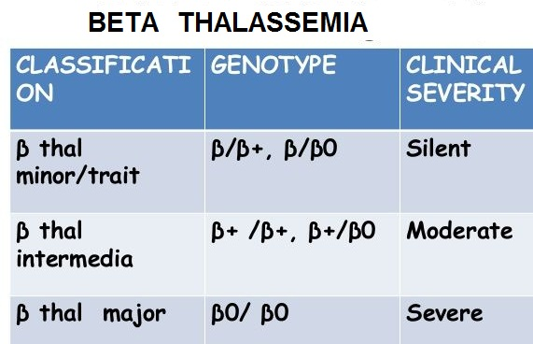
GENOTYPES OF ALPHA AND BETA THALASSEMIA :

Slide 12
THANKING YOU
ODM EDUCATIONAL GROUP

