Slide 1


MUTATION & GENETIC DISORDER
TYPES OF MUTATION,ORIGIN OF MUTATION,MUTAGENS IMPORTANCE OF MUTATION, PEDIGREE ANALYSIS AND IT’S USEFULNESS
SUBJECT : BIOLOGY
CHAPTER NUMBER: 05
CHAPTER NAME : PRINCIPLE OF INHERITANCE AND VARIATION

Slide 2
MUTATION :
Mutation refers to any sudden, heritable permanent change in the genotype of the organism.
The term mutation was coined by Hugo De Vries.
An organism that displays the usual phenotype for that species is called as wild type and which exhibits a new phenotype resulting from mutation is called as mutant.

Slide 3
TYPES OF MUTATION :
Depending on the cell type in which mutation occurs , mutation may be of two types:
Somatic
Germinal
Depending upon the mode of origin it may be of two types :
Spontaneous mutation
Induced mutation

Slide 4
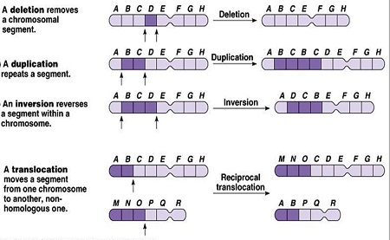
TYPES OF MUTATION :
(b) Chromosomal aberration (change in chromosome structure) – They are of many types:
Deletion – The loss of some genes due to breaking of fragments.
Duplication – Some genes my be present twice.
Translocation – Mutual exchange of chromosomal segments.
Inversion – A piece of chromosome is removed and rejoined in reverse order

Slide 5
ORIGIN OF MUTATION :
Depending upon the mode of origin it may be of two types :
Spontaneous mutation – This type of mutation occurs in nature without any cause
(b) Induced mutation – This type of mutation occurs when organisms get exposed into physical ,chemical or biological agents.

Slide 6
MUTAGENS
Such agents are called as mutagens named as physical mutagen, chemical mutagen and biological mutagen.
Physical mutagens – Temperature, energy radiations like x-ray, uv-rays, gamma rays and ionizing radiations are the examples of physical mutagens.
Chemical mutagens – Nitrous oxide, alkalyting agents ,base analogues , acridines are the examples of chemical mutagens.
Biological mutagens- Retro viruses are the examples of biological mutagens like HPV.

Slide 7
IMPORTANCE OF MUTATION :
It introduces variability in the population which brings adaptability of the organisms to its environment.
Unless until a gene mutates and has a recessive or intermediate allele it will remain unnoticed. So for studying genes mutation is important.
Mutations are the fountain head of evolution which introduces variation among organisms and the better fitted ones are selected naturally.
In animal husbandry and agriculture mutation brings better breeds and cultivars.
Increase use of mutagen may lead to dangerous health hazards in the population.

Slide 8
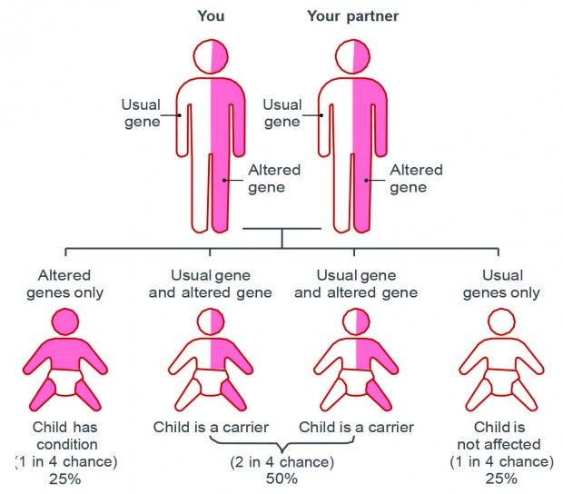
GENETIC DISORDERS:
A genetic disorder is a disease that is caused by mutation of gene or change in chromosomal structure or number.

Slide 9
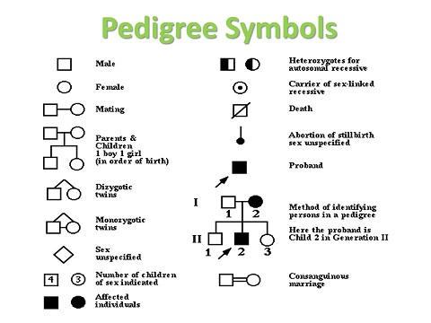
PEDIGREE ANALYSIS
A record of inheritance of certain genetic traits for two or more generations presented in form of a diagram or family tree is called pedigree.
Symbols used in pedigree :

Slide 10
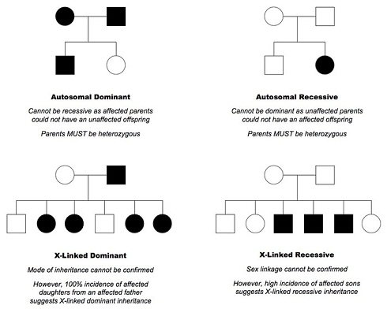
FIGURE SHOWING PEDIGREE ANALYSIS OF DIFFERENT TRAITS:

Slide 11
USEFULNESS OF PEDIGREE ANALYSIS:
It helps in study of pedigree for transmission of particular trait and finding the possibility of absence or presence of that trait in homozygous or heterozygous condition in individual.
It is helpful in finding out the disorders like haemophilia, colour blindness, alkaptonuria, thalassemia, sickle cell anemia, etc.
It also explains autosomal dominant and recessive traits, sex-linked disorders like X-linked and Y- linked ones.
Pedigree analysis indicates that Mendelism is also applicable to human genetics
.
It can indicate the origin of a trait in the ancestors.

Slide 12
THANKING YOU
ODM EDUCATIONAL GROUP

