Slide 1


SEX DETERMINATION
SUBJECT : BIOLOGY
CHAPTER NUMBER: 05
CHAPTER NAME : PRINCIPLE OF INHERITANCE AND VARIATION

Slide 2
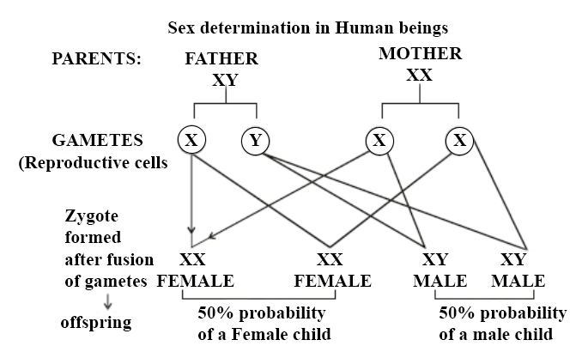
SEX DETERMINATION :
A sex-determination system is a biological system that determines the development of sexual characteristics
in an organism.
Due to involvement of X chromosome in sex determination was designated as sex chromosome.

Slide 3
SEX DETERMINATION :
Majority of sexually reproducing animals two types of chromosomes are found:
(i) Autosomes:
They are found in all cells. The genes present on autosomes are responsible for determining the somatic characters but sometime influence the sex of the organism.
ii) Sex Chromosomes or Allosomes:
They carry genes for sex. A pair of them determines the sex.

Slide 4
ENVIRONMENTAL THEORY OF SEX DETERMINATION :
According to this theory, environmental factor plays direct or indirect role in determining sex of an organism.
Example:
In case of American alligator : 34 degree or above (incubation temp.) develops into male & 30 degree or below that
develops into female.
In case of Turtle : 25 to 27 degree (incubation temp.) develops into male and 29 to 30 degree (incubation temp)
develops as female
Also in plants like Equisetum (puzzle grass), spore grown under optimum condition develops into female
gametophyte and when grown under unfavourable condition develops into male.
Other examples: In cucumber and melon, day lights length, temperature etc also differentiate sex.

Slide 5
HORMONAL CONTROL THEORY OF SEX DETERMINATION :
In certain animals, hormone plays an important role in sex determination (differentiation).
For examples- A marine worm
Male worm is sessile, lives inside uterus of female worm and smaller in size than female worm which is about 2
inch long.
Those larvae, which comes in contact with mature female get attached to their proboscis and develop into
male.
But those larvae which do not comes in contact with mature female develops into female worm.
It has been found that the proboscis of mature female worm secrete hormone like substance which
determine sex.

Slide 6
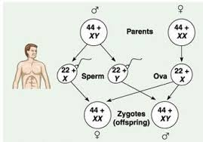
XX FEMALE AND XY MALE TYPES:
This type of sex mechanism is found in Drosophila (fruit fly) and majority of mammals including man.
In this type the female is homogametic (XX) and male is heterogametic (XY) consisting of two dissimilar chromosomes X and Y.
The females produce ova all of one type having X chromosome. Males produce two types of sperms: -50% with X-chromosome and remaining 50% with Y-chromosome.
Thus, the sex chromosomes in female are homomorphic and those of male are heteromorphic.
Such type of sex determination is also called as male heterogamety .

Slide 7
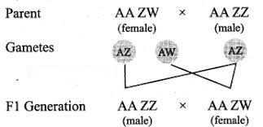
ZW FEMALE AND ZZ MALE TYPE:
In butterflies and birds, the female is heterogametic having dissimilar Z and W chromosomes whereas the male is homogametic having similar ZZ chromosomes (It is a convention to designate female as ZW instead of XY and male as ZZ instead of XX).

Slide 8
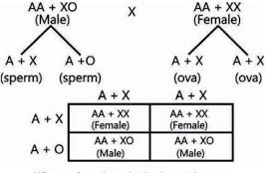
XO MALE AND XX FEMALE :
Mc Clung and Wilson (1903) described this type of sex mechanism in insects especially in grasshopper.
In male there is no mate for X chromosome, hence the name XO is given, there is no Y chromosome.
They produce sperm of two types, 50% with X chromosome and 50% without X.
In females there are two similar or homo-morphic sex chromosomes XX.

Slide 9

THANKING YOU
ODM EDUCATIONAL GROUP

