Slide 1


PRINCIPLES OF INHERITANCE AND VARIATION
INCOMPLETE DOMINANCE,CO- DOMINANCE,PLEITROPISM,MULTIPLE ALLELES,POLYGENIC INHERITANCE
SUBJECT : BIOLOGY
CHAPTER NUMBER:05
CHAPTER NAME :PRINCIPLES OF INHERITANCE AND VARIATION

Slide 2
INCOMPLETE DOMINANCE
Incomplete dominance is a form of Gene interaction in which both alleles of a gene at a locus are partially expressed, often resulting in an intermediate or different phenotype.
It is also known as partial dominance.
For e.g., in roses, the allele for red colour is dominant over the allele for white colour.
But, the heterozygous flowers with both the alleles are pink in colour.

Slide 3
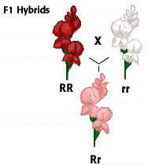
Snapdragon flower (Antirrhinum majus):
Monohybrid cross was done between the red and white coloured flowers of Snapdragon plant. Pure breed of the red flower has (RR) pair of alleles and that for the white flower is (rr).

Slide 4
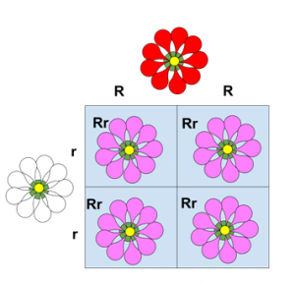
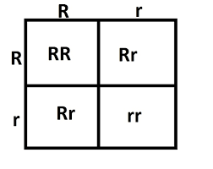
Snapdragon flower (Antirrhinum majus):
The genotype ratio of F2 generation in the monohybrid cross by Mendel also gave the same ratio of 1:2:1.
However, the phenotype ratio has changed from 3:1 to 1:2:1.
The reason for this variation is the incomplete dominance of the allele R over the allele r. This led to the blending of colour in flowers.

Slide 5
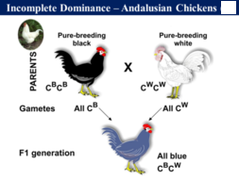
EXAMPLES OF INCOMPLETE DOMINANCE IN ANIMALS
The Andalusian chicken shows incomplete dominance in its feather colour.

Slide 6
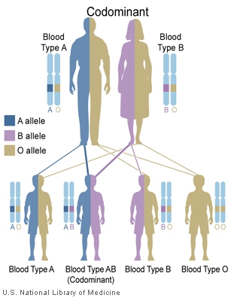
CO DOMINANCE
In co-dominance, both the alleles present on a gene are expressed in the phenotype.
Roan coat cattle is an example of co dominant coat color.
The humans with AB blood type also show co-dominance where the alleles for both blood types A and B are expressed.

Slide 7
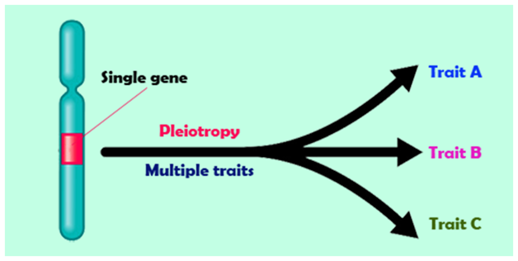
PLEIOTROPY
Pleiotropy is defined as the expression of multiple traits by a single gene.
Pleiotropic gene are therefore those genes which posses multiple effect because they control the expression of a number of traits of different characters.

Slide 8
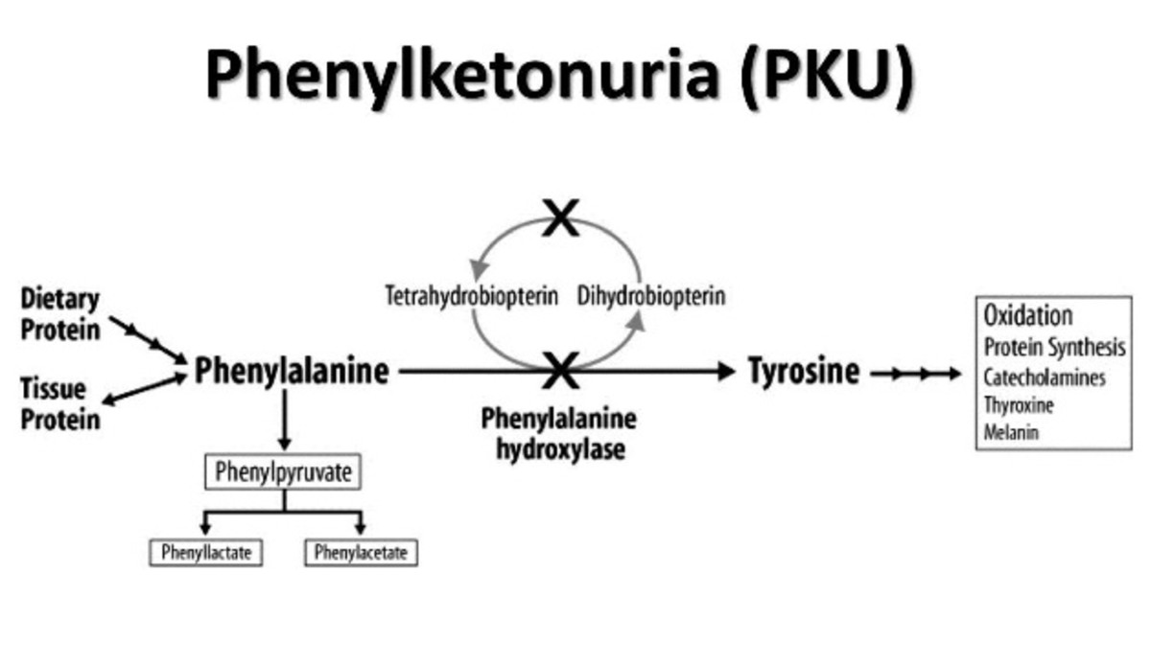
PHENYLKETONURIA
Pleiotropy is phenylketonuria, an inherited disorder that affects the level of phenylalanine in the human body.

Slide 9
PLEIOTROPY IN PLANTS
E .g. - size of the starch grains produced and shape of the seeds in pea plant are controlled by a single gene B.
Under homozygous dominant condition (BB) shape of the seed is Round and under homozygous recessive condition(bb) shape of the seed is Wrinkled which is the Primary effect of the allele. Under BB condition starch grains are full ,under Bb condition intermediate starch grains and under bb condition starch grains are small. This is its Secondary effect that shows incomplete dominance.

Slide 10
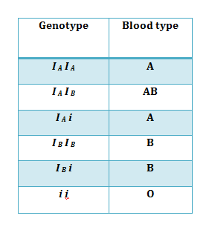
MULTIPLE ALLELISM
Multiple alleles is a type of non- Mendelian inheritance pattern that involves more than just the typical two alleles that usually code for a certain characteristic in a species. Other alleles may be co-dominant together and show their traits equally in the phenotype of the individual.

Slide 11
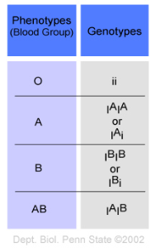
ABO BLOOD GROUPING

Slide 12
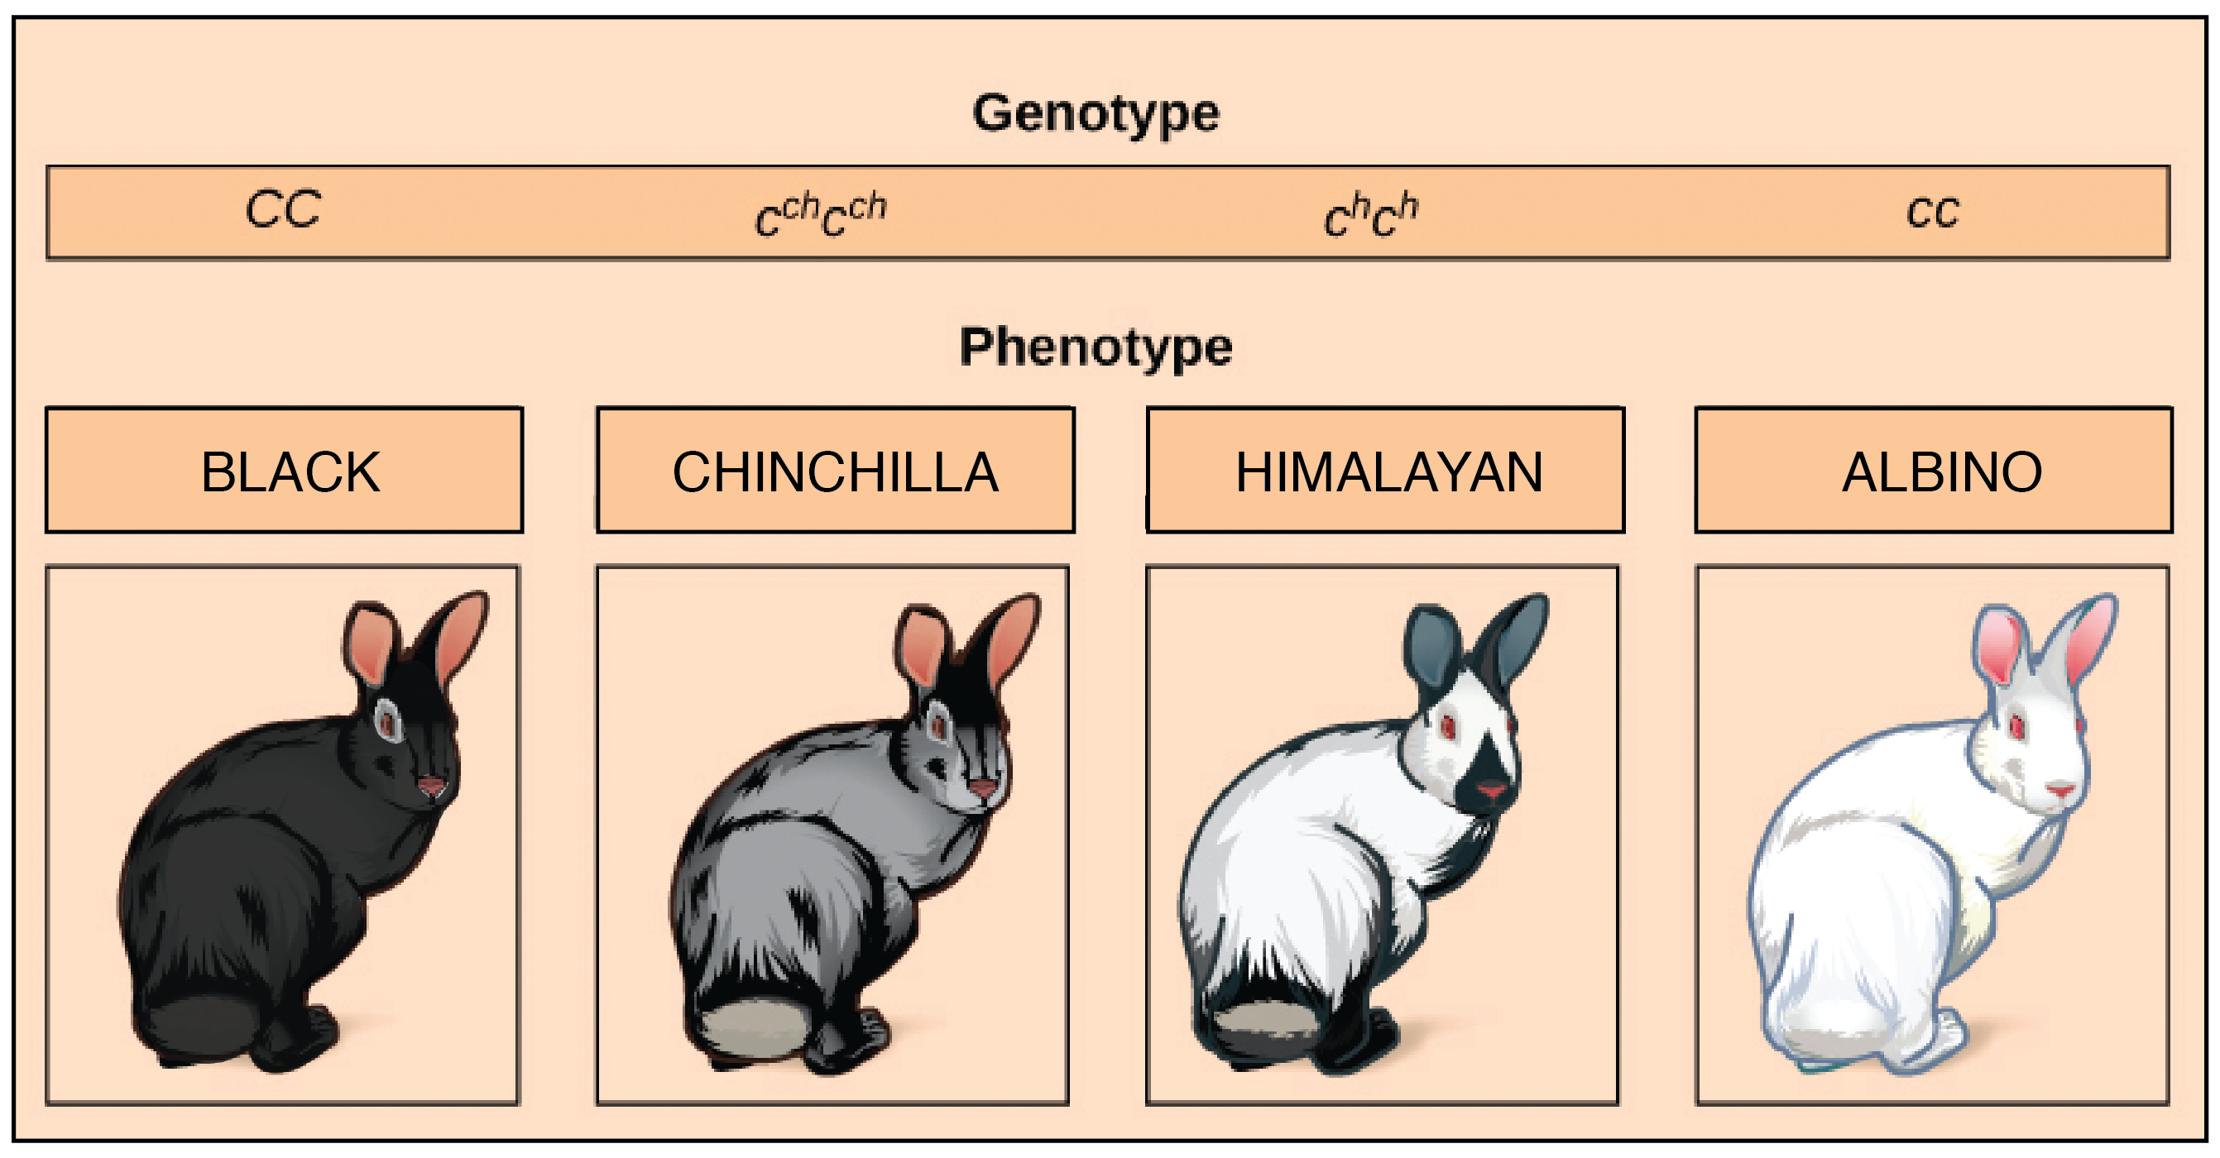

Slide 13
POLYMERIC INHERITANCE
Polygenic inheritance occurs when one characteristic is controlled by two or more genes.

Slide 14
POLYGENIC INHERITANCE IN HUMANS
we take an example of a pair of alleles of three different and unlinked loci as A and a, B and b, C and c.
The capital letters represent the incompletely dominant allele for dark skin colour.
The more capital letters show skin colour towards the darker range and small letters towards the lighter colour of the skin.
Parents having genotype AABBCC and aabbcc will produce offsprings of intermediate colour in the F₁ generation, i.e. AaBbCc genotype.
In the F₂ generation of two triple heterozygotes (AaBbCc x AaBbCc) mate, they will give rise to varying phenotypes ranging from very dark to very light in the ratio 1:6:15:20:15:6:1 .

Slide 15
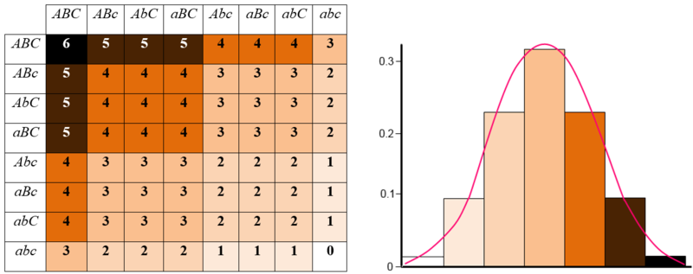
PUNNETT SQUARE SHOWING F₂ GENERATION OFFSPRINGS CONTINUOUS VARIATION

Slide 16
POLYGENIC INHERITANCE IN PLANTS
Kernel colour of the wheat:
The three independent pairs of alleles are involved in the expression of kernel colour of wheat. They show independent assortment.
When dark red wheat kernel (AABBCC) is crossed with the white wheat kernel (aabbcc) the F₁ generation has an intermediate red colour kernel (AaBbCc).
When F₁ generation is crossbred, F₂ generation has 63 red kernel plants having different shades of red and 1 white kernel.

Slide 17
MONOGENES/MONOGENIC INHERITANCE
1.They produce discontinuous variations in the expression of traits.
2.A single dominant allele expresses the complete trait.
3.Monogenic inheritance controls qualitative traits.
4.A character is represented in an individual by a pair of alleles.
5. F₁ individuals are similar to dominant parent.
6. F₂ individuals resemble both the parents in the ratio of 3: 1.
7.No intermediates are produced in monogenic or qualitative inheritance.
8.There is no cumulative action in the presence of two dominant genes.
9.Individuals with dominant phenotype are more numerous than with recessive phenotype.

Slide 18
POLYGENES/POLYGENIC INHERITANCE
1. Polygene produce continuous variations in the expression of traits.
2. A single dominant allele expresses only a unit of the trait.
3. Polygenic inheritance controls quantitative or metric trait
4. A character is represented by one to several pairs of alleles.
5. F₁, individuals are intermediate between the two parents.
6. Depending upon the number of polygene, 2/4 (one pair), 2/16 (two pairs) or 2/64 (three pairs) F: individuals resemble the parental types.
7. Intermediates are quite common in polygenic or quantitative inheritance.
8. The dominant genes have cumulative effect on the expression of the trait.
9. Individuals with dominant trait are usually as few as with recessive trait. Intermediate forms are more numerous.

Slide 19
THANKING YOU
ODM EDUCATIONAL GROUP

