Slide 1


PRINCIPLES OF INHERITANCE AND VARIATION
INHERITANCE OF TWO GENES,LAW OF INDEPENDENCE,DIHYBRID CROSS
SUBJECT : BIOLOGY
CHAPTER NUMBER:05
CHAPTER NAME :PRINCIPLES OF INHERITANCE AND VARIATION

Slide 2
INHERITANCE OF TWO GENES
To verify his results of monohybrid crosses, Mendel also crossed pea plants differing in two characters.
Study of inheritance of two genes is called inheritance of two genes.
It was found that inheritance of one pair of alleles does not interfere in the inheritance of other pair of alleles.
This inheritance was based upon Mendel ’s law of independent assortment.

Slide 3
Law of independent assortment
“The alleles of two pair of traits separate independently of each other during gamete formation and get randomly arranged in the offspring at the time of fertilization ,
producing both parental and new combinations of traits.”
In fact there is occurrence of two important events.
First is separation of the alleles of two pairs of traits independently of each other during gamete or spore formation .
Second is rearrangement or reunion of alleles in the offsprings at the time of fertilization

Slide 4
EXPLANATION OF “PRINCIPLE OF INDEPENDENT ASSORTMENT”
Alleles of different characters assort or separate independently of one another at the time of gametogenesis and get randomly rearranged in the offspring at the time of fertilization.
This principle can be deduced from a dihybrid cross.
A cross is made between a pure round yellow seeded pea plant (RRYY) with wrinkled green seeded pea plant (rryy).
Yellow colour (Y) is dominant over green(y) and round seed shape (R) is dominant over wrinkled seed shape (r).

Slide 5
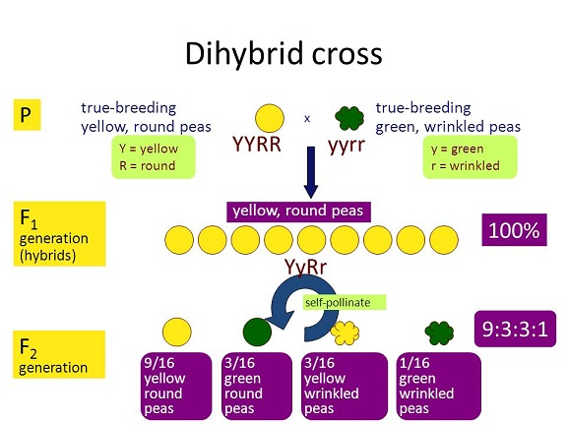
DIHYBRID CROSS
Both pea plants are crossed, F₁ plants or hybrids are obtained . F₁ plants are all round and yellow seeded.
F₁ plants are allowed to self breed and produce F₂ generation with four types of plants .
Round yellow- RRYY / RrYy
Wrinkled yellow- rrYY / rrYy
Round green –RRyy / Rryy
wrinkled green –rryy
F₂ generation has those four types of plants in the ratio 9:3:3:1.
This ratio is only possible if the alleles of 2 characters are free to recombine and assort independently.

Slide 6
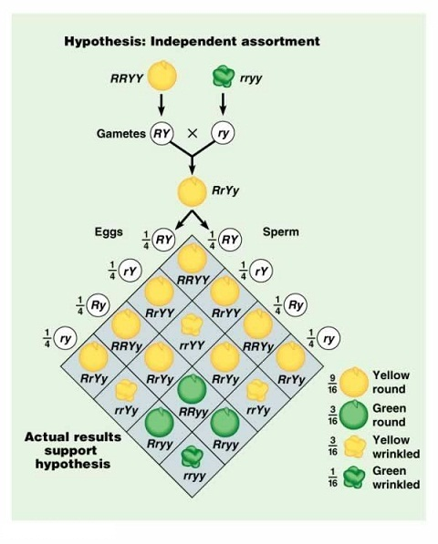

Slide 7
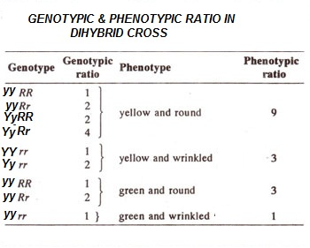

Slide 8
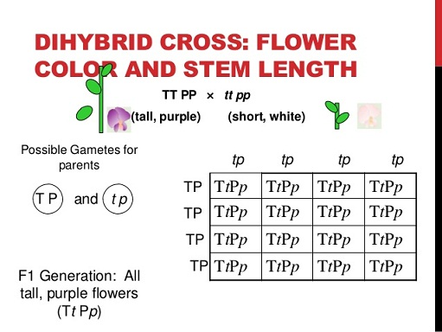
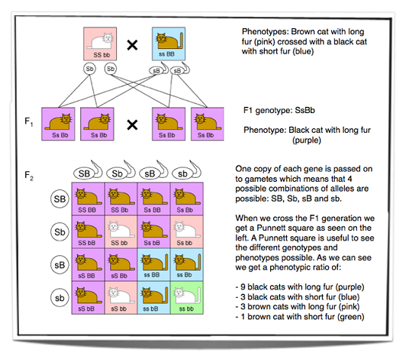
EXAMPLE OF DIHYBRID CROSS

Slide 9
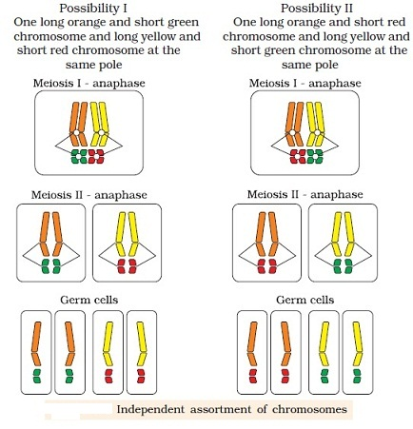
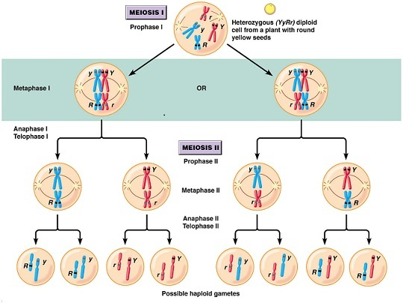
CHROMOSOMAL EXPLANATION OF LAW OF INDEPENDENT ASSORTMENT:

Slide 10
THANKING YOU
ODM EDUCATIONAL GROUP

