Slide 1


PRPNCIPLE OF INHERITANCE AND VARIATION
ONE GENE INTERACTION,BACK CROSS,TEST CROSS,PRINCIPLE OF DOMINANCE & PRINCIPLE OF SEGREGATION
SUBJECT : BIOLOGY
CHAPTER NUMBER:05
CHAPTER NAME :PRINCIPLE OF INHERITANCE AND VARIATION

Slide 2
ONE GENE INTERACTION
Interaction Of Genes:
Inter–allelic or intra – genic interaction : In this case two alleles (located on the same gene locus on two homologous chromosomes) of gene interact in such a fashion to produces phenotypic expression.
Inter - genic interaction : It is also called Non-allelic gene interaction. It is the expression of character is produced by interaction between two or more genes.

Slide 3
INHERITANCE OF ONE GENE (MONOHYBRID CROSS)
Mendel crossed tall and dwarf pea plant and collected the seeds from them.
Seeds were used to generate plants of first generation (F₁ or Filial progeny).
Mendel observed that all the first generation plants were tall, none of them were dwarf.
He made similar observations for the other pairs of traits.
He concluded that F₁ generation resembled either one of the parents.
He then self-pollinated the tall F₁ plants and he observed that some of were dwarf.
Out of all, ¼th were dwarf and 3/4th were tall.

Slide 4
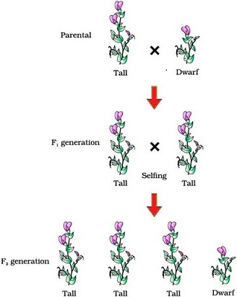

Slide 5
MONOHYBRID CROSS
Similar results were obtained for other traits too.
In F₂ generation, both the traits were expressed in proportion of 3:1 as phenotypic ratio and 1:2:1 as genotypic ratio..
Dominant trait in F₂ is about thrice of the recessive from.
These contrasting traits did not show any blending at either F₁ or F₂ stage.
Based on these observations, Mendel concluded that something was being stably passed from one generation to the other.
Mendel named this ‘factors’ which are now called as ‘genes’ .

Slide 6
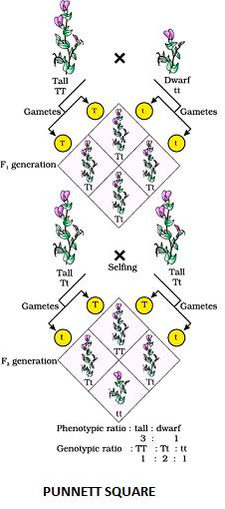
PUNNETT SQUARE
The production of gametes by the parents, the formation of the zygotes, the F₁ and F₂ plants can be understood from a diagram called Punnett square developed by British geneticist, Reginald C. Punnett .
It is a graphical representation used to calculate probability of all possible genotypes of offspring in a genetic cross.
It is typically used for monohybrid cross conducted by Mendel between true-breeding tall plants and true-breeding dwarf plants

Slide 7
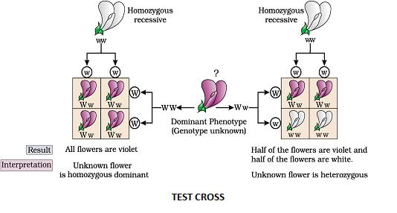
Test Cross
Crossing of F1 individual having dominant phenotype with its homozygous recessive parent is called test cross.
The test cross is used to determine whether the individuals exhibiting dominant character arehomozygous or heterozygous.

Slide 8
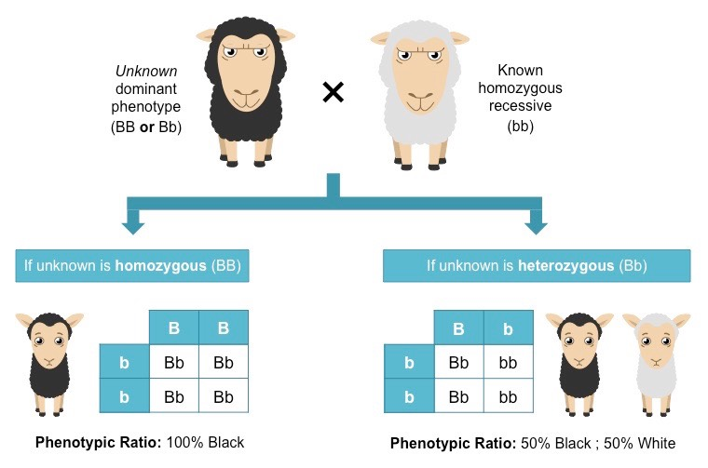

Slide 9
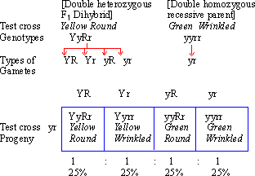
DIHYBRID TEST CROSS
Dihybrid cross is a cross which looks at the cross of two separate traits with different alleles.

Slide 10
BACK CROSS
In backcross, F1 hybrid is crossed back with any of the parent, either dominant or recessive.
Back crosses are used to increase useful traits in a population.
For example: Certain crop plant hybrids are backcrossed with wild species to obtain its useful traits such as disease resistance.
However, this process may dilute the other useful traits of hybrid.
In order to overcome this disadvantage, hybrids are backcrossed repeatedly with its parent plants over few generations to receive their good traits back into the new hybrids.
All test crosses are considered as backcrosses, but all backcrosses are not the test crosses.

Slide 11
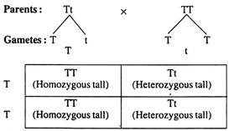

Slide 12
BACK CROSS – EXAMPLE
When F₁ individuals are crossed with one of the two parents (either CC—red flowered or cc—white flowered) from which they have been derived, then such a cross is called back cross.
When F₁ (Cc) is crossed to the parent with dominant phenotype i.e., homozygous for red colour (CC). In such a cross plants will be 100% red (A).
When F₁ plant (Cc) is crossed to the parent with pure recessive (cc) white flowered plant. In such a cross 50% plants will be red flowered and 50% plants will be white flowered (B).

Slide 13
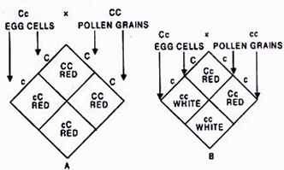

Slide 14
MENDELS FIRST LAW OF INHERITANCE
Mendel’s law of dominance states that:
“When parents with pure contrasting traits are crossed together, only one form of trait appears in the next generation. The hybrid off-springs will exhibit only the dominant trait in the phenotype.”
The dominant allele masks the effect of recessive allele.
It explains the expression of only one of the parental characters in a monohybrid cross in F₁ and expression of both in F₂.
Characters are controlled by discrete units called factors.
In a dissimilar pair of factors (heterozygous)one member of pair dominate the other. For example: allele of tallness (T) is dominant over allele of dwarf (t).

Slide 15
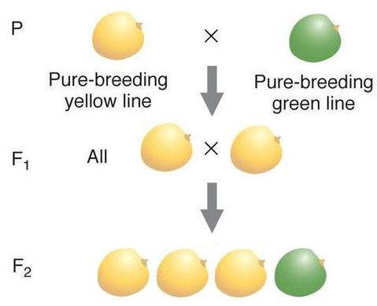

Slide 16
MENDEL’S SECOND LAW OF INHERITANCE
(Law of Segregation)
Mendel’s law of segregation states that:
“During the formation of gamete, each gene separates from each other so that each gamete carries only one allele for each gene.”
Law of segregation is the second law of inheritance.
This law explains that the pair of alleles segregate from each other during meiosis cell division (gamete formation) so that only one allele will be present in each gamete.
This law is based on four basic concepts:
A gene exists in more than one form of an allele.
When gametes are produced by meiosis, the allelic pairs separate leaving each gamete with a single allele.
Every organism inherits two alleles for each trait(one with paternal and one with maternal chromosome).
The two alleles of a pair are different, i.e., one is dominant and one is recessive.

Slide 17
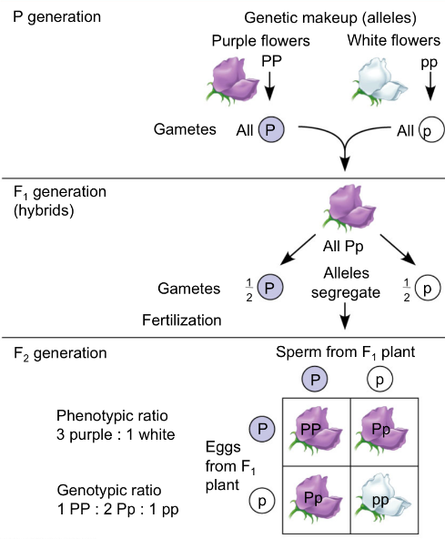

Slide 18
THANKING YOU
ODM EDUCATIONAL GROUP

