Slide 1


PRPNCIPLE OF INHERITANCE AND VARIATION
ONE GENE INTERACTION,BACK CROSS,TEST CROSS,PRINCIPLE OF DOMINANCE & PRINCIPLE OF SEGREGATION
SUBJECT : BIOLOGY
CHAPTER NUMBER:05
CHAPTER NAME :PRINCIPLE OF INHERITANCE AND VARIATION

Slide 2
ONE GENE INTERACTION
Inter–allelic or intra – genic interaction : In this case two alleles (located on the same gene locus on two homologous chromosomes) of gene interact in such a fashion to produces phenotypic expression.
Inter- genic interaction or Non-allelic gene interaction : It is the expression of character is produced by interaction between two or more genes.

Slide 3
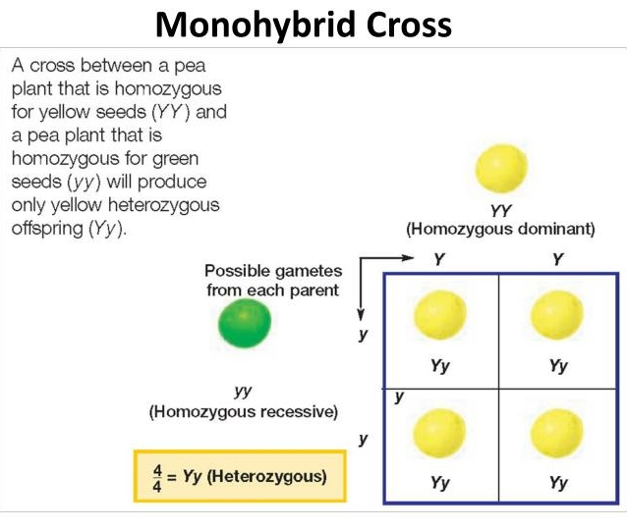
INHERITANCE OF ONE GENE (MONOHYBRID CROSS)

Slide 4
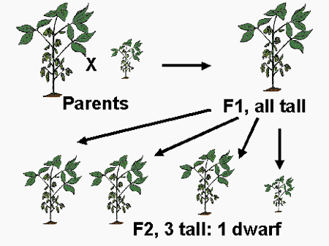

Slide 5
MONOHYBRID CROSS
In F₂ generation, both the traits were expressed in proportion of 3:1 as phenotypic ratio and 1:2:1 as genotypic
ratio.
Dominant trait in F₂ is about thrice of the recessive from.
Mendel named this ‘factors’ which are now called as ‘genes’

Slide 6
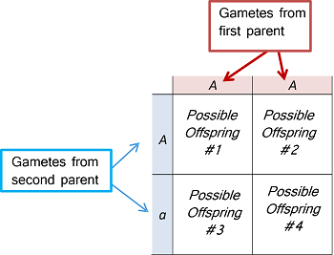
PUNNETT SQUARE

Slide 7
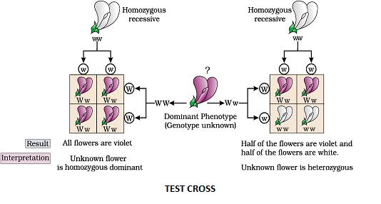
Test Cross
The test cross is used to determine whether the individuals exhibiting dominant character are homozygous or heterozygous.

Slide 8
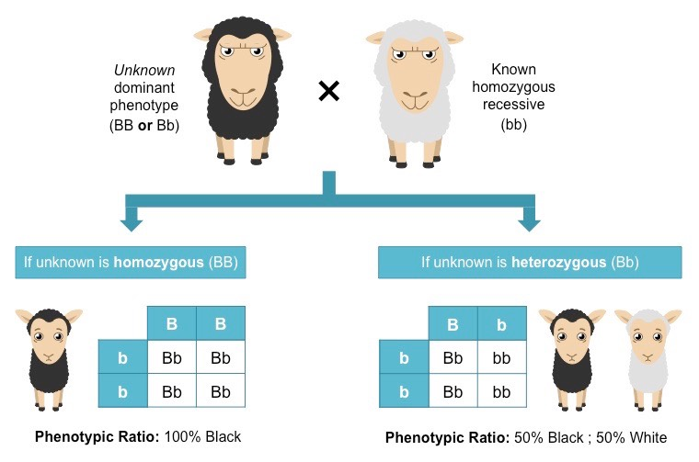

Slide 9
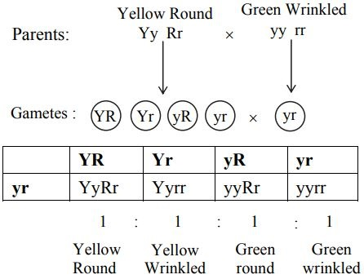
DIHYBRID TEST CROSS

Slide 10
BACK CROSS
In backcross, F1 hybrid is crossed back with any of the parent, either dominant or recessive. Back crosses are used to increase useful traits in a population.
For example: Certain crop plant hybrids are backcrossed with wild species to obtain its useful traits such as disease resistance.

Slide 11
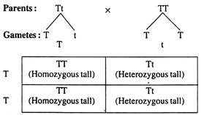

Slide 12
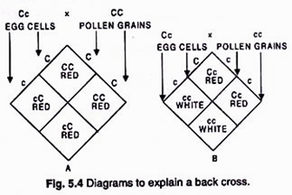
BACK CROSS – EXAMPLE

Slide 14
MENDELS FIRST LAW OF INHERITANCE
“When parents with pure contrasting traits are crossed together, only one form of trait appears in the next generation. The hybrid off-springs will exhibit only the dominant trait in the phenotype.”

Slide 15
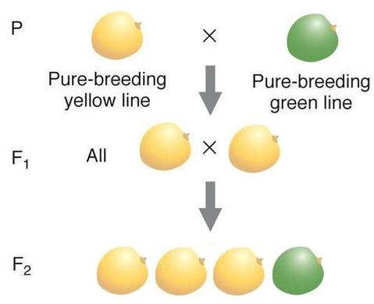

Slide 16
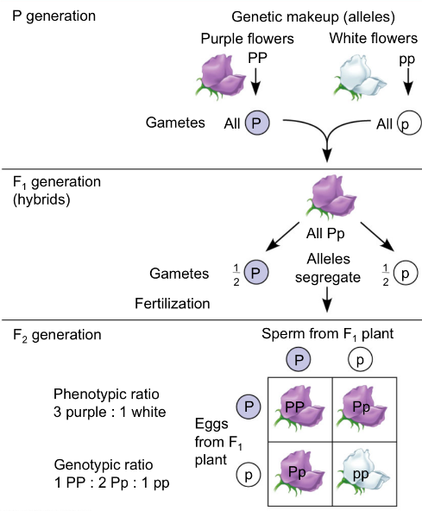
MENDEL’S SECOND LAW OF INHERITANCE
(Law of Segregation)
“During the formation of gamete, each gene separates from each other so that each gamete carries only one allele for each gene.”

Slide 18
THANKING YOU
ODM EDUCATIONAL GROUP

