Slide 1


PRINCIPLE OF INHERITANCE & VARIATIONS
INTRODUCTION OF HEREDITY & GENETICS,MENDLE’S EXPERIMENT
SUBJECT : BIOLOGY
CHAPTER NUMBER:05
CHAPTER NAME :PRINCIPLE OF INHERITANCE &VARIATIONS

Slide 2
INTRODUCTION
An elephant always gives birth only to a baby elephant and not some other animal and a mango seed forms only a mango plant and not any other plant.
“Like begets like”. Children resemble their parents. These are several related issues which dealt with scientifically in a branch of biology known as “Genetics” which deals with the inheritance as well as the variation of characters from parents to offspring.
So there are combination of traits which are only found among members of one family not in any other members.
This process of transfer of characters from parent to progeny is called inheritance.
The differences found in various traits among those members ,among progeny and their parents are called as variations. Variation is the degree by which progeny differ from their parents.

Slide 3
HEREDITY & GENETICS
Heredity is a sum of endowment obtained from the parents which includes transmission of structural, functional, behavioural characteristics from parents to offspring or from one generation to another. Heredity is a component of genetics.
VARIATION & GENETICS
Variation appear only in sexually reproducing individuals due to shuffling and recombination of genes.
Hence variation is a component of genetics.

Slide 4
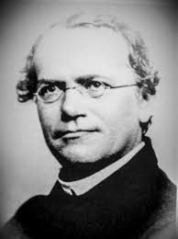
MENDEL
Gregor john mendel, father of genetics (1822 – 1884), was born in a poor peasant family of village silisian of Heinzendrof, Moravia (Austria).
He received early education at home, studied philosophy for few years and at age of 21 joined monastery in Brunn.
He was sent to University of Vienna for further studies in physics and natural sciences.
In year 1856 his attention was drawn to the regular occurrence of two different type of seeds in edible pea plant.
Then he started his hybridization experiment and continued it for seven years.

Slide 5
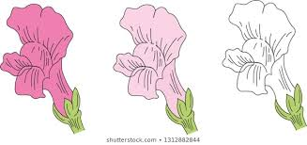
MENDEL’S EXPERIMENTAL MATERIAL
Mendel selected edible pea (Pisum sativum) as experimental plant for his study in genetics.
He selected pea plant for following reasons :
(1) Pea plant possessed a large number of varieties as this had been in cultivation for long time.
(2) The flowers of pea plant are bisexual.
(3) The plant is an annual plant with a growth period of few months.
(4) The plant is small but its flowers are large enough to be manually handled
(5) It does not require much after care.
(6) The plant does not require complicated procedure for cultivation.
(7) Each plant produces a large number of seeds.
Mendel performed cross breeding and self breeding in different varieties.
Four steps are involved in Mendel’s experiment like:
(a)Selection of parents
(b) Hybridization.
(c) Self-pollination.
(d) Documentation and Calculation.
Mendel picked a lot of varieties but finally he worked with 7 varieties. All the 7 varieties had at least one character with two contrasting traits.

Slide 6
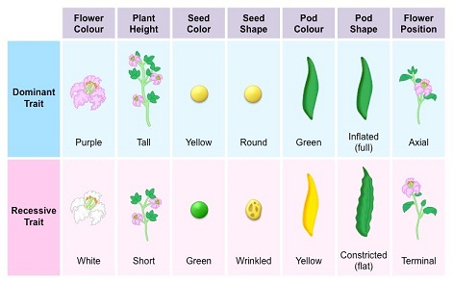
SELECTION OF PARENTS :
PEA CHARACTERS STUDIED BY MENDEL

Slide 7
HYBRIDISATION
Mendel cross pollinated plants with contrasting traits and the various steps were :
(a) Emasculation , (b) Bagging , (c) Dusting , (d) Tagging .
Mendel carried out the cross and seeds of each cross were selected, which were sown in next season.
The plants are called hybrid plants.
SELF- POLLINATION
The hybrid plants were allowed to grow and undergo self pollination to avoid contamination of foreign pollen. Again seeds were collected ,sown and plants were raised . He continued it this for several generations.
DOCUMENTATION & CALCULATION
The traits ,number of progenies and their ratio were documented and examined by Mendel.

Slide 8
REASONS FOR MENDEL’S SUCCESS
(a) Mendel selected only pure breeding varieties.
(b) He eliminated all those varieties which showed inconsistency
(c) The 7 characters selected by Mendel were not linked.
(d) Mendel took care to prevent pollen contamination.
(e) He applied statistical analysis.
NON RECOGNITION OF MENDEL’S WORK IN HIS LIFE TIME
(a) Non discovery of chromosome, meiosis & mitosis.
(b) Mendel was very shy and not at all recognized as scientist rather was a abbot.
(c) His statistical calculation was beyond the comprehension of biologist of that time.
Mendel died in 1884 without getting credit for his work.

Slide 9
GENETIC TERMINOLOGY
CHARACTER : It is a distinct morphological and physiological feature of an individual, e.g. stem height , colour of eye , colour of skin.
TRAIT : It is an expression of a character like tallness, dwarfness etc.
ALLELES : They are the various forms of a gene which are found at the same place or locus on homologous chromosomes and control the same character.
HOMOZYGOUS : It is an individual having copies of same allele of a character and these individuals are genetically pure.
HETEROZYGOUS : it is an individual having copies of contrasting allele of a character and these individuals are called hybrid for that character.
PHENOTYPE : It is observable external manifestation of morphological or physiological characters.
GENOTYPE : It is representation of genetic constitution or gene compliment of an individual w.r.t one or more characters.
DOMINANT FACTOR : It is a factor or allele of a character which expresses its effect in the phenotypic even in the presence of its alternate allele. The dominant allele is represented by capital letter like T for tall.

Slide 10
RECESSIVE FACTOR : It is an allele of a character which is unable to express its effects in hybrid but can do so in presence of another identical allele. It is represented by small letter like t for dwarf.
F1 GENERATION : It is also called as first filial generation which represents the offspring of a cross between two genetically different parents.
F2 GENERATION : It is also known as second filial generation which is formed through selfing between individuals of F1 generation.
MONOHYBRID CROSS : It is a cross between individuals where a pair of contrasting traits of a character.
DIHYBRID CROSS : It is a cross between individuals where two pair of contrasting traits of two characters.

Slide 11
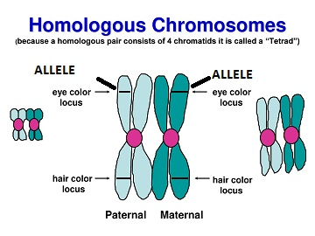

Slide 12
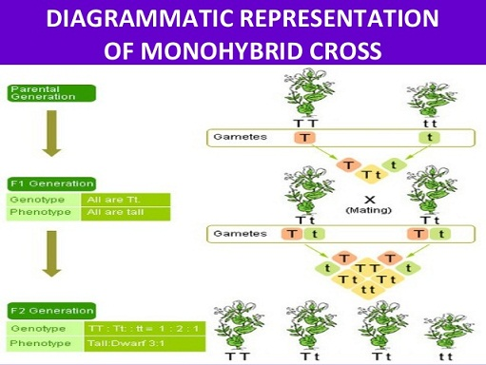

Slide 13
THANKING YOU
ODM EDUCATIONAL GROUP

