Slide 1


Electrical resistivity, Conductivity, Carbon resistors, Color code of carbon resistors
CLASS-XII
SUBJECT : PHYSICS
CHAPTER NUMBER: 03
CHAPTER NAME : CURRENT ELECTRICITY

Slide 2
LEARNING OUTCOME
After this lesson, students will be able:
Differentiate between resistance and resistivity
Define the term conductivity
Describe the electrical component known as a resistor
State the relationship between resistance of a resistor and its length, cross-sectional area, and resistivity
State the relationship between resistivity and temperature

Slide 3
REVIEW
Define conductance.
Define electrical energy in terms of charge, voltage, current and resistance.
What is the expression of Ohm’s law in vector form?.
State electrical energy and power.
State Joule’s law of heating

Slide 4
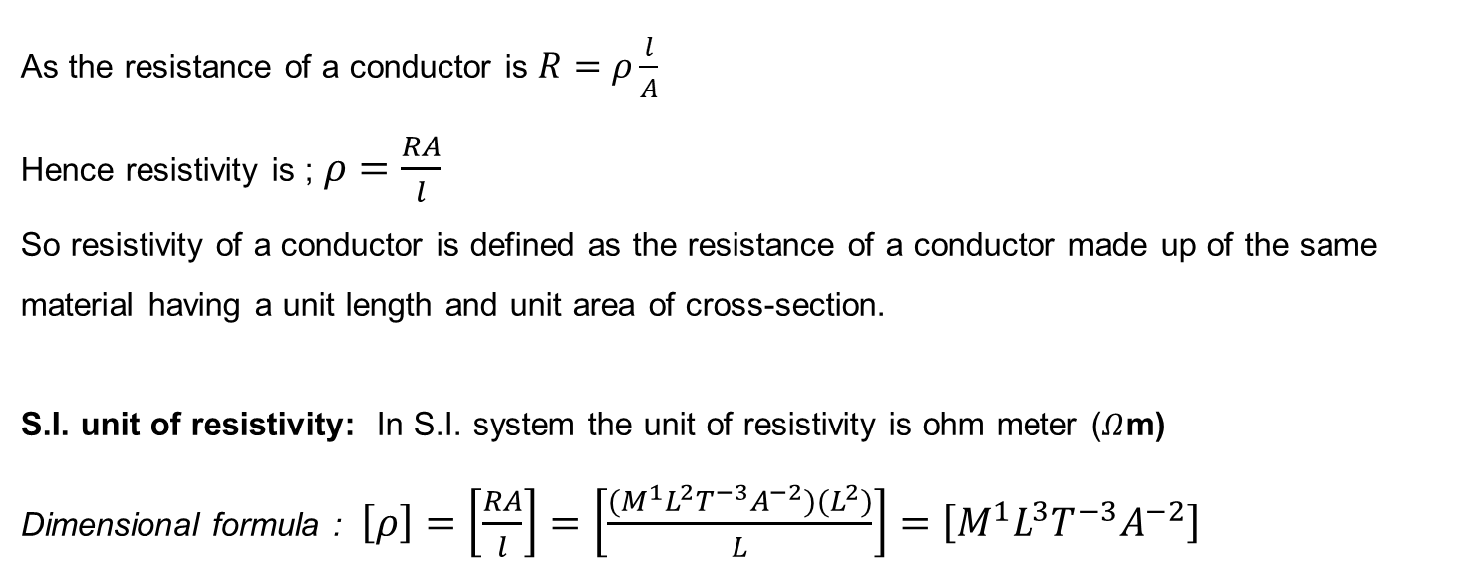
Resistivity
As the resistance of a conductor is $R=ρ\frac{l}{A}$
Hence resistivity is ; $ρ=\frac{RA}{l}$
So resistivity of a conductor is defined as the resistance of a conductor made up of the same material having a unit length and unit area of cross-section.
S.I. unit of resistivity: In S.I. system the unit of resistivity is ohm meter ($Ω$m)
Dimensional formula : $\left[ρ\right]=\left[\frac{RA}{l}\right]=\left[\frac{(M^{1}L^{2}T^{−3}A^{−2})(L^{2})}{L}\right]=\left[M^{1}L^{3}T^{−3}A^{−2}\right]$

Slide 5
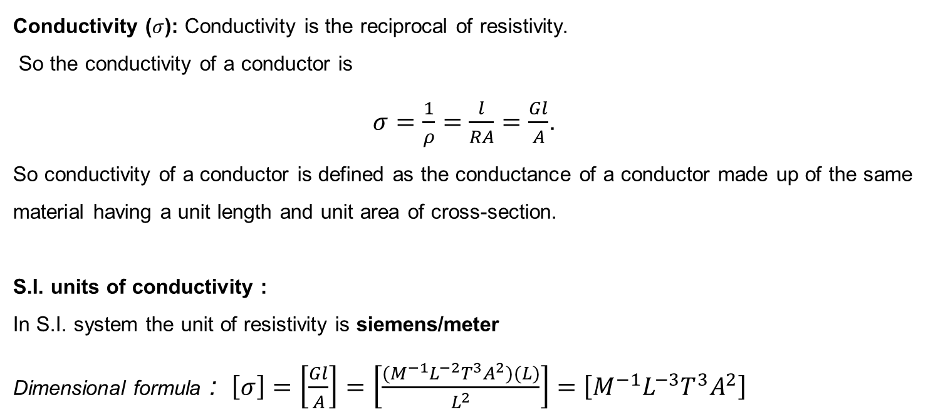
Conductivity
Conductivity ($σ$): Conductivity is the reciprocal of resistivity.
So the conductivity of a conductor is
$σ=\frac{1}{ρ}=\frac{l}{RA}=\frac{Gl}{A}$.
So conductivity of a conductor is defined as the conductance of a conductor made up of the same material having a unit length and unit area of cross-section.
S.I. units of conductivity :
In S.I. system the unit of resistivity is siemens/meter
Dimensional formula : $\left[σ\right]=\left[\frac{Gl}{A}\right]=\left[\frac{(M^{−1}L^{−2}T^{3}A^{2})(L)}{L^{2}}\right]=\left[M^{−1}L^{−3}T^{3}A^{2}\right]$

Slide 6
Numerical
Question: How will the resistance and resistivity of a cylindrical wire change if
its length is doubled
It is doubled on itself
It is stretched to double its length?

Slide 7
Numerical
Question: How will the resistance and resistivity of a cylindrical wire change if
it is stretched to n times its length
It is stretched to have radius 1/n times the original value?
Show the graphical variation between the resistance of the wire and its radius.

Slide 8
Colour code for carbon resistors:
The first two rings from the end give the first two significant figures of resistance in ohm.
The third ring indicates the decimal multiplier.
The last ring indicates the tolerance in per cent about the indicated value.
Eg. AB x 10^{C} ± D % ohm
B V B Gold
17 x 10⁰ = 17 ± 5% Ω
G R B Silver
52 x 10⁶ ± 10% Ω
Letter | Colour | Number | Colour | Tolerance
B | Black | 0 | Gold | 5%
B | Brown | 1 | Silver | 10%
R | Red | 2 | No colour | 20%
O | Orange | 3
Y | Yellow | 4
G | Green | 5
B | Blue | 6
V | Violet | 7
G | Grey | 8
W | White | 9
B V B
17 x 10⁰ = 17 ± 20% Ω
B B ROY of Great Britain has Very Good Wife

Slide 9
Another Colour code for carbon resistors:
The colour of the body gives the first significant figure.
The colour of the ends gives the second significant figure.
The colour of the dot gives the decimal multipier.
iv) The colour of the ring gives the tolerance.
Red Ends
Yellow Body
Gold Ring
Blue Dot
YRB Gold
42 x 10⁶ ± 5% Ω
Series combination of resistors:
R = R₁ + R₂ + R₃
R is greater than the greatest of all.
R₁ R₂ R₃
Parallel combination of resistors:
R₁
1/R =1/R₁ + 1/R₂ + 1/R₃
R is smaller than the smallest of all.
R₂
R₃

Slide 10
Numerical
Question: Give color coding for $42kΩ±10\%$ carbon resistance.
Letter | Colour | Number | Colour | Tolerance
B | Black | 0 | Gold | 5%
B | Brown | 1 | Silver | 10%
R | Red | 2 | No colour | 20%
O | Orange | 3
Y | Yellow | 4
G | Green | 5
B | Blue | 6
V | Violet | 7
G | Grey | 8
W | White | 9

Slide 11
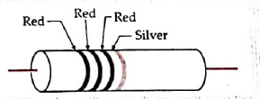

Numerical
  Question: The figure shows the color-coding of a carbon resistor. Find its resistance.
Letter | Colour | Number | Colour | Tolerance
B | Black | 0 | Gold | 5%
B | Brown | 1 | Silver | 10%
R | Red | 2 | No colour | 20%
O | Orange | 3
Y | Yellow | 4
G | Green | 5
B | Blue | 6
V | Violet | 7
G | Grey | 8
W | White | 9

Slide 12
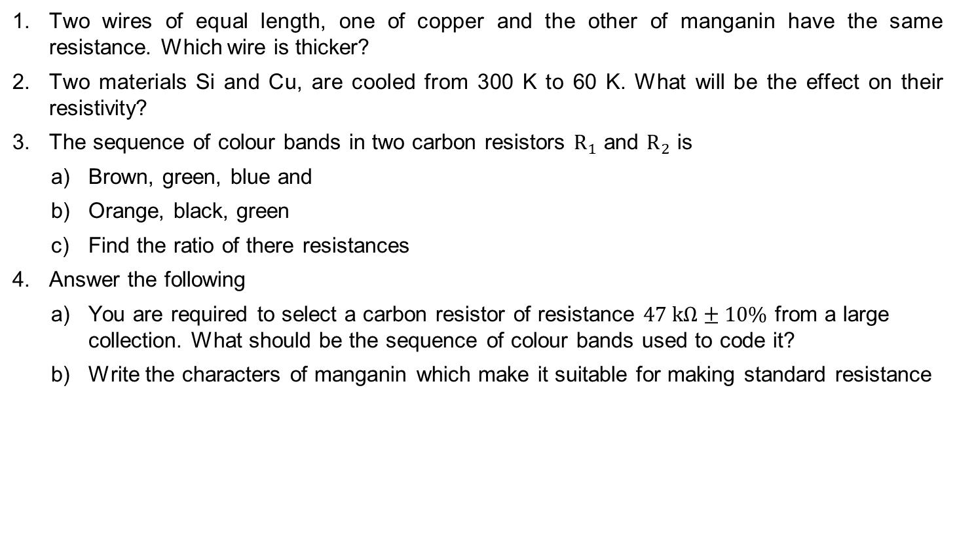
HOME ASSIGNMENT
Two wires of equal length, one of copper and the other of manganin have the same resistance. Which wire is thicker?
Two materials Si and Cu, are cooled from 300 K to 60 K. What will be the effect on their resistivity?
The sequence of colour bands in two carbon resistors $R_{1}$ and $R_{2}$ is
  Brown, green, blue and
  Orange, black, green
  Find the ratio of there resistances
Answer the following
  You are required to select a carbon resistor of resistance $47 kΩ±10\%$ from a large collection. What should be the sequence of colour bands used to code it?
  Write the characters of manganin which make it suitable for making standard resistance

Slide 13
THANKING YOU
ODM EDUCATIONAL GROUP

