Slide 1


Electrical energy and power
CLASS-XII
SUBJECT : PHYSICS
CHAPTER NUMBER: 03
CHAPTER NAME : CURRENT ELECTRICITY

Slide 2
LEARNING OUTCOME
After this lesson, students will be able:
Explain from where electricity comes and how we use it.
Define electrical energy in terms of charge, voltage, current and resistance.
Identify the types of engineering careers that work primarily with electrical energy.

Slide 3
REVIEW
Define conductance.
What is the expression of mobility in terms of relaxation time. Give its SI unit.
What is the expression of Ohm’s law in vector form?.
State ohm’s law .
State relationship between mobility and relaxation time.

Slide 4
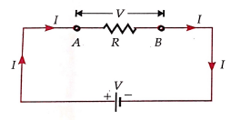
Electrical energy and power
The expression for heat dissipated from a conductor during the flow of current :
Consider a conductor AB of a uniform cross-section of area A and length be connected across a source that sends steady current I.
So $V_{A}−V_{B}=IR=V$ = Potential difference across the conductor.
Due to this, charge carriers i.e. free electrons drift from B to A.
Imagine an equivalent +ve charge flows from A to B.
In a very small time, ‘dt’ the equivalent +ve charge flowing from A to B is $dq=Idt$ ,
The potential energy of this charge at A is $U_{A}=V_{A}dq$ and at B is $U_{B}=V_{B}dq$
So change in its P.E. is $dU$ = $U_{B}−U_{A}=dq(V_{B}−V_{A})=−IRdq$

Slide 5
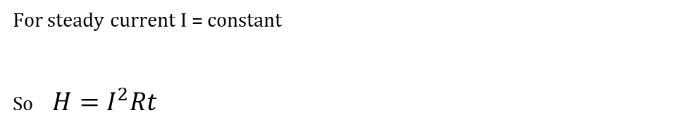
Electrical energy and power
For steady current I = constant
So $H=I^{2}Rt$

Slide 6
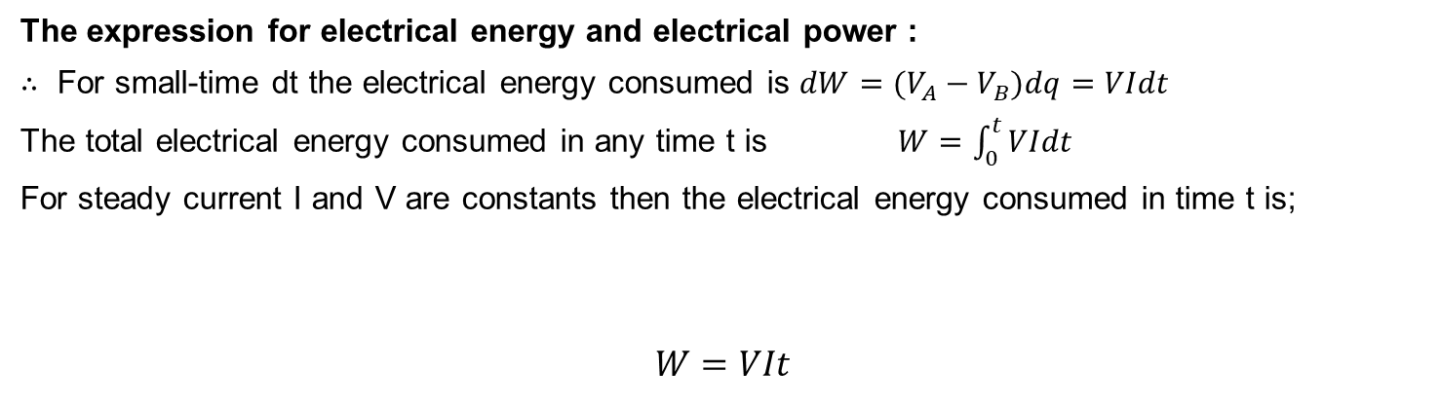
Electrical energy and power
The expression for electrical energy and electrical power :
$∴$ For small-time dt the electrical energy consumed is $dW=(V_{A}−V_{B})dq=VIdt$
The total electrical energy consumed in any time t is $W=\int_{0}^{t}{VIdt}$
For steady current I and V are constants then the electrical energy consumed in time t is;
$$W=VIt$$

Slide 7
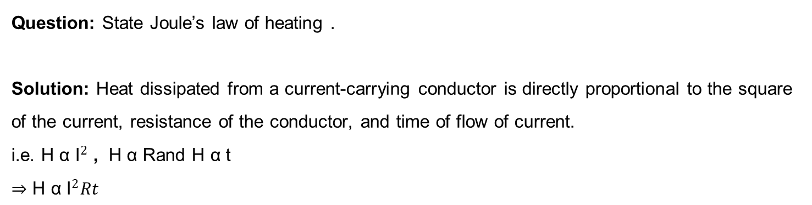
Numerical
Question: State Joule’s law of heating .
Solution: Heat dissipated from a current-carrying conductor is directly proportional to the square of the current, resistance of the conductor, and time of flow of current.
i.e. $\text{H} \text{α} {\text{I}}^{2}$ , $\text{H} \text{α} \text{R}$and $\text{H} \text{α} \text{t}$
$⇒$ $\text{H} \text{α} {\text{I}}^{2}Rt$

Slide 8
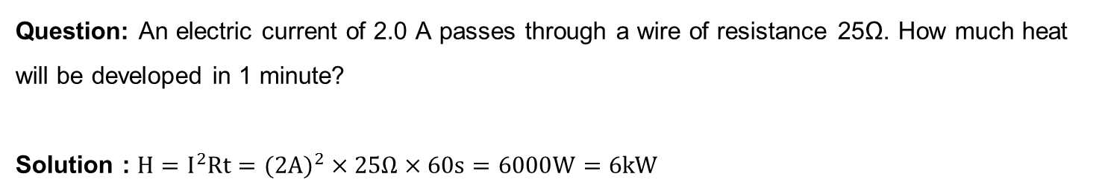
Numerical
Question: An electric current of 2.0 A passes through a wire of resistance 25Ω. How much heat will be developed in 1 minute?
Solution : $H=I^{2}Rt=(2A)^{2}×25Ω×60s=6000W=6kW$

Slide 9
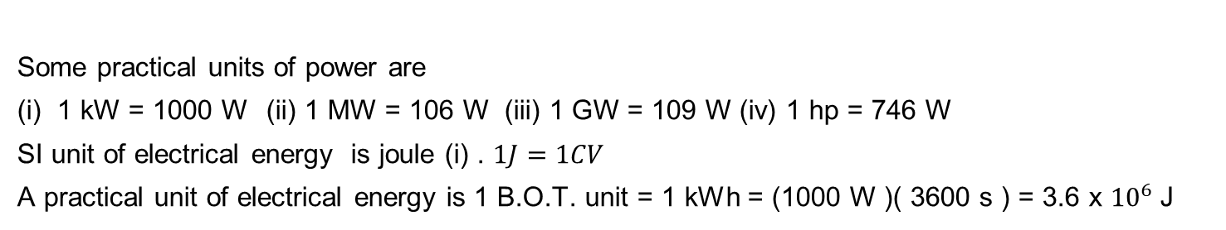
Electric power and electrical energy
Some practical units of power are
(i) 1 kW = 1000 W (ii) 1 MW = 106 W (iii) 1 GW = 109 W (iv) 1 hp = 746 W
SI unit of electrical energy is joule (i) . $1J=1CV$
A practical unit of electrical energy is 1 B.O.T. unit = 1 kWh = (1000 W )( 3600 s ) = 3.6 x ${10}^{6}$J

Slide 10
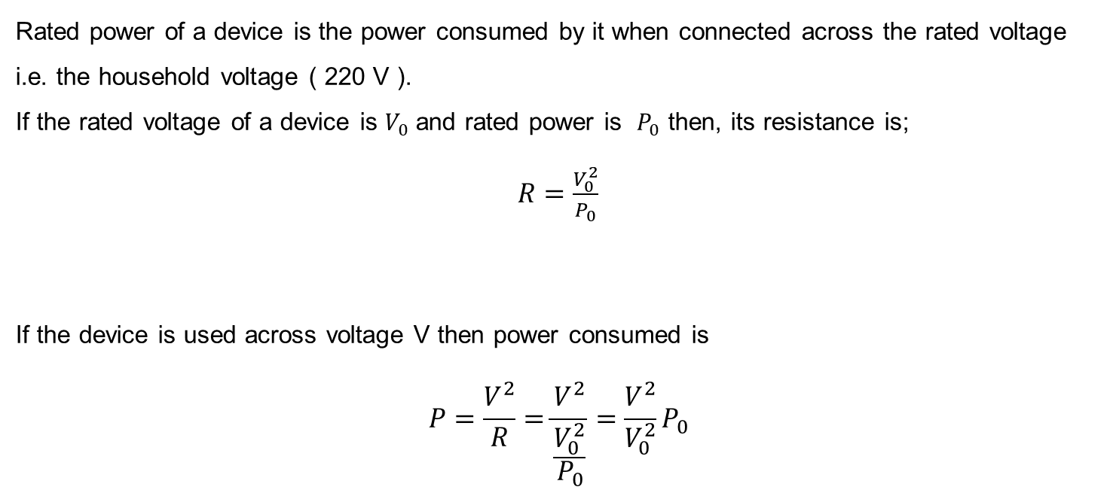
Rated power of a device
Rated power of a device is the power consumed by it when connected across the rated voltage i.e. the household voltage ( 220 V ).
If the rated voltage of a device is $V_{0}$ and rated power is $P_{0}$ then, its resistance is;
$R=\frac{V_{0}^{2}}{P_{0}}$
If the device is used across voltage V then power consumed is
$$P=\frac{V^{2}}{R}=\frac{V^{2}}{\frac{V_{0}^{2}}{P_{0}}}=\frac{V^{2}}{V_{0}^{2}}P_{0}$$

Slide 11
Numerical
Question: An electric bulb is rated as 100W - 220 V . Calculate
(i) its resistance
(ii) power consumed by it when connected across 220 V .
(iii) power consumed by it when connected across 120 V.

Slide 12
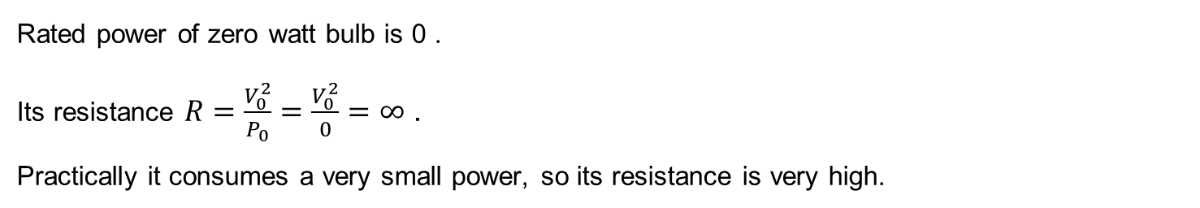
Zero watts bulb
Rated power of zero watt bulb is 0 .
Its resistance $R=\frac{V_{0}^{2}}{P_{0}}=\frac{V_{0}^{2}}{0}=∞$ .
Practically it consumes a very small power, so its resistance is very high.

Slide 13
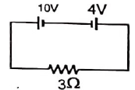
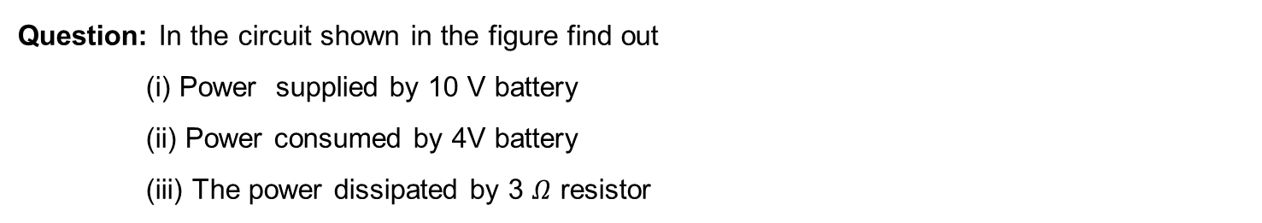
Numerical
Question: In the circuit shown in the figure find out
(i) Power supplied by 10 V battery
(ii) Power consumed by 4V battery
(iii) The power dissipated by 3 $Ω$ resistor

Slide 14
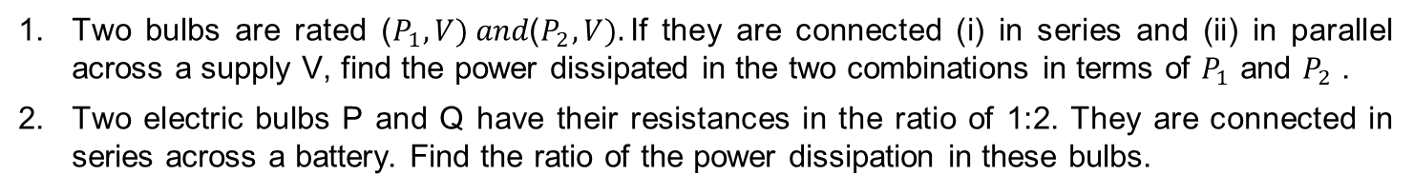
HOME ASSIGNMENT
Two bulbs are rated ($P_{1},V) and\text{(}P_{2},V).$If they are connected (i) in series and (ii) in parallel across a supply V, find the power dissipated in the two combinations in terms of $P_{1}$ and $P_{2}$ .
Two electric bulbs P and Q have their resistances in the ratio of 1:2. They are connected in series across a battery. Find the ratio of the power dissipation in these bulbs.
3. A 25 W and a 100W bulb are joined in (i) series (ii) parallel and connected to the main. Which bulb glows brighter?

Slide 15
THANKING YOU
ODM EDUCATIONAL GROUP

